Slide 1
Jenkins CI/CD Pipeline with Terraform
Infrastructure as Code on AWS and Docker
Harshada Gahininath Gujar
B.Tech Computer Engineering, MIT Academy of Engineering, Pune
github.com/Harshadagujar2005/jenkins-terraform-mini-project
Notes:
Introduce yourself and the project. In about 5 minutes I will explain what I built and how it works, then I will play the recorded live demo. The project is a complete CI/CD workflow: Jenkins automates build, test and deployment, and Terraform provisions the infrastructure as code on AWS and Docker.

Slide 2
Why automate delivery?
The problem with manual releases
Steps get forgotten or done differently each time
Bugs reach production without automatic tests
Cloud resources clicked together in a console cannot be reviewed or repeated
The goal
One git push triggers build, test, infrastructure and deployment, with no manual steps
11
2
pipeline stages
automated tests
4
1
AWS resources from code
git push to redeploy
Notes:
Explain the motivation. Doing builds and deployments by hand is error prone, and clicking resources together in a cloud console cannot be reviewed or repeated. The goal is a single push that triggers everything. The four numbers show the size of the project: 11 pipeline stages, 2 automated tests, 4 AWS resources created from code, and one git push to redeploy.

Slide 3
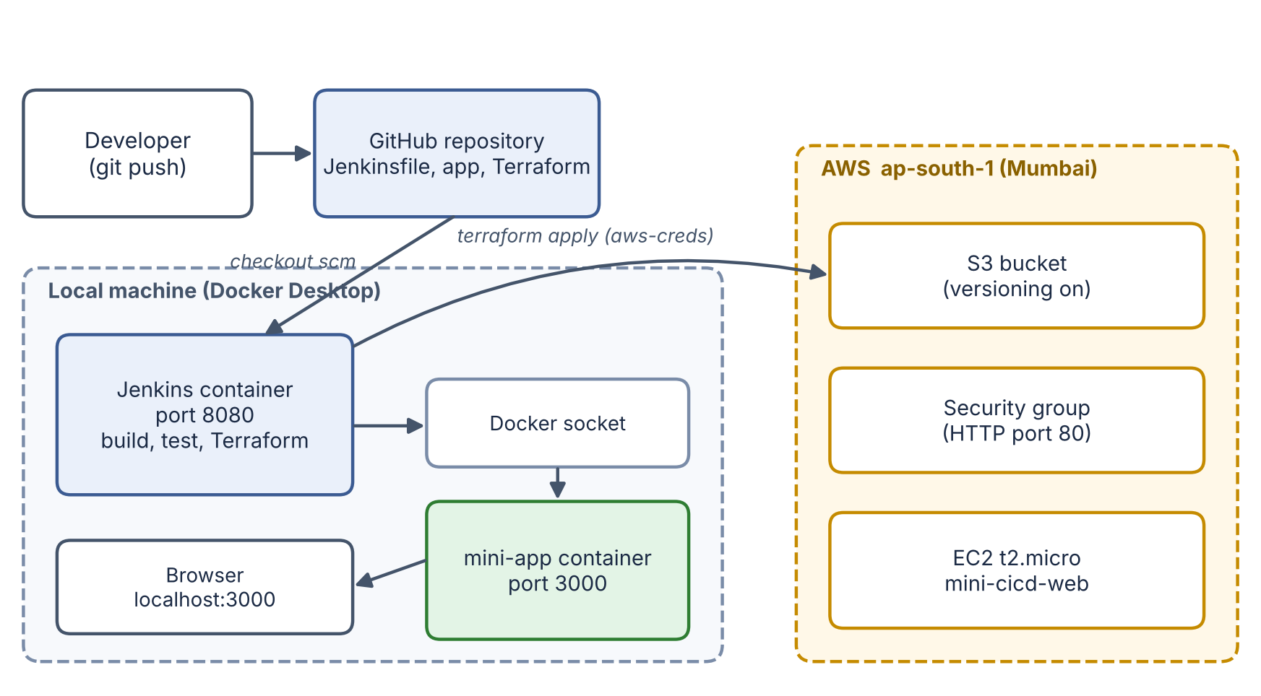



Architecture
GitHub
Holds the code, Jenkinsfile and Terraform
Jenkins in Docker
Runs the pipeline; uses the host Docker socket
AWS, Mumbai
S3, security group, EC2 created by Terraform
Notes:
Walk through the diagram left to right. The developer pushes to GitHub. Jenkins runs in a Docker container on my computer and checks out the repository. Because the Docker socket is mounted, the pipeline can build images and Terraform can create the app container on the same machine. Using the AWS credential stored in Jenkins, Terraform also creates real resources in the Mumbai region.

Slide 4
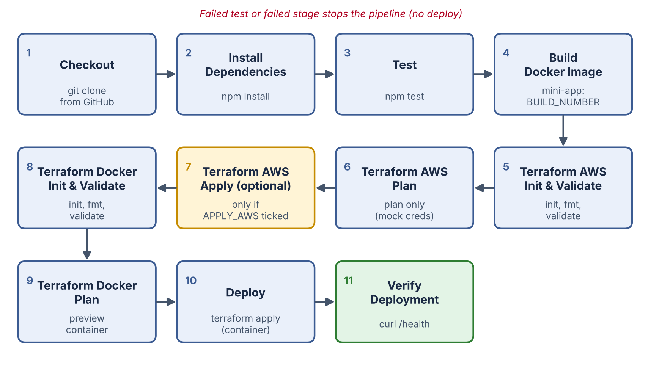
The Jenkins pipeline: 11 stages
Test before build
A failing test stops the pipeline, so broken code never deploys
APPLY_AWS gate
AWS is plan-only unless a person ticks the parameter
Verify at the end
A curl on /health proves the app really runs
Notes:
The pipeline is defined in one Jenkinsfile stored in the repository: pipeline as code. Stages: checkout, install, test, build the Docker image, then Terraform for AWS with init, validate and plan, an optional apply, Terraform for Docker, deploy, and finally verification. Three design choices: tests run before anything is built; AWS apply only runs when APPLY_AWS is ticked so nothing billable is created by accident; and the last stage calls the health endpoint so a green build means a working application.

Slide 5

Infrastructure as Code with Terraform
terraform/aws
terraform/docker
S3 bucket with versioning
Security group (HTTP 80)
EC2 t2.micro web server
use_mock_credentials: plan works with no AWS account
Reusable module: app_container
Creates the app container
Image tag = Jenkins build number
A new build replaces the old container
terraform init
download providers
›
terraform validate
check the code
›
terraform plan
preview changes
›
terraform apply
create resources
›
terraform destroy
remove resources
Notes:
Infrastructure as Code means describing infrastructure in version-controlled files instead of clicking in a console. I have two Terraform configurations. The AWS one creates an S3 bucket with versioning, a security group and a t2.micro EC2 instance. Its mock-credentials switch lets plan run without an AWS account. The Docker one uses a reusable module to run the app container, and a new build number makes Terraform replace the container. The bottom row shows the Terraform workflow: init, validate, plan, apply, destroy.

Slide 6
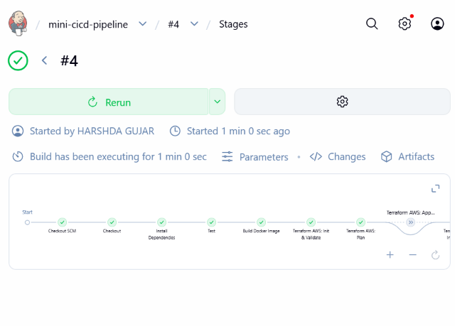
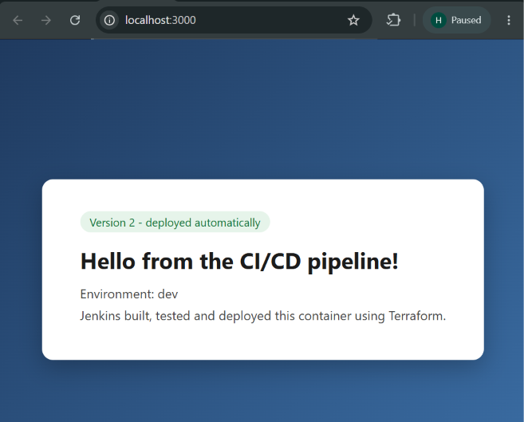
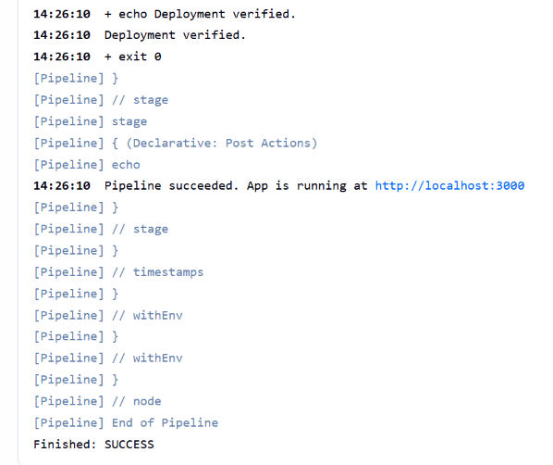
Results: four pipeline runs
Build | Purpose | Result
#1 | First run | Failed: Docker CLI missing in Jenkins image
#2 | After fix, AWS plan only | Success: tests, image, plan, deploy, health check
#3 | APPLY_AWS ticked | Success: S3 bucket and EC2 created in AWS
#4 | After a code change | Success: new image mini-app:4, container replaced
Build #4: all stages green
App after the redeploy
Console: Deployment verified
Notes:
Four runs. Build 1 failed because the Jenkins image had no Docker client, which the pipeline caught right away. After fixing the image, build 2 passed with AWS in plan-only mode. Build 3 had APPLY_AWS ticked and created the real AWS resources. Build 4 came after I changed the code and pushed to GitHub, and the new version went live automatically.

Slide 7
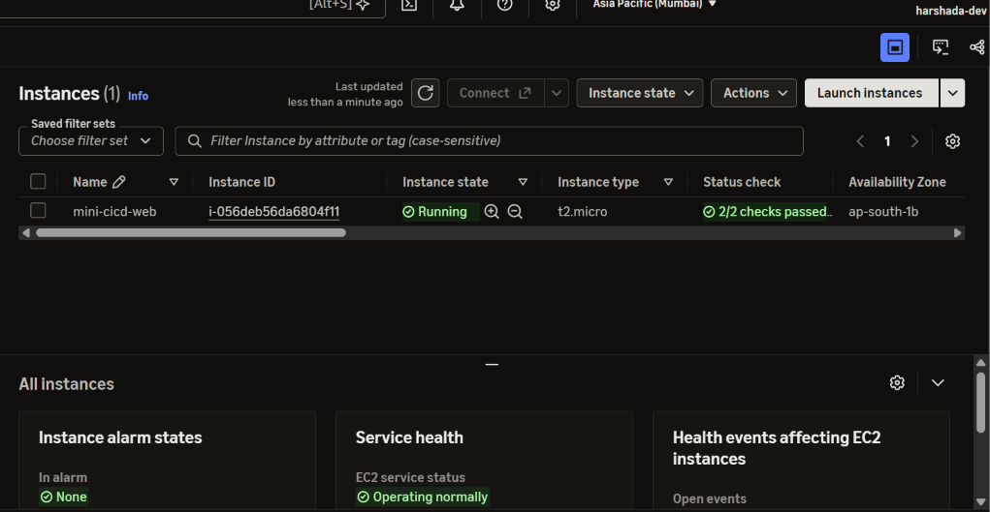
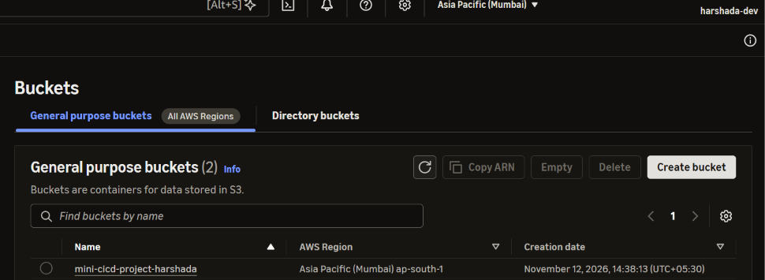
Real AWS resources created by Terraform
S3: mini-cicd-project-harshada, ap-south-1
EC2: mini-cicd-web, t2.micro, running, 2/2 checks passed
Build #3 ran terraform apply from Jenkins: 4 resources added (bucket, versioning, security group, EC2). The same code removes them with terraform destroy.
Notes:
This is the real AWS evidence in the Mumbai region. The EC2 instance named mini-cicd-web is running and the S3 bucket exists. Both were created by the Terraform apply in build 3 through the pipeline, using the credential stored in Jenkins, not by hand. The same configuration removes them with terraform destroy, which I do after the demo to avoid charges.

Slide 8



Challenges and what I learned
docker: not found in the pipeline
Newer Debian puts the Docker client in docker-cli. Added it to the Jenkins Dockerfile and a version check to the build.
Lost the Jenkins login
Recreated Jenkins from scratch. Only the credential and job were redone: the pipeline and Terraform live in Git.
Very slow first terraform init
The AWS provider is about 700 MB. I confirmed it was downloading and waited; later builds were fast.
Notes:
Three real problems. First, the pipeline failed with docker not found, because the newer Debian base image splits the Docker client into its own package. Second, I forgot the Jenkins login and had to rebuild Jenkins, which was quick because the pipeline and Terraform code live in Git. Third, the first terraform init took minutes because the AWS provider is large. The lesson: keep everything as code and check each tool the pipeline depends on.

Slide 9

Live demo (recorded)
What to watch for in the video
Jenkins job and the all-green stage view
Terraform AWS plan and apply in the console output
S3 bucket and EC2 instance in the AWS console
A code change pushed to GitHub, then the app redeployed at localhost:3000
Notes:
Play the recorded demo now. While it plays, point out the four things on this slide: the Jenkins stage view, the Terraform plan and apply, the AWS console resources, and the code change that redeploys automatically.

Slide 10

Conclusion
Automated end to end
From git push to a verified deployment with no manual steps.
Infrastructure as code
AWS and Docker described in Terraform: reviewable, repeatable, removable.
Everything in Git
Jenkinsfile, Terraform and app code are versioned and reproducible.
Future scope: GitHub webhook trigger, remote Terraform state in S3, deploying the image to EC2, multiple environments.
github.com/Harshadagujar2005/jenkins-terraform-mini-project
Thank you. Questions?
Notes:
Summarise: the workflow is automated from push to verified deployment; the infrastructure is described as code with Terraform; and everything is versioned in Git, so it can be reproduced. Mention the future scope briefly, give the repository link, and invite questions.

