Slide 1
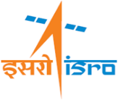
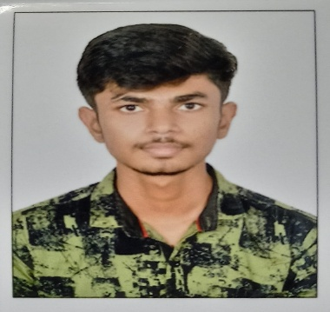
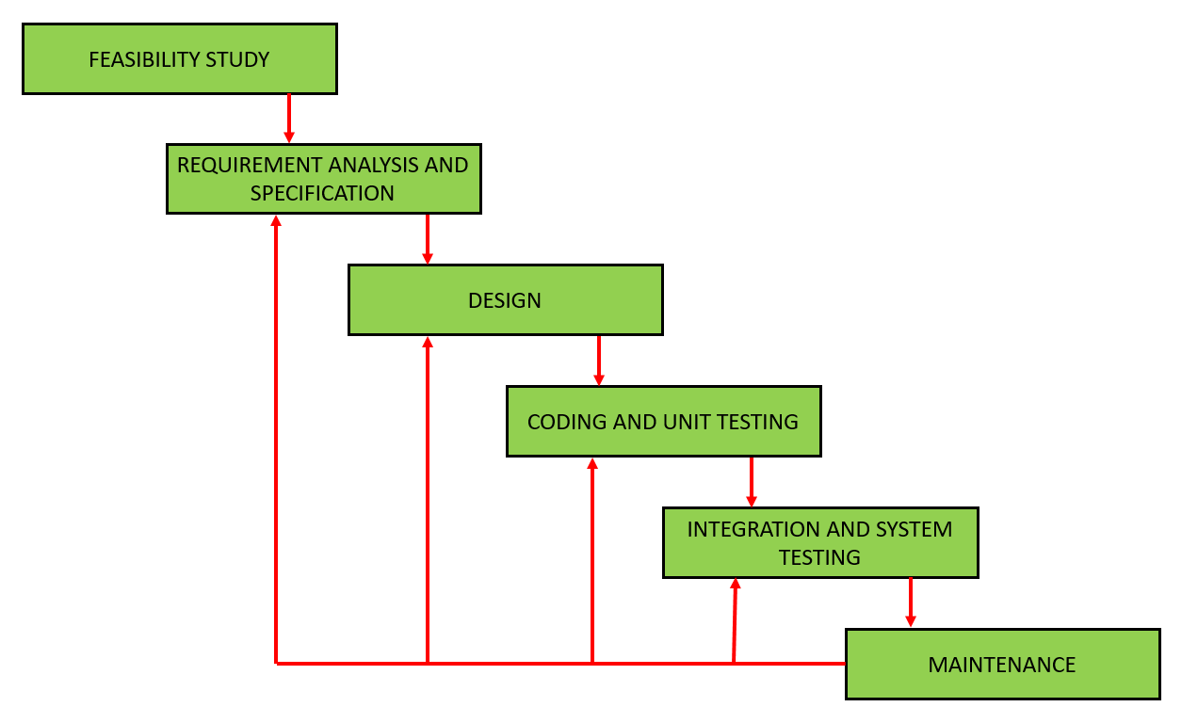
Lunar Image Simulation and Visulization
SRTD-RTMG-MISA
Name: Harshalkumar Sunilkumar Patel
Designation: Student
Institution: Parul Institute of Engineering and Technology
Guide: K.SURESH
Contact e-mail:
PHOTO
MAJOR OBJECTIVES :
To develop a user-friendly GUI application that simulates how a camera would capture the Moon’s surface using satellite image data .
To allow simulation through customizable camera parameters (altitude, focal length, FOV, detector size, etc.).
To improve simulation performance using parallel processing techniques.
09 DEC 2024 to
12 APRIL 2025
METHODOLOGY FLOW CHART:
Iterative Waterfall Model
RESULTS/MAJOR FINDINGS:
Successfully integrated the existing simulation backend with an interactive GUI using PyQt5 and PyQtGraph.
Achieved significant speedup in simulation execution through parallel processing using multiprocessing.
Provided intuitive image interaction features (marker placement, footprint preview, etc.).
Provided intuitive image interaction features (marker placement, footprint preview, etc.).
The system handles large datasets (GeoTIFF images) efficiently
CONCLUSION:
The system successfully simulates lunar surface images with customizable camera parameters, offering an interactive interface and efficient processing to provide a user-friendly tool.

