Slide 1
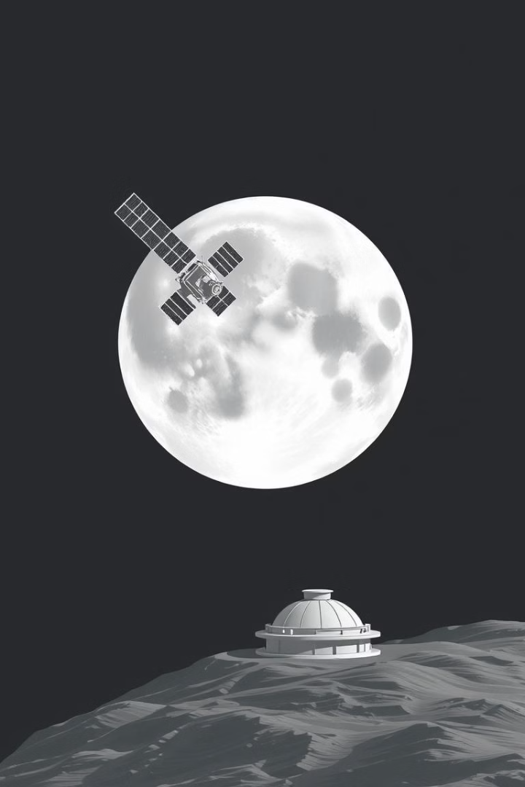
GUI for Moon Surface Image Simulation

Slide 2
Introduction
This project introduces a user-friendly Graphical User Interface (GUI) designed to enhance moon surface image simulation. The existing simulation module, while functional, lacks user accessibility and ease of use. The GUI aims to bridge this gap, offering an intuitive and efficient platform for Users . The primary objective is to simplify the simulation process, making it more accessible and efficient for mission studies.
This presentation outlines the design and methodology of GUI for simulation system. The system is engineered to simulate camera behavior in unknown lunar environments, providing an interactive tool for testing and design purposes.

Slide 3



Project Purpose and Objectives
The project is designed to simplify moon surface image simulations using camera parameters such as position, altitude, and orientation. This aims is to provide a structured, efficient, and user-friendly environment for parameter adjustment and image visualization.
User-Friendly Interface
Improved Efficiency
Aid Lunar Studies
Enhance the existing simulation module by integrating parallel processing.
Assist in Simulation by studying how cameras will capture images in lunar missions.
Provide an intuitive interface for configuring simulation parameters.

Slide 4
Scope: Capabilities and Limitations
This GUI offers an interactive environment for configuring and running moon surface image simulations, allowing input of camera settings to generate simulated images.
Capabilities
Limitations
Interactive GUI for configuration and simulation.
No real-time image capture or real-world data.
Input of camera settings for lunar surface images.
Operates only with pre-captured input images.
Improved performance via parallel processing.
Static model without dynamic changes.

Slide 5



Technologies Used
The project leverages a variety of technologies to ensure both functionality and performance.
PyQt5
Creates the graphical user interface (GUI) for parameter manipulation.
PyQtGraph
Provides visualization, efficiently displaying simulated images.
GDAL
Handles geographic data, transforming spatial data for accurate simulation.
NumPy is also essential for mathematical operations and data transformations.
Parallel Processing enhances the speed and efficiency of the simulation module.

Slide 6
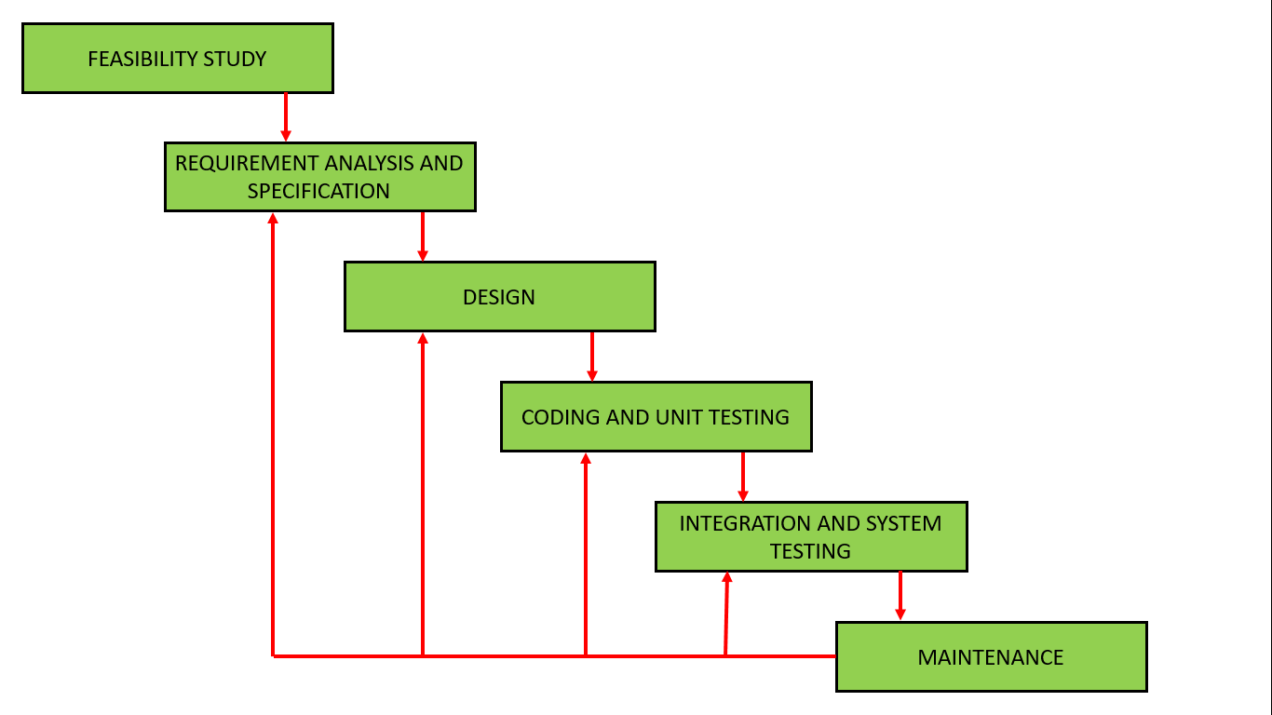
Methodology :
Iterative Waterfall Model

Slide 7
The project follows an Iterative Waterfall Model. Each phase is completed before the next begins, with iterations for continuous refinement and improvement of the system's functionality and performance.
Why Iterative Waterfall?
Structured Development
Flexibility to Refine
Provides a clear development process.
Allows refinements after each phase.
Continuous Feedback
Ensures feedback and improvements.
The Iterative Waterfall model was selected for its blend of structure and adaptability, enabling continuous improvements based on feedback.

Slide 8


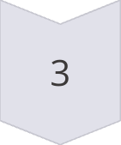
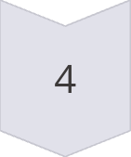
Implementation Stages
Requirements & Design
Gather GUI needs, usability issues.
Initial Development
Build initial GUI, integrate basic functionality.
Iteration & Refinement
Gather feedback, optimize simulation.
Final Adjustments
fix issues, ensure user experience.
Each stage was executed with adjustments made in subsequent iterations to enhance the final product.

Slide 9
Implementation Platform and Environment
Key Components
Programming Language: Python
Development Environment: Spyder
Hardware Requirements
The system is designed to run efficiently on standard computing hardware, ensuring better performance when processing GeoTIFF files.. At a minimum, it requires 8GB of RAM and a multi-core CPU, which helps handle computationally intensive tasks effectively. The software is developed within a Linux environment. To enhance performance and reduce processing time, the system benefits significantly from a higher number of CPU cores, allowing for parallel execution of tasks.

Slide 10
System Design
Structured Pipeline
The simulation system follows a structured pipeline. This includes image loading, parameter configuration, marker placement, and simulation output, ensuring a methodical approach to simulating camera behavior.
Loading GeoTIFF images
Configuring camera parameters
Placing markers to define latl-long for simulation
Generating simulation output

Slide 11
Data Structures & Processing Steps
1
Load Image
The user selects a GeoTIFF image to be processed, setting the stage for simulation.
2
Set Camera Parameters
Parameters are manually entered or selected from preloaded camera types using a combo box, ensuring accurate simulation conditions.
3
Mark Position(s) and Footrpint
The user marks a single or two-point location using the mouse or by entering coordinates, defining the area of interest. System calculates and overlays the expected simulated area on the original image.
4
Simulate Image
The system processes the image according to specified camera parameters, generating the simulated image output for analysis.

Slide 12
Interface Design and Access Control
Forms & Inputs
Interactive Controls
The GUI provides QLineEdit fields for numerical input and a QComboBox for selecting preloaded camera types, ensuring ease of data entry.
Buttons for loading, saving, and clearing data, along with QDials for adjusting roll, pitch, yaw, and tilt angles, provide intuitive control.
Visualization
The PyQtGraph canvas to displays input and output images with an interactive histogram, facilitating detailed image analysis.

Slide 13
Implementation :
Loading Images for Simulation
Image Selection
The "Load Image" feature allows users to select a pre-captured moon surface image for simulation. It supports the GeoTIFF format to maintain spatial accuracy, ensuring precise simulations.
Process
Users click the "Load Image" button, opening a file dialog to select a GeoTIFF image. The selected image is then displayed on the PyQtGraph canvas for further adjustments and simulation.

Slide 14
Camera Parameter Input Fields
Altitude
Determines the camera’s height from the moon’s surface.
Detector Size
Defines the sensor dimensions (Width & Height) ,(Along and Across) for accurate image capture.
Focal Length
Adjusts zoom and field of view for detailed simulations.
Field of View (FOV)
Controls the extent of the visible area in the simulation.

Slide 15
Single Point vs. Multi-Point Mode
Single Point Mode
Uses one coordinate for a fixed camera position, ideal for static simulations.
Multi-Point Mode
Simulates a moving camera along a start-to-end path, perfect for dynamic simulations.
Users select a mode via a dropdown menu, entering either one latitude-longitude pair (Single Point) or two coordinates to define the simulation path (Multi-Point). The simulation module processes the input and generates the respective image.

Slide 16
Orientation Controls (Roll, Pitch, Yaw, Tilt)
Roll: Rotates the camera along its lens axis for precise alignment.
Pitch: Tilts the camera up or down, adjusting the vertical viewing angle.
Yaw: Rotates the camera left or right, modifying the horizontal viewing angle.
Tilt: Adjusts the overall camera inclination, providing comprehensive control.

Slide 17
Footprint Preview Button
The Footprint Preview button allows users to visualize the region of the image covered by the simulated camera parameters. Clicking the "Footprint" button initiates the calculation of the camera's field of view, and a bounding box is overlaid on the input image to display the area that will be captured in the final simulated output. This feature ensures accurate and efficient simulations.

Slide 18
Mark & Clear Position Buttons
Users click "Mark Position" and then select a point on the displayed image. Clicking "Clear Position" removes all marked points and resets the selection, providing flexibility and control over the simulation process.
Clear Position
Store Coordinates
Resets marked points for a new selection.
Mark Position
The coordinates of the selected point are stored.
Select specific points on the image for simulation.

Slide 19
Save & Load Camera Parameters
Camera parameters are predefined, but users can load and save parameters.
Save Parameters
Store current settings.
Structured File
Save as Config.
Load Parameters
Restore saved settings.
Saves time and ensures consistency by storing and retrieving camera settings.

Slide 20
Parallel Processing Optimization
Parallel processing speeds up image simulation by using multiple CPU cores. Instead of processing the entire image sequentially, the simulation module divides the image into smaller segments, processes them in parallel using multiprocessing, and merges the results to generate the final output faster.
Divide Image
Image is divided into smaller segments.
Process Parallel
Segments are processed in parallel using multiprocessing.
Merge Results
Results are merged to generate the final output faster.

Slide 21
Findings and Results
Accurate Image Simulation
The system accurately simulates how a camera captures images in unknown environments.
Parameter Adjustment
Users can modify camera parameters and dynamically observe the changes.
Footprint Visualization
The footprint feature helps users understand how the final image will appear before simulation.
Efficient Processing
NumPy and GDAL ensure large GeoTIFF images are processed efficiently.
The implemented system provides accurate image simulation, enabling parameter adjustment, footprint visualization, and efficient processing of large GeoTIFF images. The simulated images align with expected outputs based on camera equations, providing an intuitive interface for parameter adjustments.

