Slide 1
INFOSYS SPRINGBOARD VIRTUAL INTERNSHIP 6.0
Hotel
RevAI
AI Driven Revenue Analysis for Hotels
Mentor: Selciya · Batch 13 · Group 2 · Team D
Duration: 8 Weeks · 02 Feb – 24 Feb 2026
TEAM MEMBERS
1. Chelikani Harshal
4. N. Akhila
2. Satbir Singh
5. G. Srilakshmi
3. Arun Kumar
HotelRevAI · Infosys Springboard Internship 6.0 · Batch 13 — Group 2, Team D

Slide 2
PROJECT INTRODUCTION
What is HotelRevAI?
Project Summary
Why This Project?
HotelRevAI is an end-to-end business intelligence system built on Microsoft Power BI that transforms 1,17,430 raw hotel booking records into five fully interactive revenue dashboards. Designed for hotel General Managers and Revenue Managers, it replaces hours of manual Excel reporting with instant, filterable insights — covering revenue performance, occupancy trends, guest segmentation, cancellation forecasting, and pricing strategy.
37% cancellation rate draining revenue
No unified view of all hotel KPIs
Manual Excel reports — hours of effort
Zero forecasting or trend visibility
Pricing decisions made without data
1,17,430
5
13
$42.72M
Records Analysed
Interactive Dashboards
DAX KPI Measures
Total Revenue Tracked
HotelRevAI · Infosys Springboard Internship 6.0 · Batch 13 — Group 2, Team D
2

Slide 3
PROJECT OVERVIEW
Project Objective
HotelRevAI transforms raw hotel booking data into actionable business intelligence through 5 interactive dashboards — empowering hotel leadership with instant, data-driven decision-making capability.
1,17,430
Records Processed
1
Load, clean & preprocess 1,17,430 records using Power Query Editor
5
2
Create 4 custom columns via M Language: total_nights, guest_type, season, revenue
Dashboards Built
3
Build 13 DAX measures covering Revenue, ADR, RevPAR, Occupancy % & more
13
4
Design 5 fully interactive dashboards with cross-filtering slicers
DAX Measures
5
Replace manual Excel reporting with a single real-time BI system
32
Final Columns
HotelRevAI · Infosys Springboard Internship 6.0 · Batch 13 — Group 2, Team D
3

Slide 4
TECH STACK
Technology Used
📊
🔧
📐
Microsoft Power BI Desktop
Power Query Editor
DAX (Data Analysis Expressions)
Primary dashboard development & reporting
Data cleaning, transformation & preprocessing
Business KPI & metric calculations
💡
📁
M Language
Microsoft Excel (.xlsx)
Custom column formulas in Power Query
Source data — hotel_booking_main.xlsx
HotelRevAI · Infosys Springboard Internship 6.0 · Batch 13 — Group 2, Team D
4

Slide 5
DATA
Dataset Overview
1,19,390
1,17,430
36 → 32
2015–2017
Raw Records
Clean Records
Columns
Data Period
Data Cleaning Steps
Custom Columns (M Language)
✓
Enabled column profiling across all 1,19,390 rows
total_nights
✓
Replaced nulls in country, agent & company columns
weekend_nights + weekday_nights
guest_type
✓
Removed 6 irrelevant / personal data columns
Solo / Family / Couple+Group
✓
Filtered out all rows where ADR = 0
season
✓
Corrected data types for all 32 remaining columns
Winter / Spring / Summer / Autumn
revenue
✓
Created 4 custom columns using M language
ADR × total_nights
HotelRevAI · Infosys Springboard Internship 6.0 · Batch 13 — Group 2, Team D
5

Slide 6
APPROACH
Project Methodology
01
02
03
04
Orientation
& Data Loading
Data Transform
& Modelling
DAX & Business
Metrics
Visualization
& Storytelling
Weeks 1–2
Weeks 3–4
Week 5
Weeks 6–8
Studied hotel_booking_main.xlsx — 36 columns, 1,19,390 rows. Loaded into Power BI via Excel connector. Explored all column definitions and data quality issues.
Power Query cleaning: nulls replaced, 6 columns removed, ADR=0 filtered. Created 4 custom columns using M language. Final: 1,17,430 rows × 32 columns.
Created 13 DAX measures: Total Revenue, ADR, RevPAR, Occupancy %, Cancellation Rate, No Show, Repeat Guest %, Revenue per Booking & more.
5 interactive dashboards with KPI cards, multi-chart layouts, cross-filtering slicers & consistent dark theme. Reviewed with mentor and submitted.
HotelRevAI · Infosys Springboard Internship 6.0 · Batch 13 — Group 2, Team D
6

Slide 7
BUSINESS METRICS
DAX Measures & KPIs
$42.72M
119.39K
$101.83
64.11%
62.96%
Total Revenue
Total Bookings
Avg Daily Rate
RevPAR
Occupancy %
SUMX(adr × nights)
COUNTROWS()
AVERAGE(adr)
Revenue / Capacity
Check-Out / Total
37.04%
104 days
409.26K
3.19%
1.21K
Cancellation Rate
Avg Lead Time
Total Nights Stayed
Repeat Guest %
No Show Count
Cancelled / Total
AVERAGE(lead_time)
SUM(total_nights)
Repeat / Total × 100
COUNTROWS(No-Show)
44.22K
$0.36K
0.57
Total Cancelled
Revenue per Booking
Avg Special Requests
COUNTROWS(cancelled)
Revenue / Bookings
AVERAGE(special_requests)
HotelRevAI · Infosys Springboard Internship 6.0 · Batch 13 — Group 2, Team D
7

Slide 8
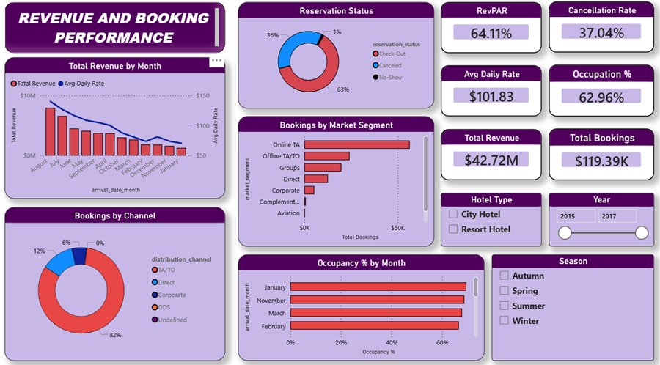
DASHBOARD 1
Revenue & Booking Performance
$42.72M
Total Revenue
62.96%
Occupancy %
$101.83
Avg Daily Rate
37.04%
Cancellation Rate
KEY INSIGHTS
August–July peak; January lowest revenue month · Online TA dominates at 82% of all bookings · City Hotel drives higher booking volumes · RevPAR at 64.11% across full dataset
HotelRevAI · Infosys Springboard Internship 6.0 · Batch 13 — Group 2, Team D
8

Slide 9
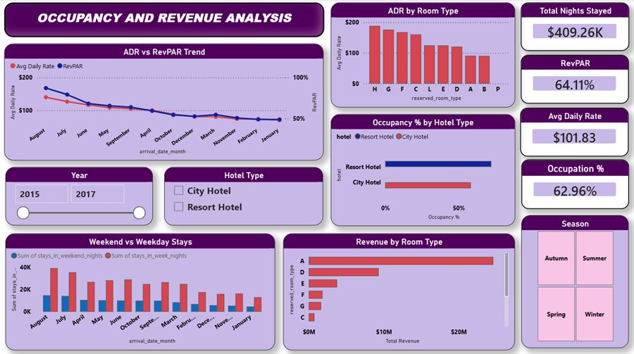
DASHBOARD 2
Occupancy & Revenue Analysis
409.26K
Total Nights Stayed
64.11%
RevPAR
$101.83
Avg Daily Rate
62.96%
Occupancy %
KEY INSIGHTS
Room Type H commands highest ADR at $656+ · Weekday stays consistently exceed weekends · Resort Hotel peaks in summer occupancy · ADR and RevPAR trend closely across months
HotelRevAI · Infosys Springboard Internship 6.0 · Batch 13 — Group 2, Team D
9

Slide 10
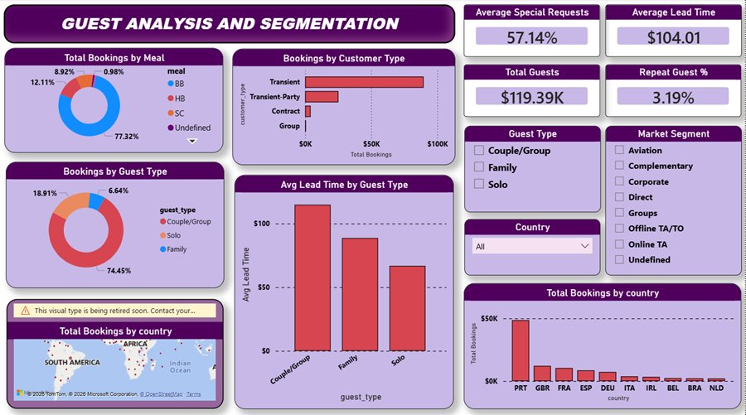
DASHBOARD 3
Guest Analysis & Segmentation
119.39K
Total Guests
57.14%
Avg Special Requests
104 days
Avg Lead Time
3.19%
Repeat Guest %
KEY INSIGHTS
Transient guests: 74%+ of all bookings · Portugal (PRT) is #1 source country · BB meal plan dominates at 77.32% share · Couple/Group guests book furthest in advance
HotelRevAI · Infosys Springboard Internship 6.0 · Batch 13 — Group 2, Team D
10

Slide 11
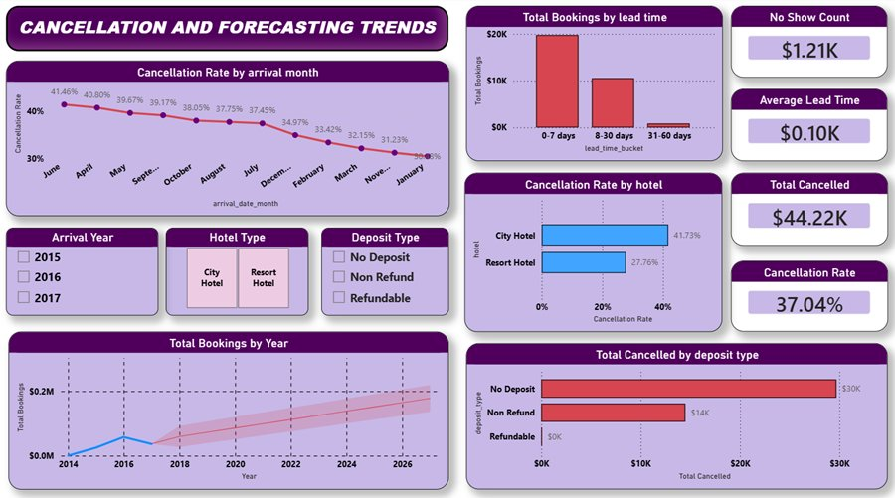
DASHBOARD 4
Cancellation & Forecasting Trends
37.04%
Cancellation Rate
44.22K
Total Cancelled
1.21K
No Show Count
41.73%
City Hotel Cancel Rate
KEY INSIGHTS
June highest cancellation month at 41.46% · City Hotel cancels far exceed Resort (27.76%) · No Deposit bookings: ~30K cancellations · 0–7 day lead time shows lowest cancellations
HotelRevAI · Infosys Springboard Internship 6.0 · Batch 13 — Group 2, Team D
11

Slide 12
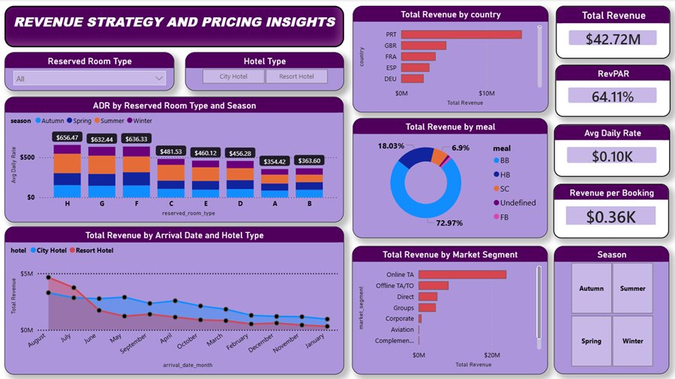
DASHBOARD 5
Revenue Strategy & Pricing Insights
$42.72M
Total Revenue
64.11%
RevPAR
$656
Room H Peak ADR
$0.36K
Revenue per Booking
KEY INSIGHTS
Room Type H: $656 ADR — highest across seasons · Portugal drives highest revenue by country · Online TA is top revenue market segment · BB meal plan: 72.97% of all meal revenue
HotelRevAI · Infosys Springboard Internship 6.0 · Batch 13 — Group 2, Team D
12

Slide 13
INSIGHTS
Key Business Insights
📈
🏨
🌍
Revenue Seasonality
Hotel Type Gap
Top Source Markets
August–September peak generates maximum revenue. January–February are weakest months. Dynamic pricing in off-peak months can reduce the revenue dip significantly.
City Hotel cancellation rate (41.73%) is significantly higher than Resort Hotel (27.76%). Non-refundable deposit policies can plug this revenue leakage.
Portugal, Great Britain & France are the top 3 revenue-generating countries. Targeted campaigns in these markets will yield the highest ROI.
🛏️
⚡
🎯
Room Type Pricing
Lead Time & Cancellations
Channel Dominance
Room Type H commands the highest ADR ($656+) in all seasons. Prioritising premium room availability during peak periods maximises RevPAR.
Bookings made 0–7 days in advance have the lowest cancellation rates. Last-minute deals convert hesitant guests during high-demand periods.
Online Travel Agents drive 82% of bookings and the highest revenue share. Investing in OTA visibility and guest reviews is critical for growth.
HotelRevAI · Infosys Springboard Internship 6.0 · Batch 13 — Group 2, Team D
13

Slide 14
TIMELINE
8-Week Project Timeline
★ Prototype Draft
★ Mid-Term Review
Wk 1
Wk 3
Wk 5
Wk 7
Dataset study & domain understanding
Power Query transforms & custom columns
Dashboards 1 & 2 built and reviewed
Dashboard 5 & business insights derived
Wk 2
Wk 4
Wk 6
Wk 8
Power BI setup, data loading & null handling
13 DAX measures & KPI development
Dashboards 3 & 4 with map & forecast
Final documentation & completion report
★ Final Submission
02 Feb 2026
24 Feb 2026
HotelRevAI · Infosys Springboard Internship 6.0 · Batch 13 — Group 2, Team D
14

Slide 15
IMPACT
Real-World Impact
BEFORE vs AFTER
Business Questions Answered Instantly
✗ Static Excel Reports
✓ 5 Interactive Dashboards
?
Which months have the highest cancellation rates?
✗ Hours of manual prep
✓ Instant cross-filtered views
?
Which room types & seasons generate the highest ADR?
✗ Siloed KPI tracking
✓ All metrics in one system
?
Which countries send the most valuable guests?
?
How does City Hotel compare to Resort Hotel?
✗ Delayed decisions
✓ Real-time business answers
?
What is the forecasted booking trend for next 30 days?
✗ No forecasting
✓ Booking trend forecast line
?
Which booking channel drives the most revenue?
HotelRevAI · Infosys Springboard Internship 6.0 · Batch 13 — Group 2, Team D
15

Slide 16
Thank
You
HotelRevAI — AI Driven Revenue Analysis for Hotels
🔍
End-to-end Power BI project from raw data to 5 production dashboards
📐
Mastered 13 DAX measures & hospitality KPIs: ADR, RevPAR, Occupancy %
🧹
Real-world data cleaning: nulls, noise removal, M language engineering
💼
Business storytelling: translating patterns into actionable hotel strategy
Mentor: Selciya · Infosys Springboard Virtual Internship 6.0 · Batch 13, Group 2, Team D
HotelRevAI · Infosys Springboard Internship 6.0 · Batch 13 — Group 2, Team D

