Slide 1
INFOSYS SPRINGBOARD VIRTUAL INTERNSHIP 6.0
HotelRevAI
AI Driven Revenue Analysis for Hotels
Mentor: Selciya | Batch 13 · Group 2 · Team D
Duration: 8 Weeks
1. Chelikani Harshal
4. N. Akhila
2. Satbir Singh
5. G. Srilakshmi
3. Arun Kumar
HotelRevAI | Infosys Springboard Internship | Batch 13 – Group 2, Team D

Slide 2
PROJECT OVERVIEW
Project Objective
HotelRevAI is an interactive, AI-driven revenue analysis system for the hotel industry built on Microsoft Power BI. It transforms 1,17,430 raw booking records into actionable business intelligence through 5 fully interactive dashboards.
1,17,430
Records Processed
Load, clean & preprocess 1,17,430 hotel booking records using Power Query Editor
5
1
Dashboards Built
2
Build 13 DAX measures: Revenue, ADR, RevPAR, Occupancy %, Cancellation Rate & more
3
Design 5 interactive dashboards covering Revenue, Occupancy, Guests, Cancellation & Strategy
13
Empower hotel GMs & Revenue Managers with faster, data-driven decisions
DAX Measures Created
4
5
Replace manual Excel reporting with a single, filterable BI system
32
Columns in Final Dataset
HotelRevAI | Infosys Springboard Internship | Batch 13 – Group 2, Team D
2

Slide 3
TECH STACK
Technology Used
📊
🔧
📐
Microsoft Power BI Desktop
Power Query Editor
DAX (Data Analysis Expressions)
Primary dashboard development & reporting tool
Data cleaning, transformation & preprocessing layer
Business metric calculations & KPI measures
💡
📁
M Language
Microsoft Excel (.xlsx)
Custom column formulas within Power Query
Source data format — hotel_booking_main.xlsx
HotelRevAI | Infosys Springboard Internship | Batch 13 – Group 2, Team D
3

Slide 4
DATA
Dataset Overview
1,19,390
1,17,430
36 → 32
2015–2017
Raw Records
Clean Records
Columns (after cleaning)
Data Period
Data Cleaning Steps
Custom Columns Created (M Language)
✓
Enabled column profiling across all rows
total_nights
Replaced nulls in country, agent & company columns
Sum of weekend + weekday nights stayed
✓
guest_type
✓
Removed 6 irrelevant/personal data columns
Couple/Group, Family, or Solo classification
✓
Filtered out rows where ADR = 0
season
Corrected data types for all 32 columns
Autumn / Spring / Summer / Winter mapping
✓
revenue
✓
Created 4 custom columns via M language
ADR × total_nights (calculated revenue)
HotelRevAI | Infosys Springboard Internship | Batch 13 – Group 2, Team D
4

Slide 5
APPROACH
Project Methodology
1
2
3
4
Phase 1
Phase 2
Phase 3
Phase 4
Orientation & Data Loading
Data Transformation & Modelling
DAX & Business Metrics
Visualization & Storytelling
[ Weeks 1–2 ]
[ Weeks 3–4 ]
[ Week 5 ]
[ Weeks 6–8 ]
Studied the hotel_booking_main.xlsx dataset with 36 columns & 1,19,390 rows. Loaded data into Power BI using Excel connector. Explored column definitions and data quality.
Used Power Query Editor for cleaning. Handled nulls, removed 6 columns, corrected types, filtered ADR=0. Created 4 custom columns using M language formulas.
Created 13 DAX measures: Total Revenue, ADR, RevPAR, Occupancy %, Cancellation Rate, No Show Count, Repeat Guest %, Revenue per Booking & more.
Designed 5 interactive dashboards with KPI cards, multi-chart layouts, cross-filtering slicers, and a consistent dark purple visual theme.
HotelRevAI | Infosys Springboard Internship | Batch 13 – Group 2, Team D
5

Slide 6
BUSINESS METRICS
DAX Measures & KPIs
$42.72M
119.39K
$101.83
64.11%
62.96%
Total Revenue
Total Bookings
Avg Daily Rate (ADR)
RevPAR
Occupancy %
SUM(revenue)
COUNTROWS()
AVERAGE(adr)
Revenue / Capacity
Checked-Out / Total
37.04%
104 days
409.26K
3.19%
1.21K
Cancellation Rate
Avg Lead Time
Total Nights Stayed
Repeat Guest %
No Show Count
Cancelled / Total
AVERAGE(lead_time)
SUM(total_nights)
Repeat / Total × 100
COUNTROWS(no-show)
44.22K
$0.36K
0.57
Total Cancelled
Revenue per Booking
Avg Special Requests
COUNTROWS(cancelled)
Revenue / Bookings
AVERAGE(special_req)
HotelRevAI | Infosys Springboard Internship | Batch 13 – Group 2, Team D
6

Slide 7
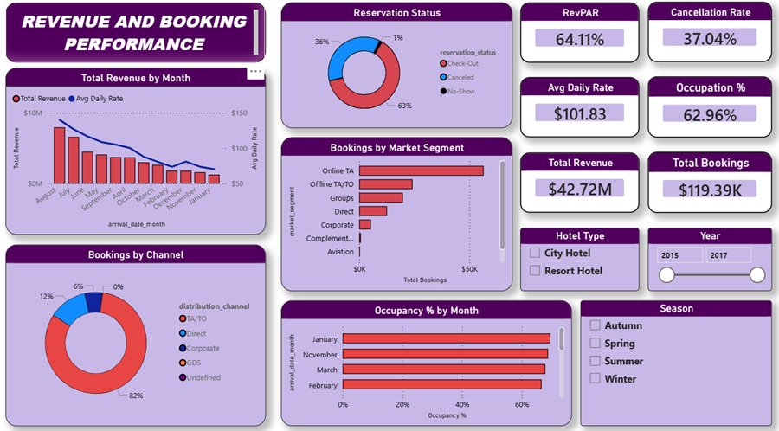
DASHBOARD 1
Revenue & Booking Performance
$42.72M
Total Revenue
62.96%
Occupancy %
$101.83
Avg Daily Rate
37.04%
Cancellation Rate
Key Insights
Total Revenue: $42.72M across 119.39K bookings
Online TA dominates booking channels at 82% share
August records highest revenue; January shows the lowest
City Hotel drives higher booking volumes overall
HotelRevAI | Infosys Springboard Internship | Batch 13 – Group 2, Team D
7

Slide 8
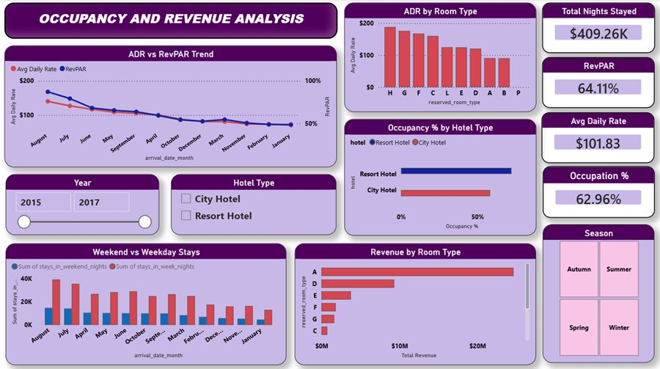
DASHBOARD 2
Occupancy & Revenue Analysis
409.26K
Total Nights Stayed
64.11%
RevPAR
$101.83
ADR
62.96%
Occupancy %
Key Insights
Resort Hotel occupancy peaks during summer months
Weekend stays consistently outperform weekday stays
RevPAR trend follows ADR closely across all months
HotelRevAI | Infosys Springboard Internship | Batch 13 – Group 2, Team D
8

Slide 9
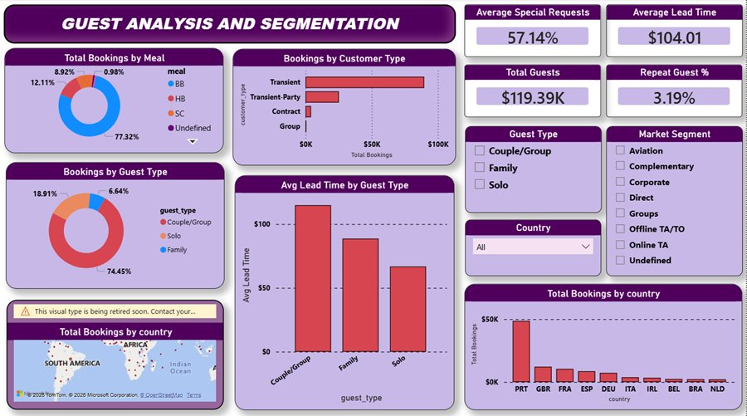
DASHBOARD 3
Guest Analysis & Segmentation
119.39K
Total Guests
57.14%
Avg Special Requests
104 days
Avg Lead Time
3.19%
Repeat Guest %
Key Insights
Transient guests form the largest booking segment (74%+)
Portugal (PRT) is the #1 source country by total bookings
Couple/Group guests have the longest avg lead time of ~$104
BB (Bed & Breakfast) is the most popular meal plan at 77%
HotelRevAI | Infosys Springboard Internship | Batch 13 – Group 2, Team D
9

Slide 10
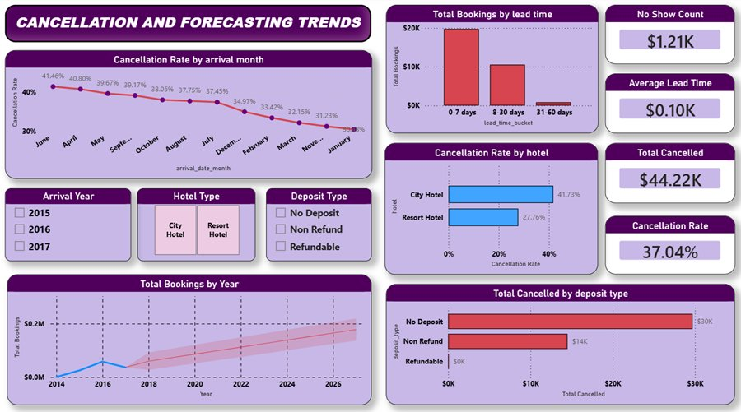
DASHBOARD 4
Cancellation & Forecasting Trends
37.04%
Cancellation Rate
44.22K
Total Cancelled
1.21K
No Show Count
0.10K
Avg Lead Time
Key Insights
Overall cancellation rate stands at 37.04% — 44.22K bookings
City Hotel cancellation rate (41.73%) far exceeds Resort Hotel (27.76%)
Guests with no deposit account for the most cancellations (~$30K)
Short lead-time bookings (0–7 days) show the lowest cancellations
HotelRevAI | Infosys Springboard Internship | Batch 13 – Group 2, Team D
10

Slide 11
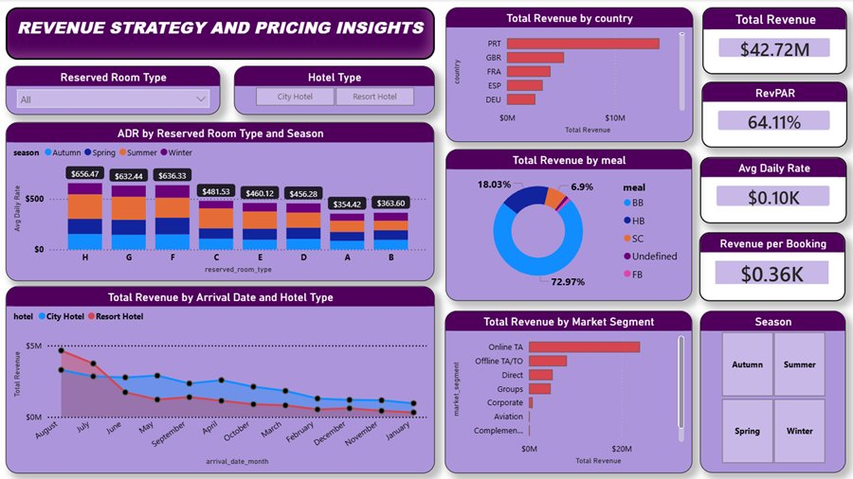
DASHBOARD 5
Revenue Strategy & Pricing Insights
$42.72M
Total Revenue
64.11%
RevPAR
$101.83
Avg Daily Rate
$0.36K
Revenue/Booking
Key Insights
Room Type H commands the highest ADR across all seasons ($656)
Portugal drives the highest total revenue among all source countries
Online TA is the top revenue-generating market segment
BB meal plan accounts for 72.97% of all meal plan revenue
HotelRevAI | Infosys Springboard Internship | Batch 13 – Group 2, Team D
11

Slide 12
INSIGHTS
Key Business Insights
📈
🏨
🌍
Revenue Seasonality
Hotel Type Gap
Top Source Markets
August–September peak generates maximum revenue. January–February are the weakest months. Dynamic pricing in off-peak months can reduce revenue dip.
City Hotel cancellation rate (41.73%) is significantly higher than Resort Hotel (27.76%). Non-refundable deposit policies can plug this leakage.
Portugal (PRT), Great Britain (GBR), and France (FRA) are the top 3 revenue-generating countries. Targeted campaigns in these markets can yield higher ROI.
🛏️
⚡
🎯
Room Type Pricing
Lead Time & Cancellations
Channel Dominance
Room Type H commands the highest ADR ($656+) in all seasons. Prioritising availability of premium room types during peak periods maximizes RevPAR.
Bookings made 0–7 days in advance have the lowest cancellation rates. Last-minute deals for high-demand periods can convert hesitant guests.
Online Travel Agents (OTA) drive 82% of bookings and the highest revenue share. Investing in OTA visibility and reviews is critical for growth.
HotelRevAI | Infosys Springboard Internship | Batch 13 – Group 2, Team D
12

Slide 13
TIMELINE
8-Week Project Timeline
★ Prototype Draft
★ Mid-Term Review
Week 1
Week 3
Week 5
Week 7
Dataset study & domain understanding
Power Query transformations & custom columns
Dashboards 1 & 2 built and reviewed
Dashboard 5 & business insights derived
Week 2
Week 4
Week 6
Week 8
Power BI setup, data loading & null handling
13 DAX measures & KPI development
Dashboards 3 & 4 with map & forecast
Final documentation & completion report
★ Final Submission
HotelRevAI | Infosys Springboard Internship | Batch 13 – Group 2, Team D
13

Slide 14
IMPACT
Real-World Impact
BEFORE vs AFTER
Business Questions Now Answered Instantly
✗ Static Excel Reports
✓ 5 Interactive Dashboards
?
Which months have the highest cancellation rates and why?
✗ Hours of manual data prep
✓ Instant cross-filtered views
?
Which room types and seasons generate the highest ADR?
✗ Siloed metric tracking
✓ All KPIs in one system
?
Which countries send the most valuable guests?
?
How does City Hotel compare to Resort Hotel performance?
✗ Delayed decision making
✓ Real-time business answers
?
What is the forecasted booking trend for the next 30 days?
✗ No forecasting capability
✓ Booking forecast trend line
?
Which booking channel drives the most revenue?
HotelRevAI | Infosys Springboard Internship | Batch 13 – Group 2, Team D
14

Slide 15
Thank You
HotelRevAI — AI Driven Revenue Analysis for Hotels
Mentor: Selciya | Infosys Springboard Virtual Internship 6.0 | Batch 13, Group 2, Team D
HotelRevAI | Infosys Springboard Internship | Batch 13 – Group 2, Team D

