Slide 1
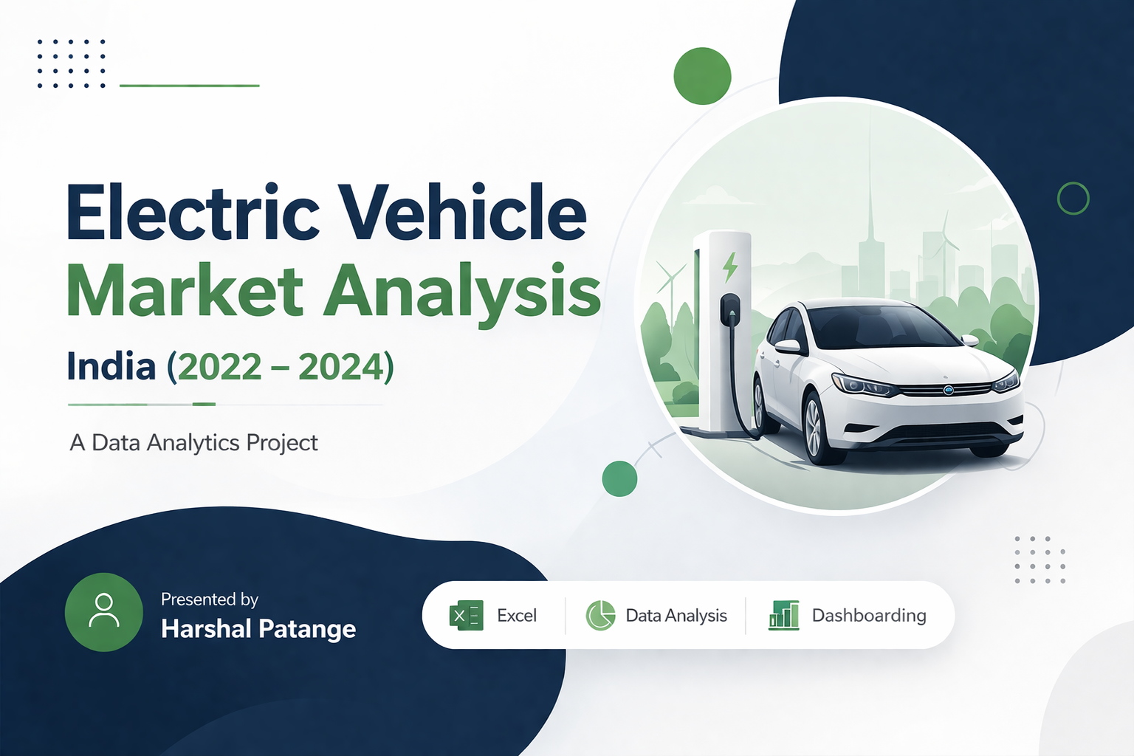

Slide 2

Problem Statement
AtliQ Motors, a leading EV manufacturer from the USA, plans to expand into the Indian market
Currently, the company holds 25% market share in North America, but less than 2% in India
Before expansion, a detailed analysis of the Indian EV market is required.
The objective is to understand market trends, competition, and growth opportunities
The analysis is assigned to the data analytics team led by Peter Pandey

Slide 3
Project Tasks
Imagine yourself as Peter Pandey and perform the following tasks.
Begin your analysis by referring to the ‘primary_and_secondary_questions.pdf’. You can use any tool of your choice (Excel) to analyze and answer these questions. More instructions are provided in this document.
Design a dashboard with your metrics and analysis. The dashboard should be self-explanatory and easy to understand.
You can use additional data based on your own research to support your recommendations and provide more insights.
Be creative with your presentation, audio/video presentation will have more weightage. You will be presenting these insights to the chief Bruce Haryali – he appreciates good storytelling and concise presentation.

Slide 4


Data Overview
Dataset Details
Data includes EV sales from 2022 to 2024
Covers 2W & 4W vehicles
State-wise & maker-wise data
Data Preparation
Cleaned missing values
Created calculated columns
(CAGR, Penetration Rate)

Slide 5

Top & Bottom EV 2-Wheeler Makers
FY 2023 & FY 2024
Top 3 EV 2-Wheeler Makers – FY 2023
Rank | Maker | Unites Sold
1 | OLA ELECTRIC | 2,71,925
2 | TVS | 1,65,030
3 | ATHER | 1,03,812
Bottom 3 EV 2-Wheeler Makers – FY 2023
Rank(Bottom) | Maker | Unites Sold
1 | JITENDRA | 1,180
2 | BEING | 1,354
3 | PURE EV | 1,789
Top 3 EV 2-Wheeler Makers – FY 2024
Rank | Maker | Unites Sold
1 | OLA ELECTRIC | 1,10,872
2 | TVS | 55,742
3 | BAJAJ | 40,072
Bottom 3 EV 2-Wheeler Makers – FY 2024
Rank(Bottom) | Maker | Unites Sold
1 | HERO ELECTRIC | 1,050
2 | BATTRE ELECTRIC | 1,128
3 | REVOLT | 1,582
Key Insight :
EV 2W market is highly concentrated. Ola Electric leads consistently in FY 2023 & 2024, while smaller players have minimal market share.

Slide 6
Problem Statement - 2
Identify the top 5 states with the highest penetration rate in 2-wheeler and 4-wheeler EV sales in FY 2024.
Top 5 States by EV Penetration(2-Wheeler) – FY 2023
Rank | State | Ev Sales | Total Sales | Penetration Rate
1 | Ladakh | 14 | 52 | 26.92%
2 | Goa | 3567 | 14856 | 24.01%
3 | Kerala | 20239 | 123774 | 16.35%
4 | Karnataka | 47762 | 348572 | 13.70%
5 | Maharashtra | 58228 | 473042 | 12.31%
Top 5 States by EV Penetration (4-Wheelers) – FY 2024
Rank | State | Ev Sales | Total Sales | Penetration Rate
1 | Kerala | 2294 | 26306 | 8.72%
2 | Chandigarh | 304 | 4339 | 7.17%
3 | Goa | 308 | 5833 | 5.28%
4 | Delhi | 2838 | 55323 | 5.13%
5 | Karnataka | 3485 | 82333 | 4.23%
Key Insight :
• Delhi and Karnataka are strong in both 2W and 4W EV adoption
• Some smaller regions like Chandigarh and Goa have high EV usage even with low total sales
• EV growth is higher in cities with good charging infrastructure and government support
• Big states don’t always have the highest penetration — policies matter more than size

Slide 7
Problem Statement - 3
List the states with negative penetration (decline) in EV sales from 2022 to 2024?
Top 5 States by EV Penetration(2-Wheeler) – FY 2023
Rank | State | Penetration Rate (2022) | Penetration Rate (2023) | Change
1 | Sikkim | 0.00% | 0.00% | 0.00%
2 | Himachal Pradesh | 0.93% | 0.94% | 0.01%
3 | Nagaland | 0.02% | 0.05% | 0.03%
4 | Arunachal Pradesh | 0.01% | 0.15% | 0.14%
5 | Tripura | 0.47% | 0.67% | 0.26%
Key Insight :
No state in India experienced a decline in EV penetration between 2022 and 2024. All states show positive or stable growth, indicating a strong and consistent increase in EV adoption across the country.

Slide 8
Problem Statement - 4
What are the quarterly trends based on sales volume for the top 5 EV makers (4-wheelers) from 2022 to 2024?
Top 5 States by EV Penetration(2-Wheeler) – FY 2023
Quarter | Makers
 | BYD India | Hyundai Motor | Mahindra & Mahindra | MG Motor | Tata Motors
Q1 | 487 | 392 | 13286 | 2309 | 13953
Q2 | 423 | 579 | 9670 | 3957 | 18581
Q3 | 454 | 586 | 9025 | 3766 | 23678
Q4 | 1055 | 519 | 9212 | 3721 | 32723
Key Insight :
The consistent rise in EV sales and strong Q4 performance indicate growing market demand. AtliQ Motors should strategically launch during high-demand periods such as Q3–Q4 to maximize sales potential.

Slide 9
Problem Statement - 5
How do the EV sales and penetration rates in Delhi compare to Karnataka for 2024?
EV Sales & Penetration Comparison (FY 2024)
Delhi vs Karnataka
 | Delhi | Karnataka
Ev Sales | 13277 | 51247
Total Vehicals sold | 155839 | 430905
Penetration Rate | 8.52% | 11.89%
Key Insight :
In FY 2024, Karnataka outperforms Delhi in both EV sales and penetration rate, making it a more favorable market for expansion, while Delhi continues to be a strong and competitive EV market.

Slide 10
Problem Statement - 6
List down the compounded annual growth rate (CAGR) in 4-wheeler units for the top 5 makers from 2022 to 2024.
Top 5 Makers by CAGR (4-Wheelers)
Rank | Maker | CAGR
1 | Volvo Auto India | 115.41%
2 | BMW India | 50.70%
3 | Mercedes -Benz AG | 36.63%
4 | BYD India | 10.26%
5 | MG Motor | 2.74%
Key Insight :
The high CAGR of premium EV brands suggests strong growth potential in the luxury segment, while mass-market players require strategic innovation to maintain growth.

Slide 11
Problem Statement - 7
List down the top 10 states that had the highest compounded annual growth rate (CAGR) from 2022 to 2024 in total vehicles sold.
Top 10 States by CAGR (Total Vehicle Sales) – 2022–2024
Rank | State | CAGR
1 | Nagaland | -37.81%
2 | Puducherry | -40.63%
3 | Assam | -41.65%
4 | Chhattisgarh | -42.63%
5 | Haryana | -42.96%
6 | Karnataka | -43.36%
7 | Meghalaya | -43.61%
8 | Tamil Nadu | -43.79%
9 | Mizoram | -44.68%
10 | Goa | -44.85%
Key Insight :
All states show a negative CAGR in total vehicle sales from 2022 to 2024, indicating an overall decline in vehicle sales during this period.

Slide 12
Problem Statement - 8
What are the peak and low season months for EV sales based on the data from 2022 to 2024?
Monthly EV Sales Summary
Jan | 189.10K
Feb | 198.05K
Mar | 291.59K
Apr | 134.66K
May | 159.87K
Jun | 106.71K
Jul | 127.43K
Aug | 141.96K
Sep | 145.97K
Oct | 185.19K
Nov | 205.20K
Dec | 180.40K
Key Insight :
AtliQ Motors should plan major launches and marketing campaigns around March and festive months to maximize sales, while preparing strategies to boost demand during slower months like June.

Slide 13
Problem Statement - 9
What is the projected number of EV sales (including 2-wheelers and 4 wheelers) for the top 10 states by penetration rate in 2030, based on the compounded annual growth rate (CAGR) from previous years?
Monthly EV Sales Summary
Rank | State | CAGR | Projected 2030 Sales
1 | Uttar Pradesh | -5.59% | 15017
2 | Karnataka | -25.06% | 9079
3 | Mizoram | 95.79% | 7773
4 | Maharashtra | -30.84% | 6766
5 | Kerala | -22.23% | 4984
6 | Tamil Nadu | -29.84% | 3764
7 | Madhya Pradesh | -22.11% | 3108
8 | West Bengal | -19.95% | 1579
9 | Goa | -16.93% | 1273
10 | Arunachal Pradesh | 123.61% | 1250
Key Insight :
AtliQ Motors should not rely only on past trends, as EV adoption is growing quickly. It should focus on high-potential states like Karnataka, Maharashtra, and Kerala for future expansion.

Slide 14
Problem Statement - 10
Estimate the revenue growth rate of 4-wheeler and 2-wheelers EVs in India for 2022 vs 2024 and 2023 vs 2024, assuming an average unit price.
Monthly EV Sales Summary
Category | Growth(2022-2024) | Growth(2023-2024)
2-Wheelers | -53.59% | -65.81%
4-Wheelers | -37.66% | -70.30%
Key Insight :
EV adoption is improving even though total revenue is falling, which means EVs are gaining a larger share of the market.

Slide 15
Secondary Research Questions: 1
Q1.What are the primary reasons for customers choosing 4-wheeler EVs in 2023 and 2024 (cost savings, environmental concerns, government incentives)?
💰 Cost Savings: EVs offer much lower running and maintenance costs compared to petrol or diesel vehicles. Over time, this leads to significant savings, making them a cost-effective long-term choice.
🌱 Environmental Concerns: Growing awareness of pollution and climate change has encouraged people to adopt cleaner transportation. EVs help reduce emissions, supporting a more sustainable environment.
🏛️ Government Incentives: Subsidies, tax benefits, and reduced registration charges have made EVs more affordable. These policies have helped lower the initial cost and increased customer adoption.
⛽ Rising Fuel Prices: Increasing petrol and diesel prices have made traditional vehicles expensive to maintain. This has pushed consumers to shift toward EVs as a more economical alternative.
📈 Technological Advancements & Awareness: Better battery performance, improved driving range, and expanding charging infrastructure have increased EV reliability. Along with rising awareness, this has boosted customer confidence and demand.

Slide 16
Secondary Research Questions: 2
How do government incentives and subsidies impact the adoption rates of 2-wheelers and 4-wheelers?
Impact of Government Incentives on EV Adoption
🚀 Boost in Adoption Rates: Government subsidies reduce the upfront cost of EVs, making them more affordable. This directly increases adoption, especially in price-sensitive segments like 2-wheelers.
🛵 Strong Impact on 2-Wheelers: Schemes like FAME-II and PM E-DRIVE mainly support 2-wheelers through direct subsidies. This has led to the highest growth in adoption among all EV segments.
🚗 Limited but Growing Impact on 4-Wheelers: 4-wheeler EVs receive fewer central subsidies and depend more on state policies. This results in slower adoption compared to 2-wheelers, though growth is increasing.
📉 Reduction in Total Cost of Ownership: Subsidies, tax benefits, and low running costs make EVs more economical over time. This improves affordability and encourages more consumers to switch.

Slide 17
Secondary Research Questions: 2
Which states in India provided most subsidies?
States Providing the Most EV Subsidies in India
Delhi: Offers the highest subsidies with tax exemptions and purchase incentives, making EVs highly affordable.
Maharashtra: Provides cash benefits, road tax exemption, and strong policy support for EV buyers.
Gujarat: Gives attractive subsidies, especially for 2-wheelers, promoting mass adoption.
Karnataka: Focuses on tax exemptions and EV infrastructure rather than direct subsidies.
Tamil Nadu: Supports EV growth through policies, tax benefits, and manufacturing incentives.

Slide 18
Secondary Research Questions: 3
How does the availability of charging stations infrastructure correlate with the EV sales and penetration rates in the top 5 states?
Correlation Between Charging Infrastructure & EV Adoption (Top 5 States)
🔗 Positive Correlation (Direct Relationship): States with more charging stations generally have higher EV adoption and penetration. Better infrastructure reduces range anxiety and builds consumer confidence.
🏙️ Top States with Strong Infrastructure & Sales: Karnataka, Maharashtra, Delhi, Uttar Pradesh, and Tamil Nadu lead in both charging stations and EV sales. This shows infrastructure availability supports higher adoption.
📉 Infrastructure Gaps Slow Adoption: Limited charging stations create inconvenience and increase range anxiety. This slows EV adoption, especially for 4-wheelers.
📈 Overall Insight: There is a strong positive correlation between charging infrastructure and EV adoption. However, policies, cost, and vehicle type also influence growth.

Slide 19

Secondary Research Questions: 4
Who should be the brand ambassador if AtliQ Motors launches their EV/Hybrid vehicles in India and why?
Brand Ambassador Recommendation
Suggested: Rohit Sharma
Why Rohit Sharma?
• Mass Popularity Across India Strong fan base in both urban and rural markets
• Calm & Reliable Personality Represents trust, consistency, and dependability
• Strong Family Audience Connect Appeals to middle-class and family buyers (key 4W segment)
• Positive & Clean Image Aligns well with eco-friendly and sustainable brand values
Key Insights :
Rohit Sharma’s strong popularity and trustworthy image can help AtliQ Motors build brand credibility and connect with a wider audience across India.

Slide 20
Secondary Research Questions: 5
Which state of India is ideal to start the manufacturing unit? (Based on subsidies provided, ease of doing business, stability in governance etc.)
Best State for EV Manufacturing
Suggested: Maharashtra
Why Maharashtra?
• Strong Industrial Base One of India’s leading manufacturing hubs with established auto industry
• High Government Incentives Provides subsidies, tax exemptions, and EV-friendly policies
• Large Market Demand
High EV adoption in cities like Mumbai and Pune
• Skilled Workforce Availability of technical and industrial talent
Key Insights :
Maharashtra is ideal due to its strong industrial ecosystem, high demand, and supportive government policies for EV growth.

Slide 21
Secondary Research Questions: 6
Your top 3 recommendations for AtliQ Motors.
Top 3 Recommendations for AtliQ Motors
1. Focus on High-Growth States
• Target states like Karnataka, Maharashtra, Tamil Nadu • These regions show high EV penetration and demand • Helps achieve faster market entry and sales growth
2. Invest in Charging Infrastructure
• Expand charging stations in cities and highways • Partner with local providers and governments
3. Build Strong Brand Awareness
• Run marketing campaigns highlighting cost savings & sustainability • Educate customers about EV benefits
Key Insights :
AtliQ Motors should focus on strong markets, infrastructure development, and brand awareness to successfully enter and grow in the Indian EV market.

Slide 22
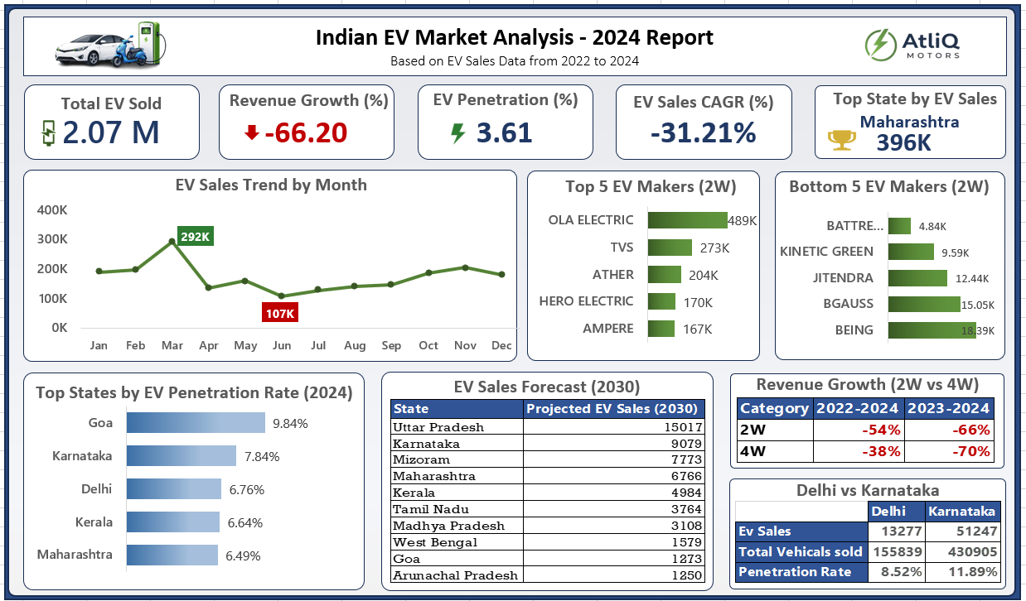

Slide 23
Strategic Recommendations for AtliQ Motors
Expand in High-Potential States
Focus on Karnataka, Maharashtra, and Tamil Nadu for faster growth.
Prioritize 2-Wheeler Segment
High demand and strong government support make it the best entry point.
Invest in Charging Infrastructure
Improve accessibility to reduce range anxiety and boost adoption
Leverage Government Incentives
Align strategy with subsidy-driven markets to maximize benefits.
Build Strong Brand Awareness
Use marketing and brand ambassador to educate and attract customers
Final Recommendation
AtliQ Motors should adopt a focused, infrastructure-driven, and customer-centric strategy to successfully enter and grow in the Indian EV market.

