Slide 1
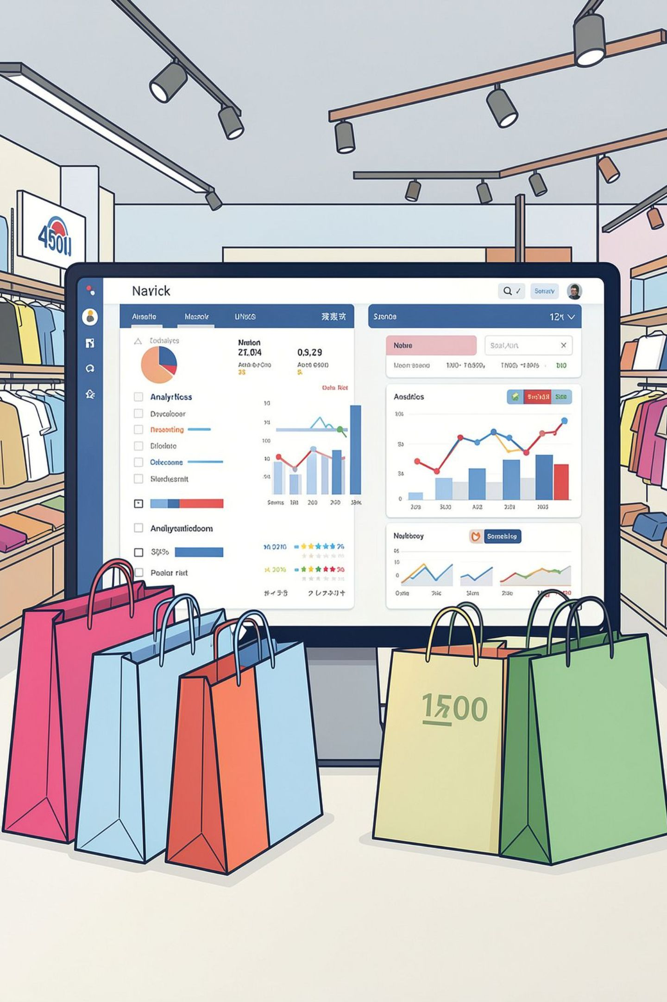
Customer Shopping Behavior Analysis
Analyzing 4,500 customer records to uncover purchasing trends, segmentation, and actionable business insights.

Slide 2

Dataset at a Glance
4,500
20
54
Customer Records
Columns
Missing Values
Review Rating column
Customer Details
Purchase & Behavior
Age, Gender, Location, Subscription Status
Category, Amount, Discount, Frequency, Payment Method, Review Rating

Slide 3
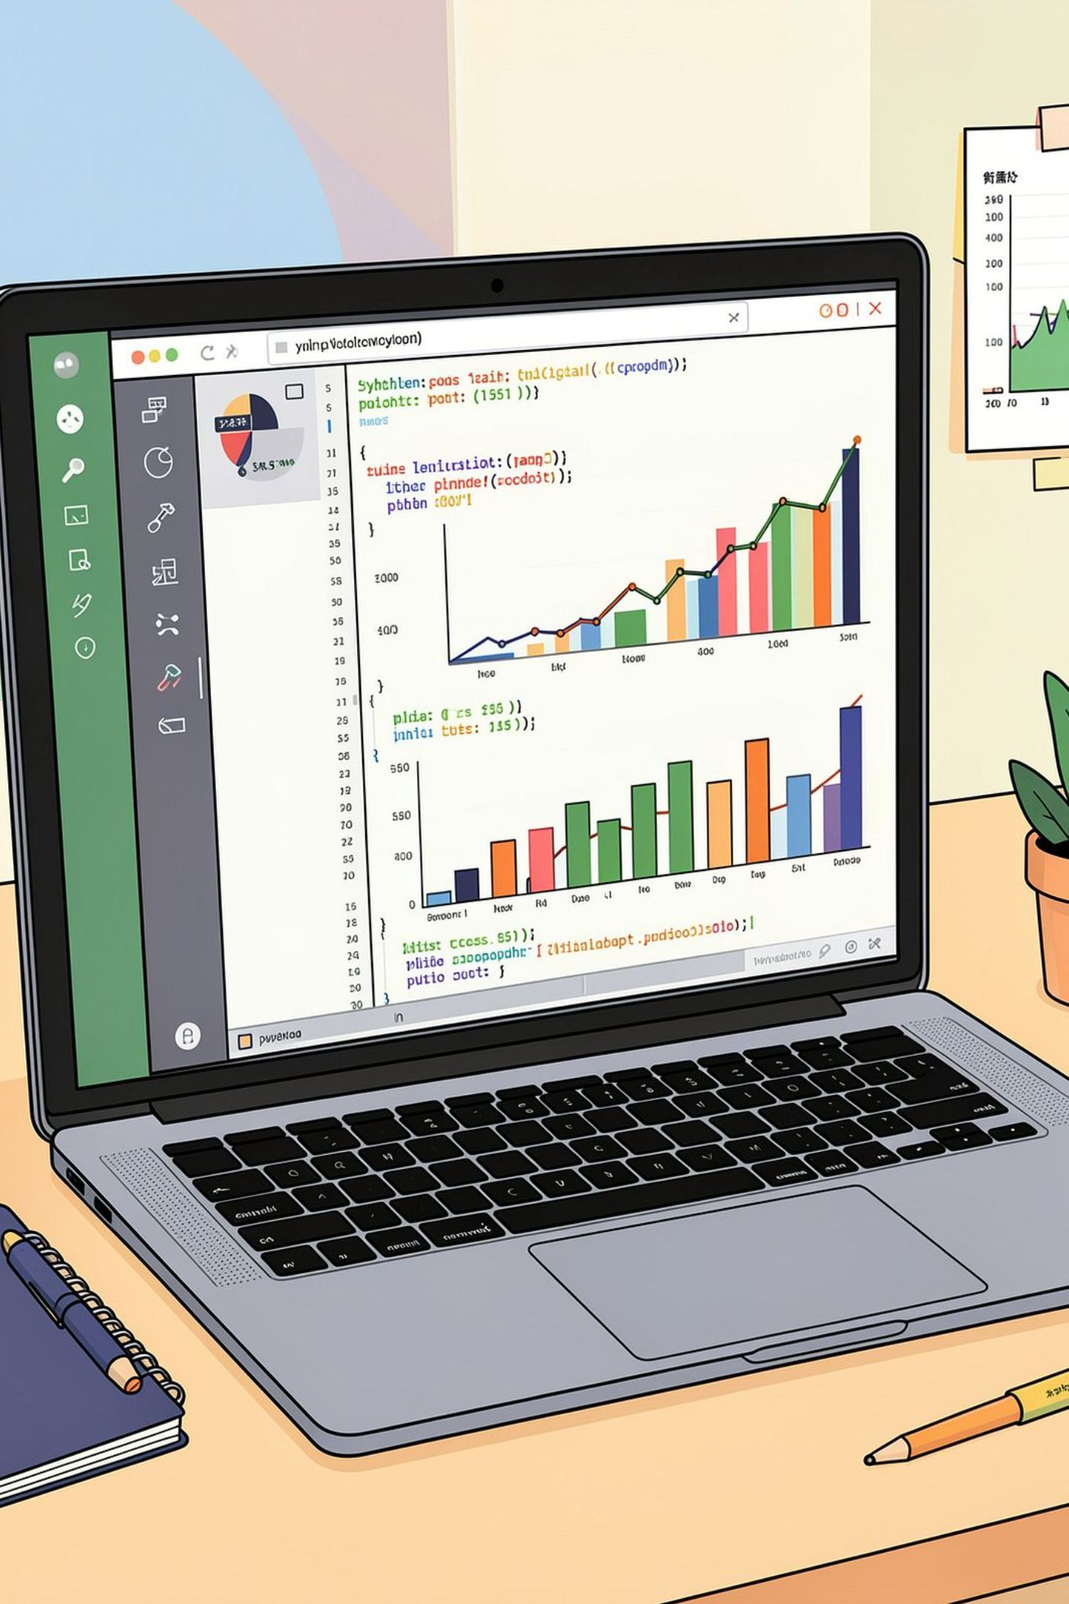
Exploratory Data Analysis — Python
01
Load & Explore
Imported via pandas; used df.info() and .describe()
02
Clean Data
Imputed missing Review Ratings using median per category; standardized column names
03
Feature Engineering
Created age_group and purchase_frequency_days columns
04
Database Integration
Loaded cleaned DataFrame into PostgreSQL for SQL analysis

Slide 4
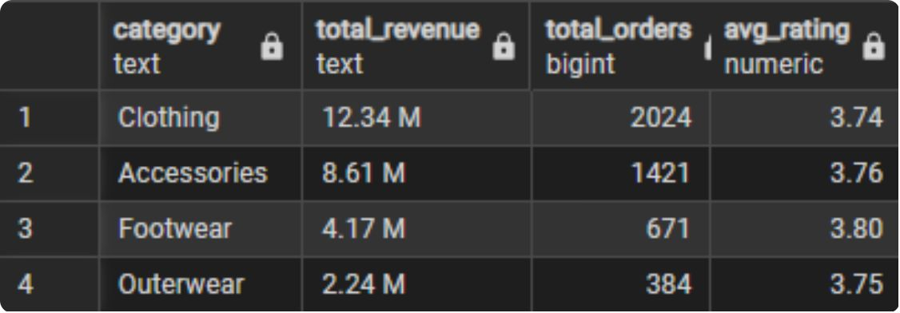
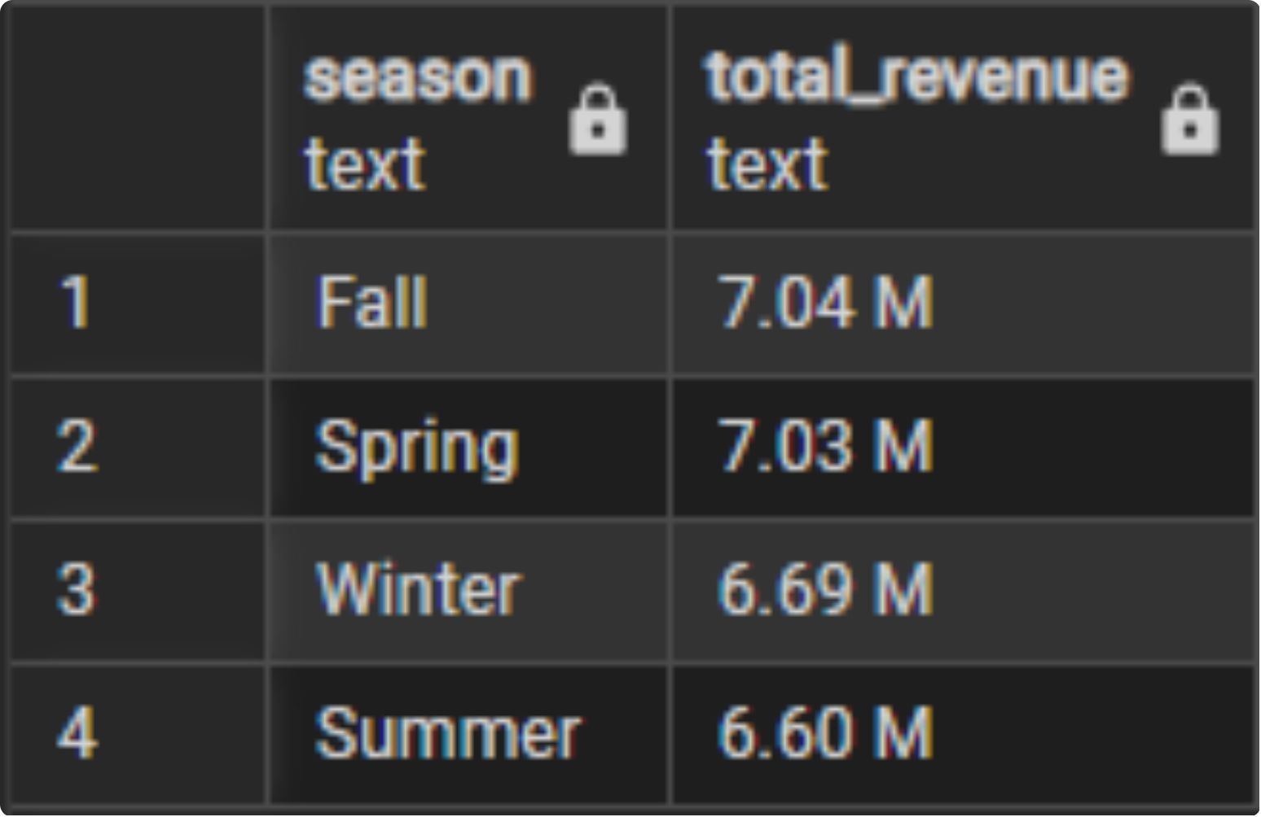
Revenue by Category & Season
Category Performance
Compared total revenue across product categories to identify top performers.
Seasonal Revenue

Slide 5
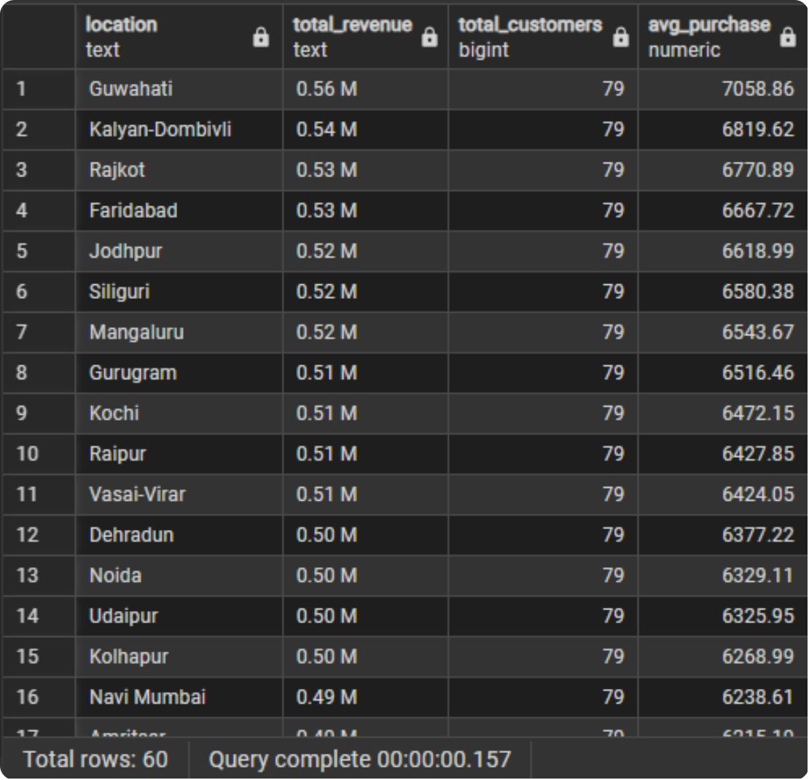
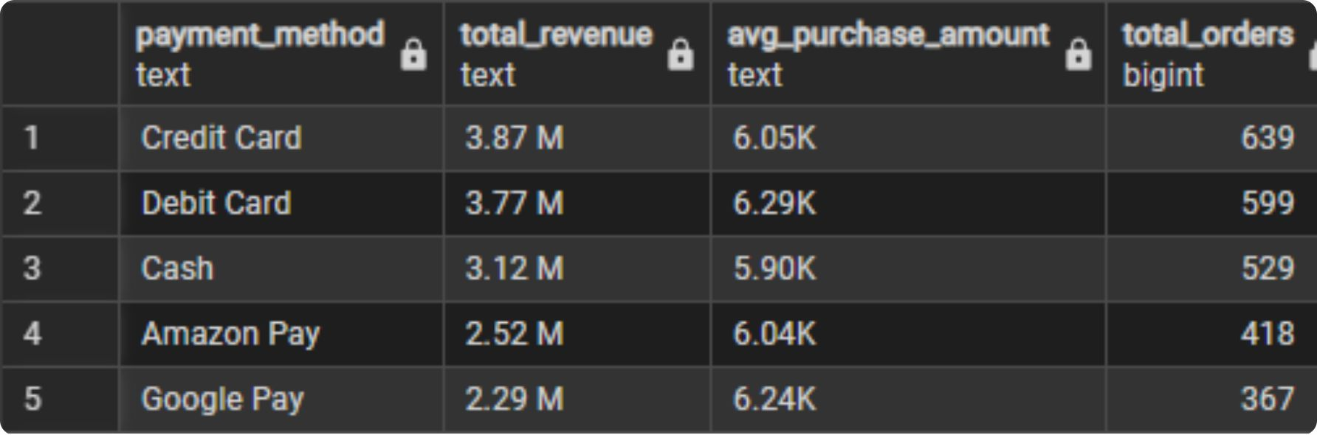
Location & Payment Insights
Revenue by Location
Identified top-performing geographic locations by total revenue.
Top Payment Methods
Top 5 payment methods ranked by revenue contribution.

Slide 6
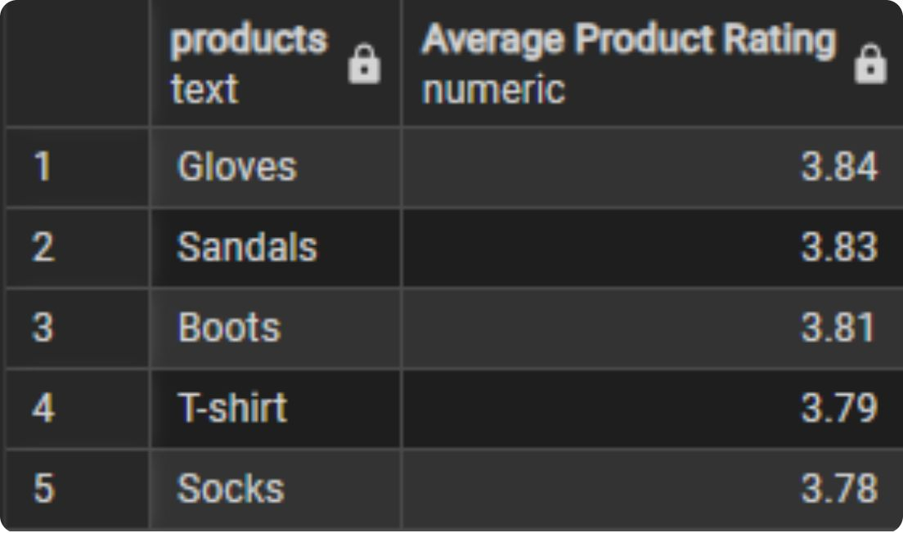
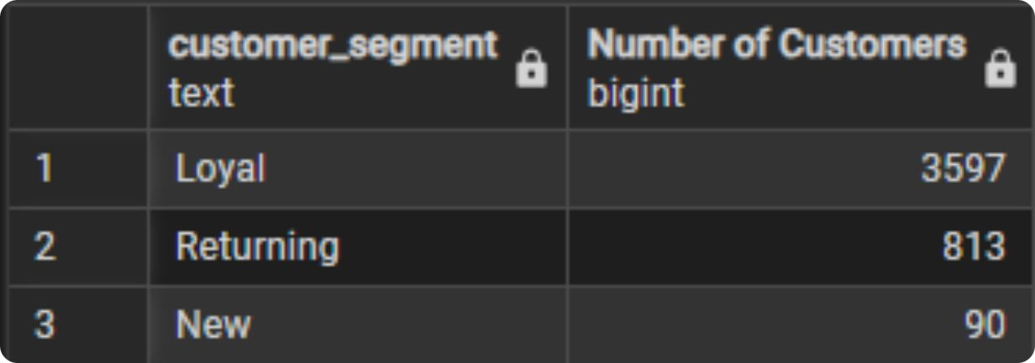
Product Ratings & Customer Segments
Top 5 Products by Rating
Highest-rated products identified from customer reviews.
Customer Segmentation
Distribution across New, Returning, and Loyal customer segments.

Slide 7
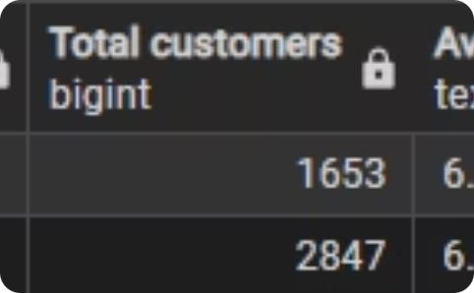
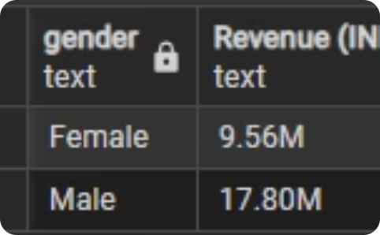
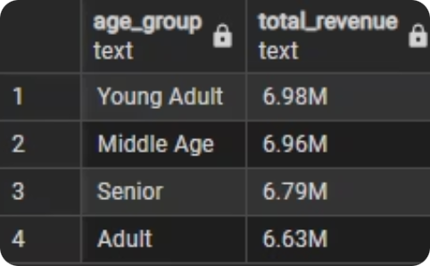
Demographics & Spending Patterns
Spend by Subscription
Revenue by Gender
Revenue by Age Group
Subscribed vs. non-subscribed average purchase amounts
Male vs. female customer revenue comparison
Total revenue across customer age segments

Slide 8
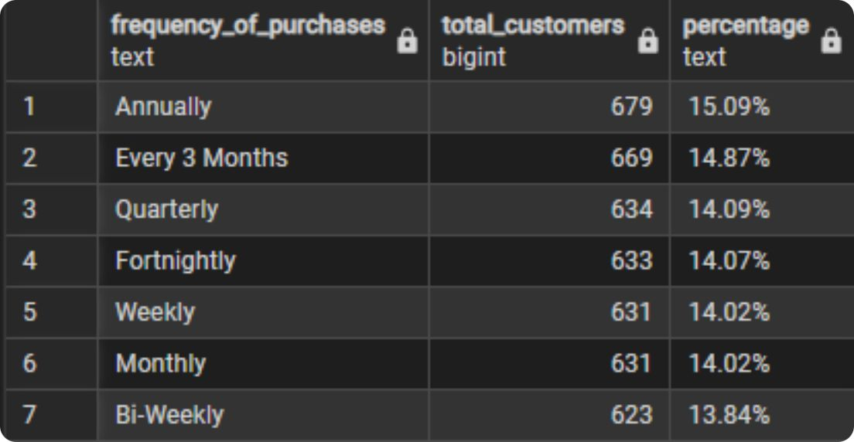
Purchase Frequency Distribution
Recurring Shopping Patterns
Analyzed customer distribution across purchase frequency groups to understand repeat behavior and loyalty signals.

Slide 9
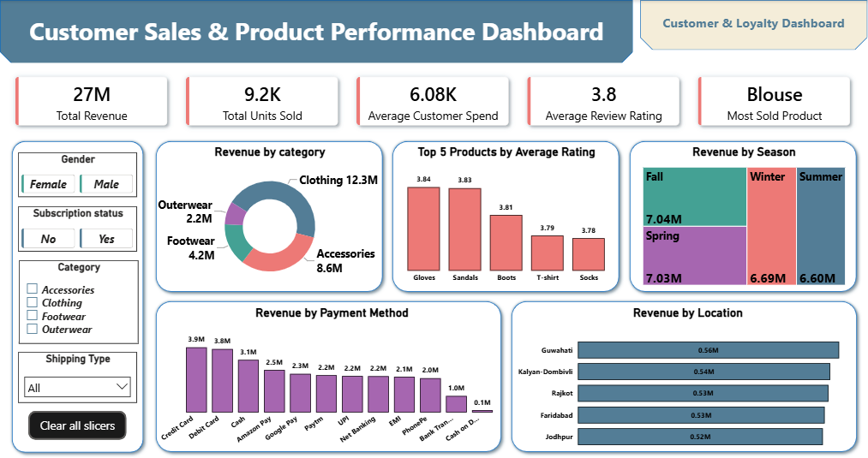
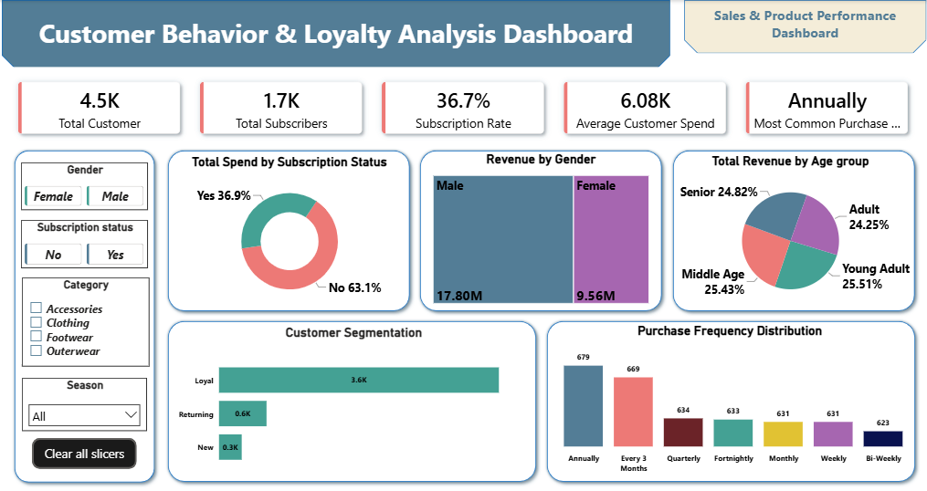
Power BI Dashboards
Dashboard 1
Dashboard 2
Customer Sales & Product Performance
Customer Behavior & Loyalty Analysis

Slide 10






Business Recommendations
Optimize Inventory
Cross-Sell Products
Personalize Offers
Improve Experience
Expand Market Reach
Optimize Payments

