Slide 1


Department of Information Science and Engineering
Major Project – Phase 1 - Review 1
“AI-Powered System Design Platform”
Harshal Srirampura Lokesh 1BY23IS079
Manu J P 1BY23IS111
Supriya Gouda 1BY23IS227
Vidhi Poddar 1BY23IS248
Under the Guidance of
Prof. Spandana L
Assistant Professor

Slide 2
Problem Statement
Designing scalable software architectures requires expertise to determine system components, technology stacks, databases, and infrastructure. Currently, developers must manually create High Level Design (HLD) and Low Level Design (LLD) from application requirements, which is time-consuming and challenging for beginners. There is no dedicated system that automatically converts natural language application descriptions into complete and structured architecture designs.
Why this Project is Important & Target Users
An automated architecture generation system can reduce design effort and help users quickly create reliable system designs. The primary beneficiaries are software developers, students learning system design, and startups performing rapid application prototyping.

Slide 3
Motivation
Current Challenges in Existing Systems
Software architecture design requires significant expertise and is mostly done manually.
Existing AI tools mainly assist in code generation, not complete system architecture (HLD, LLD, infrastructure).
Limitations of Current Approaches
Many solutions rely only on LLMs or templates, leading to inconsistent designs.
They lack architecture validation, cost estimation, and explanation of design decisions.
Real-World Impact of Solving This Problem
Automating architecture design can reduce development planning time and improve design quality.
It helps developers, students, and startups quickly create reliable system architectures.

Slide 4
Literature Survey (Tabular column)
Paper Title | Source | Year | Techniques | Results | Limitations
MetaGPT: Meta Programming for a Multi-Agent Collaborative Framework | arXiv | 2023 | Multi-agent LLM system, prompt engineering, role-based agents | Generates PRD, system design, task lists and code automatically | Requires large LLMs and high compute resources
Automated Software Design Using Machine Learning with NLP | IEEE Xplore | 2020 | NLP preprocessing, SVM, Decision Trees | Generates UML design models from textual requirements | Needs structured requirement documents
Class Diagram Extraction from Textual Requirements Using NLP | IEEE Xplore | 2019 | POS tagging, semantic role labeling, rule-based extraction | Extracts UML classes, attributes and relations | Limited scalability due to rule-based system
Class Diagram Generation from User Stories Using LLMs | IEEE Xplore | 2025 | LLM reasoning, NLP preprocessing, PlantUML generation | Converts user stories into UML class diagrams | Sensitive to unclear user stories

Slide 5
Literature Survey (Tabular column)
Paper Title | Source | Year | Techniques | Results | Limitations
Automatic Extraction of Structural Model from Semi-Structured SRS | IEEE Xplore | 2018 | NLP preprocessing, semantic analysis | Extracts conceptual system models | Difficult for complex requirements
Assessing LLMs for Front-end Software Architecture Knowledge | ACM | 2024 | Prompt-based evaluation of LLM architecture reasoning | Shows LLMs understand architecture concepts | Does not generate full architectures
Leveraging Generative AI for Architecture Knowledge Management | IEEE Xplore | 2024 | Generative AI + semantic retrieval | Suggests architecture best practices | Depends on knowledge base quality

Slide 6
Literature Survey (Tabular column)
Paper Title | Source | Year | Techniques | Results | Limitations
Two-Phase NLP-Driven Framework for Requirements Classification | IEEE | 2022 | NLP preprocessing + CNN/LSTM models | ~90% accuracy in requirement classification | Does not generate architecture
Identifying Non-Functional Requirements Using NLP and ML | ACM Digital Library | 2021 | TF-IDF, SVM, BERT | Identifies NFRs such as security and scalability | Requires labeled datasets
LLM-Assisted Approach to Designing Software Architectures Using ADD | arXiv | 2024 | LLM reasoning with Architecture Decision Records | Suggests architecture styles and trade-offs | Requires human validation

Slide 7
Literature Survey(Summary)
Existing Systems | Proposed System (AI System Design Engine)
Single-task solutions (UML generation, requirement classification) | End-to-end pipeline (Prompt → Requirements → HLD → LLD)
NLP / ML only approaches | Hybrid AI (LLM + RAG + Rule Engine)
Limited outputs (UML / structural models) | Full architecture output (components, DB, APIs, tech stack)
No architecture validation | Architecture validation engine
No explainability | Explainable AI for design decisions
No infrastructure cost analysis | Cloud cost estimation (AWS/GCP/Azure)
Static outputs | Architecture evolution & versioning
Limited knowledge base | RAG-based architecture knowledge retrieval

Slide 8
Research Gap Identified
What existing works are missing
Existing works generate only specific design artifacts (e.g., UML diagrams or requirement classifications) instead of complete system architectures.
Current research does not provide a system that converts natural language requirements into both High-Level Design (HLD) and Low-Level Design (LLD).
Most approaches do not integrate multiple system design components such as architecture style, database design, API structure, and deployment configuration.
Why current solutions are insufficient
Generate only partial outputs (e.g., UML diagrams or requirement labels).
Lack complete architecture generation (HLD + LLD) from natural language.
Do not integrate multiple design aspects (architecture, database, APIs, deployment).
Lack knowledge-based reasoning using architecture patterns and best practices.
Do not include architecture validation for feasibility and consistency.
What improvement is required
Develop an AI system that generates complete system architecture (HLD + LLD) from natural language requirements.
Integrate LLM reasoning with architecture knowledge retrieval (RAG) for informed design decisions.
Include validation mechanisms to ensure feasible and consistent architecture designs.

Slide 9
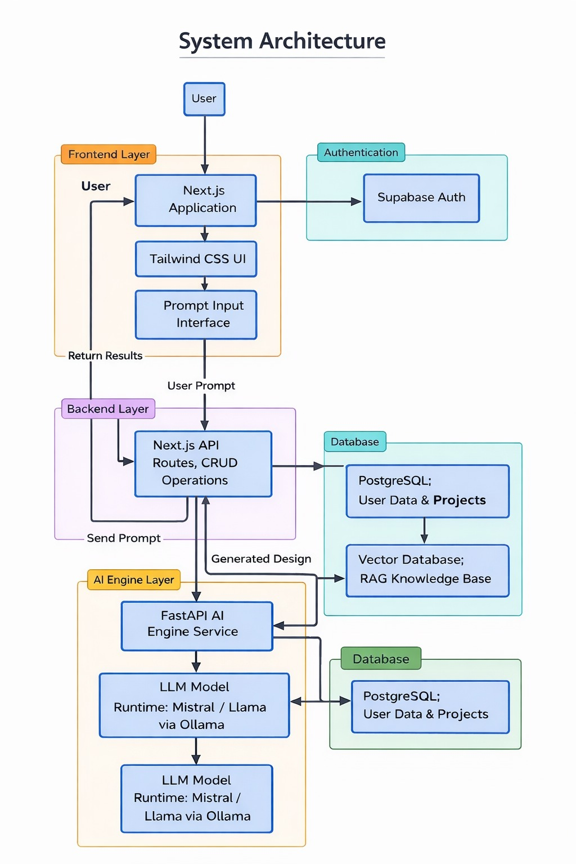
Proposed System
The proposed system is an AI System Design Engine that automatically generates software architecture designs from natural language application requirements.
The system analyzes the user prompt and extracts structured requirements such as application domain, scale, and functional needs.
It generates High Level Design (HLD) including architecture style, major system components, and recommended technology stack.
It further produces Low Level Design (LLD) including database schema, API structures, backend services, and infrastructure configuration.
The system uses a hybrid approach combining Large Language Models (LLMs), Retrieval Augmented Generation (RAG), and a rule-based decision engine to improve design accuracy.
The final output provides a validated and structured system architecture along with technology recommendations and estimated cloud infrastructure cost.

Slide 10
Objectives
To develop an AI-based system that generates software architecture designs (HLD and LLD) from natural language application requirements.
To extract structured requirements and identify suitable architecture patterns, system components, and technology stacks.
To enhance architecture generation using AI techniques such as Large Language Models (LLMs) and Retrieval Augmented Generation (RAG).
To validate and produce reliable system designs including database schema, API structure, and infrastructure cost estimation.

Slide 11
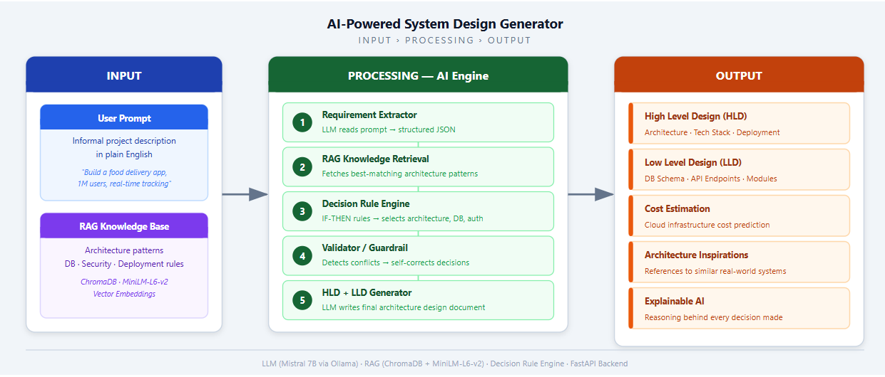

Slide 12
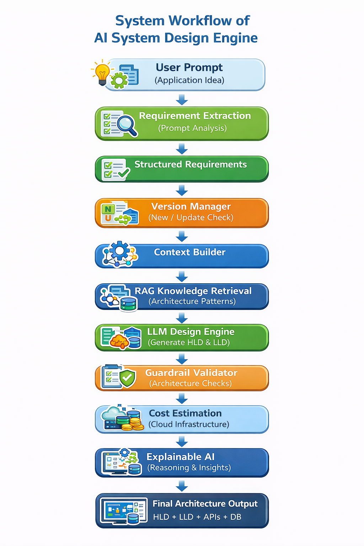
Methodology
Data Collection System design knowledge such as architecture patterns, security strategies, and deployment practices is collected from research papers and technical resources.
Data Preprocessing The data is cleaned, structured into knowledge chunks, and stored in a vector database for RAG retrieval.
Requirement Analysis User prompts are analyzed to extract structured system requirements.
Architecture Generation An LLM with RAG generates system architecture including HLD and LLD.
Validation & Output The design is validated and the system outputs architecture design, database schema, APIs, and tech stack.

Slide 13
Tools and Technologies
Programming Languages : Python , Typescript , PostgreSQL
Frameworks :
FastAPI – Connects the frontend with the AI engine and RAG system.
Next.js – Build Frontend Interface and perform CRUD operations
LangChain – Implement RAG pipeline integration
HuggingFace Transformers – Used to load and interact with LLM models and embedding models.
Software Tools :
Ollama – Used to run LLM locally
ChromaDB – Used as vector database for RAG
Supabase – Data storage
Docker – Used to containerize the application
Git & GitHub – Version control system used for code management and collaboration
VS Code – Integrated development environment

Slide 14
Feasibility Study
Technical Feasibility:
The system can be developed using modern technologies such as LLMs, RAG systems, Python, FastAPI, and React.
AI models like Mistral can run locally using tools like Ollama, making the implementation technically achievable.
Economic Feasibility
The project uses mostly open‑source tools and frameworks, which significantly reduces development costs.
Free‑tier platforms such as Supabase and open‑source AI models make the system cost‑effective to build and deploy.
Operational Feasibility
The system provides a simple user interface where users can generate system architectures using prompts.
It automates architecture design, documentation, and cost estimation, improving developer productivity.

Slide 15
SDG (Sustainable Development Goals)
mapped (as per the metrics provided by Dept.)
SDG 4 – Quality Education
Indicator: 4.4.1 — Proportion of youth and adults with ICT skills
Justification: The project develops an AI-based system that assists students and developers in learning software architecture concepts such as HLD, LLD, database design, and technology selection, thereby improving ICT and software engineering skills.
SDG 9 – Industry, Innovation and Infrastructure
Indicators:
9.5.1 — Research and development expenditure
9.b.1 — Medium and high-tech industry value added
Justification: The project contributes to technological innovation by developing an AI-driven architecture generation system that integrates Large Language Models (LLMs), Retrieval Augmented Generation (RAG), and rule-based validation to automate software system design.
SDG 8 – Decent Work and Economic Growth
Indicator: 8.2.1 — Annual growth rate of real GDP per employed person
Justification: The proposed system improves developer productivity by reducing the time and effort required to design scalable software architectures, enabling faster and more efficient software development.

Slide 16
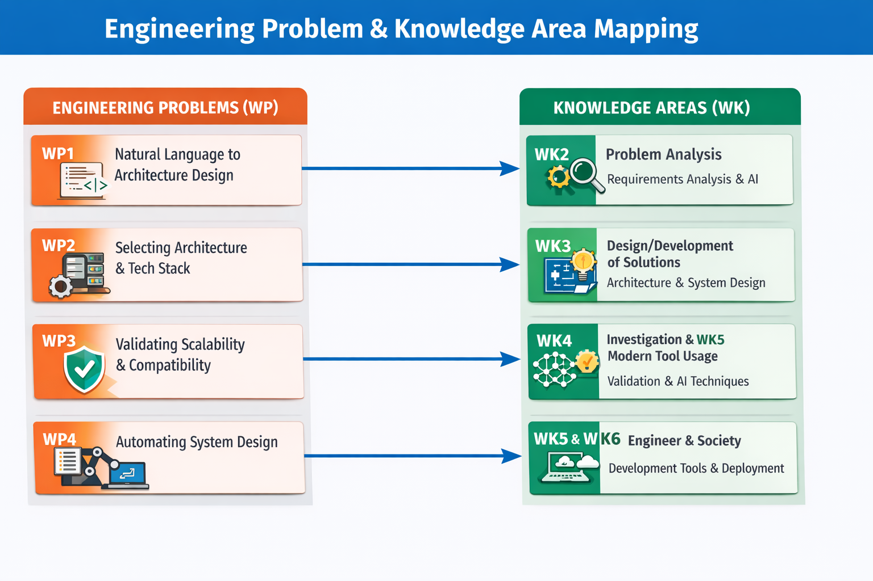

Slide 17
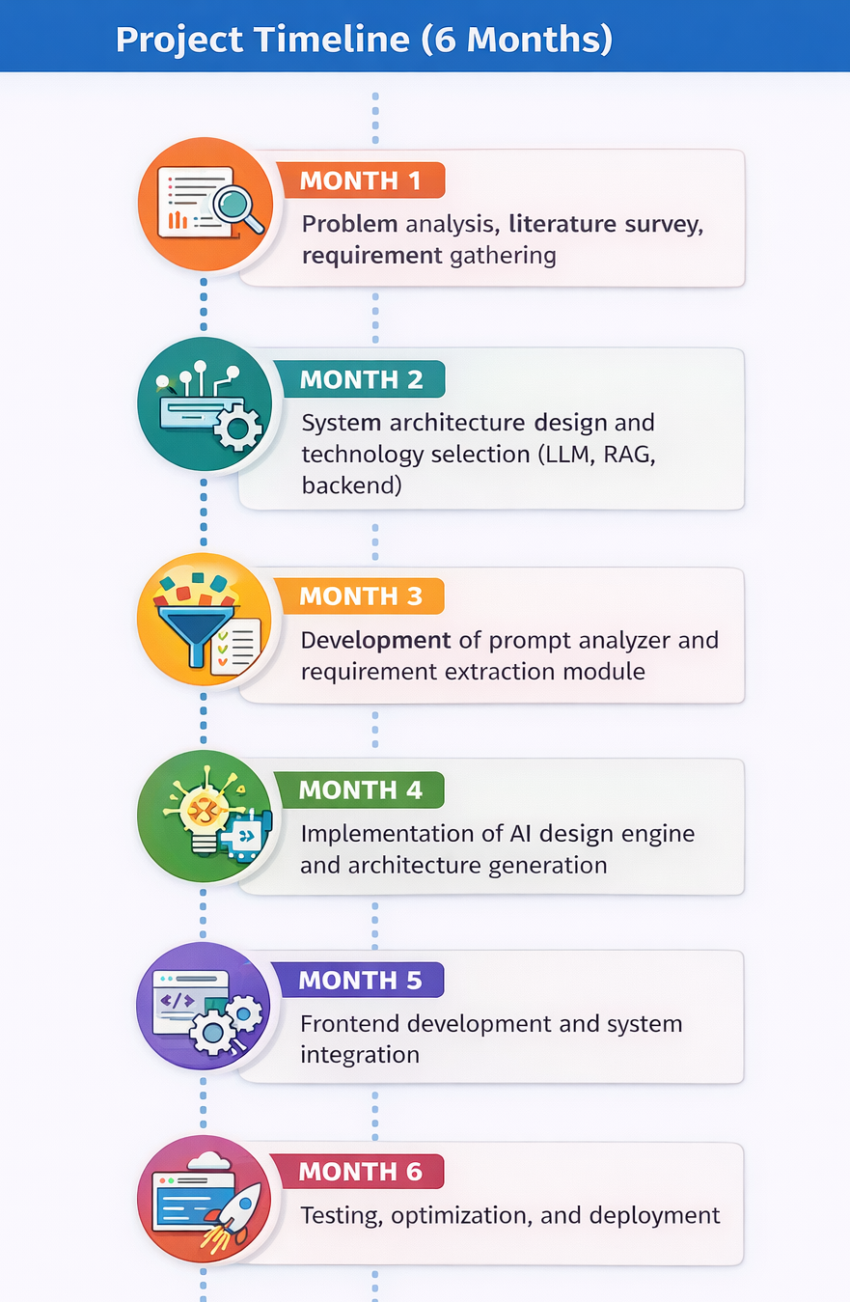
Work Plan (Timeline)
Team Roles (Team Size: 4)
AI & Architecture Developer: Develops AI Design Engine and integrates LLM + RAG for generating HLD and LLD.
Backend Developer: Builds backend using FastAPI, handles database integration, validation, and cost estimation modules.
Frontend Developer: Develops Next.js UI for user prompts and displaying architecture outputs.
Deployment & Integration Engineer: Handles system integration, testing, and deployment on Render (backend) and Vercel (frontend).
Business / Financial Details
Uses open-source technologies (Python, FastAPI, Next.js, AI models).
Deployment on free-tier cloud platforms (Render, Vercel).
Requires personal computers and internet for development.
Overall project cost is minimal.

Slide 18
Work Plan (Timeline)
Performance Expectations
The system should accurately generate High Level Design (HLD) and Low Level Design (LLD) from natural language application requirements.
It should provide valid architecture suggestions, technology stack recommendations, and structured system design outputs.
The system should respond within reasonable time and generate consistent architecture designs using LLM and RAG-based knowledge retrieval.
Innovation Contribution
Development of an AI-driven system architecture generation engine that converts natural language prompts into complete software architecture designs.
Provides a structured and automated approach to system design, which is traditionally done manually by experienced architects.
Outcome Component | Tick which one is your project outcome
Publication
Patent
Product | ✔

Slide 19
References
[1] H. Ren et al., “MetaGPT: Meta Programming for a Multi-Agent Collaborative Framework,” International Conference on Learning Representations (ICLR), 2024.
[2] A. Sharma et al., “Automated Software Design Using Machine Learning with Natural Language Processing,” IEEE International Conference on Software Engineering Research and Innovation, pp. 1–6, 2020.
[3] S. K. Sahoo and A. K. Rath, “Class Diagram Extraction from Textual Requirements Using Natural Language Processing Techniques,” IEEE International Conference on Advances in Computer Engineering, pp. 1–6, 2010.
[4] A. Abdelnabi et al., “Towards Class Diagram Generation from User Stories Using LLMs,” IEEE International Conference on Software Engineering and Artificial Intelligence, pp. 1–6, 2024.
[5] A. B. Alwan and H. S. Farhan, “Automatic Extraction of Structural Model from Semi-Structured Software Requirement Specification,” IEEE International Conference on Computer and Communication Engineering, pp. 1–5, 2018.
[6] M. Abdellatif et al., “Assessing LLMs for Front-End Software Architecture Knowledge,” IEEE International Conference on Software Architecture, pp. 1–10, 2024.
[7] P. Avgeriou et al., “Leveraging Generative AI for Architecture Knowledge Management,” IEEE Software, vol. 41, no. 5, pp. 50–58, 2024.

Slide 20
References
[8] S. Khan et al., “A Two-Phase NLP-Driven Deep Learning Framework for Automated Software Requirements Classification and User Story Generation in Agile Development,” IEEE Access, vol. 11, pp. 1–14, 2023.
[9] A. Ferrari et al., “Identifying Non-Functional Requirements From Unconstrained Documents Using Natural Language Processing and Machine Learning Approaches,” IEEE Access, vol. 9, pp. 1–15, 2021.
[10] M. Shahin et al., “An LLM-Assisted Approach to Designing Software Architectures Using ADD,” arXiv preprint arXiv:2506.22688, 2025.
[11] H. Zhang et al., “SpecGen: Automated Generation of Formal Program Specifications via Large Language Models,” IEEE International Conference on Software Engineering and Knowledge Engineering, pp. 1–8, 2024.
[12] J. Li et al., “Semantic Modeling of Architecture Decision Records to Enable AI-Based Analysis,” IEEE International Conference on Software Architecture, pp. 1–10, 2024.
[13] M. Ahmed et al., “Leveraging RAG and LLMs for Access Control Policy Extraction From User Stories in Agile Software Development,” IEEE International Conference on Software Engineering, pp. 1–10, 2024.
[14] M. U. Islam et al., “BERT-Based Approach for Greening Software Requirements Engineering Through Non-Functional Requirements,” IEEE Access, vol. 11, pp. 1–15, 2023.

Slide 21
References
[15] L. Zhao et al., “The Use of NLP-Based Text Representation Techniques to Support Requirement Engineering Tasks: A Systematic Mapping Review,” IEEE Access, vol. 10, pp. 1–20, 2022.
[16] S. Rahman et al., “A Review of AI-Assisted Impact Analysis for Software Requirements Change: Challenges and Future Directions,” IEEE Access, vol. 12, pp. 1–20, 2024.
[17] B. Gorer and F. B. Aydemir, “Generating Requirements Elicitation Interview Scripts with Large Language Models,” IEEE International Requirements Engineering Conference Workshops (REW), pp. 44–51, 2023.
[18] K. Ronanki, C. Berger and J. Horkoff, “Investigating ChatGPT’s Potential to Assist in Requirements Elicitation Processes,” IEEE 49th Euromicro Conference on Software Engineering and Advanced Applications (SEAA), pp. 354–361, 2023.
[19] K. Mich et al., “Automatic Generation of a Software Requirements Specification (SRS) Document,” IEEE International Conference on Computer Systems and Applications, pp. 1–6, 2011.
[20] W. Li et al., “Automated Classification and Identification of Non-Functional Requirements in Agile-Based Requirements Using Pre-Trained Language Models,” IEEE Access, vol. 12, pp. 1–15, 2024.
[21] A. Spoletini et al., “Automated Extraction of Conceptual Models from User Stories via Natural Language Processing,” IEEE International Conference on Requirements Engineering, pp. 1–10, 2016.

