Slide 1

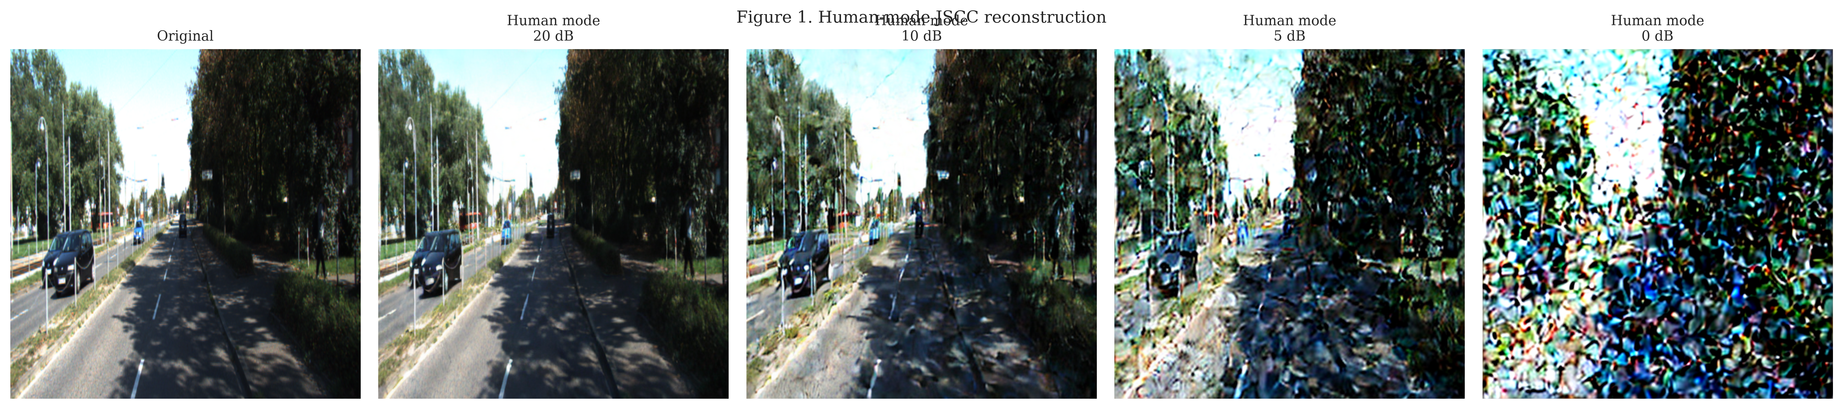
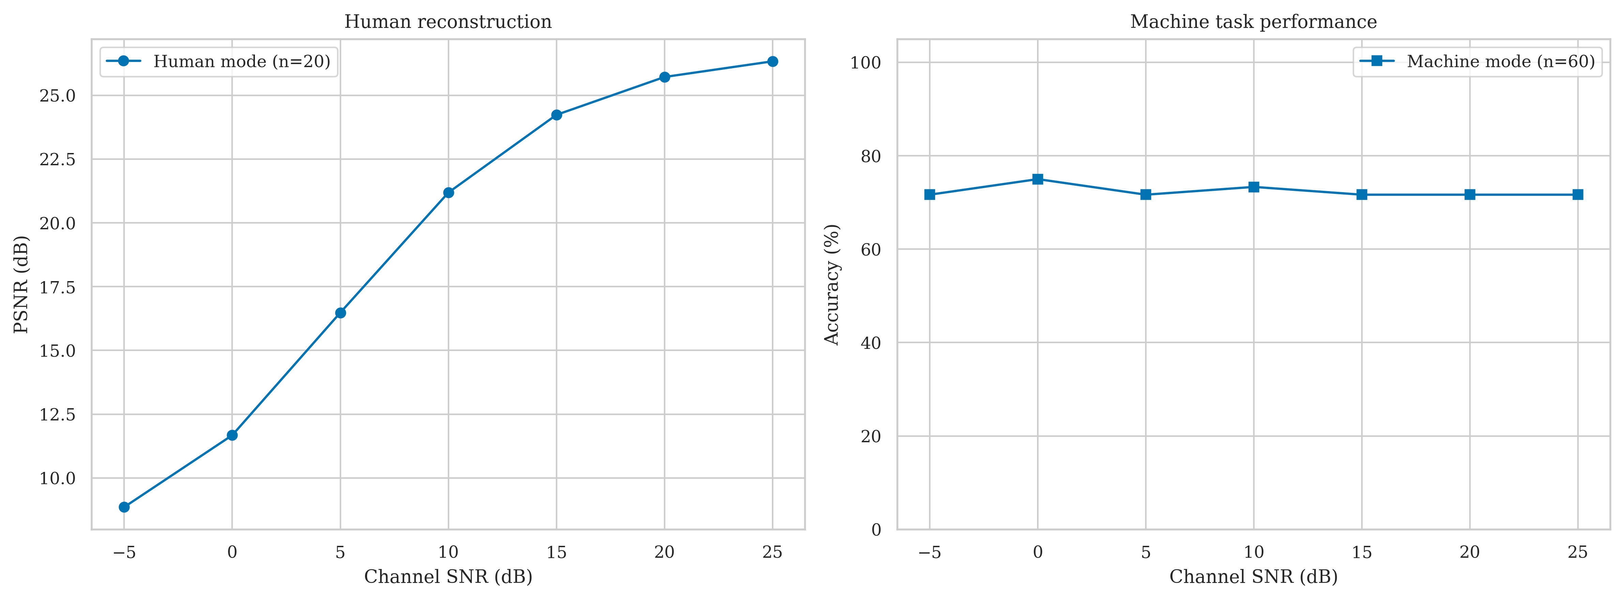
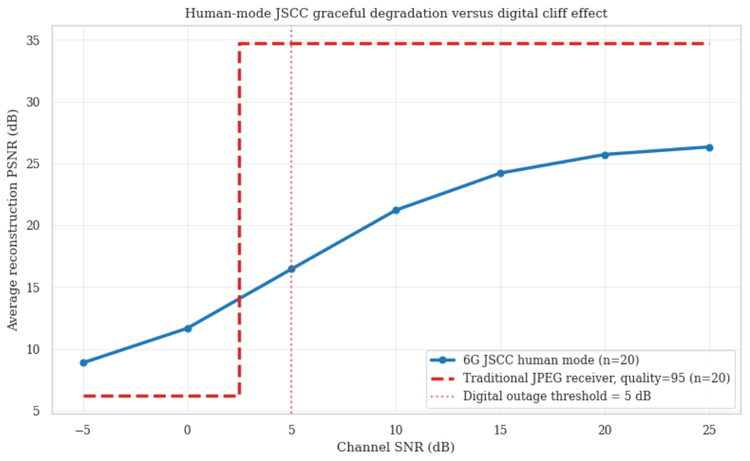
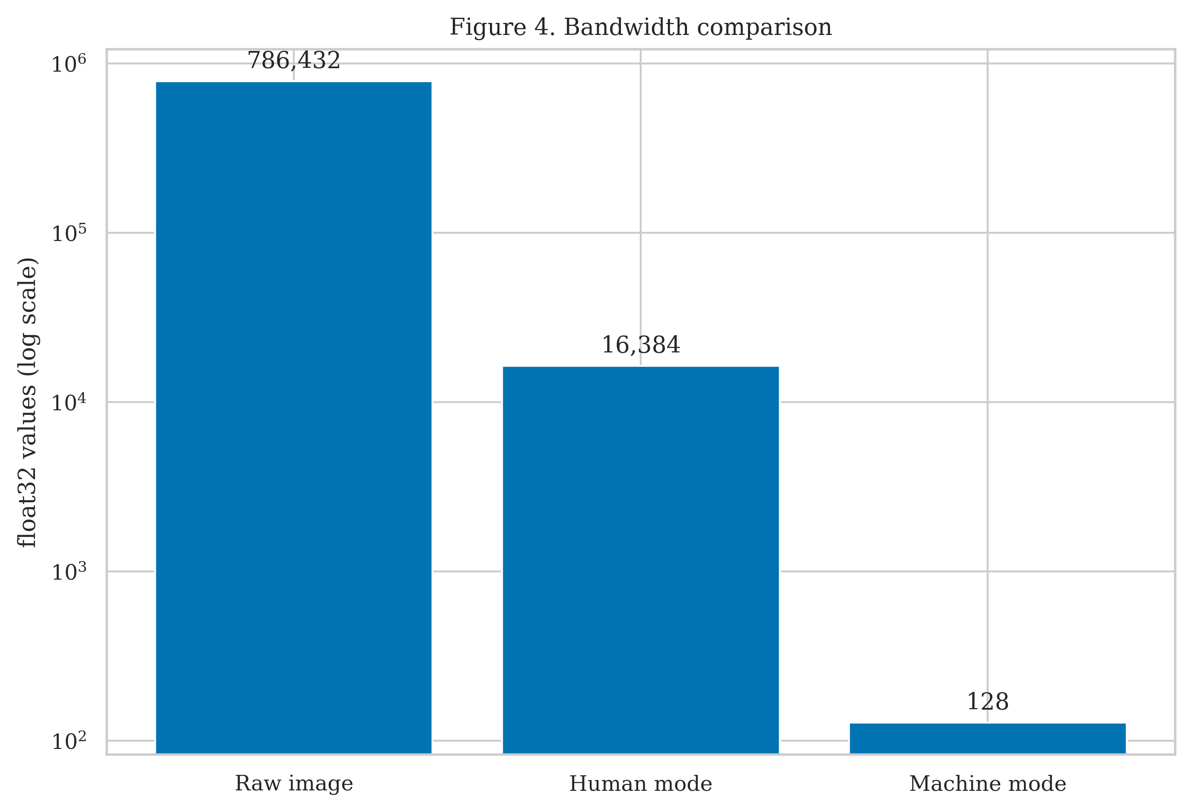
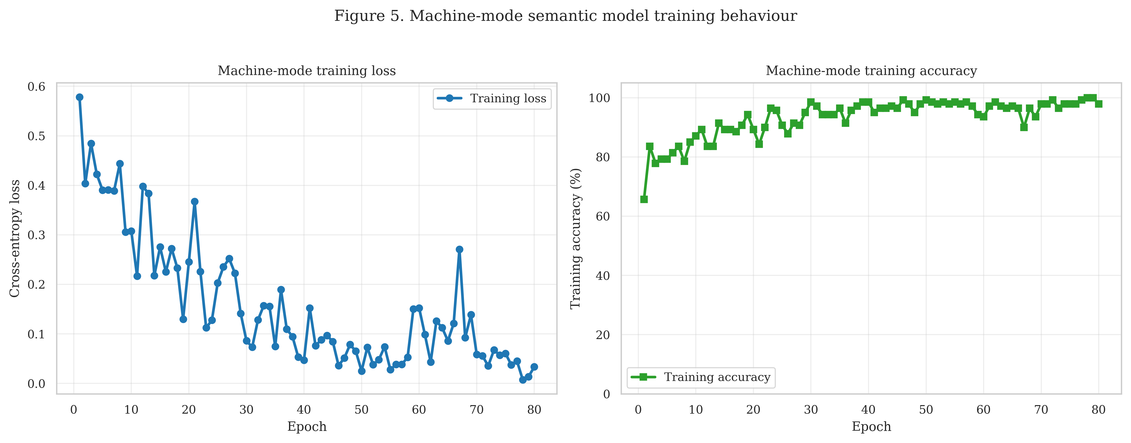
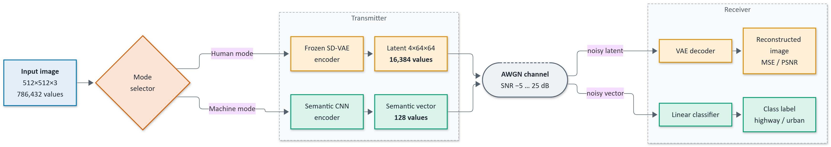
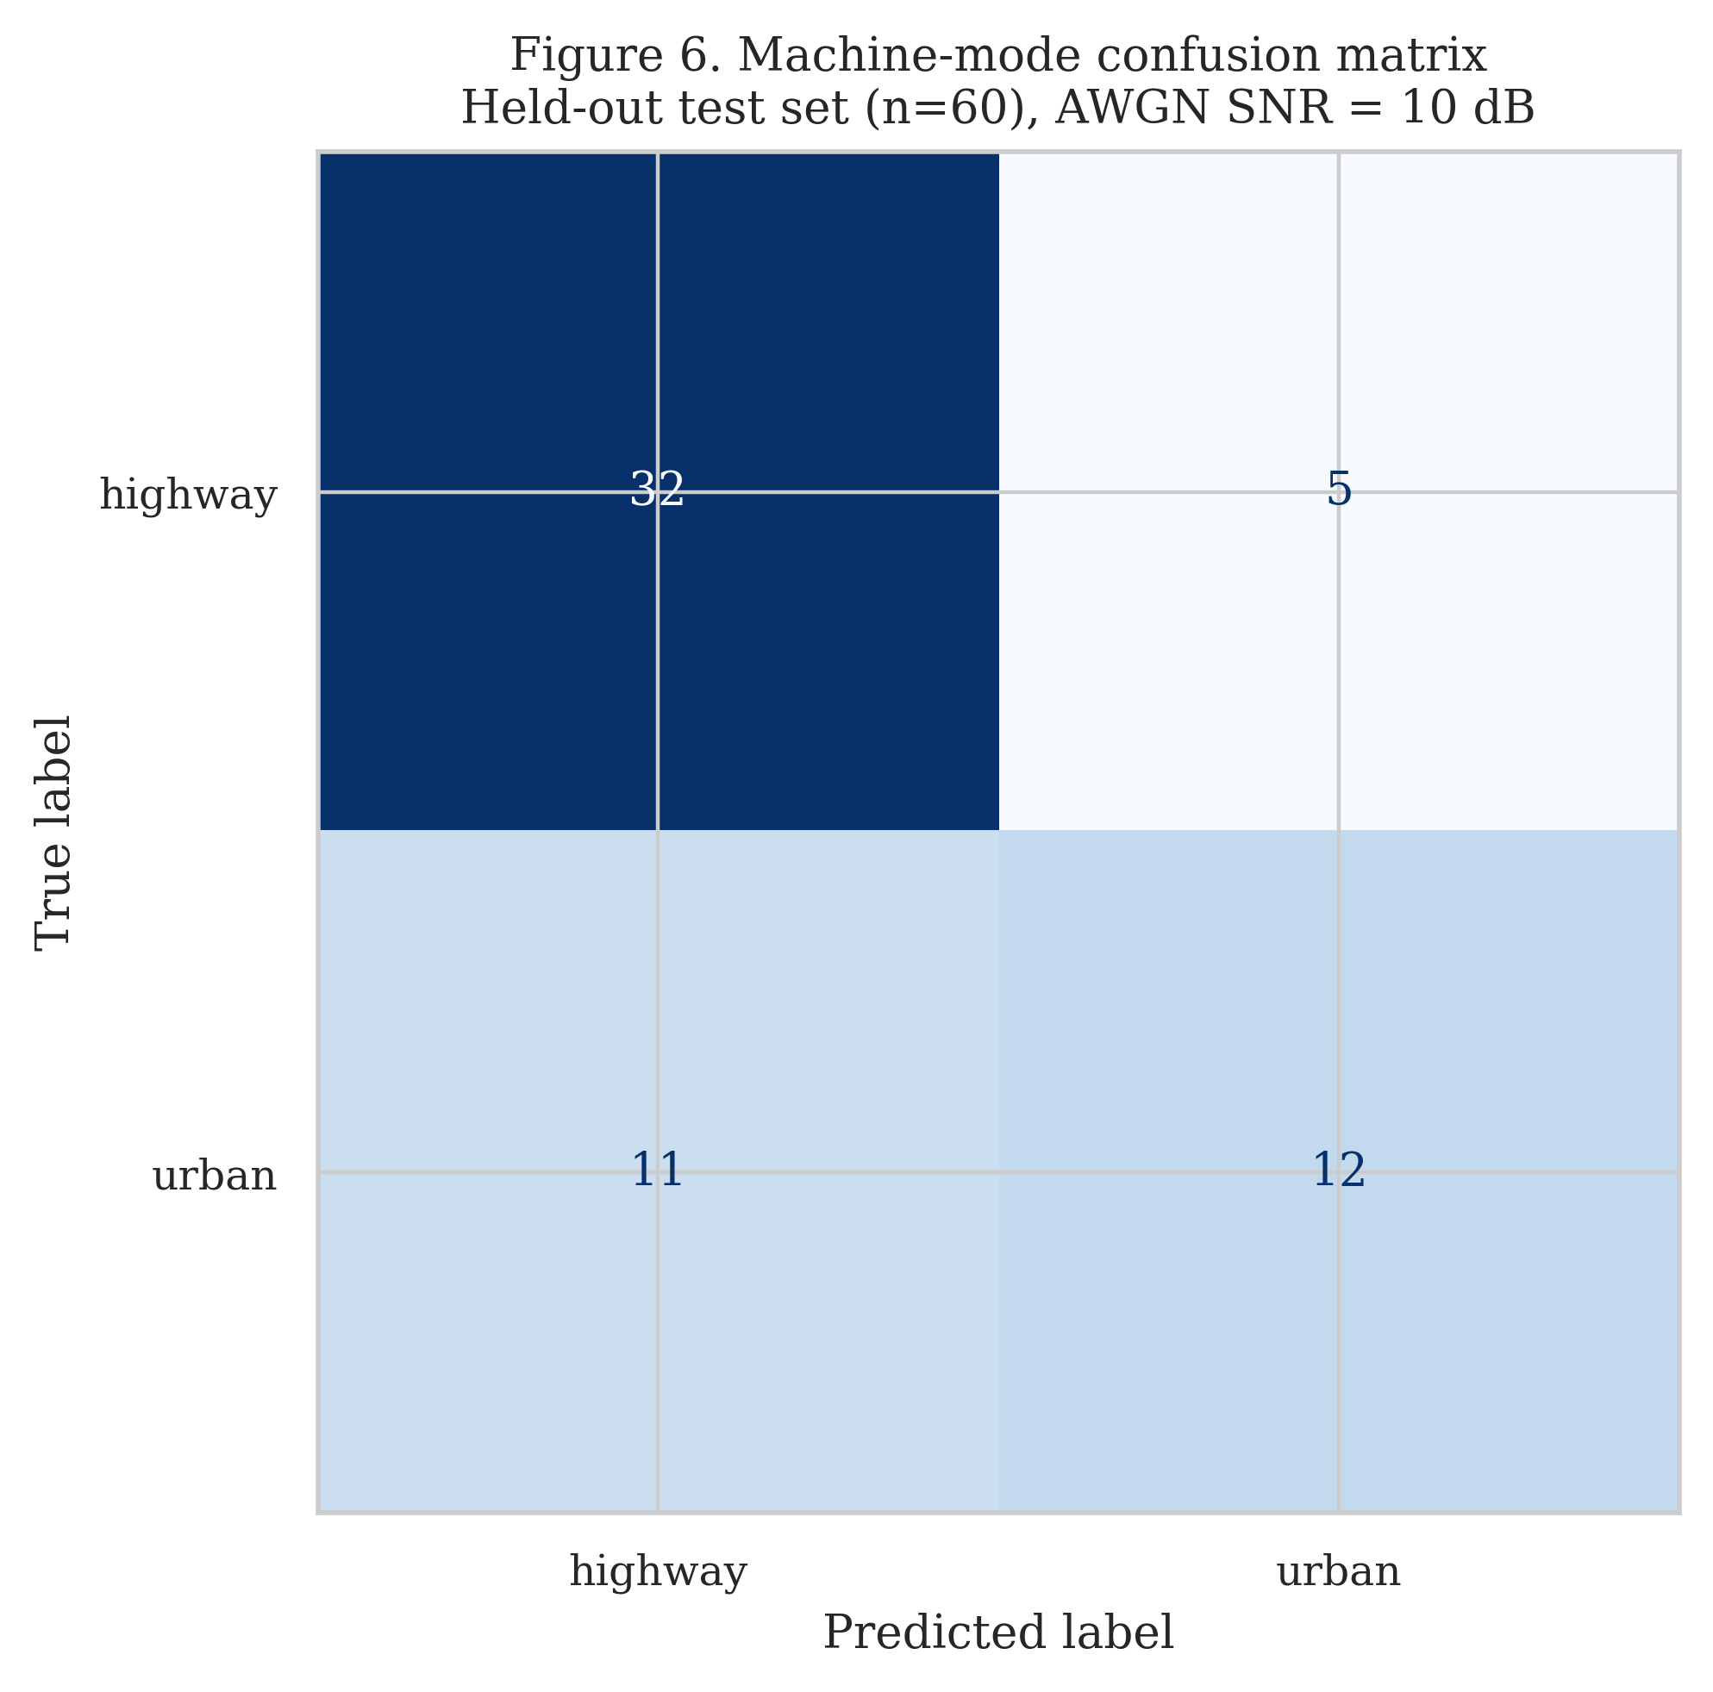
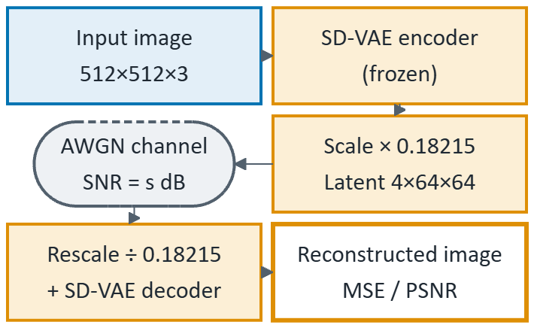
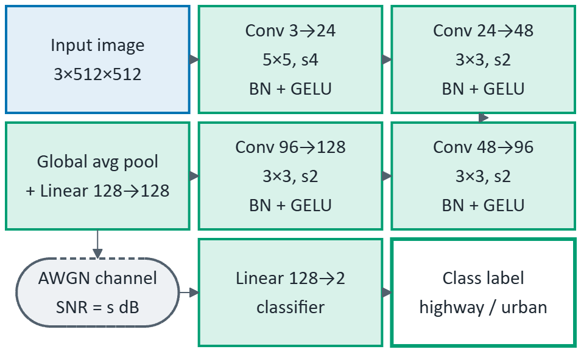
Task Aware Dynamic Semantic Compression Framework for 6G Deep JSCC
Harshal Yadav (24BEC0639), Milind Sharma (24BEC0078), P. Chaitanyaprasad (24BEC0551), Abhrant R. Pal (24BEC0545)
Dr. Thanikaiselvan V., Professor | SENSE
Motivation / Introduction
Results
6G is shifting from bit-accurate delivery to meaning- and task-oriented delivery, yet raw camera and sensor data is too large for the radio link. Separate source and channel coding also suffers a cliff effect, failing abruptly below a threshold SNR, while deep JSCC degrades gradually. Receivers differ too: a human operator needs a viewable image, whereas a traffic AI needs only task-relevant semantics. Existing JSCC work usually optimizes either reconstruction or task accuracy, and often ignores payload size.
Scope of the Project
Fig. 4 Reconstructions degrade smoothly as SNR drops.
We design a dual-mode semantic transmitter for traffic imagery (highway vs urban): one transmitter, two kinds of receiver. Human mode sends a 4×64×64 latent (16,384 values) from a frozen pretrained VAE and reconstructs the image. Machine mode sends a 128-value semantic vector from a lightweight CNN and classifies it directly. Both travel over a power-normalized AWGN channel (SNR −5 to 25 dB). We measure MSE, PSNR, accuracy and bandwidth savings, and compare JSCC behavior against a conceptual digital outage (cliff) model.
Fig. 5 Human-mode PSNR falls smoothly; machine accuracy stays at 71.7–75.0%.
Fig. 6 Graceful JSCC degradation vs a conceptual digital cliff (5 dB threshold).
Methodology
Fig. 7 Payload: raw 786,432, human 16,384, machine 128 values.
Fig. 8 Machine-branch training over 80 epochs (train accuracy 98%).
SNR (dB) | PSNR (dB) | Acc. (%)
25 | 26.34 | 71.7
20 | 25.72 | 71.7
15 | 24.24 | 71.7
10 | 21.19 | 73.3
5 | 16.48 | 71.7
0 | 11.68 | 75.0
−5 | 8.86 | 71.7
Fig. 1 Overall dual-mode semantic communication system.
Fig. 9 Held-out set at 10 dB: 73.33% accuracy.
Table 1 Performance vs SNR.
SDGs Addressed:
3
Good Health and Well-being
Faster road-incident detection
9
Industry, Innovation, Infrastructure
Efficient AI-native 6G links
Fig. 2 Human-mode branch.
Fig. 3 Machine-mode branch.
11
Sustainable Cities and Communities
Bandwidth-light traffic monitoring
13
Climate Action
Fewer values sent, less energy
Dataset and setup: traffic_data, 200 images, 2 classes (highway, urban), resized to 512×512. Split: 140 train, 60 machine-test, 20 human-test. Python 3, PyTorch, Hugging Face diffusers (AutoencoderKL, sd-vae-ft-mse), AdamW (lr 1e-3, weight decay 1e-4), 80 epochs, cross-entropy, seed 6.
Conclusion / Summary
a) Human mode: A frozen VAE encoder maps the image to a 4×64×64 latent (scaled by 0.18215). The latent is corrupted by AWGN and the VAE decoder reconstructs the image. Fidelity is reported as MSE and PSNR.
A dual-mode semantic architecture serves human and machine receivers over a noisy 6G-style channel. Payload is cut by 97.92% (human, 48×) and 99.98% (machine, 6,144×). Human PSNR degrades gracefully from 26.34 dB to 8.86 dB, and machine accuracy stays stable at 71.7–75.0% across −5 to 25 dB SNR. Future work: larger multi-class datasets, fading and MIMO channels, a SwinJSCC backbone, a simulated JPEG/BPG + LDPC baseline, and SDR hardware validation.
b) Machine mode: A lightweight CNN (4 Conv + BatchNorm + GELU blocks, global average pooling, Linear 128) produces a 128-value semantic vector. After AWGN, a Linear(128→2) head outputs highway or urban.
Contact Details:
Email: harshal.suhasyadav2024@vitstudent.ac.in | paidi.2024@vitstudent.ac.in | abhrant.rpal2024@vitstudent.ac.in | milind.sharma2024@vitstudent.ac.in
Guide: Dr. Thanikaiselvan V., Professor, SENSE, VIT
c) Channel-robust training: one SNR is drawn at random per batch from {25, 20, 15, 10, 5, 0, −5} dB, so the encoder and classifier learn with the noisy channel in the loop.
Acknowledgments / References
σ² = P_signal / 10^{(SNR/10)} PSNR = −10·log₁₀(MSE)
Saving = 1 − N_tx / 786,432
σ²: AWGN noise power; P_signal: average transmitted signal power; N_tx: number of transmitted values.
We thank Dr. Thanikaiselvan V. and SENSE, VIT for guidance and support.
J. Huang et al., “D²-JSCC: Digital deep joint source-channel coding for semantic communications,” IEEE JSAC, 2025.
L. X. Nguyen et al., “A contemporary survey on semantic communications: Theory of mind, generative AI, and deep JSCC,” IEEE Commun. Surveys Tuts., 2025.
K. Yang et al., “SwinJSCC: Taming Swin Transformer for deep joint source-channel coding,” IEEE TCCN, 2025.
Y. Diao et al., “Aligning task- and reconstruction-oriented communications for edge intelligence,” IEEE JSAC, 2025.
M. F. Zia et al., “A survey on explainable AI for semantic communication,” Comput. Netw., 2026.

