Slide 1
Task Aware Dynamic Semantic Compression Framework for 6G Deep JSCC
Harshal Yadav – 24BEC0639
Milind Sharma – 24BEC0078
P. Chaitanyaprasad – 24BEC0551
Abhrant R. Pal – 24BEC0545
Dr. Thanikaiselvan V.
Professor, SENSE

Slide 2
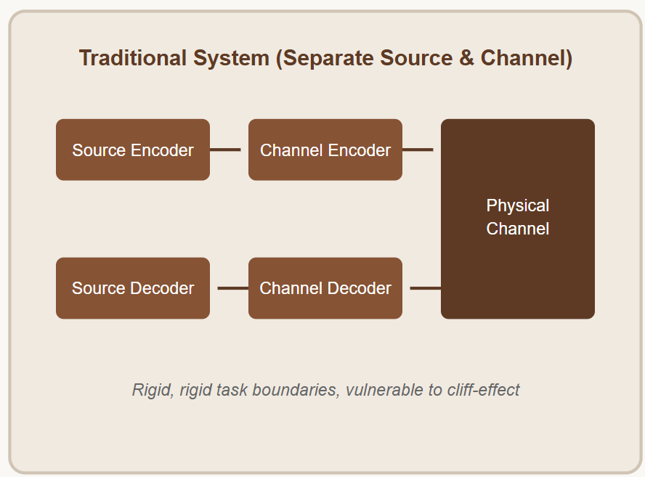
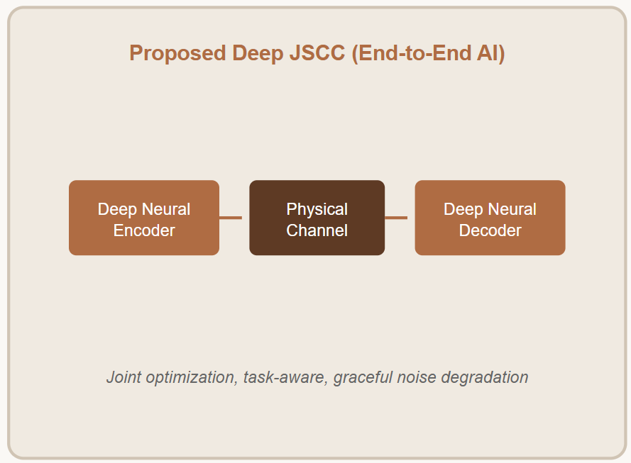
Introduction
6G shifts from bit-accurate delivery to meaning- and task-oriented delivery. Raw camera and sensor data is too large for the radio link.
Cliff effect: separate source and channel coding fails abruptly below a threshold SNR, while JSCC degrades gradually.
Receivers differ: a human operator needs a viewable image; a machine (traffic AI) needs only task-relevant semantics.
Proposed system: one transmitter, two modes.
Use case: traffic imagery (highway vs urban).
Human mode: compressed latent, reconstructed image. Machine mode: 128-value semantic vector, classification.

Slide 3
Literature Review: Foundations, Surveys and Deep JSCC
Work | Contribution | Relevance to this project
Nguyen et al., IEEE COMST, 2025 | Survey: theory of mind, generative AI and deep JSCC for semantic communication | Frames the shift to meaning-centric 6G
Huang et al., D²-JSCC, IEEE JSAC, 2025 | Digital deep JSCC that works with practical digital transceivers | Bridges JSCC and real digital links
Yang et al., SwinJSCC, IEEE TCCN, 2025 | Swin-Transformer JSCC, adaptive to SNR and rate | Candidate backbone for future work
Semantic-aided parallel image transmission, IEEE TWC, 2025 | JSCC compatible with practical systems | Coexistence with conventional coding
Semantic base with fine-grained HARQ, IEEE TWC, 2025 | Reliable semantic image transmission with HARQ | Reliability extension
Zia et al., Computer Networks, 2026 | Survey on explainable AI for semantic communication | Explainability direction
Jain et al., IEEE Commun. Standards Mag., 2025 | Standardization of AI-native 6G and semantic protocols | Places work in 6G standards context
Surveys and deep JSCC show gradual degradation and practical compatibility, but target a single objective.
Notes:
Full citations are on the References slides.

Slide 4
Literature Review: Task-Oriented and Generative Approaches
Work | Contribution | Relevance to this project
Diao et al., IEEE JSAC, 2025 | Aligns task- and reconstruction-oriented communications for edge intelligence | Closest to the dual-objective idea
DRL + information bottleneck, IEEE JSAC, 2025 | Task-oriented semantic communication with IB and deep RL | Sends only task-relevant features
End-to-end learning over MIMO, IEEE JSAC, 2025 | Information-theoretic task-oriented design over MIMO channels | MIMO extension
Semantics-guided diffusion for DeepJSCC, IEEE TWC, 2025 | Diffusion guided by semantics improves wireless image quality | Upgrade for human mode
Semantic-prior latent diffusion, IEEE TWC, 2025 | Channel-adaptive equalizing and denoising with latent diffusion | Latent-based, like our VAE branch
Visual-language-model cross-modal SC, IEEE TWC, 2025 | Cross-modal semantic communication with a VLM | Richer semantic extraction
RSMA panoramic video semantic transmission, IEEE TWC, 2025 | Adaptive semantic video transmission with RSMA | Multi-user extension
Most work optimizes reconstruction or a task, rarely both in one lightweight design with explicit bandwidth accounting.
Notes:
Full citations are on the References slides.

Slide 5
Research Gap
Existing JSCC work optimizes either pixel reconstruction (human) or task accuracy (machine), rarely both in one architecture.
Many designs ignore the transmitted payload size, a major cost in 6G links.
Digital pipelines have a threshold SNR below which they fail completely.
No simple, reproducible, lightweight dual-mode demonstrator with explicit bandwidth accounting for traffic imagery.

Slide 6
Project Objectives
Design a dual-branch semantic transmitter: human mode (VAE latent) and machine mode (128-d semantic vector).
Model the wireless link as a power-normalized AWGN channel over SNR −5 to 25 dB.
Train the machine branch with SNR-randomized training for channel robustness.
Quantify human-mode fidelity (MSE, PSNR) and machine-mode accuracy across SNR.
Quantify bandwidth savings against raw transmission.
Compare JSCC behavior with a conceptual digital outage (cliff) model.

Slide 7
Implementation Details
Language / framework: Python 3, PyTorch, torchvision
Libraries: Hugging Face diffusers (AutoencoderKL), scikit-learn, NumPy, Matplotlib, Seaborn
Platform: Jupyter Notebook
Pretrained model: stabilityai/sd-vae-ft-mse
Dataset: traffic_data, 200 images, 2 classes (highway, urban), resized to 512×512
Split: 140 train (87/53), 60 machine test (37/23), 20 human test (12/8)
Training: AdamW, lr 1e-3, weight decay 1e-4, 80 epochs, cross-entropy, seed 6
Status: dual architecture, AWGN channel, training, evaluation and Figures 1–6 complete; digital baseline is conceptual

Slide 8
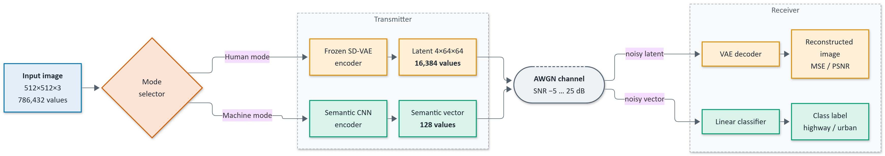
Block Diagram
Notes:
INSERT: Diagram 1, overall dual-mode block diagram. Image → mode selector → [human branch | machine branch] → AWGN channel → [VAE decoder → image | classifier → label]. Annotate payloads: 16,384 and 128 values.

Slide 9
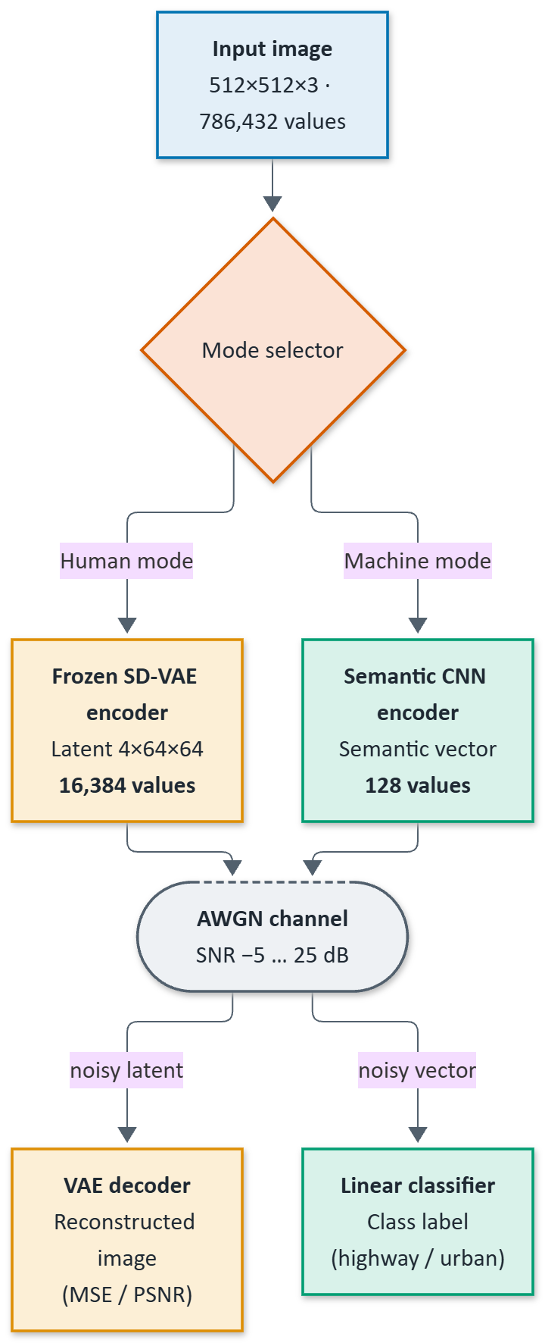
System Overview
Transmitter: takes a 512×512×3 image and selects the mode.
Human mode: frozen VAE encoder → 4×64×64 latent (16,384 values).
Machine mode: lightweight CNN → 128 values.
Channel: AWGN, noise power = signal power / 10^(SNR/10).
Notes:
INSERT: Diagram of transmitter, channel and receiver (system overview).

Slide 10
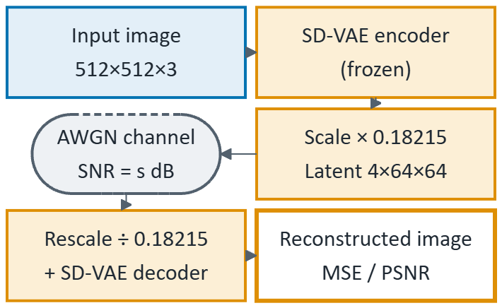
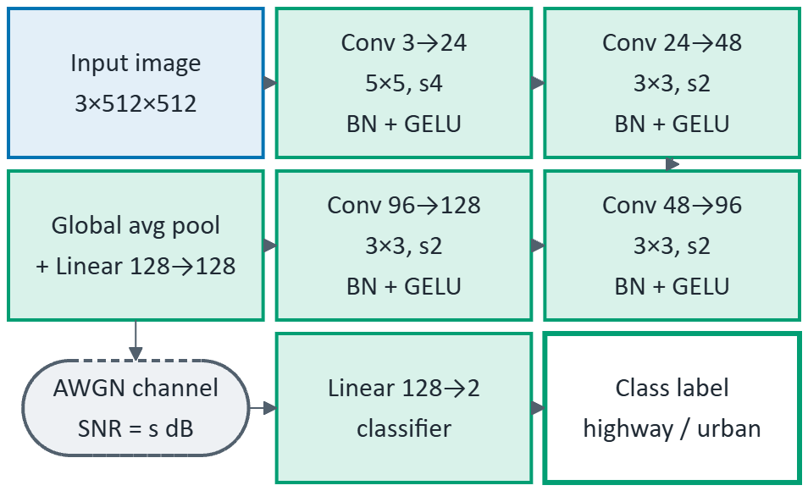
System Overview: Receiver Branches
Human mode: VAE decoder reconstructs the image from the noisy latent.
Machine mode: linear classifier outputs highway / urban from the noisy 128-d vector. Sanity check: empirical SNR measured against target.
Notes:
INSERT A: human-mode branch diagram: 512×512×3 → VAE encoder → 4×64×64 latent → AWGN → VAE decoder → reconstructed image.
INSERT B: machine-mode branch diagram: image → 4 Conv blocks → pooling → Linear 128 → AWGN → Linear 2 → class.

Slide 11
Design: Semantic Encoder and Classifier (Machine Mode)
Layer | Configuration
Input | 3 × 512 × 512, normalized to [−1, 1]
Conv1 | 3 → 24, 5×5, stride 4, BatchNorm, GELU
Conv2 | 24 → 48, 3×3, stride 2, BatchNorm, GELU
Conv3 | 48 → 96, 3×3, stride 2, BatchNorm, GELU
Conv4 | 96 → 128, 3×3, stride 2, BatchNorm, GELU
Pool + Linear | Global average pool → Linear(128 → 128): transmitted vector
Classifier head | Linear(128 → 2)
AWGN-augmented training: one SNR drawn at random per batch from {25, 20, 15, 10, 5, 0, −5} dB.

Slide 12
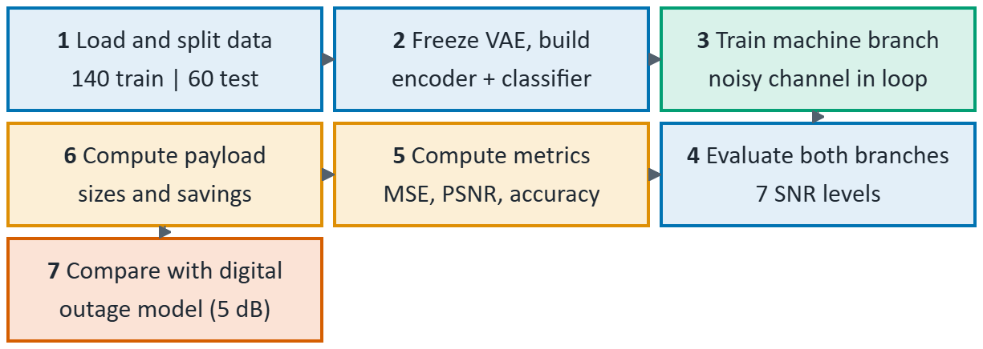
Methodology
Load dataset, resize, normalize, stratified split.
Freeze the VAE; build the semantic encoder and classifier.
Train the machine branch with the noisy channel in the loop.
Evaluate both branches at 7 SNR levels on held-out images.
Compute MSE, PSNR = −10·log10(MSE) and accuracy.
Compute payload sizes and savings.
Compare with the conceptual digital outage model (5 dB).
Notes:
INSERT: Methodology flowchart (7 steps) and/or training flowchart.

Slide 13
Algorithm
Training (machine mode)
for each epoch:
for each batch (x, y):
s <- random SNR from S
z <- Encoder(x)
z' <- z + N(0, P(z)/10^(s/10))
loss <- CE(Classifier(z'), y)
update Encoder, Classifier (AdamW)
Inference
Human:
l <- VAE.enc(x) * 0.18215
l' <- AWGN(l, snr)
x^ <- VAE.dec(l' / 0.18215)
Machine:
z <- Encoder(x)
y^ <- argmax Classifier(AWGN(z, snr))

Slide 14
Novelty
Dual-mode framework: one design serves both human and machine receivers with different payloads.
Extreme payload reduction: 97.92% (human) and 99.98% (machine) fewer values than raw.
Channel-robust training: randomized-SNR AWGN augmentation.
Cliff comparison: explicit comparison of graceful degradation against a digital cliff model.
Lightweight and reproducible: seeded notebook, small CNN, pretrained VAE, no heavy training.

Slide 15
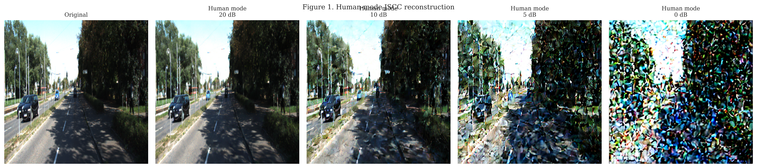
Results 1: Human-Mode Reconstruction
Original and reconstructions at 20, 10, 5 and 0 dB. Quality degrades smoothly as SNR drops.
Notes:
INSERT: figure1_qualitative_human_reconstructions.png (Figure 1).

Slide 16
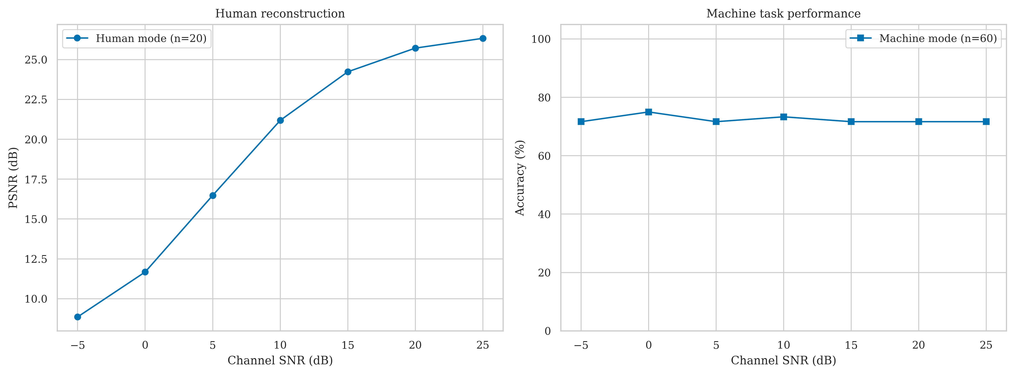
Results 2: Performance versus SNR
Human mode: PSNR falls smoothly from 26.34 dB (25 dB SNR) to 8.86 dB (−5 dB SNR); no cliff.
Machine mode: accuracy stays at 71.7–75.0% over the whole SNR range (n = 60).
Reading: accuracy does not collapse as noise grows, showing channel robustness of the semantic vector.
Notes:
INSERT: figure2_performance_vs_snr.png (Figure 2).
Table: SNR(dB): 25,20,15,10,5,0,-5
MSE: 0.00246, 0.00282, 0.00393, 0.00780, 0.02272, 0.06827, 0.13023
PSNR(dB): 26.34, 25.72, 24.24, 21.19, 16.48, 11.68, 8.86
Machine accuracy(%): 71.7, 71.7, 71.7, 73.3, 71.7, 75.0, 71.7

Slide 17
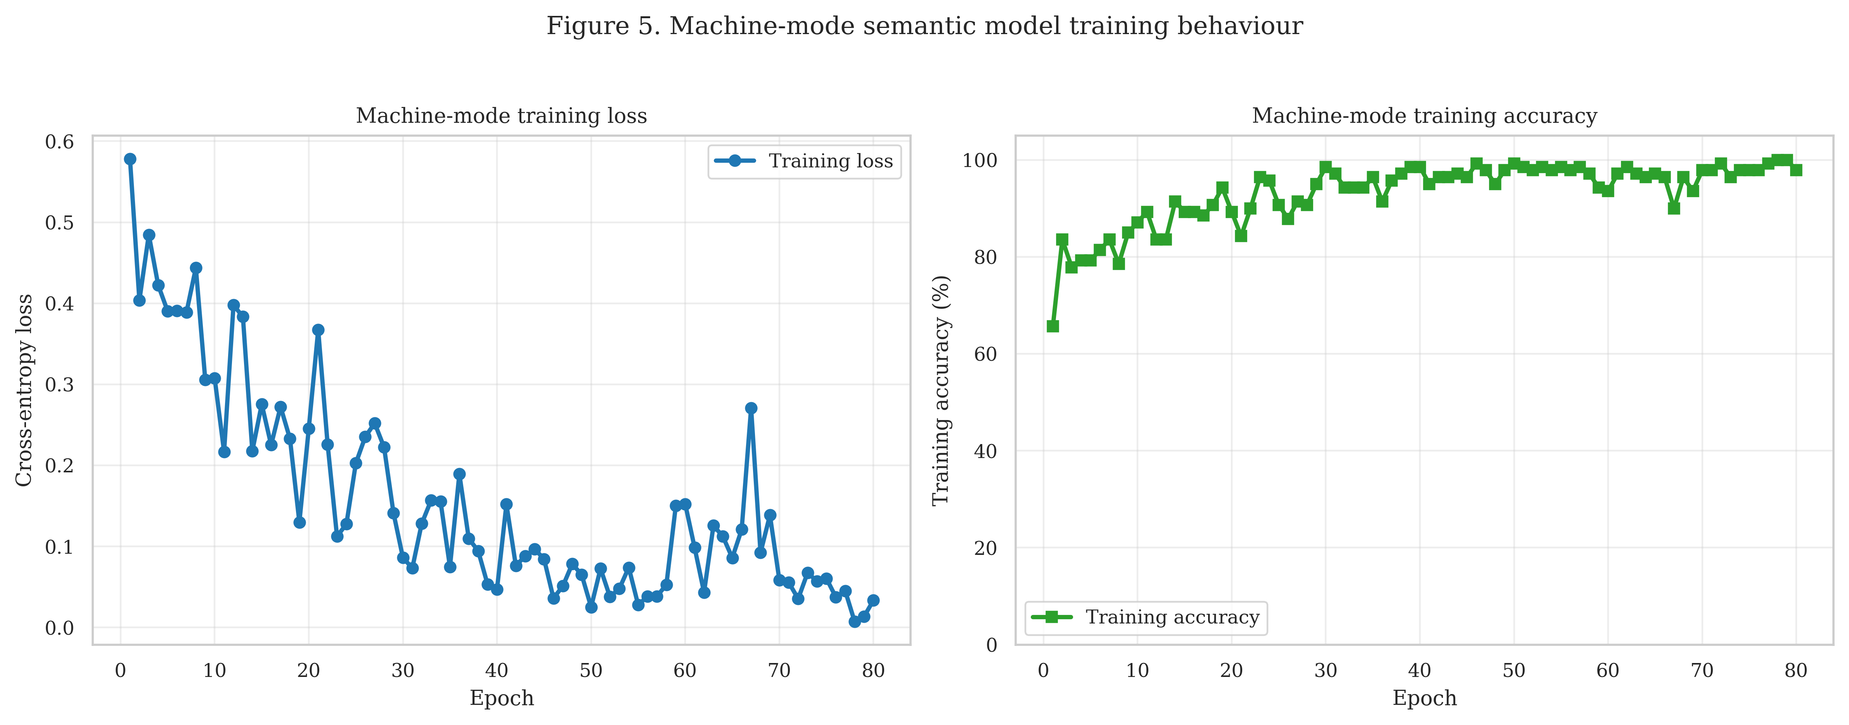
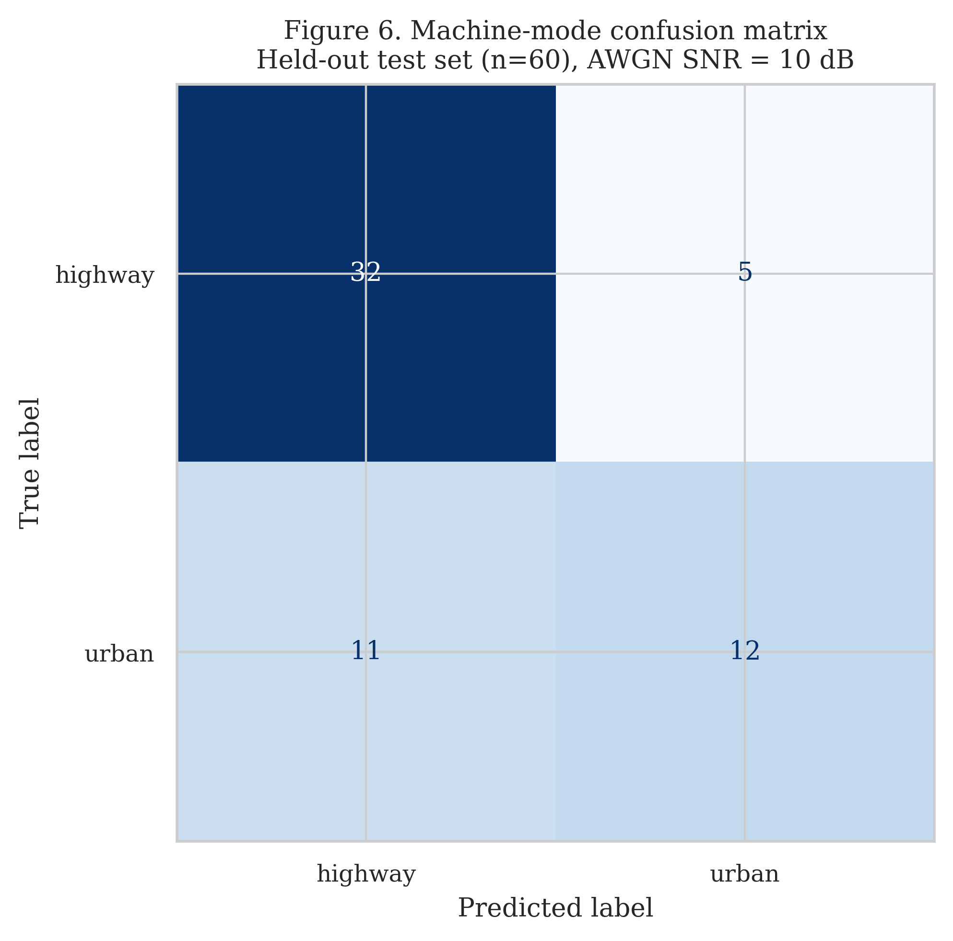
Results 3: Training Behavior and Confusion Matrix
Figure 5. Training loss and accuracy over 80 epochs; training accuracy reaches 98%.
Figure 6. Confusion matrix on the held-out set (n = 60) at 10 dB SNR: 73.33% accuracy. The train–test gap reflects the small dataset.
Notes:
INSERT A: figure5_machine_training_curves.png (Figure 5).
INSERT B: figure6_confusion_matrix_10db.png (Figure 6).

Slide 18
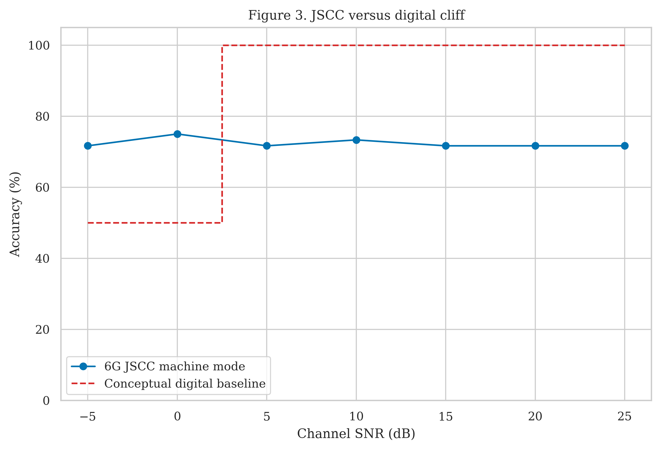
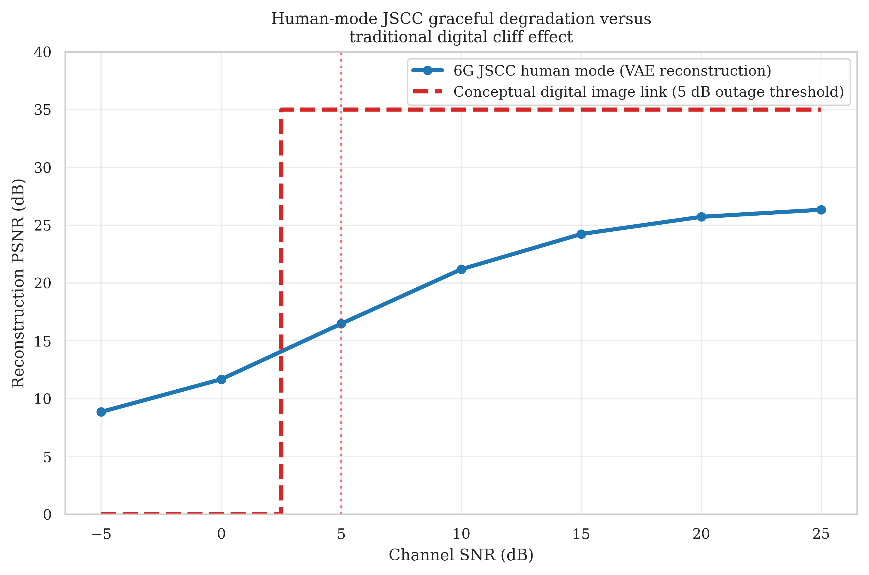
Results 4: Graceful Degradation vs Digital Cliff
Figure 3. Machine-mode accuracy vs a conceptual digital baseline (assumed 5 dB outage threshold).
Human-mode PSNR vs a conceptual digital image link. JSCC degrades gradually; the digital link does not.
Notes:
INSERT A: figure3_jscc_vs_digital_cliff_effect.png (Figure 3).
INSERT B: figure_human_jscc_vs_digital_cliff_effect.png (human-mode PSNR vs conceptual digital cliff).

Slide 19
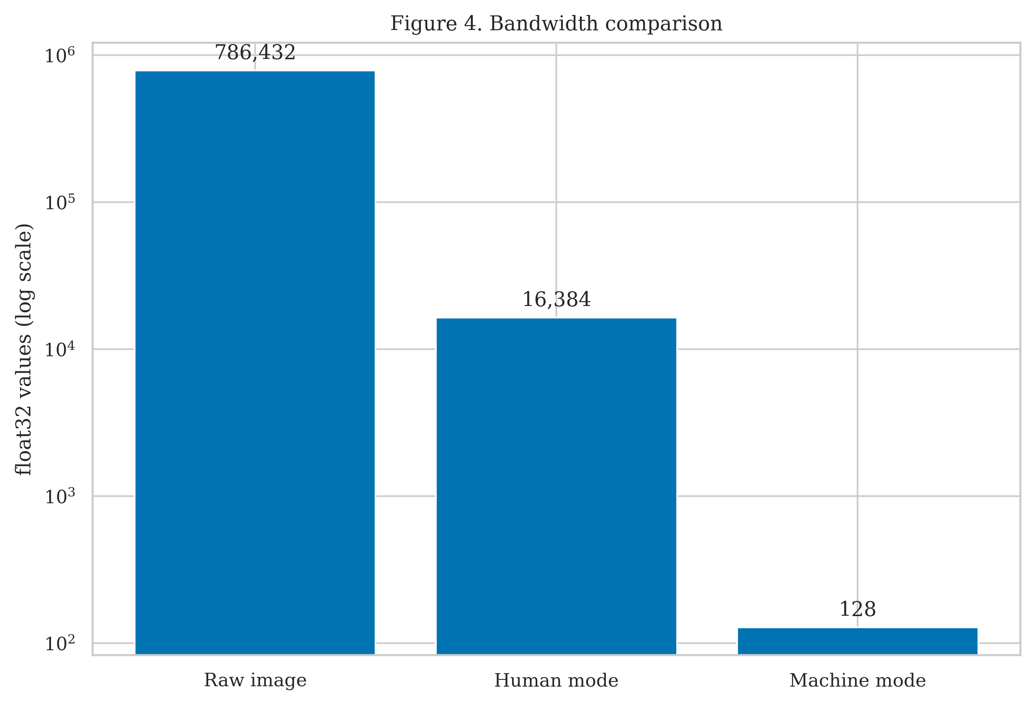
Results 5: Bandwidth Consumption
Raw image: 786,432 float32 values (3.15 MB).
Human mode: 16,384 values (65.5 KB), 97.92% saving, 48× compression.
Machine mode: 128 values (512 B), 99.98% saving, 6,144× compression.
Machine vs human: a further 128× reduction.
Notes:
INSERT: figure4_bandwidth_comparison.png (Figure 4).
Table: Raw 786,432 values / 3,145,728 bytes / 0% saving; Human 16,384 / 65,536 / 97.917%; Machine 128 / 512 / 99.984%.

Slide 20
SDG Mapping
SDG 9: Industry, Innovation and Infrastructure. Efficient, AI-native 6G communication infrastructure.
SDG 11: Sustainable Cities and Communities. Bandwidth-efficient traffic monitoring for smart cities.
SDG 13: Climate Action. Fewer transmitted values means lower communication energy.
SDG 3: Good Health and Well-being. Faster road-incident detection for safety.

Slide 21
Conclusion and Future Work
Conclusion
A dual-mode semantic architecture serves human and machine receivers over a noisy 6G-style channel.
Payload cut by 97.9% (human) and 99.98% (machine).
Human-mode PSNR degrades smoothly, from 26.34 dB at 25 dB SNR to 8.86 dB at −5 dB.
Machine accuracy is stable (71.7–75.0%) across SNR.
Future work
Larger multi-class datasets to close the train–test gap.
Fading channels and MIMO.
Trainable human-mode JSCC and a SwinJSCC backbone.
A simulated digital baseline (JPEG/BPG + LDPC).
Adaptive rate control and SDR hardware validation.

Slide 22
References
[1] J. Huang, K. Yuan, C. Huang, K. Huang, “D²-JSCC: Digital deep joint source-channel coding for semantic communications,” IEEE J. Sel. Areas Commun., 2025, doi:10.1109/JSAC.2025.3531546.
[2] L. X. Nguyen, A. D. Raha, P. S. Aung, D. Niyato, Z. Han, C. S. Hong, “A contemporary survey on semantic communications: Theory of mind, generative AI, and deep JSCC,” IEEE Commun. Surveys Tuts., 2025, doi:10.1109/COMST.2025.3616973.
[3] K. Yang, S. Wang, J. Dai, X. Qin, K. Niu, P. Zhang, “SwinJSCC: Taming Swin Transformer for deep joint source-channel coding,” IEEE Trans. Cogn. Commun. Netw., 2025, pp. 90–104.
[4] Y. Diao, Y. Zhang, C. She, P. G. Zhao, E. L. Li, “Aligning task- and reconstruction-oriented communications for edge intelligence,” IEEE J. Sel. Areas Commun., 2025, doi:10.1109/JSAC.2025.3559121.
[5] “Deep reinforcement learning- and information bottleneck-enabled task-oriented semantic communication,” IEEE J. Sel. Areas Commun., 2025, doi:10.1109/JSAC.2025.3623199.
[6] “End-to-end learning for task-oriented semantic communications over MIMO channels: An information-theoretic framework,” IEEE J. Sel. Areas Commun., 2025, doi:10.1109/JSAC.2025.3531575.
[7] “Visual language model based cross-modal semantic communication systems,” IEEE Trans. Wireless Commun., vol. 24, no. 5, 2025, doi:10.1109/TWC.2025.3539526.
[8] “Semantics-guided diffusion for deep joint source-channel coding in wireless image transmission,” IEEE Trans. Wireless Commun., 2025, doi:10.1109/TWC.2025.3591456.
[9] “Rate splitting multiple access-enabled adaptive panoramic video semantic transmission,” IEEE Trans. Wireless Commun., 2025, doi:10.1109/TWC.2025.3570465.
[10] M. F. Zia, M. A. Ouameur, M. Bagaa, D. Massicotte, A. Ksentini, “A survey on explainable AI for semantic communication: Architecture, challenges, and future opportunities,” Comput. Netw., 2026, doi:10.1016/j.comnet.2026.112142.
Notes:
Entries 5-9 and 13-20: add authors/journal from IEEE Xplore before submission. Drop any entry that cannot be confirmed.

Slide 23
References
[11] K. Jain, P. Krishnan, P. Pachiyannan, L. Jaganathan, M. A. Khan, Y. Li, “Toward smart 5G and 6G: Standardization of AI-native network architectures and semantic communication protocols,” IEEE Commun. Standards Mag., 2025.
[12] M. Xu et al., “Semantic-aided parallel image transmission compatible with practical system,” IEEE Trans. Wireless Commun., 2025.
[13] “Semantic prior aided channel-adaptive equalizing and de-noising semantic communication system with latent diffusion model,” IEEE Trans. Wireless Commun., vol. 24, no. 6, pp. 4614–4630, 2025.
[14] “Semantic base enabled image transmission with fine-grained HARQ,” IEEE Trans. Wireless Commun., vol. 24, no. 4, pp. 3606–3622, 2025.
[15] [Add authors], “Generative semantic communication: Architectures, technologies, and applications,” Engineering, 2025.
[16] [Add authors], “Generative AI-driven semantic communication networks: Architecture, technologies and applications”, 2025, pp. 27–47.
[17] [Add authors], “Semantic successive refinement: A generative AI-aided semantic communication framework”, 2025, pp. 687–699.
[18] Z. Qin, J. Ying, G. Xin, X. Tao, “Ten challenges in semantic communications”, 2025.
[19] R. Gu, W. Xu, Z. Yang, D. Niyato, A. Yener, “Task-oriented low-label semantic communication with self-supervised learning”, 2025.
[20] L. Guo, W. Chen, Y. Sun, B. Ai, N. Pappas, T. Quek, “Diffusion-driven semantic communication for generative models with bandwidth constraints”, 2025.

Slide 24
Thank You

