Slide 1

WORD HUNT
Vishwakarma Institute of Technology
COAA COURSE PROJECT
GROUP 3 CS-A BATCH 1

Slide 2
GROUP MEMBERS
Rollno | NAME
2 | Aahan Jain
3 | Aarya Tiwari
5 | Harshal Abak
8 | Omkar Abhang
9 | Abu Ansari

Slide 3
INTRODUCTION
This Project is a game of word-hunt where the code generates a random set of letters in a 14X30 grid and there are certain words hidden in that random grid that the user has to find.

Slide 4
ALGORITHM
First, we declare the data such as word pointers, the hidden words, etc. Then we set the index for word pointers and the direction of the words. We sort 30 columns and multiply by 2, the result is only even columns. To generate random words, we first sort a random number between 0 and DH, then do XOR with Al, then store that in dl register. Now using that data, we print the word stored in SI register. For D1, 0 = vertical, 1 = horizontal. If di is horizontal, print blank space. Then Get and set video mode, print content stored in AL. print content stored in Al, initiate screen, print character stored in DL.

Slide 5
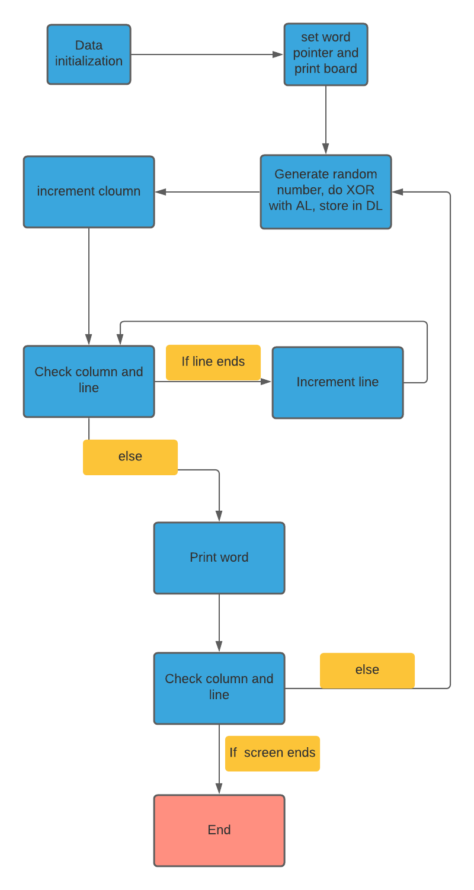
FLOWCHART

Slide 6
INSTRUCTIONS USED
mov – for copying the data between registers
call – for calling different functions
ends - for declaring the end of a particular function
add – for adding digits
mul – for multiplying digits
XOR – for doing binary XOR between digits

Slide 7
INSTRUCTIONS USED
loop – for making code that is run repeatedly
cmp – to compare digits
jmp – to jump to a certain line in code
je – for doing if else statements
inc – for increment operation
ret – to return from a procedure

Slide 8


