Slide 1
Robotic Process Automation
March 3, 2017

Slide 2
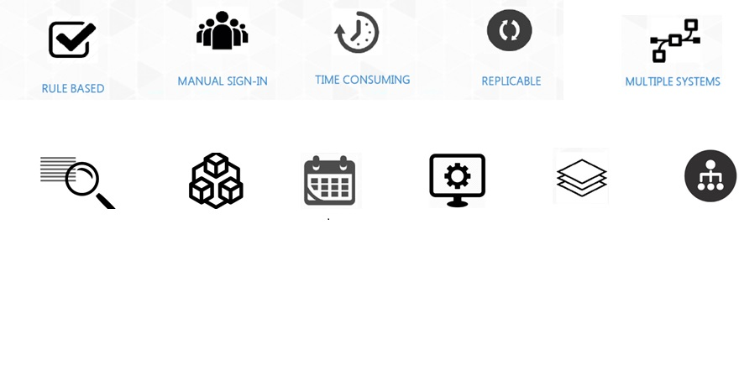
What is Robotic Process Automation (RPA)?
Robotic Process Automation (RPA) is the automation of back and front office processes that are largely rules based, structured, and repetitive. The automation takes place when software “robots” (not physical robots) carry out processes or tasks normally completed by with humans.
RPA is best geared for repetitive, rules-driven, and structured tasks. Here is list of just a few tasks that RPA can do
IDEAL PROCSSES FOR RPA AUTOMATION
KEY DIFFERENTIATORS FROM OLD AUTOMATION
Screen scraping / capture: Tools could be programmed to capture specific information on web forms using OCR technique and place into fields / application
Application/System Agnostic: RPA systems is highly versatile, they’re flexible and can be used with any application
Rolls out faster: because there is no complex/large integration
Code Free: Does not requires programming skills. process definitions are created graphically by dragging, dropping
Non-disruptive: RPA is to avoid the complexity and risk of system changes where they are not warranted.
Product specific workflows : Can be build basis the dynamic business requirements

Slide 3
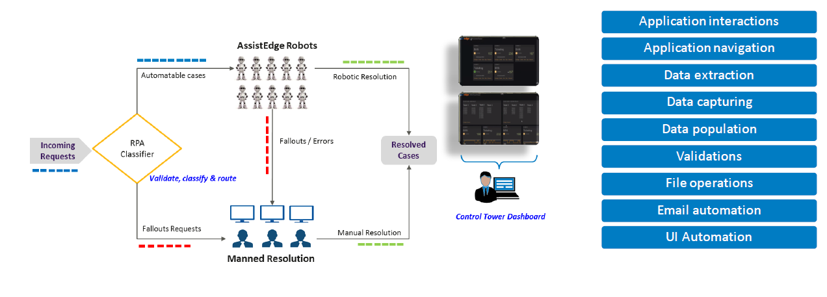
What Can RPA Do?
FEATURES
PROCESS FLOW
CAPABILITIES
Control tower to monitor, manage and scale virtual workforce
Multi-skilled Robots
provide flexibility to
manage peak loads
OCR capabilities to
process documents and
images
Application interaction
and navigation
Data extraction and
capture
Control tower to monitor, manage and scale virtual workforce
Multi-skilled Robots
provide flexibility to
manage peak loads
OCR capabilities to
process documents and
images
Application interaction
and navigation
Data extraction and
capture
Business validations and rules
Business validations and rules
Data entry and
population
Data entry and
population
Structured and
unstructured data automation
Business validations and rules
Data entry and
population
Structured and
unstructured data automation
Multiple options for process configuration including Record-and-Play and UI automation
Data extraction and
capture
Structured and
unstructured data automation
Multiple options for process configuration including Record-and-Play and UI automation
Enables single-sign on for multiple disparate
applications

Slide 4

Benefits
Higher Quality Services:
Better accuracy and better customer service.
Greater Compliance: Business processes can be set to operate in accordance with the necessary regulations and standards
Increased Speed: Processes can be completed at unprecedented speeds
Comprehensive Insights: Improved efficiency by digitizing and auditing process data
Reduced Costs: Manual or repetitive tasks are carried out by RPA software at a fraction of the cost
Employee Experience: Increased staff productivity and reduced attrition
Do more with Same: RPA logic can be replicated across systems with the same / less manpower
Increased Efficiency: Huge volume of work can be done in less time
Fast ROI: Fast, easy, and relatively inexpensive to implement
Flexibility: Depending on project requirements, robotics tools can be developed either in “batch mode,” or in “assisted mode.”
Technology & IT Independence: Robotic solutions can be implemented with limited assistance from IT
Simplicity:
Development of an RPA solution requires limited or no coding

Slide 5
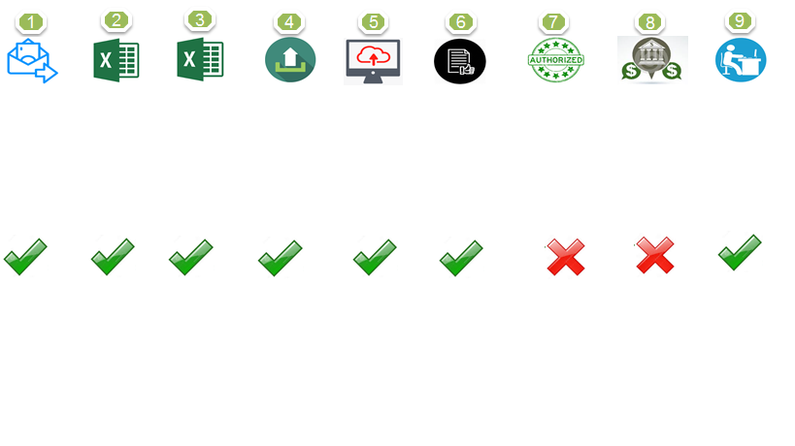
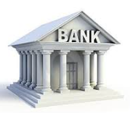
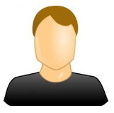
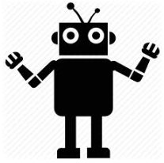
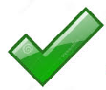
Use Case- Escrow Bank Process
Escrow bank account is a special bank account wherein lender & borrower appoint the
bank as the escrow agent to manage the funds as per the agreement
1
USER INTERVENTION
BEFORE RPA
User will log into Multiple Bank’s portal for extracting Escrow bank statements
Based on Bank statements, user will prepare Escrow Balance-MIS
User will identify the customers to whom Fund to be taken into ABFL bank A/c, Excess refund or investment to AMC
User will prepare upload file in pre-defined format for identified customers
Login to Multiple Bank’s portal to upload file
Post successful upload,
user intimates to authorized signatories for authorization
Authorized signatories will provide
authorization on bank’s portal and will intimate user accordingly
Post authorization, user will intimate the Fund Transfer details to AMC & Customers
User will post the entries in R-system for Fund received from Escrow A/c
AFTER RPA
Challenges: | Benefits:
High turnaround time of handling end-to-end escrow bank account transactions | TAT improvement since no manual intervention will required Reduce Business Risk; Optimization of existing processes and systems Reduction In Cycle time Improved Customer Experience & also Process efficiency

Slide 6

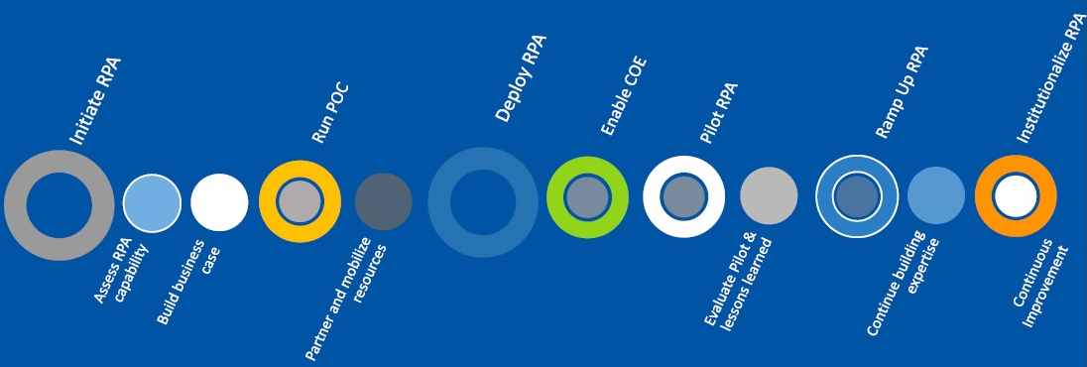

RPA Journey Roadmap
POC – High Level timelines would be Min. 2 months.
Note-Further action on Deliverables and Timelines would be decided on successful completion of POC
Build Business
Case
Run POC

Slide 7
Thank You

