Slide 1
PRESENTING YOU
Harshal Dave
Sargundeep Sachdeo
Soham Bhoir
Aditya Pai

Slide 2

ANY TRACKER
Harshal Dave
Sargundeep Sachdeo
Soham Bhoir
Aditya Pai

Slide 3




TARGET USERS
Inventory Manager
Warehouse Employee
Users
Custom User
Warehouse Owner

Slide 4







FEATURES
Smart Recommendations and Forecasting
GIS barcodes.
Space management system
Inventory Management
Report Generation
Emergency Notification
Third Party API

Slide 5
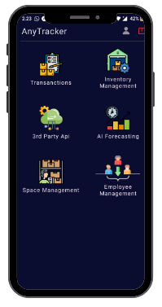
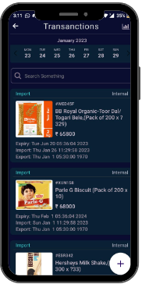
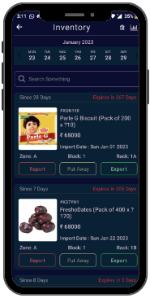
PROTOTYPE

Slide 6
BUSINESS IMPACT
Can’t locate Inventory Stocks
Lack of Centralised Inventory Hub
Data
Inconsistency
Market Demand
U
I
E
S
B
S
N
S
Inventory
Management
Product Expiry Missed & Overstocking
Can’t handle waste as expected
Product Import
Restricted

Slide 7
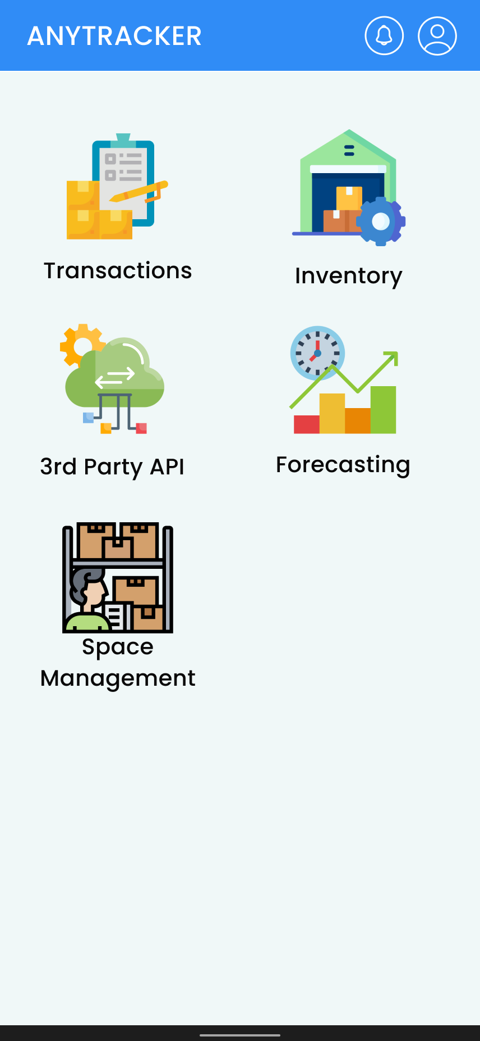
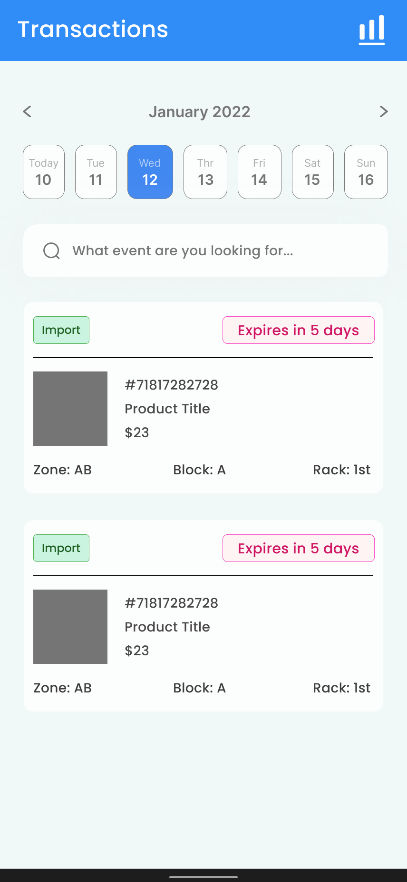
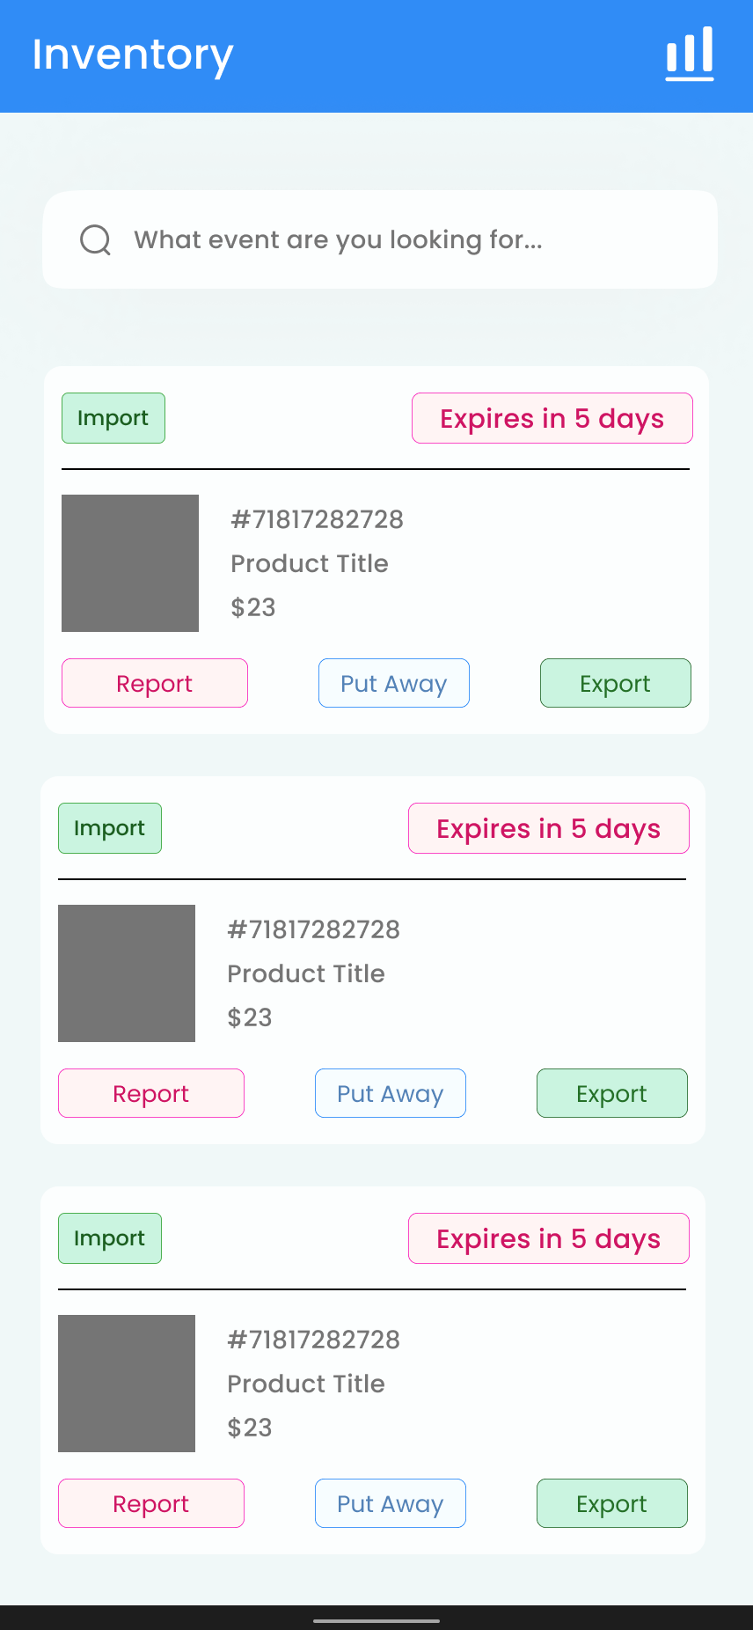
PROTOTYPE

Slide 8
SWOT ANALYSIS
THREATS
WEAKENESS
Up-to-date data.
High cost of development and maintenance
Competition
Deprecate due to tech changes
Dependence on a single Economic
STRENGTHS
OPPORTUNITIES
Real-time tracking
Calculate inventory stock
Generates reports
Mobile app
Expanded to include other features.
Marketing
Integration with other business

Slide 9
FINANCIAL PLAN
FREE
BASIC
PREMIUM
Inventory Management System
Report Generation
Space Management System
Smart Recommendations and Forecasting
APIs for third party integrations
GIS Barcodes
Inventory Management System
Report Generation
Space Management System
Smart Recommendations and Forecasting
APIs for third party integrations
GIS Barcodes
Inventory Management System
Report Generation
Space Management System
Smart Recommendations and Forecasting
APIs for third party integrations
GIS Barcodes

Slide 10
COMPETITORS IN MARKET
Warehouse Management System | Services served for | Top/Best Features
Sortly | Small brick-and-mortar businesses | Creating custom QR labels and barcodes.
NetSuite WMS | Advertising, Apparel, Footwear, Food & Beverage, Healthcare, Health & Beauty Manufacturing etc. | Strategy definition for put away and picking up.
MaroPost | Retailers and Wholesalers of all types | Strategy definition for put away and picking up.

Slide 11
Source of Revenue
SAAS Product
Advertisement
Anonymous Data Distribution
BUINESS MODEL
Major Expenses
Technical Infrastructure
Marketing

Slide 12
“
THANK YOU
“

