Slide 1
Logistic Regression
Notes:
‹#›

Slide 2
Flow of the Presentation
The Normality Assumption
‹#›
Notes:
‹#›

Slide 3
Logistic Regression using Excel
Logistic regression is a predictive modelling algorithm that is used when the Y variable is binary categorical.
That is, it can take only two values like 1 or 0. The goal is to determine a mathematical equation that can be used to predict the probability of event 1.
Once the equation is established, it can be used to predict the Y when only the X’s are known.

Slide 4
Here are some examples of binary classification problems:
Spam Detection : Predicting if an email is Spam or not
Credit Card Fraud : Predicting if a given credit card transaction is fraud or not
Health : Predicting if a given mass of tissue is benign or malignant
Marketing : Predicting if a given user will buy an insurance product or not
Banking : Predicting if a customer will default on a loan.

Slide 5
The Normality Assumption
Why not Linear regression?
Nature of the scale on which the dependent variable is being measured
Let’s look at the residual which is difference of actual weights and the predicted
Distribution of residual at each point should be normally distributed
What happens when linear regression is applied to dataset with categorical outcome

Slide 6
The Normality Assumption
Why not Linear regression?
The predicted variable can vary from –infinity to + infinity and there is no artifical or arbitrary limit can be set
Predicated probabilities can go below 0 or can cross 1 so logically this doesn’t make sense

Slide 7
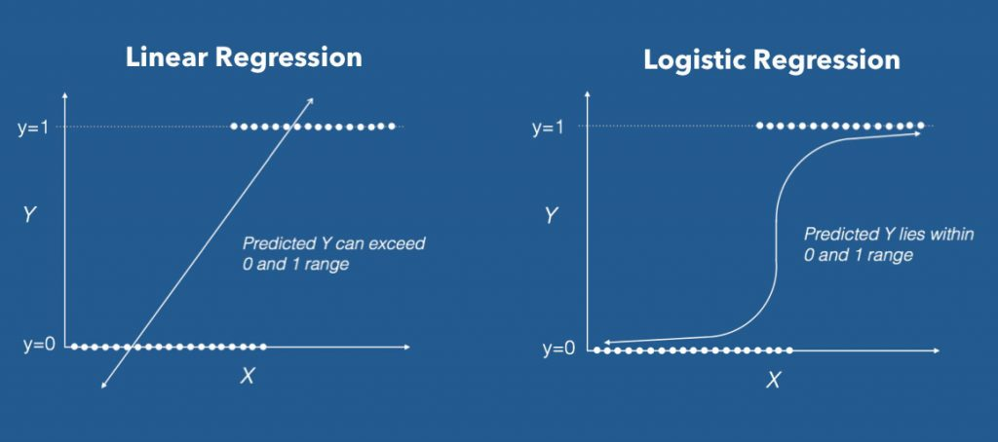

Slide 8
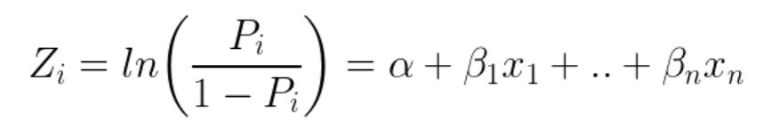
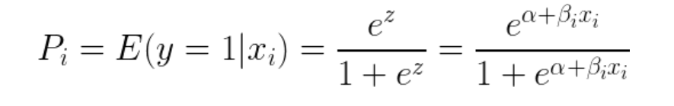
Logistic regression achieves this by taking the log odds of the event ln(P/1−P), where, P is the probability of event. So P always lies between 0 and 1.

Slide 9
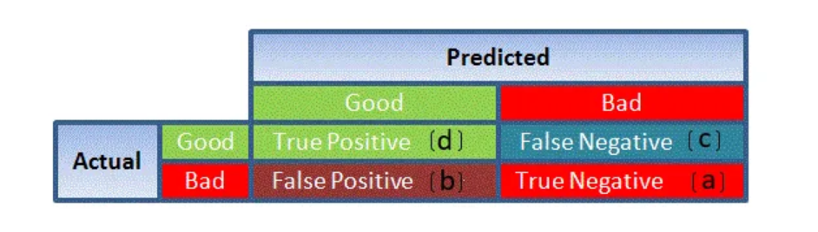
Confusion Matrix: It is nothing but a tabular representation of Actual vs Predicted values. This helps us to find the accuracy of the model and avoid overfitting. This is how it looks like:

Slide 10
