Slide 1

Stock Price Forecaster
Data Science app to forecast stock prices for the next month
By
Harshal Khilari
Oliver Priyan

Slide 2

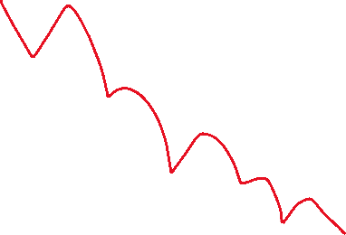
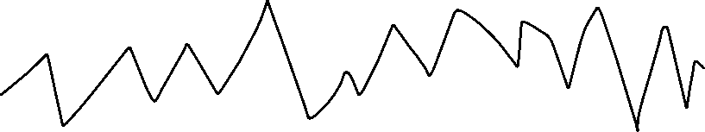

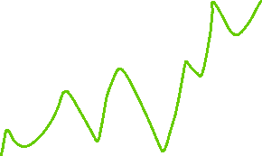
Problem Statement
We want to predict stock prices for the upcoming month for any stock

Slide 3
Gathering Data
We used yfinance library to get data
To avoid getting blocked, we implemented rate-limiting on the yfinance API
We download the entire historical data using the stock ticker symbol
Yfinance uses finance.yahoo.com to scrape data
Yahoo Finance uses extensions for stock symbol to denote stock exchanges e.g. reliance.ns for reliance symbol in National Stock Exchange of India

Slide 4
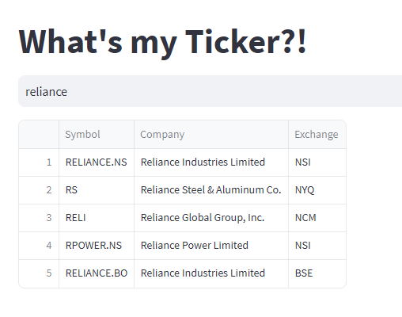
Don’t know the exact symbol?
We’ve implemented a module that scrapes drop-down suggestions from the search bar on Yahoo Finance website, and displays them in the app
We do this using Selenium

Slide 5
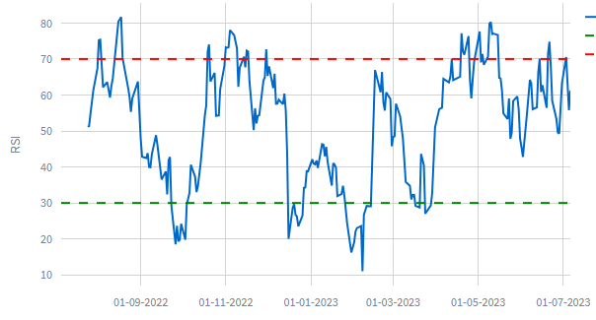
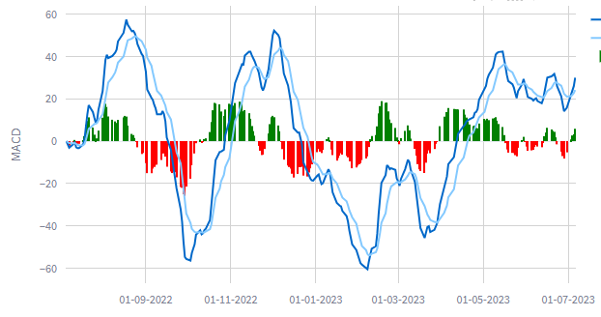
Exploring the Data
Stock prices depend on a vast number of micro and macro factors, and thus does not usually show clear patterns
Hence, we don’t consider seasonality to be important here
High trading volume correlates to trend reversal
We plot Technical Indicators like RSI, MACD for User’s benefit

Slide 6
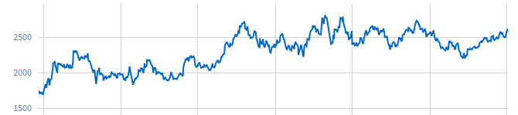
Model Validation
We use the past 3 years of closing prices as using the entire dataset might lead to overfitting and leads to a higher runtime as well
Of the 3 years, the latest quarter is used for testing
We use Mean Squared Error, Symmetric mean absolute percentage error, and Directional Accuracy to understand errors

Slide 7
Auto-ARIMA model
Using pmdarima library, we get an optimally fitted model
We use Rolling Window Forecast technique to integrate each new value from the test set
The final forecast is done using Rolling Window Forecast as well

Slide 8
LSTM model
We use a sequential model with 6 layers
We use 2 LSTM layers of 128 and 64 nodes
We use dropout layers between them
Finally using a dense layer of 16 nodes with relu activation
We narrow it down to a single node
Using ‘adam’ optimizer, and MSE for loss, we compile the model
The batchsize is 60 which is also the size of the input, with 10 epochs

Slide 9
MCMC model
We use Metropolis-Hastings algorithm for MCMC

Slide 10
Model evaluation
Auto-ARIMA gives the least errors
LSTM performs well with higher number of epochs and smaller batch sizes but takes a very long time to run
MCMC has high errors as its predictions simulate a random walk sequence
Directional Accuracy is nearly 50% for all models which can be attributed to random chance

Slide 11
Final Forecast
Auto-ARIMA forecasts have very little variation and sometimes no variations at all(depending on the stock data), with the model predicting the last price
LSTM also has very little variation in its forecast
MCMC, forecasting a random walk sequence, provides variability
Hence, we use an average of the three model’s forecasts to get the final forecast

Slide 12
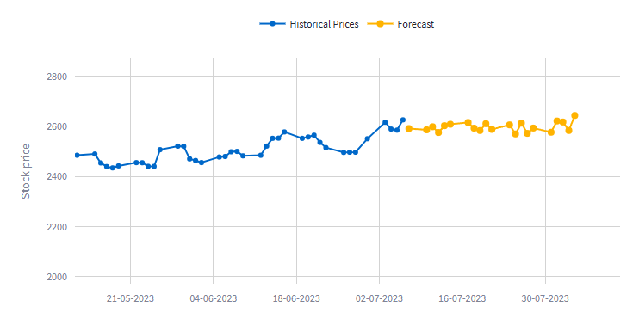
Forecast for the next month

Slide 13
Extras
We plot closing price for the last two years and the next month’s forecast using Plotly
We print a table of these values as well
Finally, we provide trending news for the user-defined stock

Slide 14
External Links
https://github.com/HarshalKhilari/P-246-Group-6-Stock-Price-Forecasting
https://delphi-the-stock-forecaster.streamlit.app/

