Slide 1
UNIT-2
THEME
Prof. Nilesh Parghi
KSC - AMRELI

Slide 2
What is theme?
A WordPress Theme is a collection of files that work together to produce a graphical interface with an underlying design for a weblog.
These files are called template files.
A Theme modifies the way the site is displayed, without modifying the underlying software.
It includes image files, templates, CSS stylesheets, etc. that can help to make your website look great.

Slide 3
How to install & activate theme.
1)
First thing you need to do is login to your WordPress admin area. Next, click on Appearance » Themes.
Once you are on the themes page, click on the Add New button at the top.
From there you’ll see an option for “Upload Theme” at the top of the screen. Click the “Browse” button, navigate your computer files and select the .ZIP file for your downloaded extension.
Once uploaded, click the “Install Now” button
Your WordPress application will installed the theme for you. Simply click the Activate link on the next page you will be redirected to.

Slide 4
2)
Locate XAMPP's htdocs folder.
If your site is installed in a sud-directory in htdocs, go there. If not skip to next step.
Open the wp-content folder
Open the themes folder
Copy in your downloaded theme and extract it there (if its zipped)
Go to your Wordpress Dashboard and go to the Appearance button on the left and click Themes from the drop down. Find your newly installed theme and hit Activate.

Slide 5
Introduction of common WordPress theme template files
style.css - The main stylesheet. This must be included with your Theme, and it must contain the information header for your Theme.
rtl.css :- The rtl stylesheet. This will be included automatically if the website's text direction is right-to-left.
index.php :- The main template. If your Theme provides its own templates, index.php must be present.
comments.php :- The comments template.
home.php :- The home page template, which is the front page by default. If you use a static front page this is the template for the page with the latest posts.

Slide 6
single.php :- The single post template. Used when a single post is queried.
page.php :- The page template. Used when an individual Page is queried.
category.php :- The category template. Used when a category is queried.
tag.php :- The tag template. Used when a tag is queried.
author.php :- The author template. Used when an author is queried.
date.php :- The date/time template. Used when a date or time is queried. Year, month, day, hour, minute, second.

Slide 7
search.php :- The search results template. Used when a search is performed.
image.php :- Image attachment template. Used when viewing a single image attachment.
404.php :- The 404 Not Found template. Used when WordPress cannot find a post or page that matches the query.
header.php :- The header of your site is typically the first thing people see.The header of your site is set using this file.
footer.php :- The footer of your site is set using this file. Use the wp_footer() call, to appear just before closing body tag.

Slide 8
Theme Customize Options
Theme options is a custom admin page which comes with some WordPress themes.
It allows users to change theme settings without modifying theme files or touching any code.
These theme option pages can be very simple with a handful options or it can have tons of customization options split into either tabs or multiple pages.
It is important to understand that WordPress themes are NOT required to have an options page.
For example, Twenty Twelve, one of the default WordPress themes does not have a Theme Options page.

Slide 9
Site Identity
Site identity option allow developer to perform setting like site tile, tagline, new logo, site icon etc.
Steps to perform for site identity are:
Log into your WordPress Dashboard.
In your navigation menu click Appearance then Customize.
You will then be on the front Customizer page. Click the Site Identity link.
If you want to replace the Site Title with a logo click the Select logo button. Then, upload your logo or choose it from the Media Library.
Enter your Site Title and Tagline if you are not using a logo.
If you want to use a custom Site Icon click the Select Image button. Then, upload your icon or choose it from the Media Library if it was uploaded previously.
Click the Publish button to save your changes.

Slide 10
Menus
Navigation allows the definition of the placement of your menu. Select which menu appears in the location.
The Wordpress Twenty Fifteen Theme supports two menu locations, Primary Menu and Social Links Menu.
From the pull down box, select the menu that will be presented in the location.

Slide 11
Widgets
Themes usually have at least 1 or 2 sidebars.
Sidebars are the narrow columns to the left or right of your blog posts.
Each section in the sidebar is known as a “Widget” that you can add or remove, and move up or down.
You configure Widgets in your sidebar by via this Widgets menu.
Although you can configure Widgets via Apperance> Customize > Widgets menu, you can see your changes in live preview of this Customizer.

Slide 12
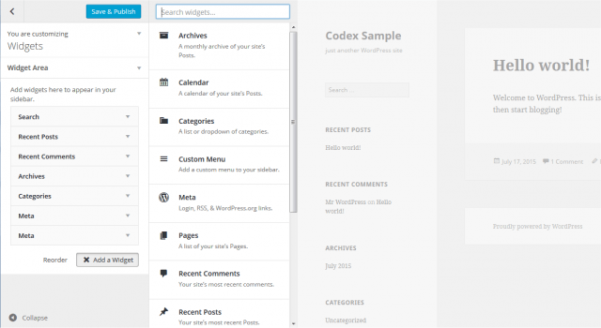

Slide 13
HomePage Settings
You site’s home page can either contain your latest posts or display a static page or post.
Your latest posts – select this to show your latest posts in your home page
A static page – select either a Front page or Posts page.

Slide 14
Additional CSS
A panel that lets you add CSS statements which will override the current theme.

