Slide 1
Exposys Data lab
Topic Name : COVID SAHARA
Student Name : Sahil Vaidya (Web Developer Intern)
Email-id : sahilvaidya7777@gmail.com

Slide 2
CONTENTS
Abstarct
Introduction
Existing Method
Proposed Method With Architecture
Methodology
Benefits
Implementation
Conclusion

Slide 3
ABSTRACT
We get easy availability of plasma to the person who is affected.
To reduce time of the person finding plasma .
Easy availability of plasma .
By viewing website can save time for finding plasma for patient.

Slide 4
INTRODUCTION
I am Sahil Vaidya, first of all you know that what kind of
situation we are suffering from .
Our government and health department of India is dealing good with this Covid-19 Pandemic, but on the ground field something is not getting good.
So by seeing this condition I decided solve it in my project.

Slide 5
EXISTING METHOD
By seeing this critical situation my objective is to get easy
availability of plasma to the person who is affected by corona
virus .
And also as this web based application is only limited for the
College Students.
My aim is to reach maximum people in the state and
the country.

Slide 6
PROPOSED METHOD WITH ARCHITECTURE
To reduce time of the person finding plasma .
Person can reach the plasma donor by there information .
Corona positive person can get fast medical treatment .
And the person will not panic or frustrate to find the plasma .

Slide 7
METHODOLOGY
In this project student has to register .
When he/she is register they can view their profile by login .
Admin can also login to their profile and can see many
options .
Admin can view the details of students by their own login .

Slide 8
When the web based application is hosted , students and admin can visit site, by putting
WWW.COVIDSAHARA.COM in
their url and can able to see home page of
website.
AS SHOWN IN BELOW IMAGE

Slide 9
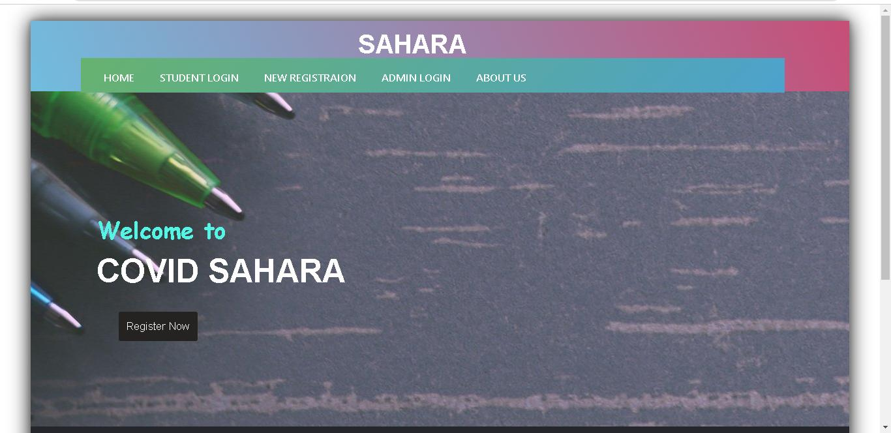

Slide 10
Student have to click on the REGISTRATION link. when they click on registration link they are directed to STUDENT REGISTRATION PAGE .
After that they have to fill the necessary details
such as personal information and create their
own login id .
And press on the SUBMIT button
AS SHOWN IN BELOW EXAMPLE

Slide 11
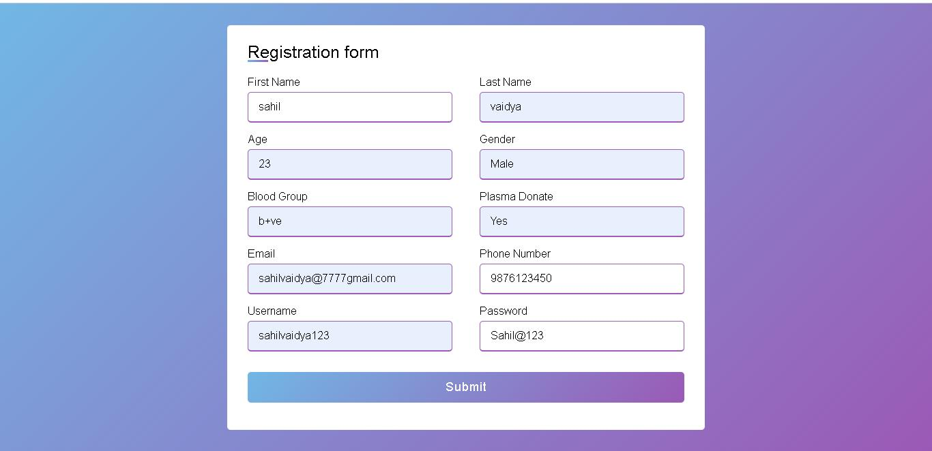

Slide 12
After clicking on the SUBMIT BUTTON. the registration details of students are stored inside the DATABASE.
AS SHOWN IN BELOW IMAGE

Slide 13
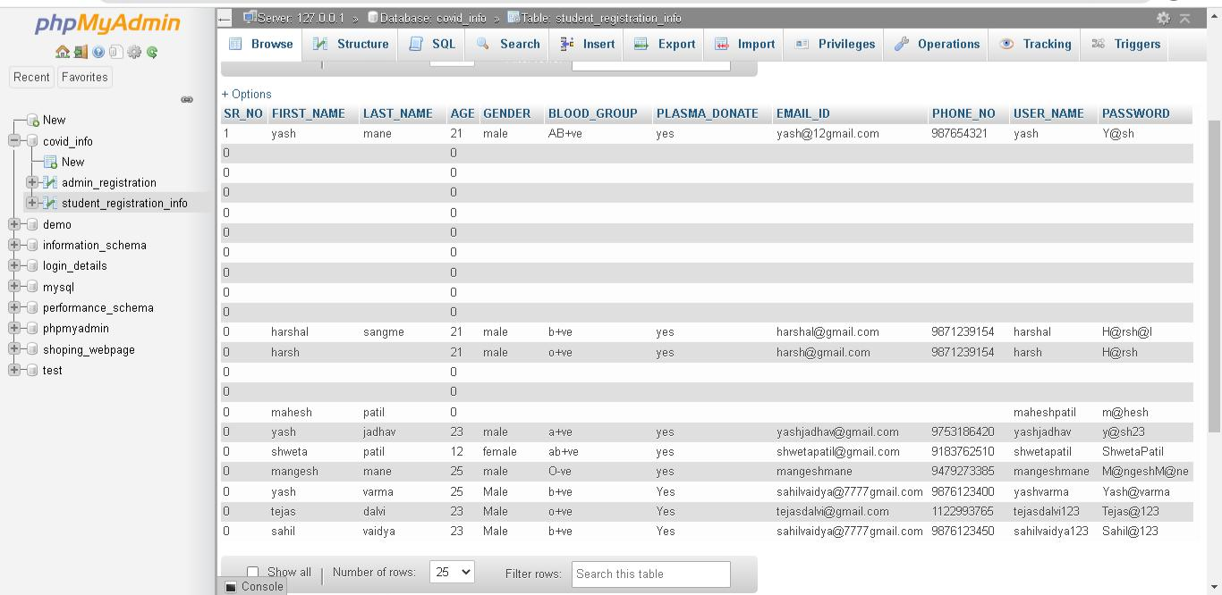

Slide 14
After successful registration students are able to LOGIN themselves. When students goes to LOGIN PAGE they can put there Username and Password.
And press on the LOGIN button.
AS SHOWN IN BELOW IMAGE

Slide 15
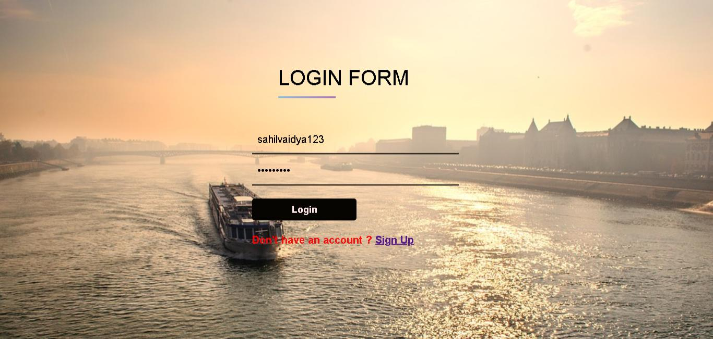

Slide 16
After clicking on the LOGIN button, the AUTHENTICATION of student is done in the backend by checking their Username and Password of student . if the entered details is true they are directed to STUDENT HOME PAGE .
AS SHOWN IN BELOW IMAGE

Slide 17
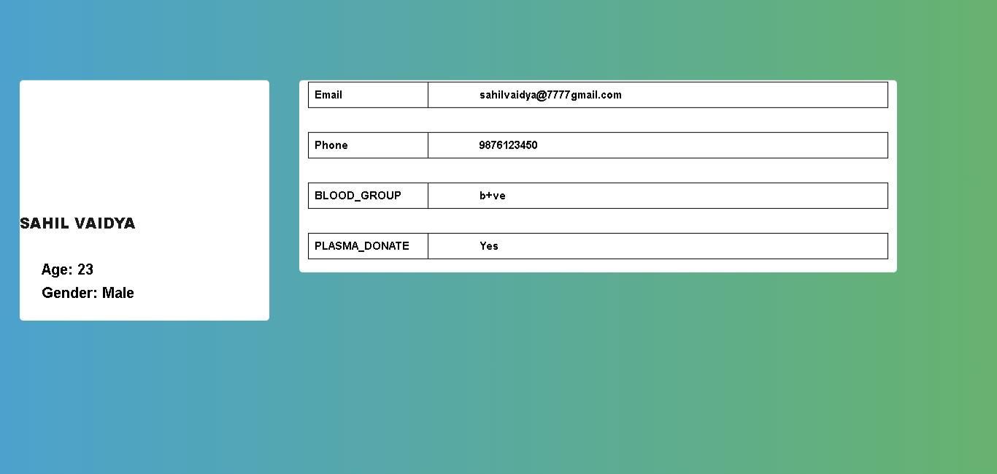

Slide 18
To logout from the student profile you can use LOGOUT BUTTON. By clicking on LOGOUT BUTTON you are redirected to the STUDENT LOGIN PAGE.
AS SHOWN IN BELOW IMAGE

Slide 19


Slide 20
Now after all the functions of students, we come across ADMIN FUNCTIONS .
First of all when the admin or teacher visits our site namely WWW.COVIDSAHARA.COM
They can see Homepage of our site .
AS SHOWN IN BELOW IMAGE

Slide 22
Teachers have to click on the ADMIN LOGIN BUTTON .
When they click on ADMIN LOGIN BUTTON they are directed to ADMIN LOGIN PAGE.
AS SHOWN IN BELOW IMAGE

Slide 23
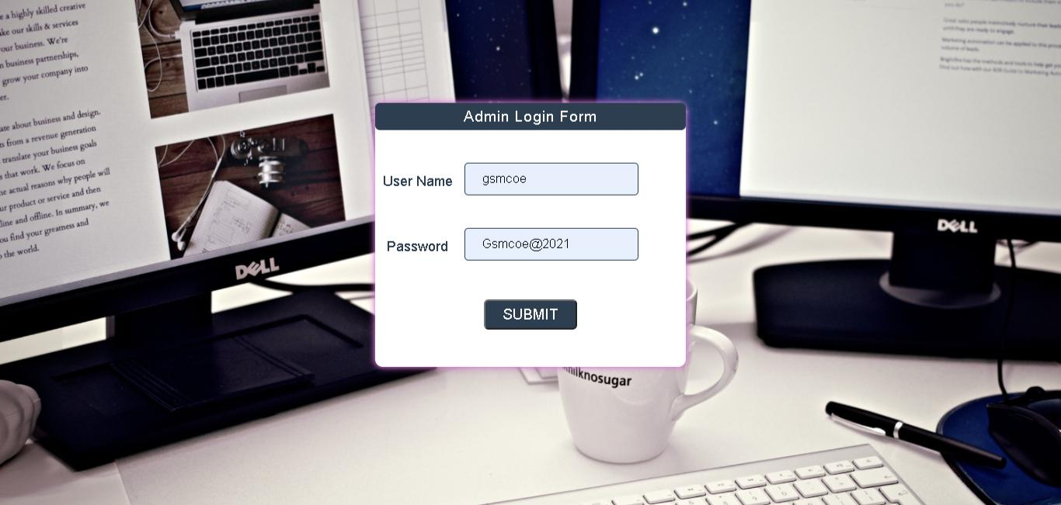

Slide 24
After clicking on the LOGIN button, the AUTHENTICATION of Admin or Teacher is done in the backend by checking their Username and Password of Admin .
If the entered details is true they are directed to ADMIN PORTAL PAGE .
AS SHOWN IN BELOW IMAGE

Slide 25
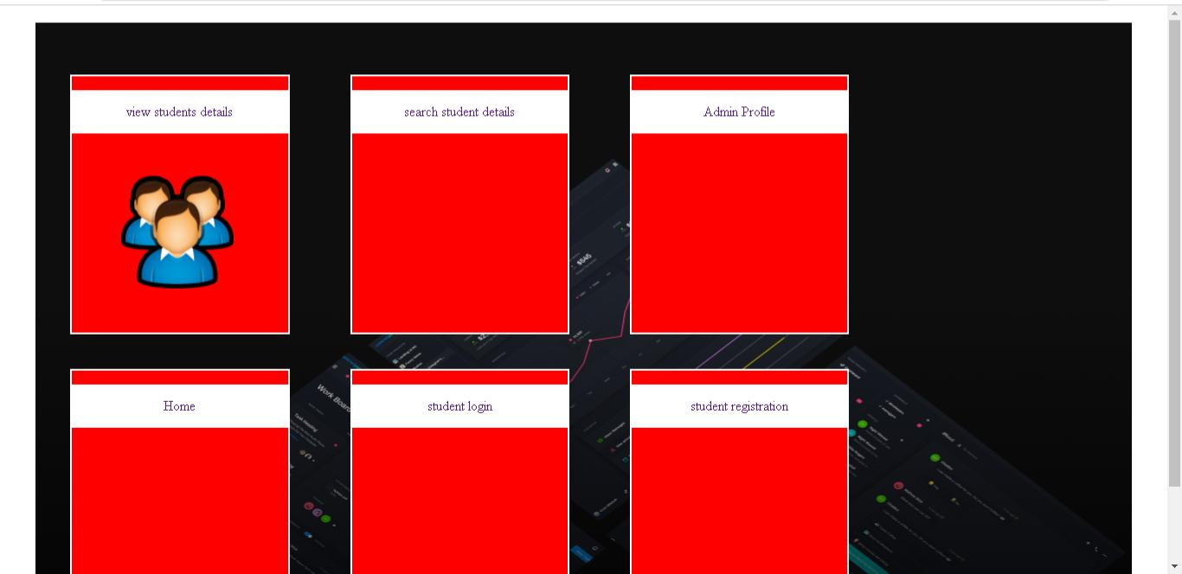

Slide 26
When they are directed to ADMIN PORTAL PAGE Teachers or admin can see many options for operations
As by clicking on first option namely VIEW STUDENT DETAILS, Teachers can able to see details of students in tabular format
AS SHOWN IN BELOW IMAGE

Slide 27
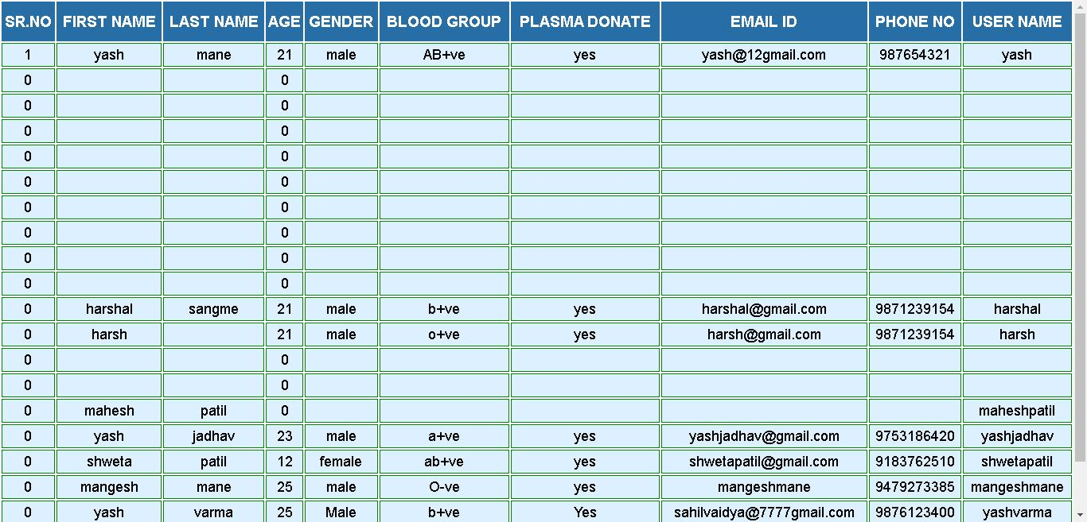

Slide 28
To logout from the Admin portal just click on LOGOUT BUTTON. After that you are you can go into homepage of COVID SAHARA.
To check our information Just click on.
About Us Button.
After that you will see Our About Us page.

Slide 29


Slide 30
BENEFITS
Easy availability of plasma .
By viewing website can save time for finding plasma for patient.
There is no need to travel here and there .
As there is no travel, wastage of fuel and resources are reduce
do which we can avoid pollution.

Slide 31
IMPLEMENTATION
Implementation of this project are developed using
Programming Language.
I used languages like HTML & CSS.

Slide 32
CONCLUSION
Technology is make our life easier.
As patient is getting plasma soon, he/she will get
recover soon.

Slide 33
PROJECT CREATED BY SAHIL VAIDYA

Slide 34
THANK YOU …

