Slide 1









Search:From Lexical to Semantic &Hybrid
How modern search sy stems retri eve,rank,and return relevant results.

Slide 2
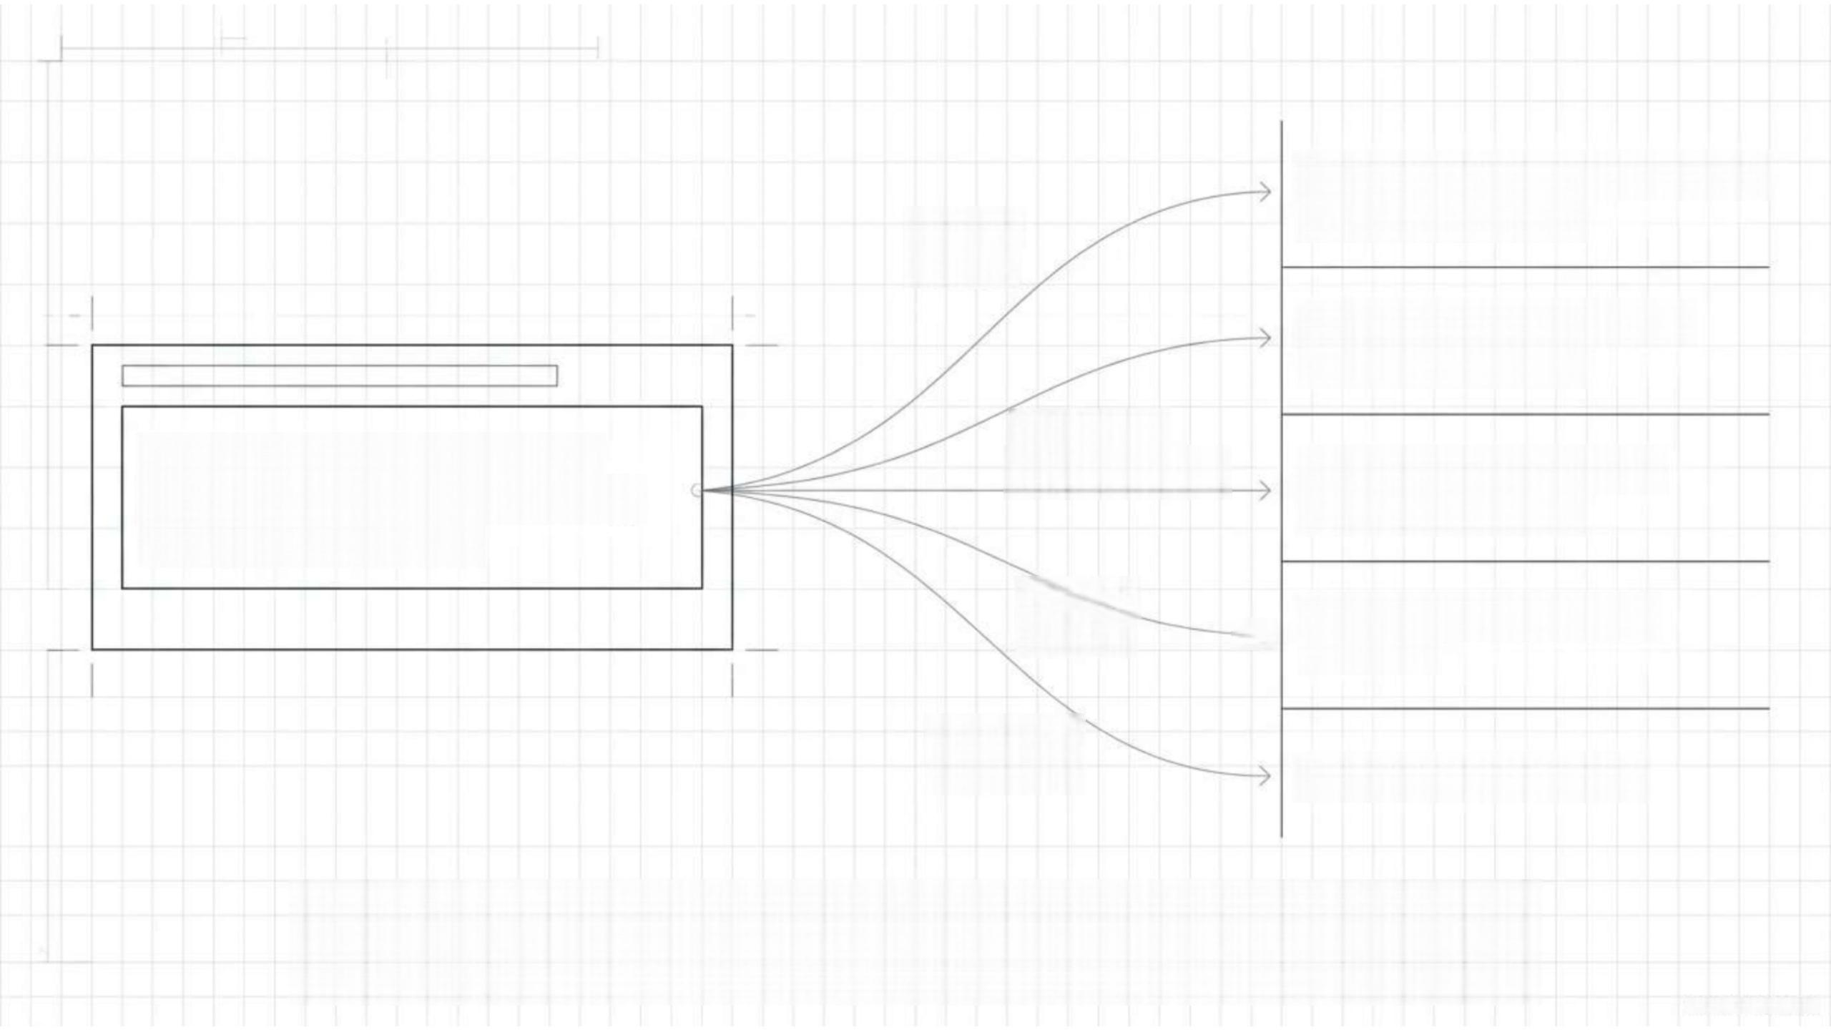
Samsung 8kg Fully Automatic Washing Machine
Samsung 9kg Front Load Washing Machine
Partial match
I need a Samsung automatic
washing machine,around 8kg,
with good efficiency.
Different
terminology
Partial
match →
LG 8kg Fully Automatic Washing Machine
Samsung 7kg Washing Machine
Meaning
vs Intent Samsung Refrigerator
Which products should appear first?
Gemini otebook

Slide 3
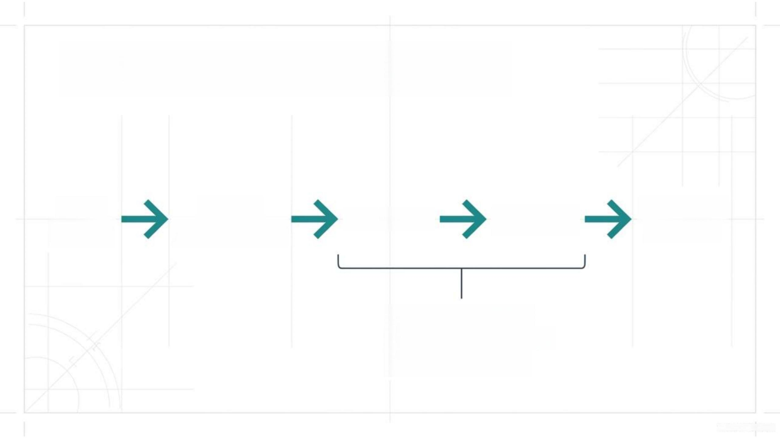
System Architecture Overview
User
Query
Query
Processing
Relevant
Results
Retrieval Ranking
1.Lexical Search
2.Semantic Search
3.Hybrid Search

Slide 4
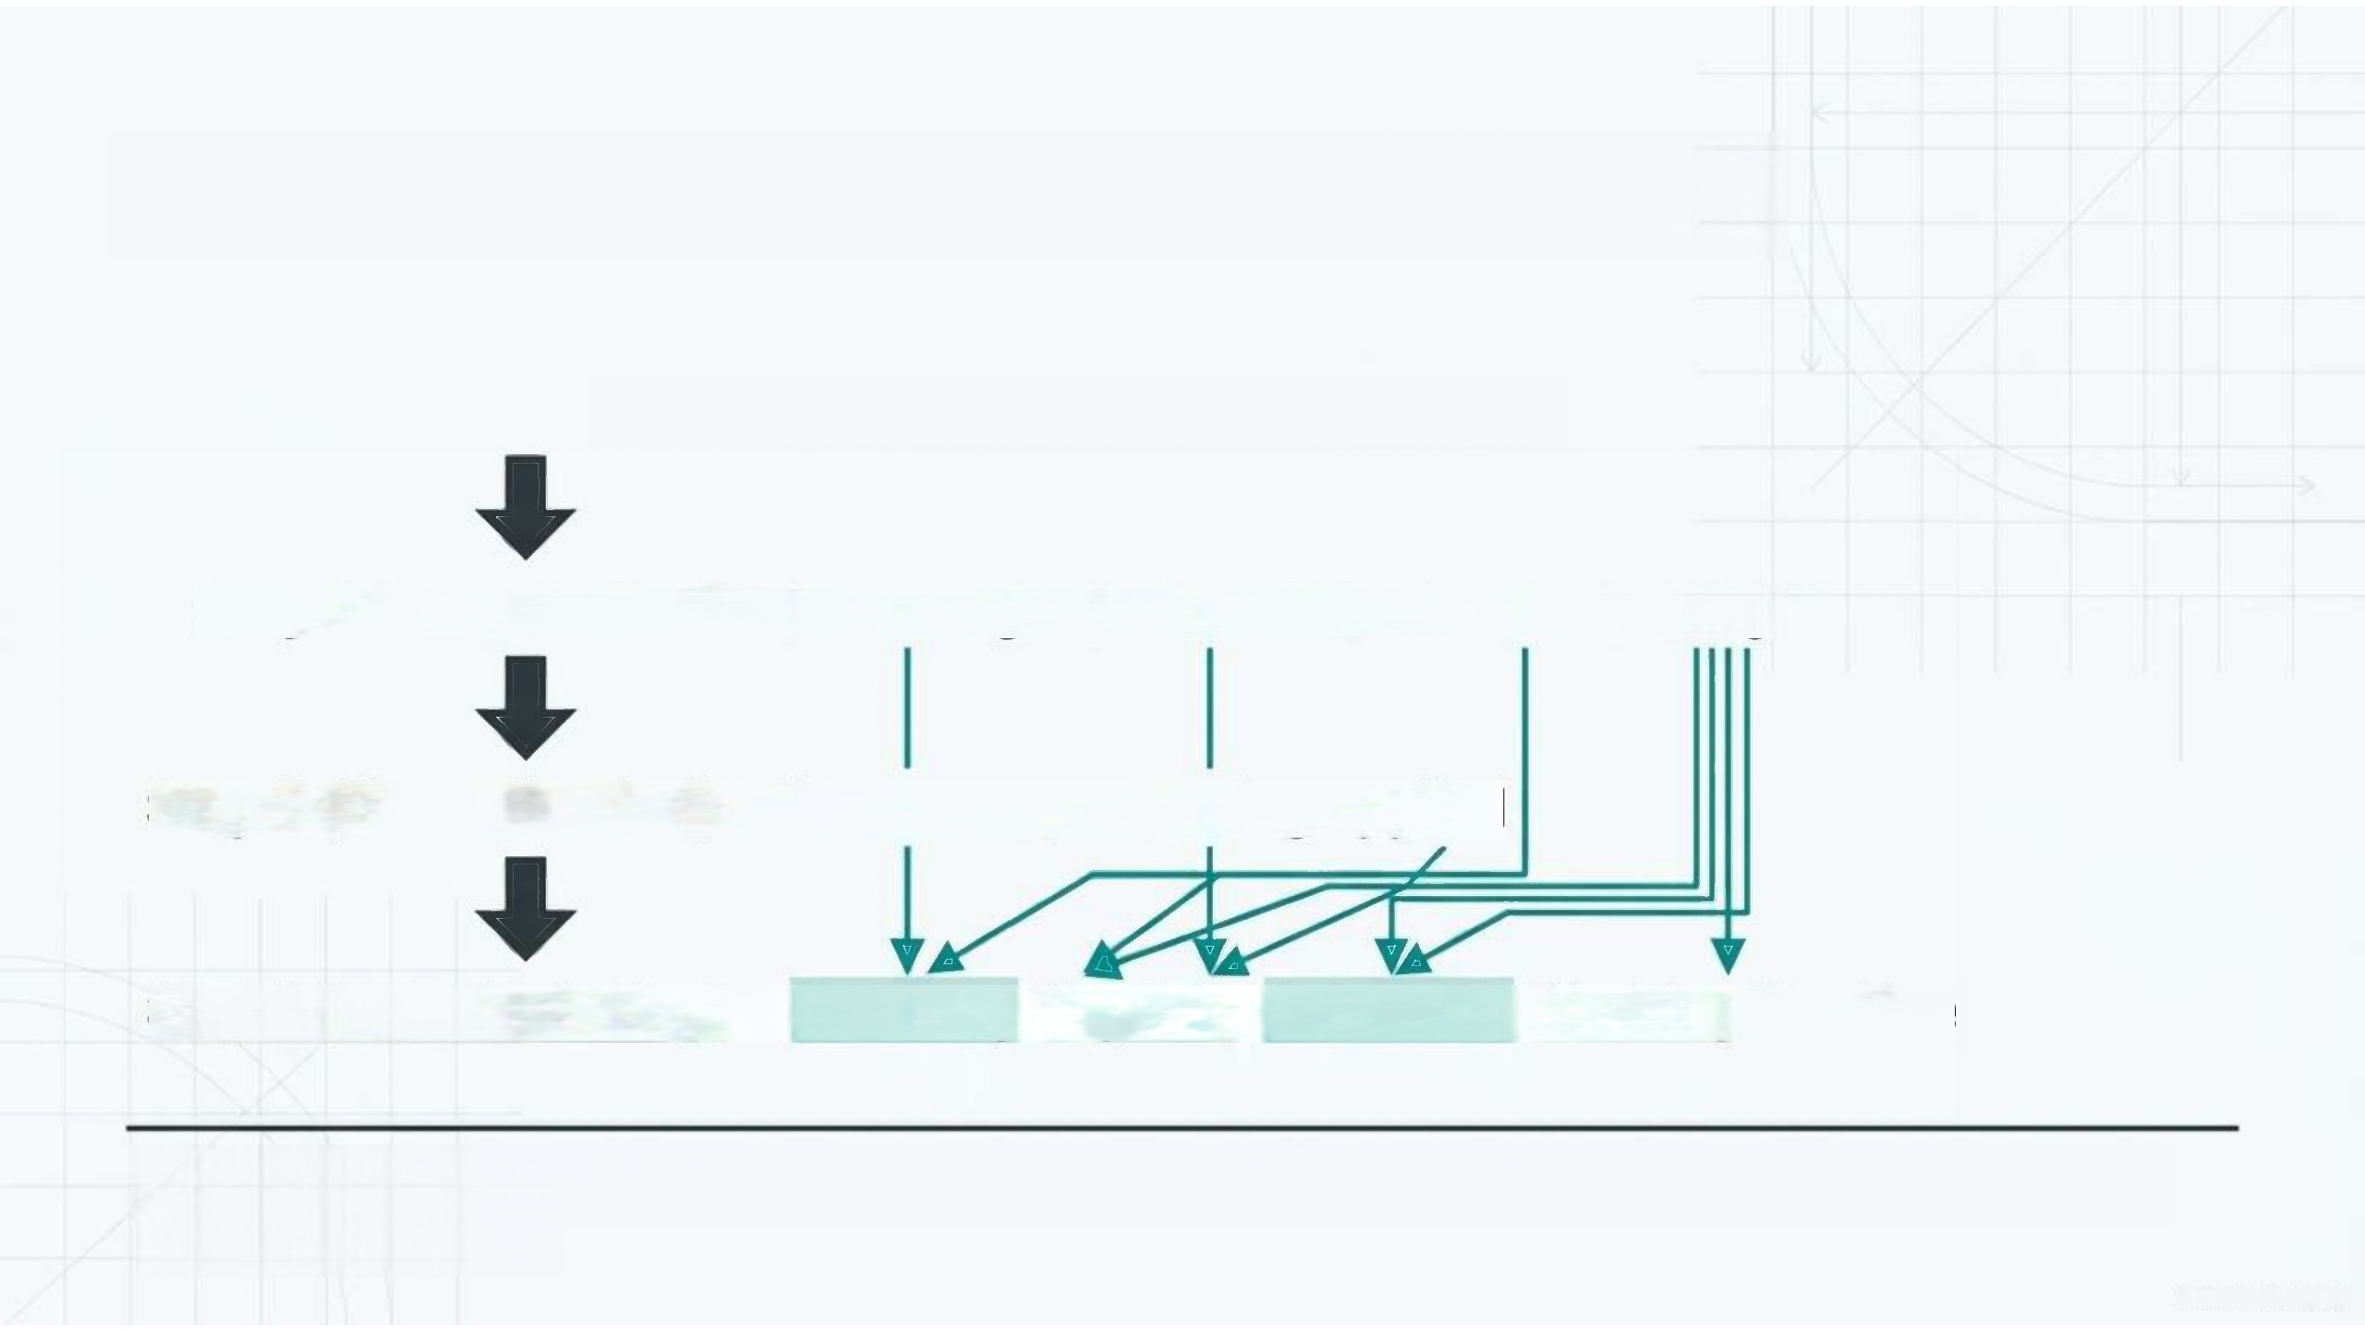
The Baseline:Lexical Search
Input: Samsung automatic washer 8kg
Step 1(Tokenization): [Samsung][automatic][washer][8kg]
Step 2(Normalisation): lowercase,stemming applied
Step 3(Term Matching): Samsung 8kg Fully Automatic Washing Machine
Lexical search strictly matches the actual terms in the query with the terms in the documents.

Slide 5

Bypassing the Full Scan:
The Inverted Index
washing
machine Samsung 8kg
Product 1
Product 2
▶ Product 4
→ Product 5
→ Product 7 Product 9
The search engine efficiently retrieves candidate documents by looking up pre-indexed terms,bypassing a complete catalogue scan.

Slide 6

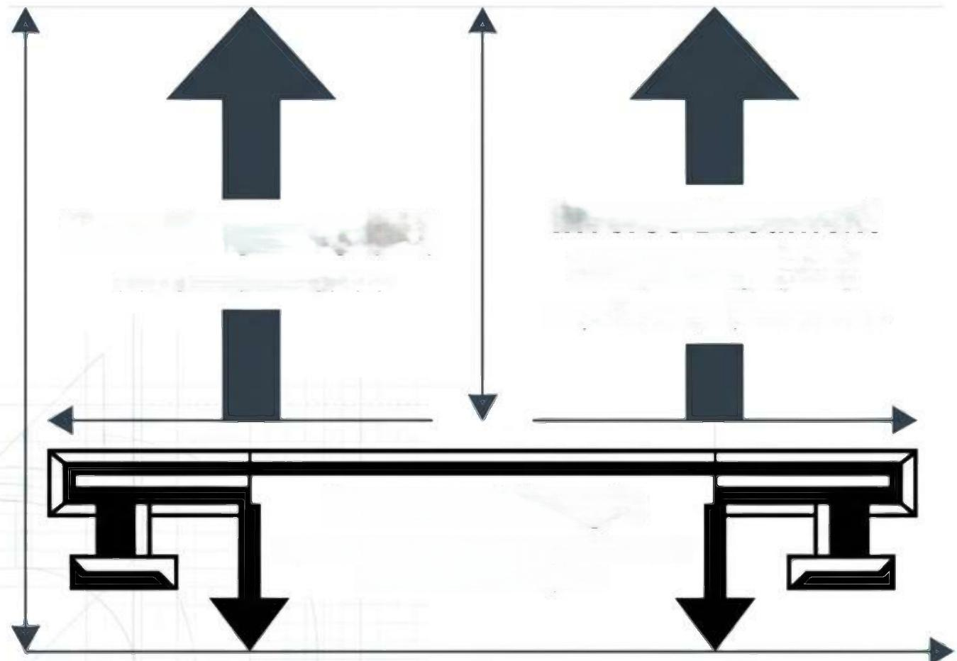
Resolving Ties:BM25 Relevance Ranking
Inverse Document Frequency(IDF) Amplifies rare/important words Document Length Normalises scores so long documents don't automatically win | 1.Product 2.Product 3.Product
Term Frequency(TF) How often a term occurs
A→ BM25 Score:9.4
B→ BM25 Score:6.7
C → BM25 Score:2.1
*Scores are illustrative.

Slide 7
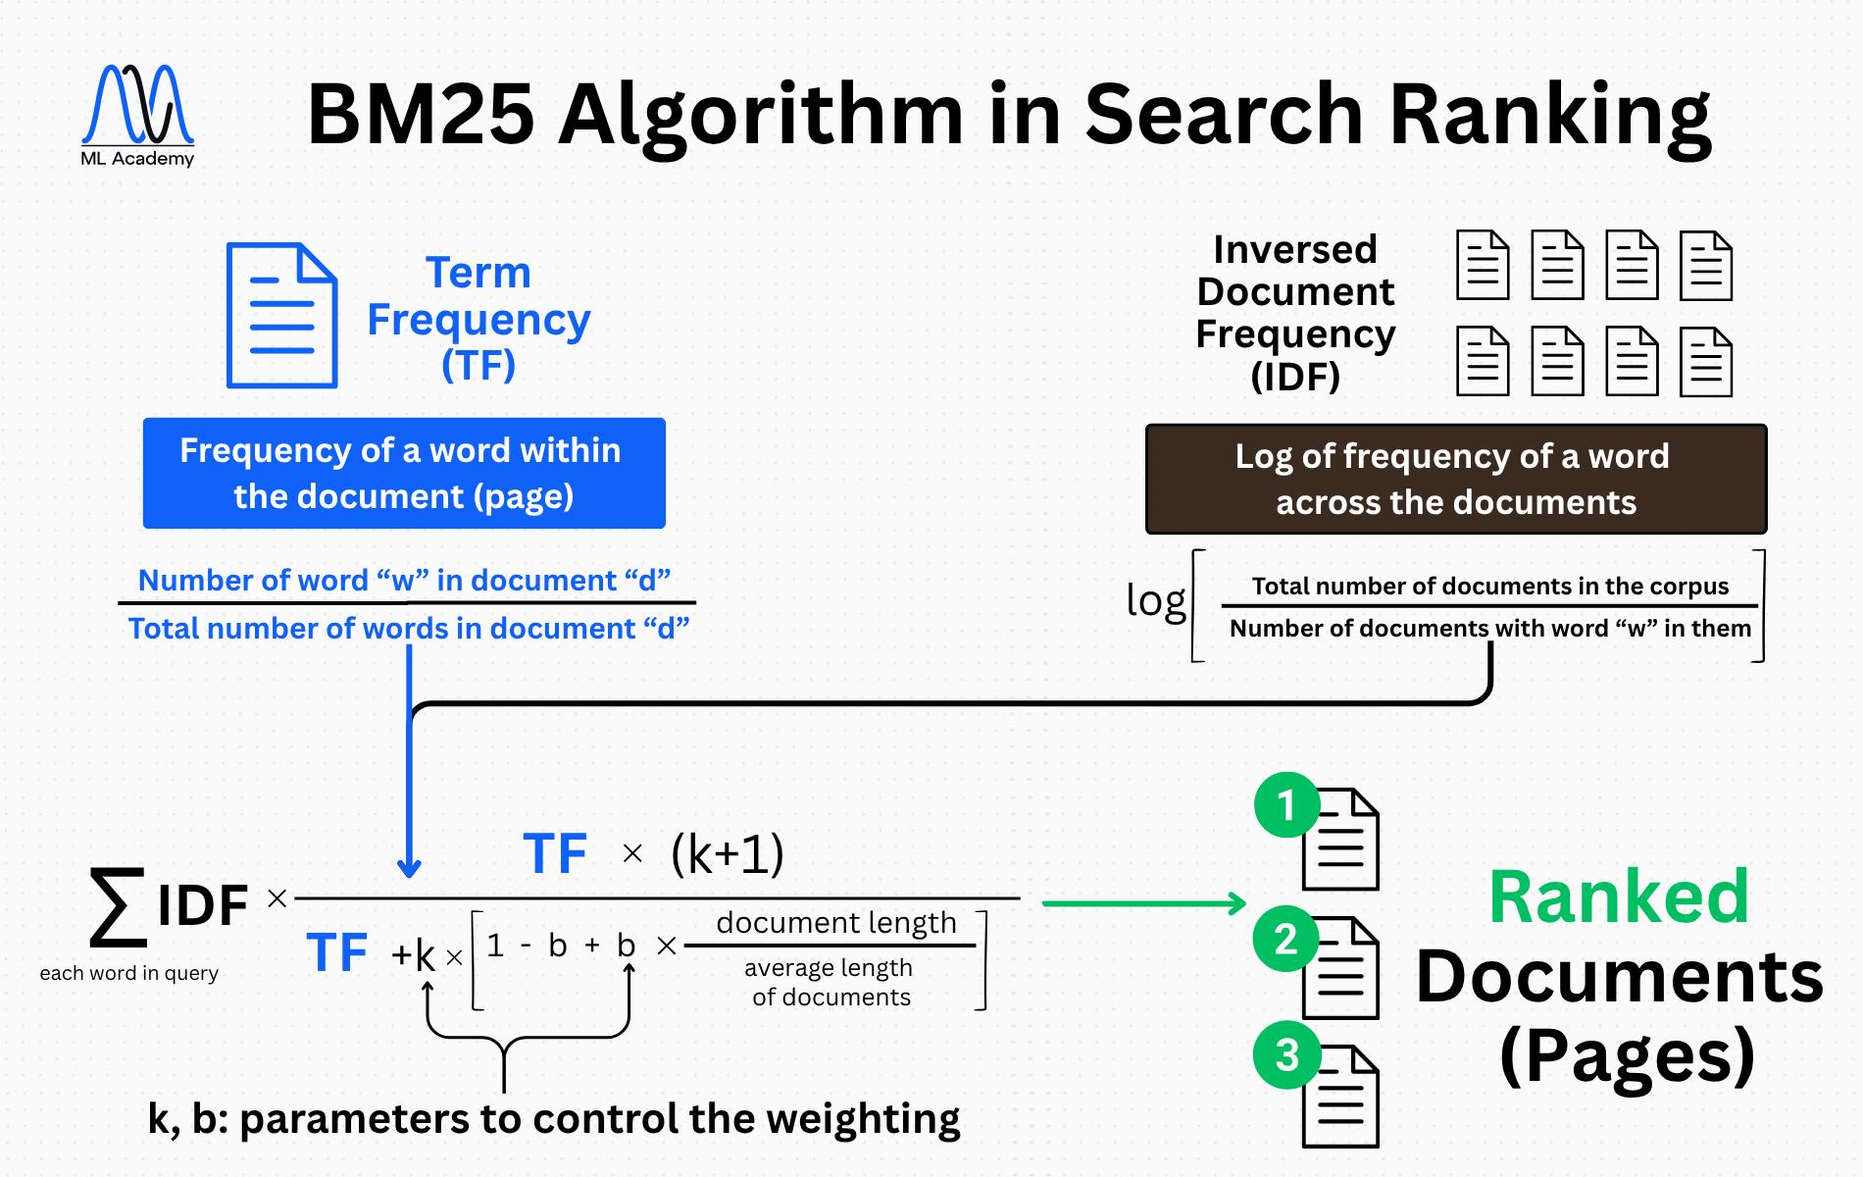

Slide 8



The Lexical Ceiling: Vocabulary Mismatch
Synonyms
washer
Paraphrasing
washing machine
urban
commuter
car
vehicle for city travel
Vocabulary mismatch
Lack of synonym awareness
Poor handling of paraphrases
Zero understanding of intent
Lexical Search is strong at exact terminology,but blind to underlying meanina.
Gemini Notebook

Slide 9
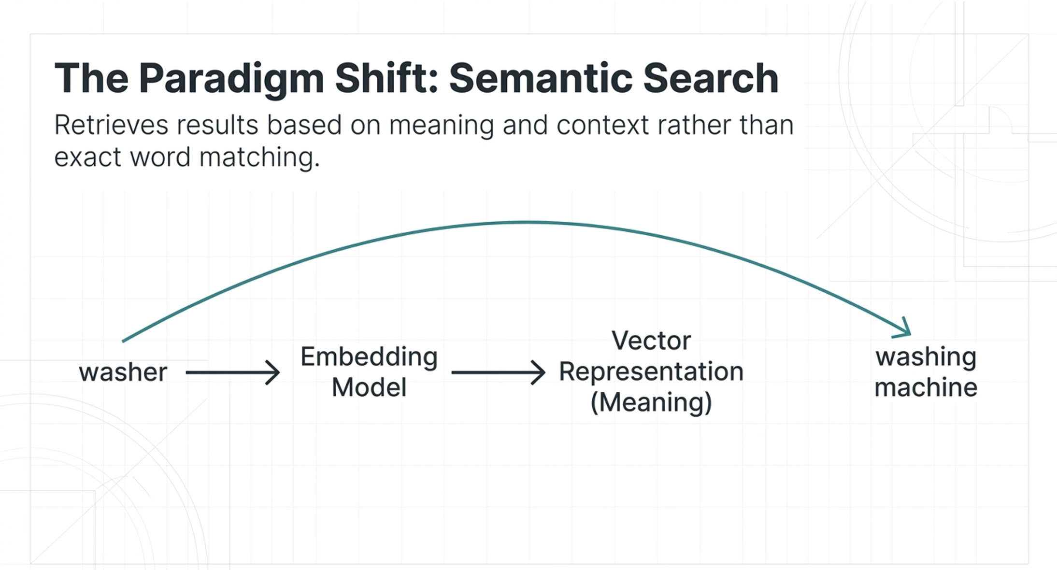

Slide 10

Mapping Meaning into Vector Space
Washing Machine
Cosine Similarity/
Dot Product
●Automatic Washer
Washing Machine
↓
Embedding Model
↓
[0.21,-0.43,0.87,0.12,…]
● Refrigerator

Slide 11
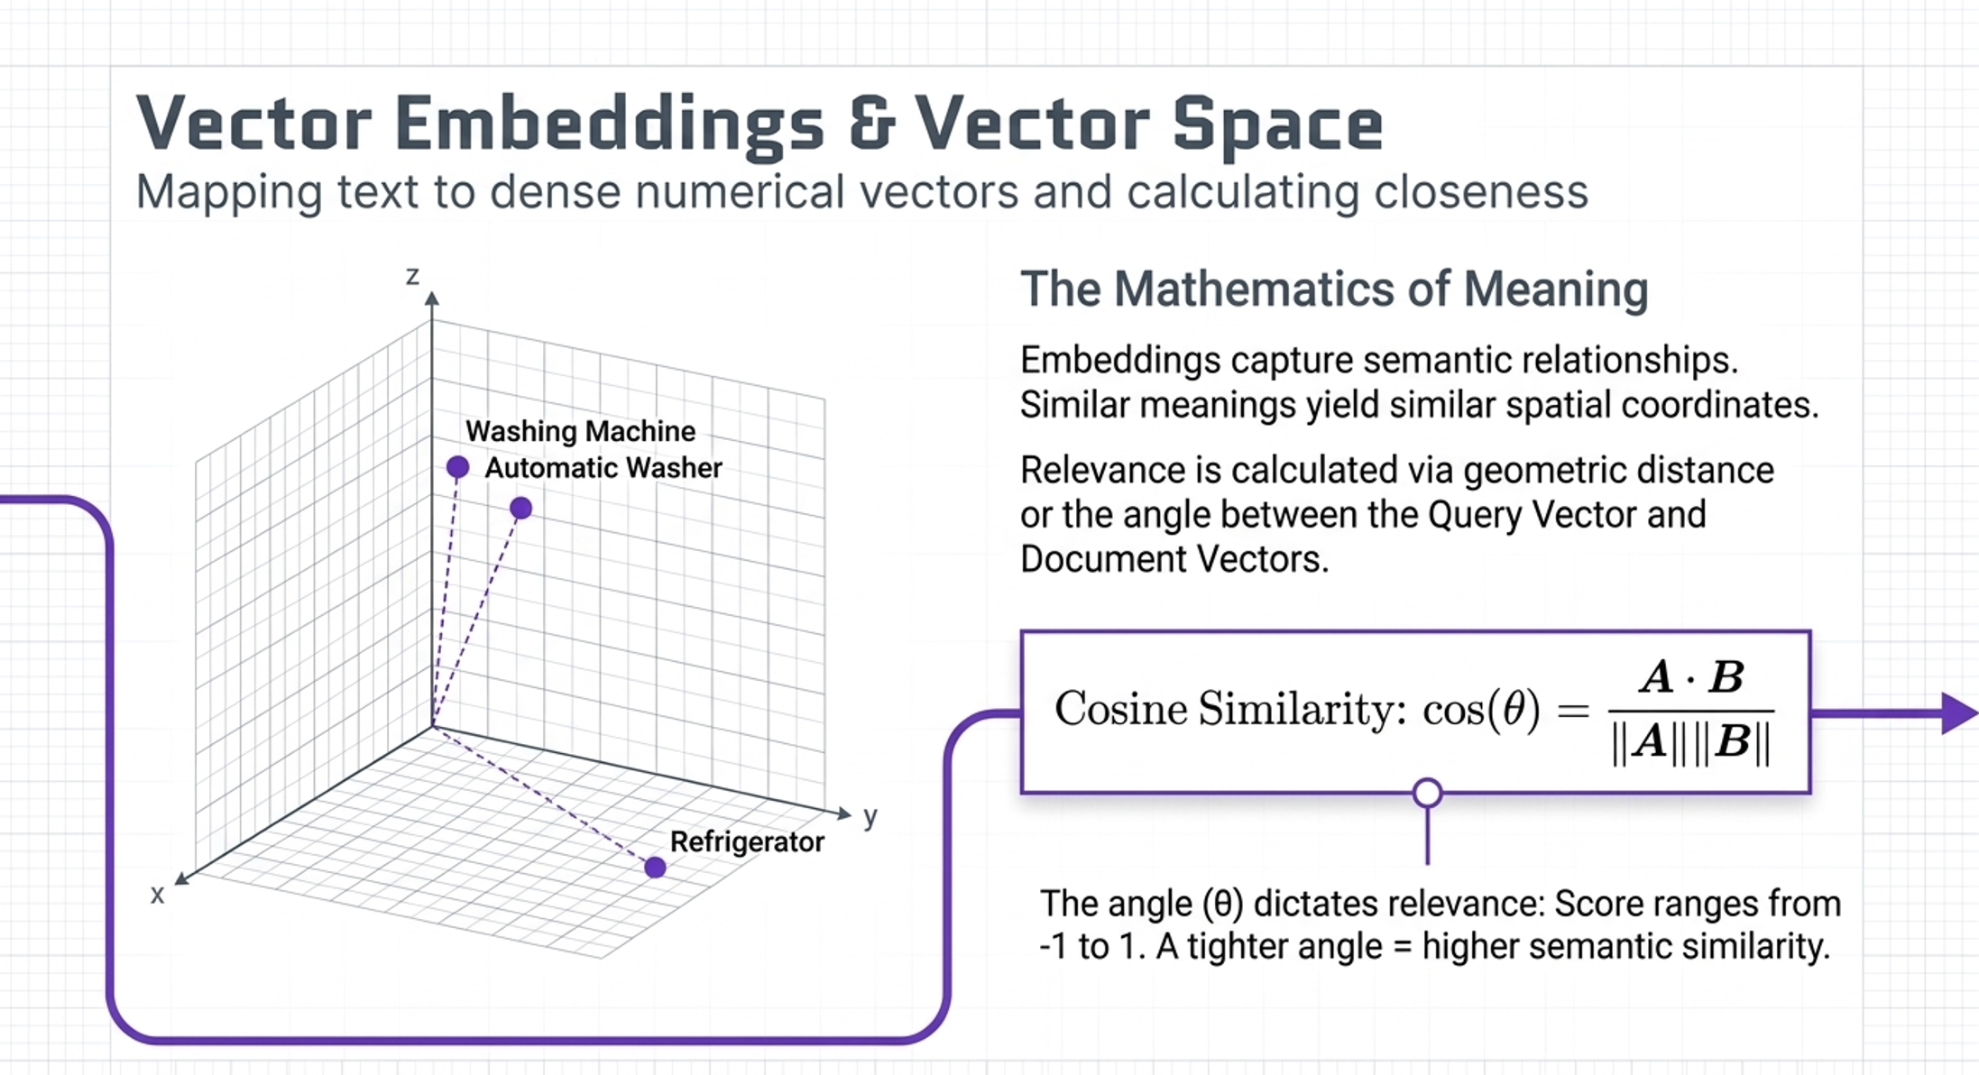

Slide 12
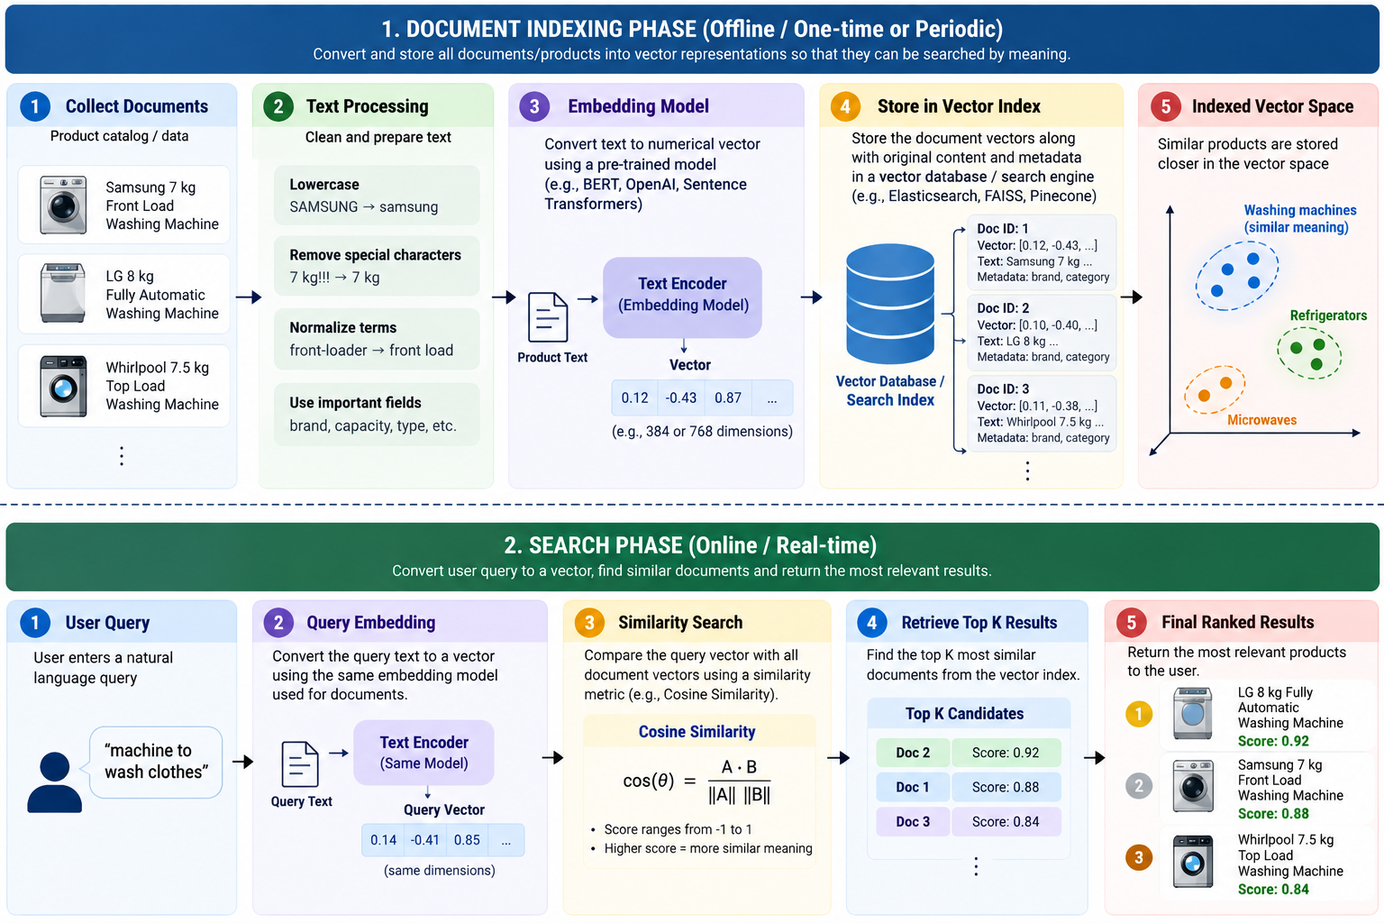

Slide 13
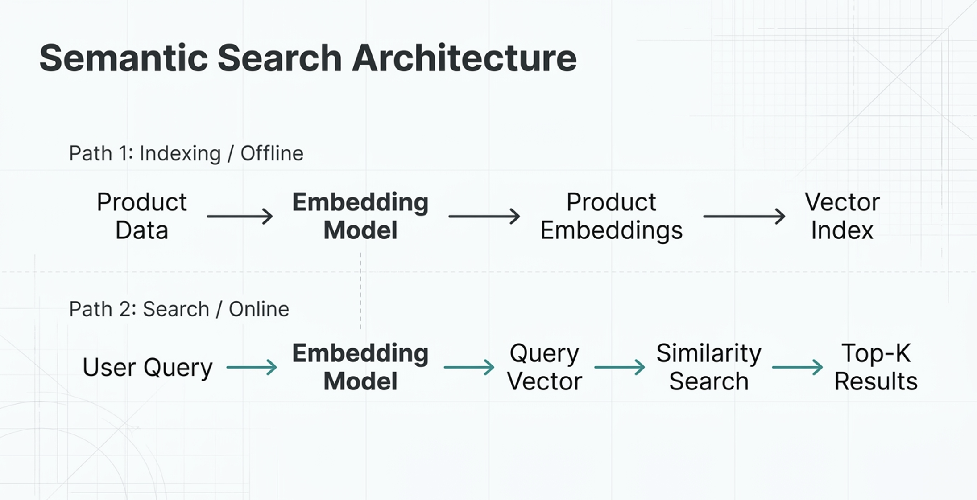

Slide 14

The New Friction:Semantic Blindspots
User Query:iPhone 16 Pro 256GB → Semantic search understands: Premium Apple smartphone, missing exact SKU,storage,and model precision.
 | Lexical | Semantic
Exact terms | Strong | Moderate
Exact model/SKU | Strong | Weaker
Meaning | Limited | Strong
Synonyms | Configurable
 |  | Strong
Paraphrases | Weak | Strong
Intent | Limited | Strong
Both approaches solve completely different parts of the search problem.

Slide 15


The Synthesis:Hybrid Search
Lexical Search
(Excellent exact matching, limited meaning)
Semantic Search
(Excellent meaning, weaker exact matching)
Hybrid Search
十
Combining exact keyword precision with deep semantic understanding.

Slide 16
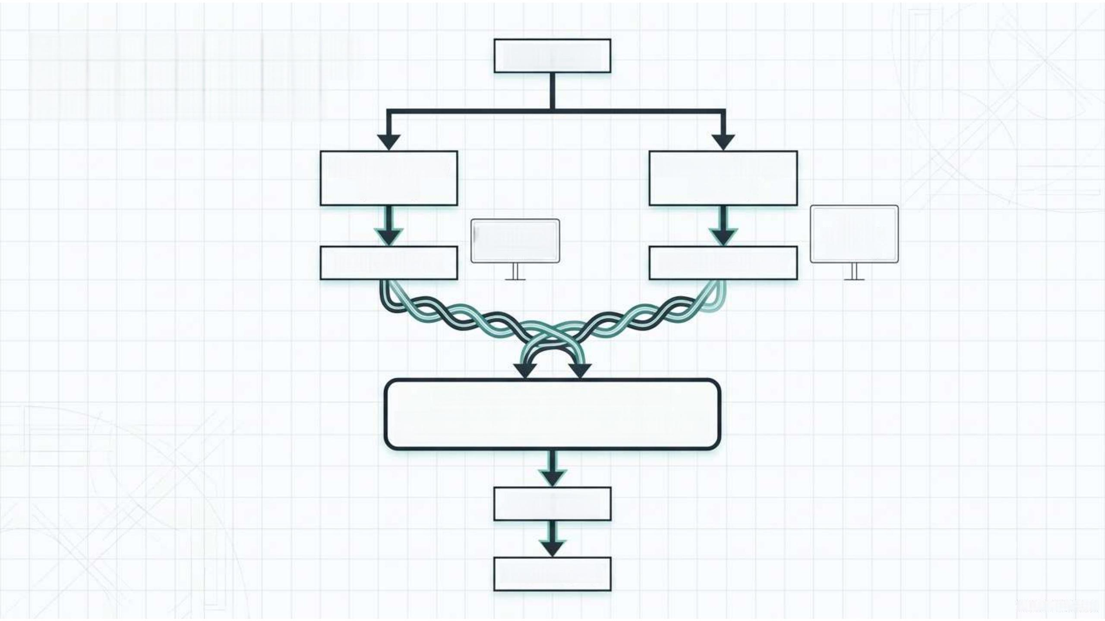
Parallel Retrieval
&Score Fusion
User Query
Lexical Search
(BM25)
Semantic Search
(Vector)
intent, synonyms, meaning
Semantic Score
exact words, SKUs,specs
Lexical Score
Score Normalisation &
Reciprocal Rank Fusion(RRF)
Re-ranking
Final Results

Slide 17
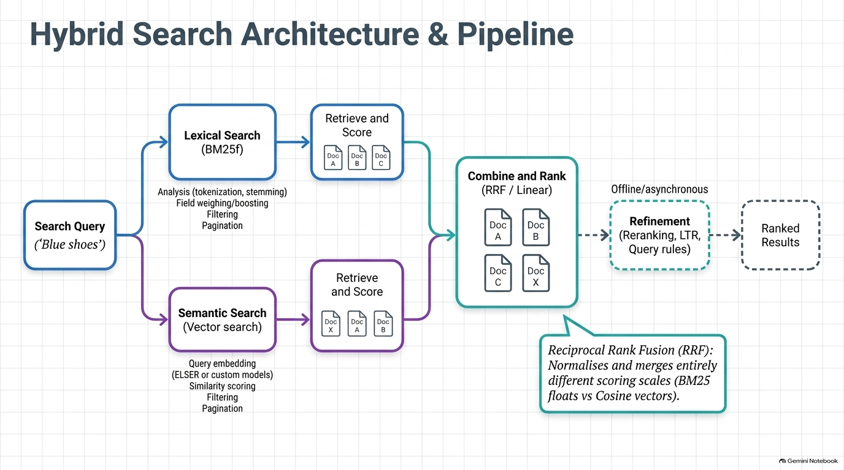

Slide 18
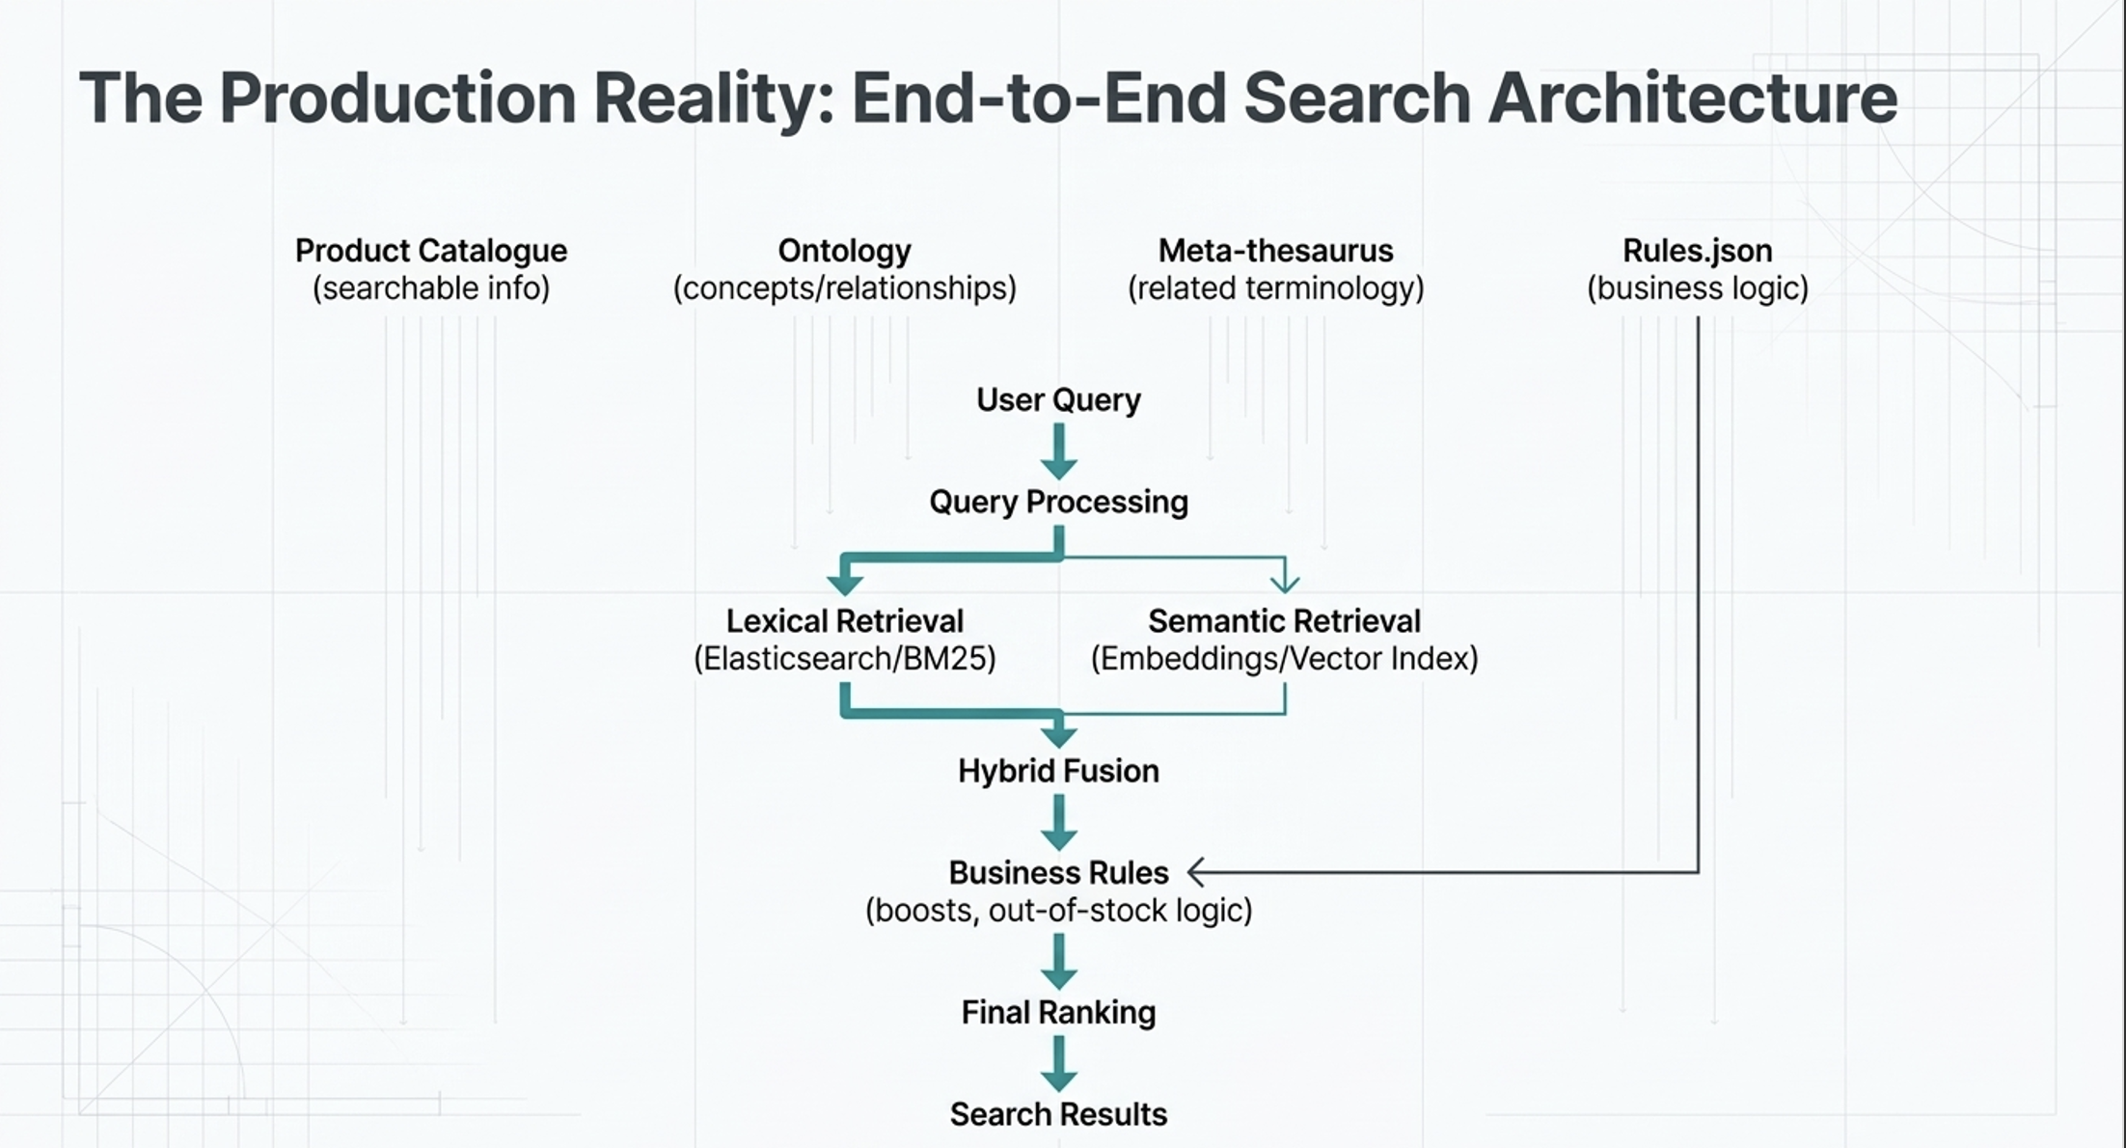

Slide 19

Proving the Value:Search Quality Metrics
Run BM25,Semantic, and Hybrid parallel
Compare Search Metrics
Determine Top Performer against Ground Truth
Precision@K
Of the top K results, how many are
relevant?
MRR(Mean
Reciprocal Rank)
How high is the first relevant result?
Recall@K
Of all relevant results,
how many were
retrieved?
NDCG@K
How well are highly
relevant results ranked
near the top?
We do not assume Hybrid is better.We measure it.

