Slide 1
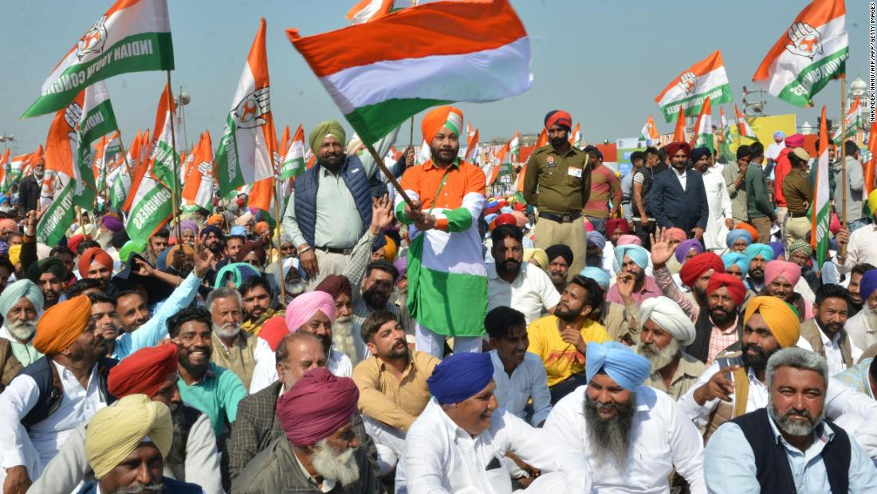

TWITTER DATA ANALYSIS OF INDIAN ELECTION 2019
Harshali Patil
MSc. In Computing (Data Analytics)
18212797

Slide 2
AGENDA
Introduction
Research question
Research objective
Literature Review
Data Understanding
Data Preparation
Research Methodology
Implementation
Results

Slide 3
INTRODUCTION
India has witnessed the General Election for 17th Lok Sabha in the month of May 2019.
Two main parties involved are BJP and Congress.
Twitter is a Microblogging site: used by different people to express their opinion on different topics.
Twitter has been widely used by researchers to assess public opinion.
India has seven most users of Twitter in the world.
34 Million active users

Slide 4
RESEARCH QUESTION
Can twitter serve as a predictor of public moods regarding Elections?
How accurately can microtext inform us about the electorate’s political sentiment?

Slide 5
RESEARCH OBJECTIVE
Conduct literature review to study recent scholarly works done in the field of analyzing public opinion using social media.
Need to do sentiment analysis as texts in form of messages and posts
Use Natural language processing with Deep neural networks .
Examine multi-mood classification associated with 2 prominent parties in the Indian Election 2019.

Slide 6
LITERATURE REVIEW
Text based work was mostly focused on metaphoric models, document management, evidentiality in text.
(Marti A. Hearst; 1992)
Earlier the sentiment analysis was focused on long text based document, Improvement in text-based social media give rise to research in sentiment analysis.
(Lee et al. ; 2008)
Use of microblogs from twitter to classify sentiment
(Bermingham et al. ; 2010)
Application of Sentiment analysis in different domains.
(Bollen et al. ; 2011) , (Andreas et al. ; 2013)

Slide 7
LITERATURE REVIEW
Sentiment analysis using Machine Learning approach.
(Wang et al. ; 2009), (Saif et al. ; 2012)
Sentiment analysis using Knowledge based approach.
(Gokulakrishnan et al. ; 2012), (Brooke et al. ; 2011)
Semi-supervised learning for sentiment analysis using hashtags and smileys.
(Go et al. ; 2009), (Saif et al. ; 2012)
Introduction of transfer learning from supervised data.
(Yosinski et al. ; 2014)
Introduction of unsupervised feature based learning.
LSTM (Hochreiter et al. ; 1997), ELMO (Peters et al. ; 2018)

Slide 8
DATA UNDERSTANDING
DATA SOURCE
Crawled tweets using API provided by twitter.
Hashtags used for search query are:
Hashtags
#BJP #Narendramodi #BJPwins
#Congress #RahulGandhi #Congresswins
#LoksabhaElection2019 #IndianElection2019

Slide 9
DATA UNDERSTANDING
DATA DESCRIPTION
Time Period: 1st Dec 2018 to 31st Mar 2019.
Total : 1,50,000 tweets
Duplicate tweets were dropped.
Tweets remained after processing : 65000

Slide 10
DATA PREPERATION
Remove Pattern user mentions (@), hashtags (#) , URL, retweets (“RT”)
Special Characters (e.g.: “” , / . ! [] * &) are removed.
Spell check was done to fix spelling mistakes.
Elongated words are brought into their normal form.
Data cleaning

Slide 11
DATA PREPERATION
Remove Stopwords
Tokenization
Lemmatization
Parts-of-speech
NORMALIZATION

Slide 12
RESEARCH METHODOLOGY
Evaluate
Results
Visualize
Results
Model Data
Get Data
Process Data
Explore Data
Get Data

Slide 13
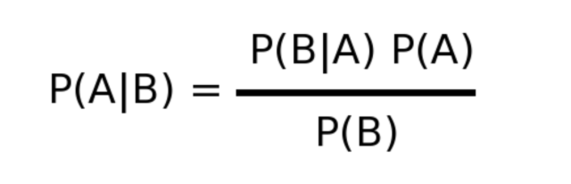
NAÏVE BAYES Classifier
Classification problem
Based on Bayes Theorem
Multinomial Bayes Theorem
Features/predictors - Frequency of the words present in the tweet.
Fast and Easy.
predictors needs to be independent of each other.

Slide 14
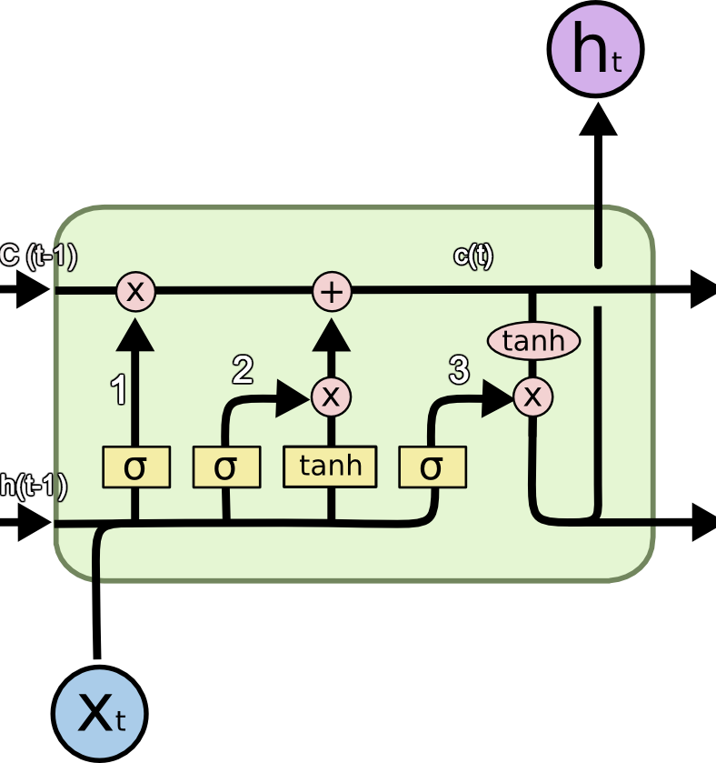
LSTM
Sequence of data is important.
Long short term memory is type of RNN
Problem in RNN:
Vanishing Gradient Exploding Gradient
Handles Long Term Temporal Dependencies.
Consist of cell, input gate, output gate, forget gate.

Slide 15
IMPLEMENTATION
Sentiment Analysis using LSTM
Twitter
1.6 M sentiment labelled tweets
Keras Tokenizer
Data Preparation and cleaning
Python Implementation of Twitter API
Database
Data Preparation and cleaning
Train & Evaluate LSTM model
Keras Tokenizer
Trained LSTM model
Database
Result and visualization

Slide 16

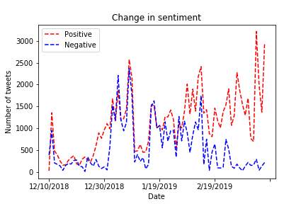
RESULTS
Sentiment Analysis using LSTM
Metrics | Score
Accuracy | 0.8143
F1 score | 0.801
Evaluation loss | 0.4101

Slide 17
IMPLEMENTATION
Sentiment Analysis using Naïve Bayes
Twitter
1.6 M sentiment labelled tweets
TfIdf Vectorizer
Data Preparation and cleaning
Python Implementation of Twitter API
Database
Data Preparation and cleaning
Train & Evaluate Naive Bayes model
TfIdf Vectorizer
Trained Naïve Bayes model
Database
Result and visualization

Slide 18
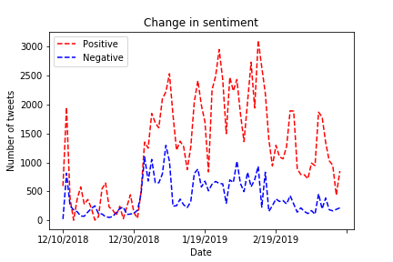
RESULTS
Sentiment Analysis using Naïve Bayes
Metrics | Score
Accuracy | 0.7534
F1 score | 0.7526

Slide 19
IMPLEMENTATION
Emotional Analysis
Twitter
40000 emotion labelled tweets
Keras tokenizer
Data Preparation and cleaning (ADYSN)
Python Implementation of Twitter API
Database
Data Preparation and cleaning
Train & Evaluate Naive Bayes model
Keras tokenizer
Trained Naïve Bayes model
Database
Result and visualization

Slide 20

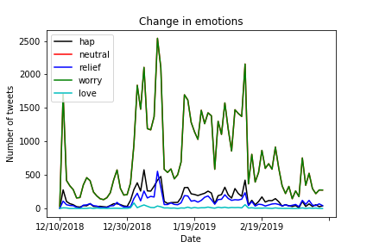
RESULTS
Emotional Analysis using LSTM
Metrics | Score
Accuracy | 0.623
F1 score | 0.604
Evaluation loss | 1.22

Slide 21
IMPLEMENTATION
Emotional Analysis
Twitter
Python Implementation of Twitter API
Haghtags as label (BJP, Congress)
Database
Keras Tokenizer
Data Preparation and cleaning
Train & Evaluate LSTM model
Keras tokenizer
Trained LSTM model
Database
Result and visualization

Slide 22
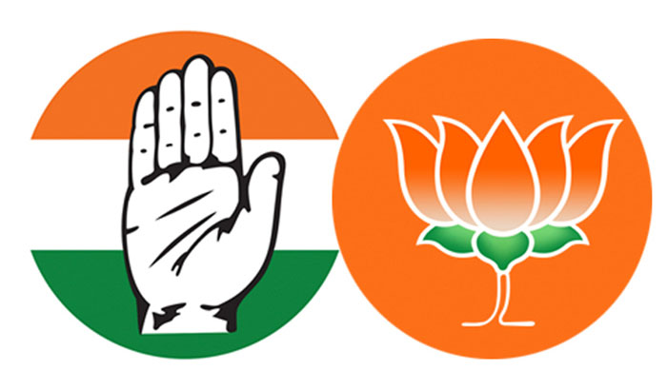
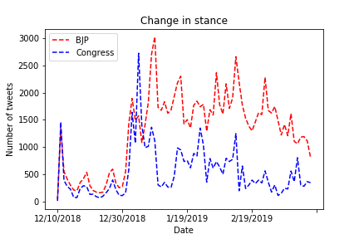
RESULTS
Stance Analysis using LSTM
Metrics | Score
Accuracy | 0.8892
F1 score | 0.872
Evaluation loss | 0.2596

Slide 23
CONCLUSION
This study attempts to observe the nature of political disclosure.
LSTM outperforms Naïve Bayes Classifier.
It was observed that the overall sentiment of tweets was positive and emotion was worry.
BJP is the dominating party in the Indian Election of 2019.

Slide 24
THANK YOU

