Slide 1
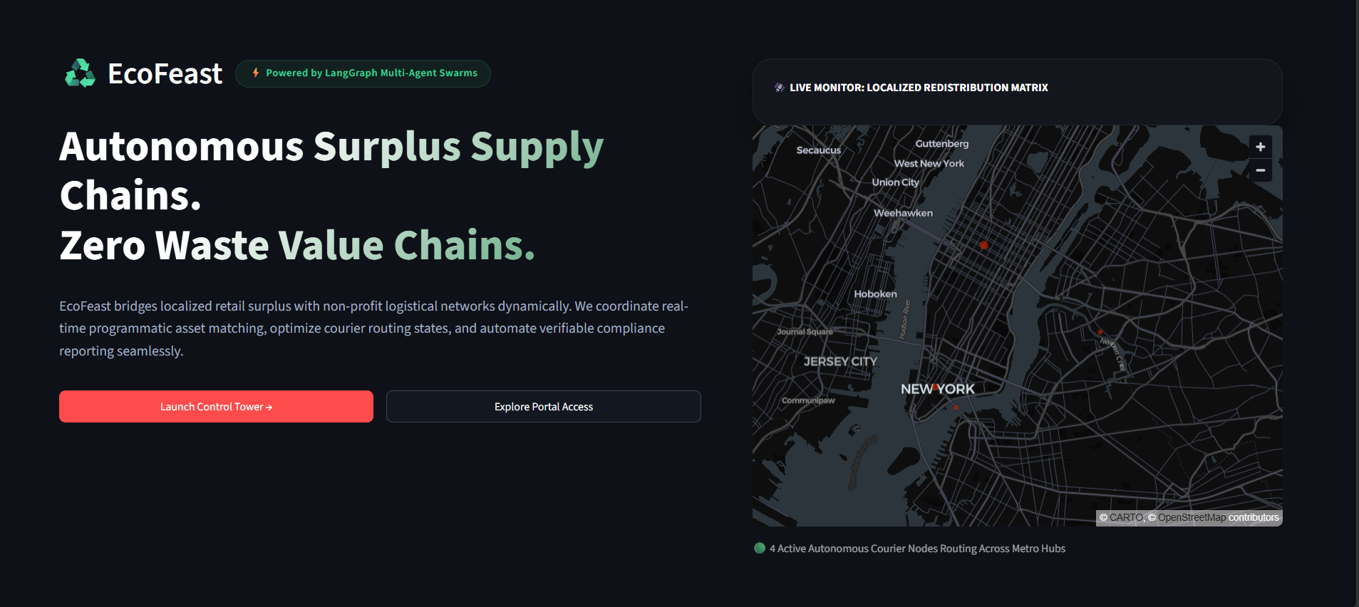
EcoFeast AI
Control Tower
An Agentic AI System for Autonomous Surplus Supply Chains and Zero Waste Value Chains
Applied AI · Agentic Systems · Sustainability
01

Slide 2
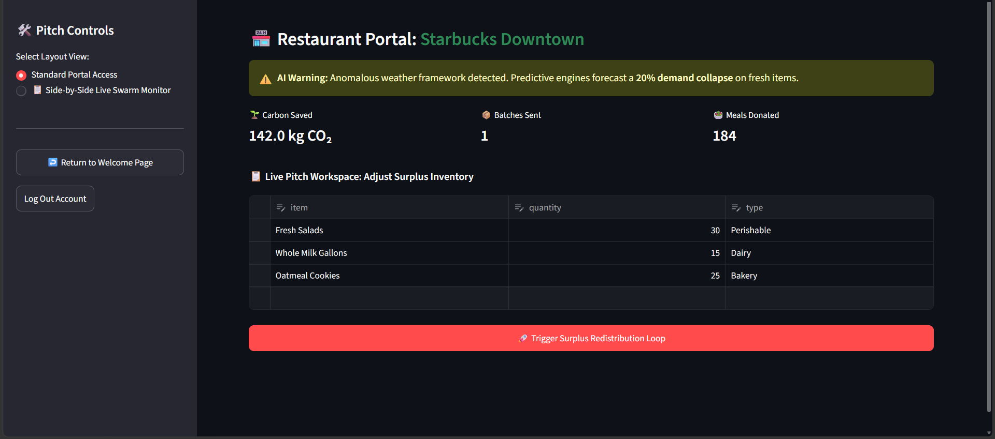



INTRODUCTION
Why an EcoFeast AI Control Tower
Managing retail food surplus and bridging the gap with community food security systems has changed little over time. Local businesses must manually identify excess inventory, contact non-profit networks one by one, and sort through unpredictable dispatch mechanics — a process that is time-consuming, uneven in logistical quality, and impossible to scale.
This concept note proposes EcoFeast — an agentic multi-agent swarm system that independently captures localized retail surplus, negotiates real-time logistical handoffs, and dynamically routes field courier fleets, while automating verifiable compliance reporting.
Live restaurant surplus dashboard
→
→
Surplus logged
Swarm matches
Impact reported
Restaurant registers excess inventory
Agents negotiate routing in real time
ESG + delivery data compiled live
02

Slide 3



THE PROBLEM
Why Existing Approaches Fall Short
Labor-intensive matching
Static demand forecasts
Manual supply-chain pairing between retail centers and shelters depends heavily on staff bandwidth and arbitrary schedules.
Inventory systems lack live environmental context, failing to predict localized demand shifts such as sudden weather disruptions.
Step-by-step micro-management
The widening resource gap
Donation setups require administrators to issue every pickup and verify every route manually, with no end-to-end delegation.
As operational waste across metro centers grows, coordination lag causes perishable assets to expire before reaching non-profits.
03

Slide 4
OBJECTIVES
What the Control Tower Should Achieve
1
Allow a commercial user to register localized food surplus and let a multi-agent swarm calculate redistribution paths with minimal human planning
2
Equip independent agent nodes with stateful planning and cross-organization negotiation via LangGraph execution loops
3
Ground every active contract in live logistical metadata — distance matrices, ETA predictions, and coordinate mapping
4
Maintain transparency by tracking live transit courier ledgers and warehouse intake schedules on a shared dashboard
5
Deliver verifiable ESG validation metrics — carbon aversion data and tax write-off estimates — alongside operational activity
04

Slide 5


PROPOSED APPROACH
A Plan → Act → Observe Swarm Loop
A large language model acts as the reasoning engine within a LangGraph state machine. At each transaction trigger, the swarm evaluates available surplus volumes, determines optimal destination capacity, and negotiates delivery parameters programmatically — updating its global state until an active inbound contract is compiled.
→
→
→
→
Register
Plan
Negotiate
Track
Report
Restaurant logs surplus inventory
Swarm identifies destination capacity
Agents route couriers & confirm handoff
Live ledgers monitor transit & intake
ESG + tax metrics compiled automatically
Reference implementation: food-distribution-swarm — Streamlit + LangGraph proof of concept
05

Slide 6
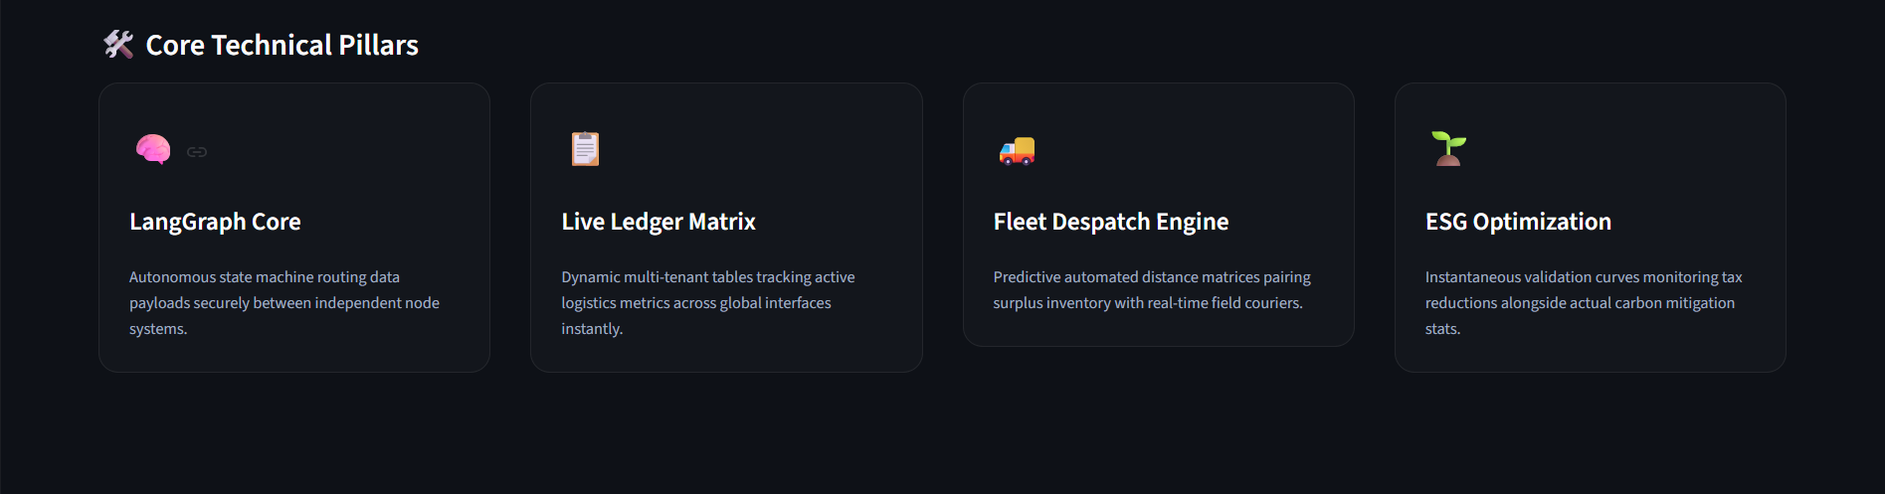
KEY FEATURES
Core Technical Pillars
The platform is built around four pillars that make autonomous redistribution possible end to end.
• Dual-tenant structural view for restaurants and non-profits
• Evidence-grounded routing from live coordinate & cargo data
• Configurable swarm depth balancing thoroughness vs. cost
06

Slide 7
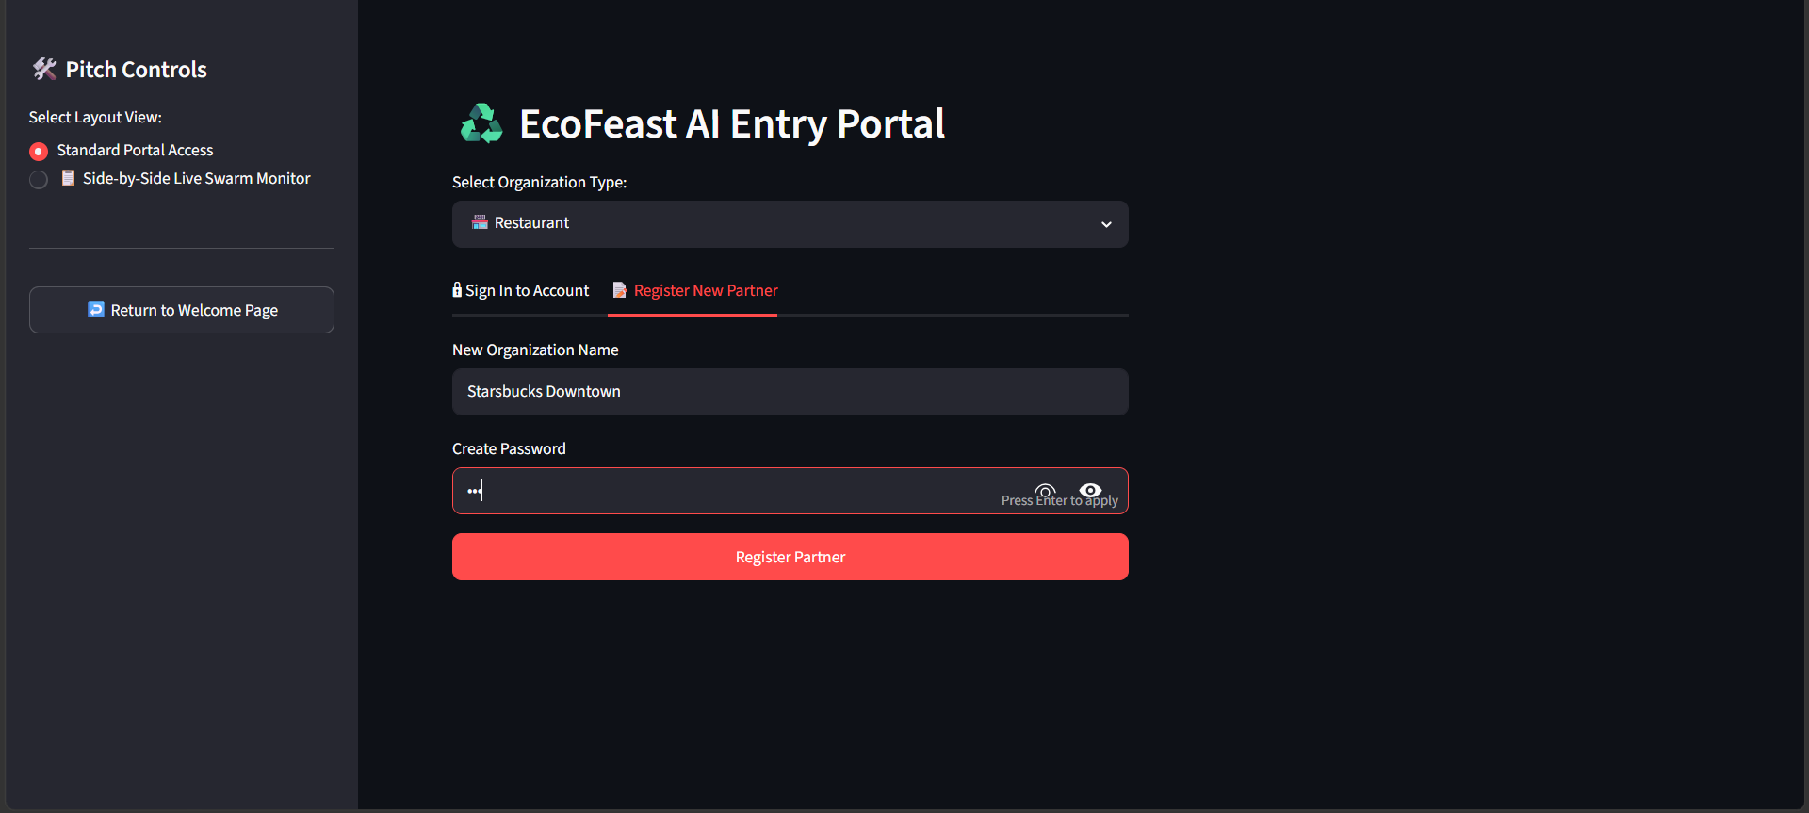
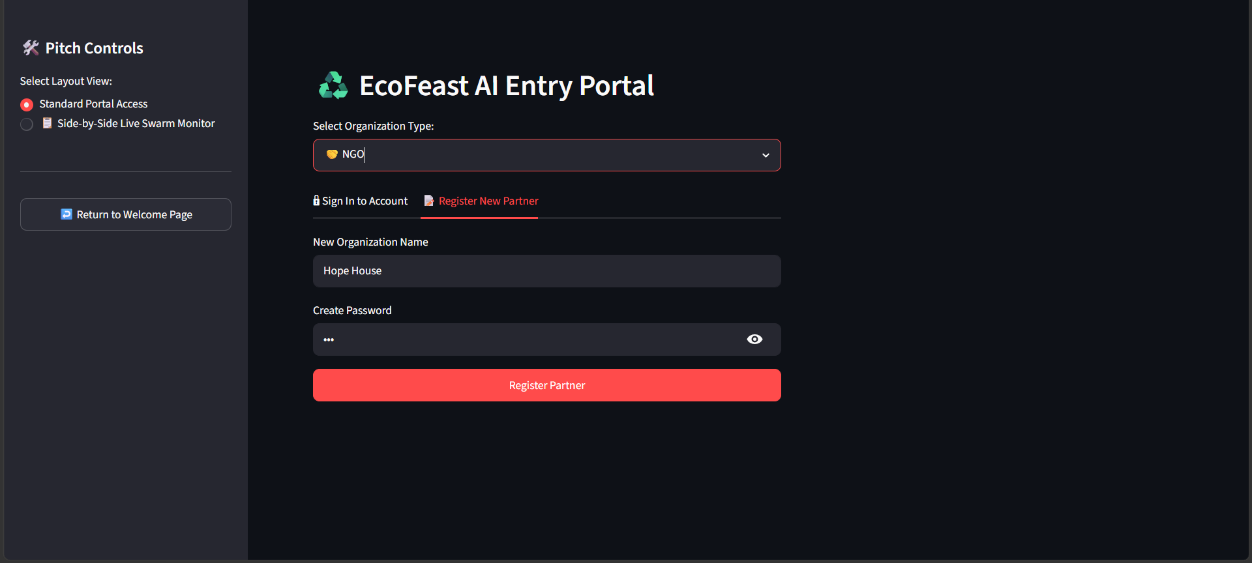
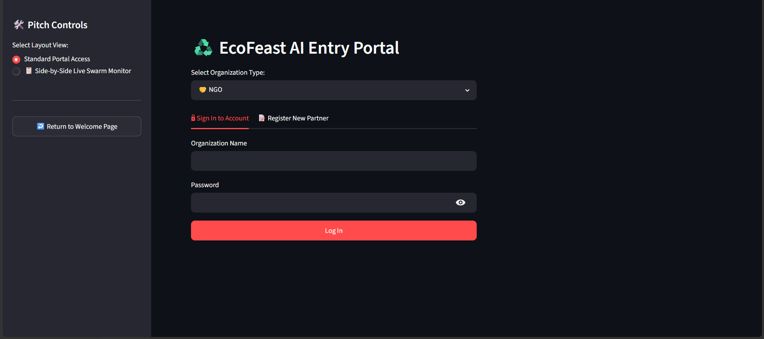
PRODUCT WALKTHROUGH
Onboarding — Restaurants & NGOs Register in Seconds
Restaurant partner registration
NGO partner registration
Secure sign-in for returning partners
07

Slide 8
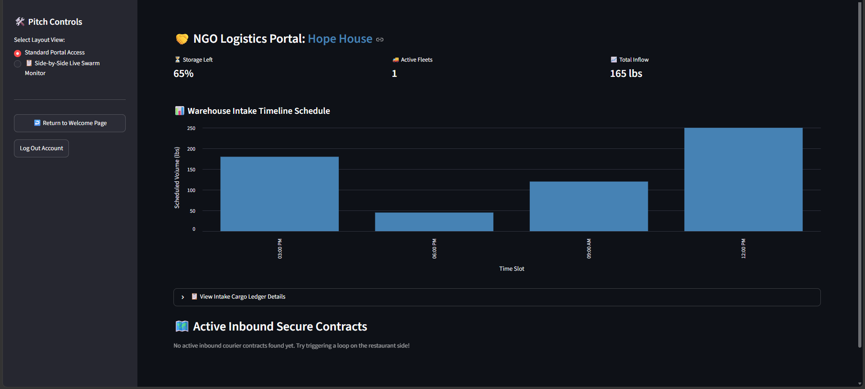
PRODUCT WALKTHROUGH
Live Portals — Restaurant & NGO Dashboards
Restaurant portal: surplus inventory & AI demand warnings
NGO logistics portal: intake timeline & active contracts
08

Slide 9
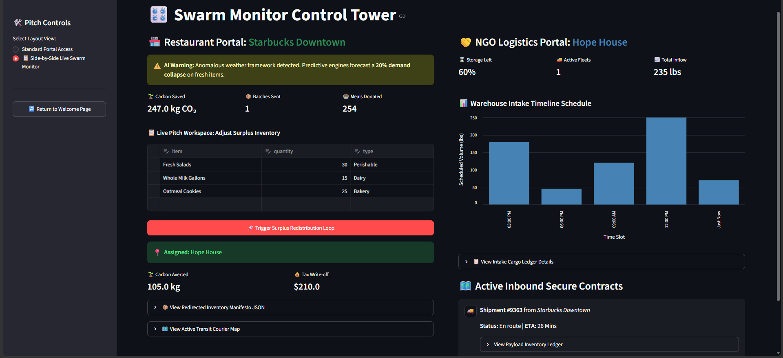
PRODUCT WALKTHROUGH
Swarm Monitor — Full Control Tower View
09
Side-by-side restaurant and NGO views with live ESG metrics, ledgers, and courier routing

Slide 10
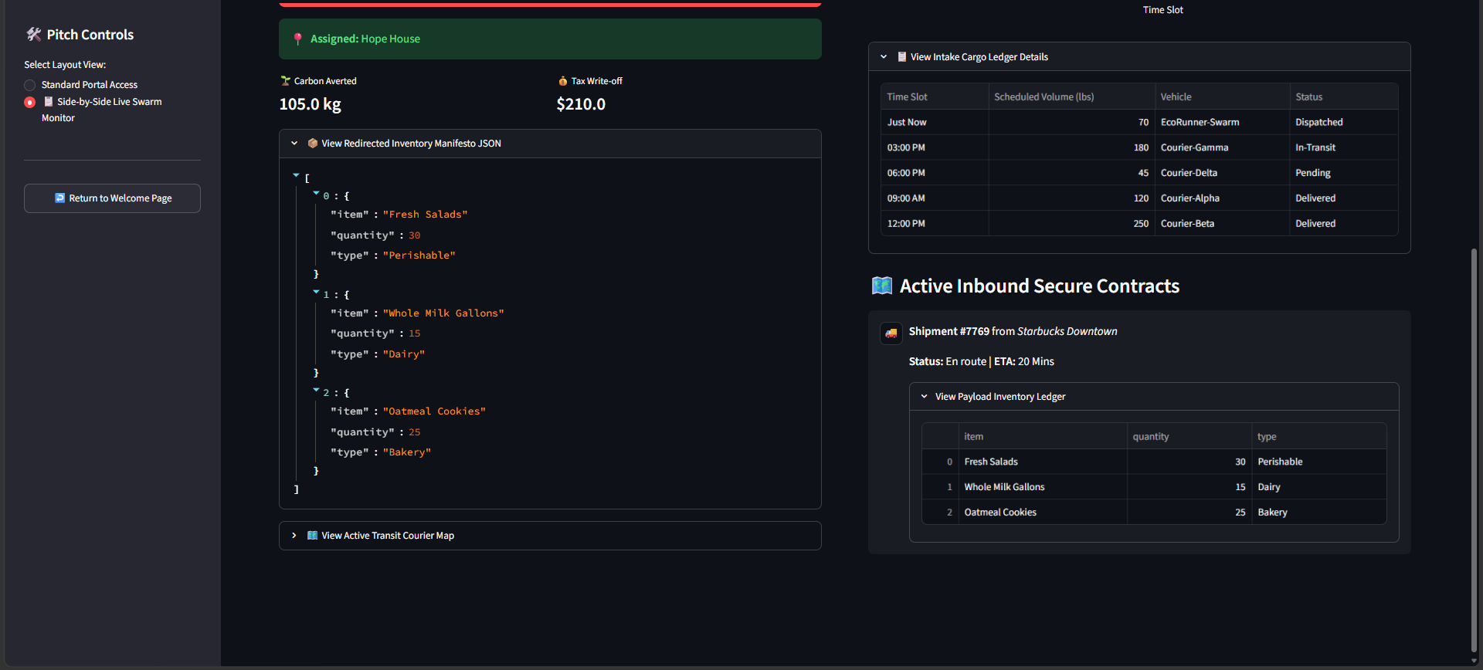
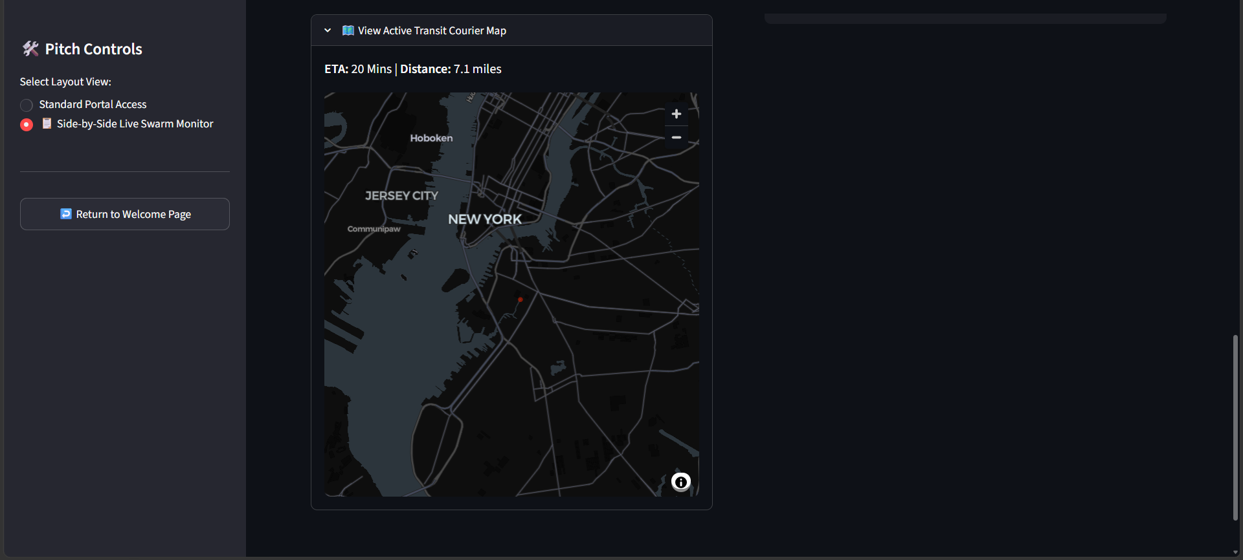
PRODUCT WALKTHROUGH
Verifiable Ledgers & Live Courier Tracking
Inventory manifest & active inbound contracts (JSON ledger)
Live transit courier map with ETA & distance
10

Slide 11



WHO BENEFITS
Target Users & Use Cases
Restaurants & Cafes
Non-Profits & Shelters
Corporate CSR Teams
Independent Couriers
Reduce daily operational waste and automate environmental compliance data
Organized intake timelines to prepare warehouse capacity for inbound volume
Auditable sustainability indices for year-end corporate reporting
Integrate with algorithmic dispatch for hyper-localized delivery tasks
11

Slide 12
EXPECTED IMPACT
Outcomes This Concept Delivers
Faster
Consistent
Transparent
Scalable
turnaround from surplus registration to confirmed redistribution vs. manual coordination
logistics tracking, independent of individual operator skill or bandwidth
auditable data builds corporate and NGO trust versus opaque manual reporting
foundation extendable from storefront hubs to dense metropolitan clusters
12

Slide 13
RISKS & CONSIDERATIONS
What to Plan For
Matching accuracy depends directly on the quality of data entered by individual restaurant operators
Complex traffic conditions and shifting physical parameters may create gaps between simulated ETAs and real courier times
Multi-agent reasoning iterations require ongoing API calls, so computation depth must balance thoroughness against cost
Sensitive or high-stakes redistribution decisions warrant additional human review safeguards
13

Slide 14

FUTURE SCOPE
Where This Concept Can Grow
Predictive deficit forecasting
Automated cold-chain tracking
Multi-carrier route stacking
Regulatory compliance integration
Domain-specific tuning
Warn storefronts of demand drops using external datasets before waste occurs
IoT integration to track ambient temperature of perishables during transit
Bundle fragmented drops from multiple vendors into one optimized courier run
Map localized waste tracking directly to official tax write-off platforms
Configurations tailored to grocery, hospitality, and institutional catering
14

Slide 15
CONCLUSION
Localized retail surplus, matched and routed autonomously — delivered as verifiable, ESG-ready redistribution contracts.
Project Access
GitHub Repository: https://github.com/HarshaliAlave/food-distribution-swarm
Live Demo: https://ecofeast.streamlit.app/
15

