Slide 1


PITCH DECK: AI-Powered Customer Support SystemGENAI_003_PROJECT_02

Slide 2


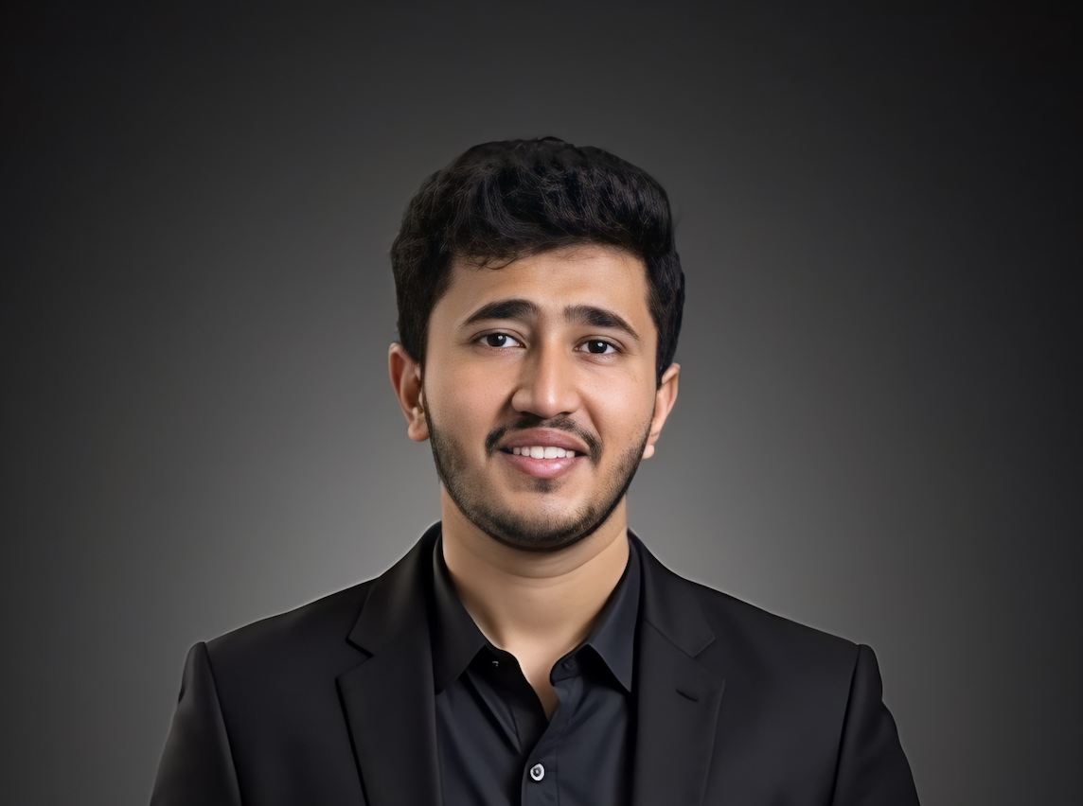

Meet the Team
Abhay Prabhakar
Data analyst
Harshal Kamble
LLM engineer
Vishnu Sankhyan
Full stack developer

Slide 3

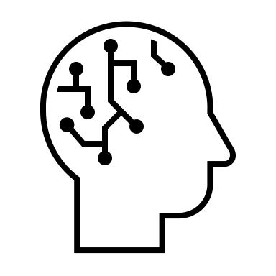
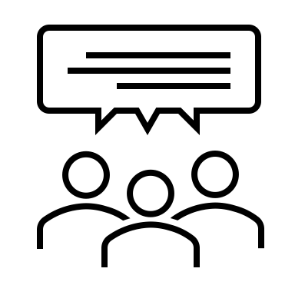

Why This Project Matters
Business
Human agent
Customer Exp
Most businesses face rising customer service costs.
24/7 multilingual support is difficult to scale with human agents.
Poor customer experience = high churn & reduced brand loyalty.
Our solution
Our Solution: An intelligent AI chatbot that answers common customer queries supports multiple languages, and escalates complex issues to human agents. ,
Target Users: E-commerce platforms, Educational institutions, Healthcare providers, Small-to-mid-size businesses

Slide 4
What We’re Building
Project Overview
We’re creating a modular, multilingual, AI-powered customer support system to:
Human Escalation Mechanism
Answer FAQs and common queries using OpenAI GPT
Escalate non-resolvable issues to human support
Automated Query Resolution
CHATBOT FEATURES
Continuous Improvement Analytics
Multilingual Support System
Analyze user interactions to continuously improve
Support global users through language detection and translation
Business Outcome: Improved customer satisfaction & reduced operational costs.

Slide 5
Technology Stack
Component | Tools / Libraries
LLM Backend | OpenAI GPT-4 via API
Frontend | Streamlit or React (for chatbot UI)
Backend API | Python with Flask or FastAPI
Multilingual | Google Translate API / DeepL
Conversation Logs | SQLite / Firebase / MongoDB
Escalation | Slack Webhooks / Email Integration
Optional Add-ons | ChromaDB + LangChain for RAG support

Slide 6
Project Milestones
March 31
April 5
April 15
April 22
May 1
May 6
Team formed, repo created, project defined
Basic chatbot built with 5–10 intents
Escalation logic + multilingual translation added
Logging & analytics module implemented
Frontend polish, testing, deploy first live version
Final presentation, pitch-ready demo & documentation completed
20%
40%
60%
100%

