Slide 1

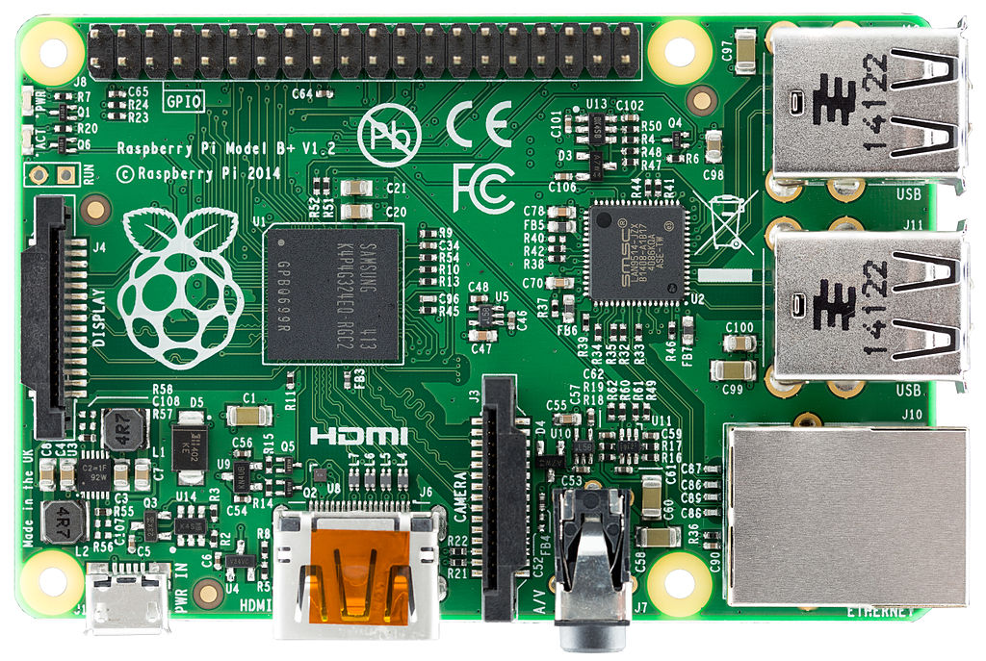
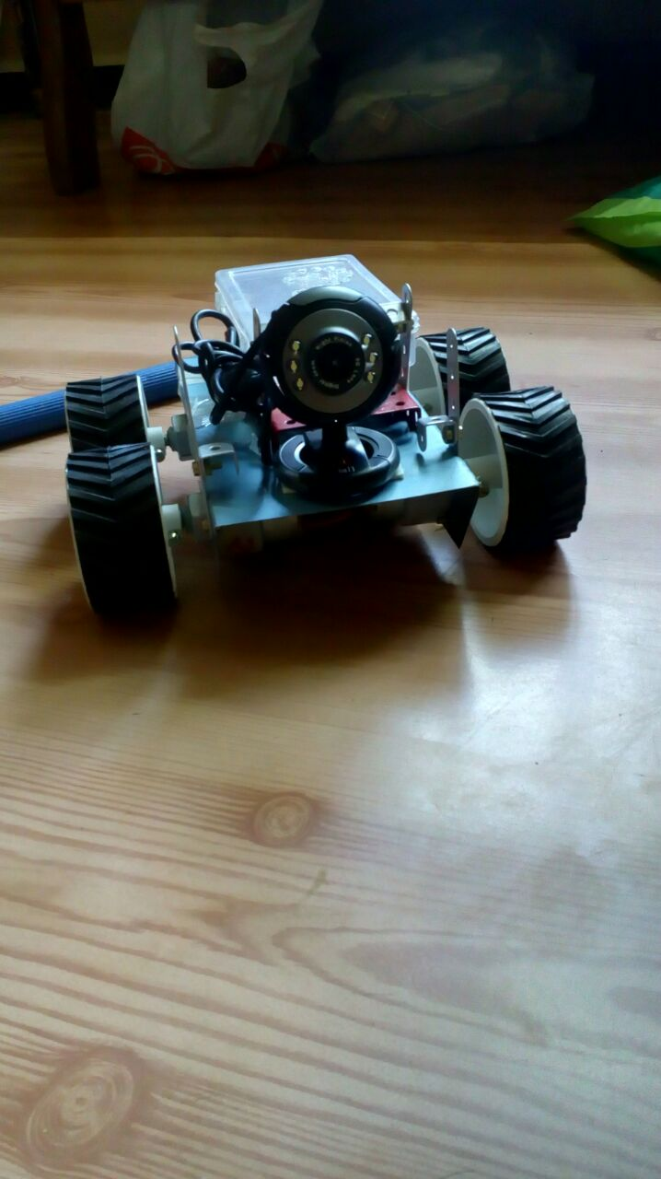
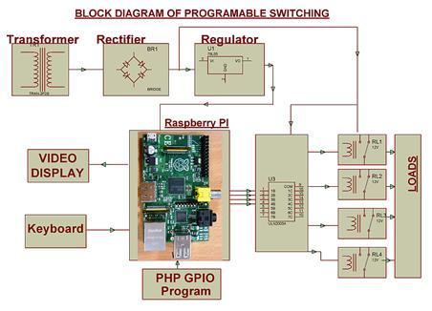
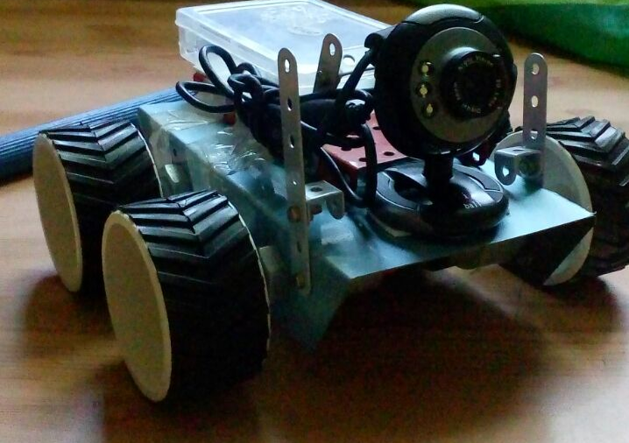
Robot Security : With Raspberry-Pi
*B.T.Jadhav, #M.D.Salunkhe, #H.S.Khedekar, #S.C.Ghare
*Rayat Institute of Research and Development, Satara
btj21875@gmail.com
#Department of BCS, YCIS, Satara
ABSTRACT
This project is based on IOT with Raspberry pi for security purposes. The history of the Raspberry Pi began in 2006. Its concept is based on Atmel ATmega644 which is designed for educational use. A Raspberry Pi is a credit card sized single board computer, which is developed in the United Kingdom by a foundation called Raspberry Pi. With Raspberry pi B+ and Internet of things we have created an robot for security purpose, with a simple idea we have made an Four wheel driven robot ,and mounted it with webcam and connected the webcam to Raspberry with motion software ,we can access the webcam through raspberry pi and live stream with remote SSH(Secure shell) .The purpose behind creating such is rather than send a soldier into a Warfield we can send this bot which could live stream video footage to any laptop and we could analysis situations and threats without losing a soldier, Quadcopter can give you aerial view but we can send this bot inside building. Increase in Internet and wireless networks this has made it easy to access this bot and control it through a remote location. And it costs less than we can imagine .
SOFT COMPUTING TECHNIQUES
CSI camera port for connecting the Raspberry Pi camera
DSI display port for connecting the Raspberry Pi touch screen display
Micro SD port for loading your operating system and storing data
Micro USB power source
Proposed System is for Security Purpose, using Robotics and Rasbin OS through Raspberry Pi for control of this robot. This technique is newly used for security purpose and cheaper than any high tech robotic solutions in our country.
This robotic technique is controlled by human itself so that he can analyze the situations where he cannot physically access them. It allows to learn the difficulties and threats present in current situation without any difficulties.
It itself will automatically save life and contribute in human security
OBJECTIVE:
Proposed System is for security purposes. It is an autonomous robot which will directly stream live feed through its web cam and provide us with live visuals which will help us in dangerous and tricky situation.
ADVANTAGES
Although Raspberry Pi is as small as the size of a credit card, it works as if a normal computer at a relatively low price.
It is possible to work as a low-cost server to handle light internal or web traffic.
Grouping a set of Raspberry Pi to work as a server is more cost-effective than a normal server.
Continuous improvement and ability to load normal Linux OS and there are many Linux Distributions exclusively for RPi and Windows 10 IoT Core is also possible to load in RPi
Result and Conclusion
INTRODUCTION
SYSTEM IMPLEMENTATION
The Raspberry Pi is a series of small single-board computers developed in the United Kingdom by the Raspberry Pi Foundation to promote the teaching of basic computer science in schools and in developing countries. The original model became far more popular than as robotics. Peripherals ( including keyboards, mice and cases) are not included with Raspberry Pi. Some accessories however have been included in several official and unofficial bundles.
The Raspberry Pi charitable foundation is working with partners to get software materials developed, as well as with the open source community. Computing at School.org.uk are writing a user guide and programming manual, the foundation is aware of books being planned and written around the Raspberry Pi, and enthusiasts have already started to produce some excellent tutorials including video. The foundation is also working with partners to use it as a teaching platform for other subjects, including design, art, languages and maths.
Broadcom BCM2837 Arm7 Quad Core Processor powered Single Board Computer running at 900MHz
1GB RAM
40pin extended GPIO
4 x USB 2 ports
4 pole Stereo output and Composite video port
Full size HDMI
The following software is installed on Raspberry Pi by default with Rasbian OS .
Browser - Basic but capable web browsing
Scratch - Simple programming language for young children based around drag and dropping actions
Python - Powerful programming language which is a good starting point for learning programming
Music player - Listen to you favourite music whilst you do a bit of programming
Operating System :- Linux on a bootable SD card or Rasbian OS.
This autonomous robot directly provides accurate visual threat, present around us and which gives us prior time to act on this threats correctly without losing any human life.
Proposed System Model
Acknowledgement
Department of B.C.S., Yashavantrao Chavan Institute of
Science,Satara and RIRD, Satara
Specifications
Block Diagram :
It’s a combination Raspberry Pi model b+ , IOT.
Webcam can be accessed from remote places,

