Slide 1
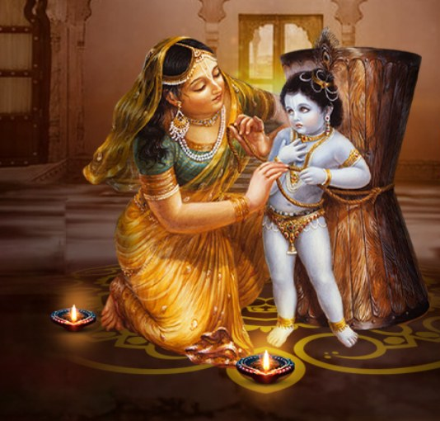
Śrī Dāmodarāṣṭakam
From the Padma Purāṇa – Hymn by Satyavrata Muni

Slide 2
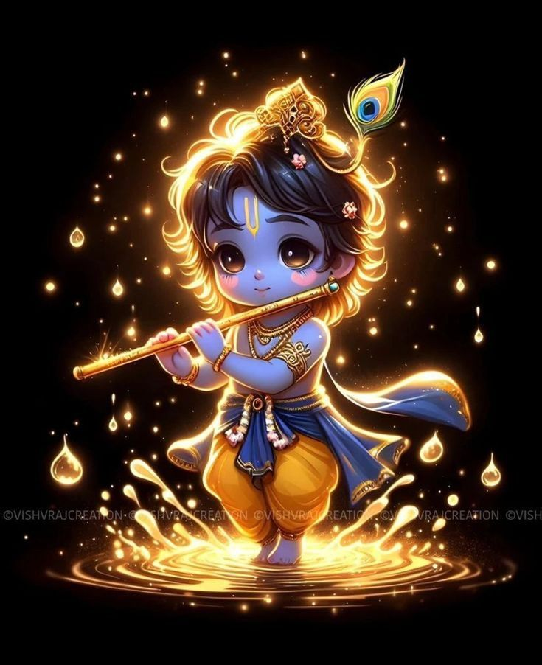
namāmīśvaram sac-cid-ānanda-rūpam lasat-kuṇḍalam gokule bhrājamanam yasodā-bhiyolūkhalād dhāvamānam parāmṛṣṭam atyantato drutya gopyā

Slide 3
rudantam muhur netra-yugmam mṛjantam karāmbhoja-yugmena sa-tanka-netram muhuḥ svāsa-kampa-trirekhāṅka-kaṇṭha-sthita-graivam dāmodaram bhakti-baddham

Slide 4
iti-dṛk sva-līlābhir ānanda-kuṇḍe sva-ghoṣaṁ nimajjantam ākhyāpayantam tadīyeśita-jñeṣu bhaktair jitatvam punah prematas taṁ śatāvṛtti vande

Slide 5
varam deva mokṣam na mokṣāvadhiṁ vā na cānyaṁ vṛṇe ‘haṁ vareśād apiha idaṁ te vapur nātha gopāla-bālaṁ sadā me manasy āvirāstām kim anyaiḥ

Slide 6
idaṁ te mukhāmbhojam atyanta-nīlair vṛtaṁ kuṇṭalaiḥ snigdha-raktaiś ca gopyā muhuś cumbitaṁ bimba-raktādharaṁ me manasy āvirāstām alaṁ lakṣa-lābhaiḥ

Slide 7
namo deva dāmodarānanta viṣṇo prasīda prabho duḥkha-jālābdhi-magnam kṛpā-dṛṣṭi-vṛṣṭy-ati-dīnam batānu-gṛhāṇeśa mām ajña-m edhy akṣi-dṛśyaḥ

Slide 8
kuverātmajau baddha-mūrtyaiva yadvat tvayā mocitau bhakti-bhajau kṛtau ca tathā prema-bhaktiṁ svakaṁ me prayaccha na mokṣe graho me ‘sti dāmodareha

Slide 9
namas te ‘stu dāmne sphurad-dīpti-dhāmne tvadīyodarayātha viśvasya dhāmne namo rādhikāyai tvadīya-priyāyai namo ‘nanta-līlāya devāya tubhyam

Slide 10
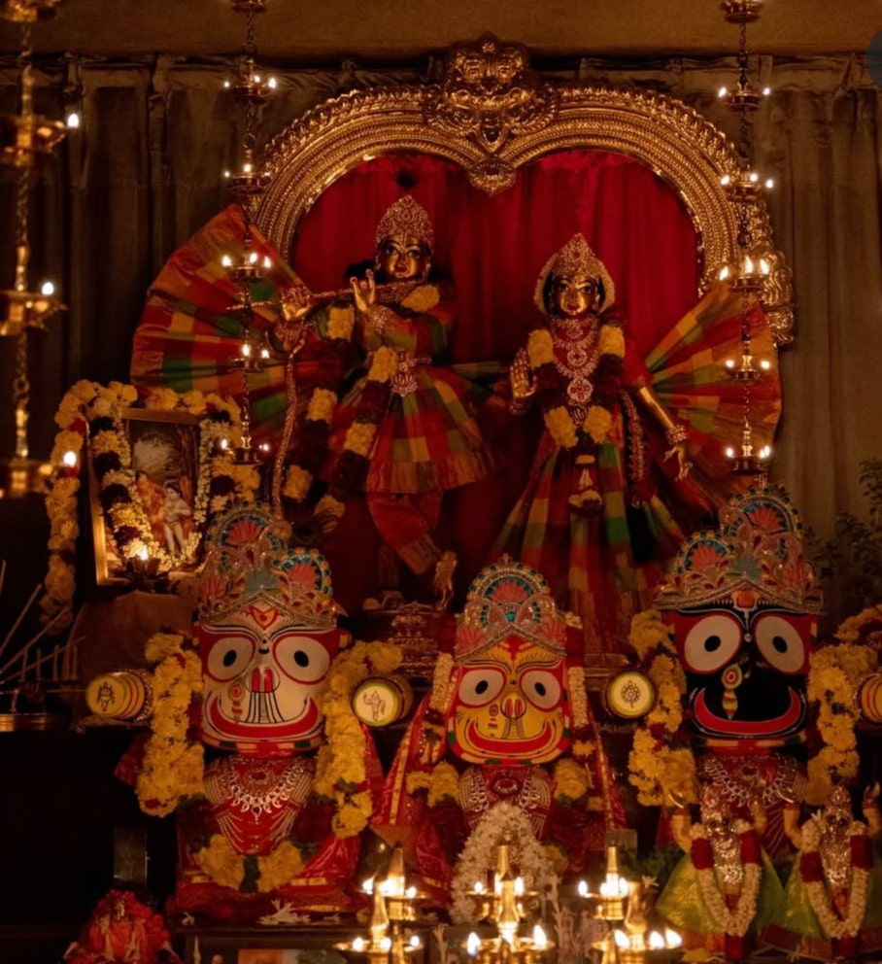
Hare Krishna Hare Krishna Krishna Krishna Hare Hare
Hare Rama Hare Rama Rama Rama Hare Hare

