Slide 1
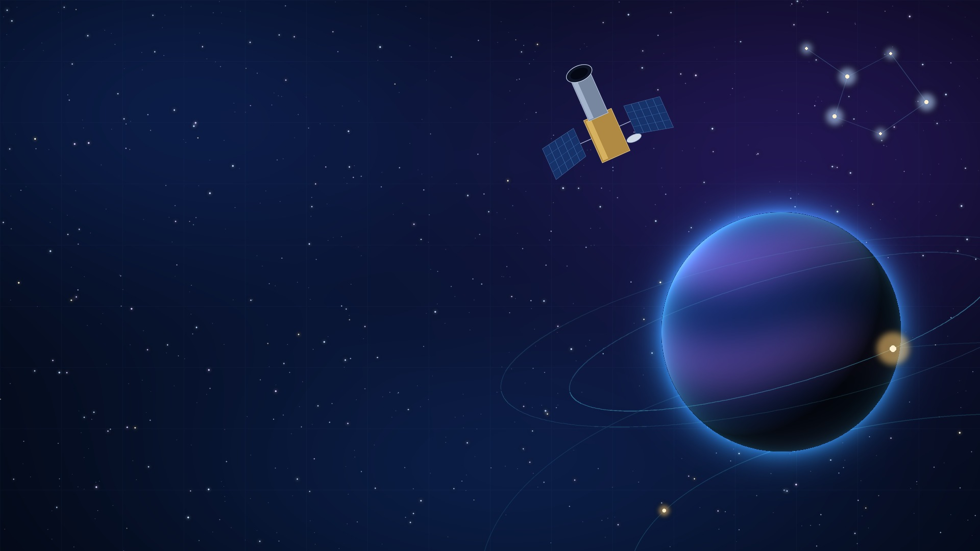
NASA KEPLER EXOPLANET SEARCH RESULTS · HACKATHON PROJECT
AI-Assisted Kepler
Exoplanet Analysis
Platform
Exploring Exoplanet Candidates with AI, Machine Learning & Data Visualization
TEAM Hack vok

Slide 2




01 | CONTEXT
The Problem & The Dataset
THE PROBLEM
THE DATASET
NASA’s Kepler mission gathered a huge amount of information about stars and possible planets beyond our Solar System.
NASA Kepler Exoplanet Search Results
Selected parameters: planet candidate, transit and signal, host star
Thousands of records
PLANET / CANDIDATE
Radius
Orbital period
Est. temperature
Many technical parameters per record
Hard to understand what each measurement means
TRANSIT & SIGNAL
Transit duration
Transit depth
Signal-to-noise
Manual searching is time-consuming
HOST STAR
Users know what they want, but not which columns to use
Temperature
Radius
Surface gravity
Brightness
Raw numerical data is difficult to interpret
Source: NASA Kepler Exoplanet Search Results — Kaggle

Slide 3







02 | SOLUTION
Our Solution
“An Interactive AI-Assisted Kepler Exoplanet Analysis Platform”
KEPLER ASSISTANT
Natural Language Question
Show me small planet candidates with an orbital period greater than 20 days.
AI Understanding
Filtering the Kepler dataset by radius and orbital period… showing matching candidates.
Dataset Search / Filtering
PLANET CANDIDATE
HOST STAR
Radius: 1.2 R⊕
Orbital Period: 25.4 days
Temperature: 280 K
Temperature: from dataset
Radius: from dataset
Surface Gravity: from dataset
Relevant Kepler Candidates
Give me the details of this candidate and its host star.
Human-Readable Insights
Natural-language interaction
Dataset search & filtering
Candidate information
Host-star information
Human-readable explanations

Slide 4





03 | ARCHITECTURE
System Workflow
01
02
03
04
05
NASA Kepler Dataset
User Question through Chatbot
Chatbot Understands Request
Dataset Search / Filtering
Planet + Host-Star Characteristics
10
09
08
07
06
Human-Readable Result
Visualizations
Transit / Event Analysis
Candidate Screening / Prioritization
ML Classification
Conceptual workflow of the proposed platform

Slide 5
04 | MACHINE LEARNING
Machine Learning & Candidate Screening
Kepler Features
Model Training
Logistic Regression / Random Forest
Classification
Candidate Screening
Priority Level
THE MODELS
CANDIDATE SCREENING
FEATURE IMPORTANCE
Logistic Regression
High Priority
koi_period
Highest follow-up priority
koi_prad
Random Forest
Medium Priority
Moderate follow-up priority
koi_depth
Learn patterns from previously classified Kepler objects
Use multiple parameters together
Classify candidates from learned patterns
Low Priority
koi_model_snr
Lower follow-up priority
koi_teq
Assigned using the implemented screening criteria.
Conceptual layout — not model output. Actual importances come from the trained model.
This screening prioritizes candidates for further investigation; it does not scientifically confirm whether a planet is real or false.

Slide 6



05 | ANALYSIS
Understanding Transit Events
TRANSIT LIGHT CURVE · CONCEPTUAL
Orbital period
Brightness change
Duration
Transit depth: how much the star dims
How long the transit lasted
Transit
depth
Relative brightness
Signal-to-noise: how clearly the dip stands out
Transit duration
Frequency
Signal strength
Time
How often it occurs (orbital period)
How strong the detected signal was
A planet crossing in front of its star briefly dims the star’s light
TRANSIT TIMING
VISUALIZATION CONCEPTS
Expected transit = reference transit time + n × orbital period
Transit light curve
Distribution plot
When timing and orbital-period information is available, the system can calculate an expected future transit time. This is a calculation based on available data, not a claim that ML is predicting an entirely new planetary event.
Correlation view
Feature importance
Model comparison
Screening results

Slide 7


06 | IMPACT
From Raw Data to Understandable Insights
BEFORE · RAW VALUES
AFTER · HUMAN-READABLE
koi_prad = 1.2
koi_period = 25.4
koi_teq = 280
“This candidate has a radius of approximately 1.2 Earth radii and completes an orbit around its host star approximately every 25.4 days. Its estimated equilibrium temperature is around 280 K.”
Astronomers & Exoplanet Researchers
Students & Researchers
Search
Analyze
Understand
Classify
Prioritize
Explore:
Exoplanet properties
Stellar properties
Transit events
Kepler candidates — without manually going through the entire dataset.
Data-analysis techniques
ML classification
We are developing an AI-assisted interactive platform that allows users to ask questions about the NASA Kepler dataset in natural language and receive relevant, understandable information about exoplanet candidates, their host stars, transit events, and ML-based candidate classification and screening.

