Slide 1
TECHGIG
APPATHON SEASON 2
Harsha Priya G
priyaharsha22@gmail.com

Slide 2
NUM
This is an application in which user can type the number.
The API displays the facts of numbers
API is being created is cool and uses an effective technical trivia of displaying more than one fact for the number the user entered

Slide 3
NUM
API provides facts for following categories:
1. Trivia
2. Math
3. Date
4. Year

Slide 4
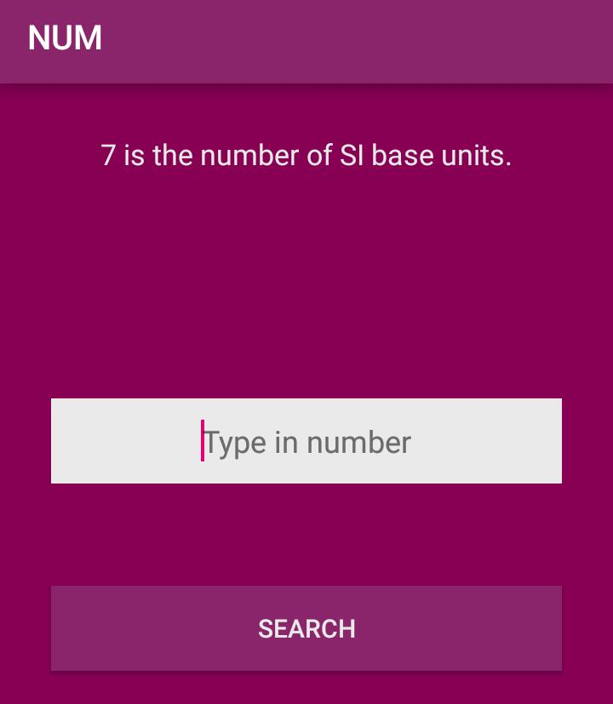
App view
On typing the number on Edit text
The random API generates the facts about the numbers

Slide 5
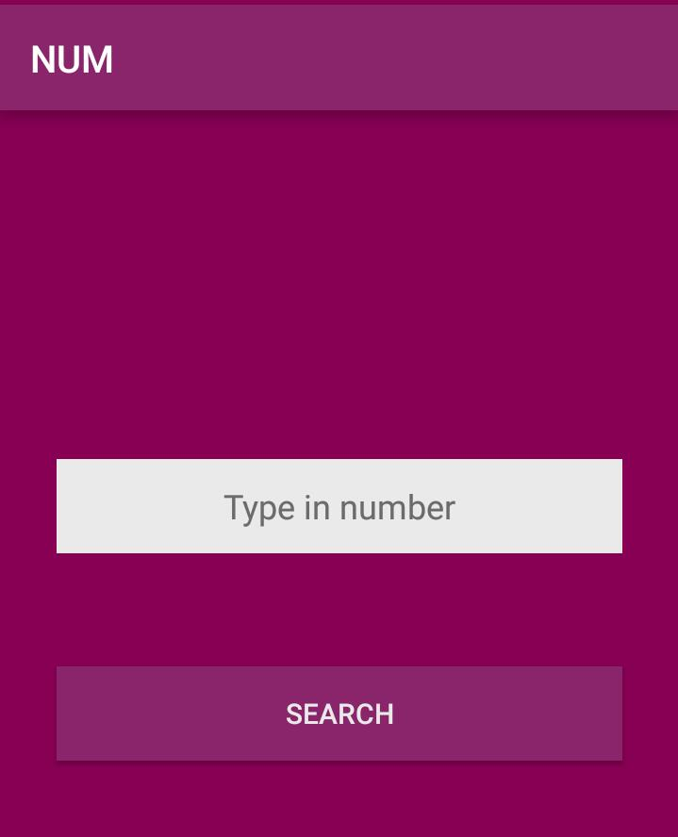
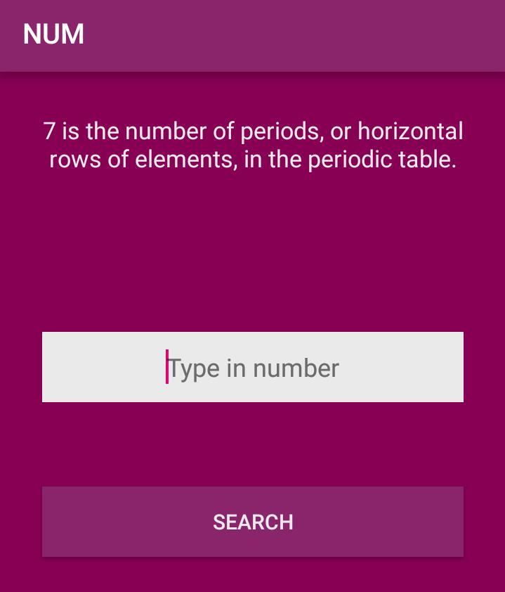

Slide 6
THANK YOU !!!!

