Slide 1
PredictFX: Machine Learning Approach to Exchange Rate Prediction
Team Members: Harshavardhan and Aditya Rajpurohit

Slide 2
Introduction
The USD/CAD exchange rate is a vital indicator for international trade and monetary policy.
Traditional methods like ARIMA or linear regression are often limited by their assumptions.
Deep learning allows us to learn complex patterns from macroeconomic data.
This project explores multiple architectures to predict exchange rates effectively.

Slide 3
Problem Statement
Goal: Forecast the USD/CAD exchange rate using historical macroeconomic data from the U.S. and Canada.
Challenges:
Time-series nature and multi-source data.
Missing or uneven time intervals.
High correlation between features.
Preventing data leakage during model testing.

Slide 4
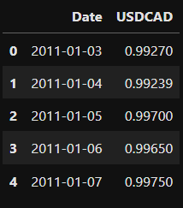
Data Source
Forex Data:
Source: Yahoo Finance
Frequency: Daily
Variable: USD/CAD close price
Macroeconomic Data:
Source: FRED (Federal Reserve Economic Data)
Frequency: Monthly
Countries: U.S. and Canada
Period: January 2011 – April 2025

Slide 5
Data Preprocessing
Forward-filled missing values to preserve monthly continuity
Scaled all features using MinMaxScaler
Aligned all series by monthly dates
Split dataset into 85% training and 15% test
Masked USD/CAD value during test to avoid leakage

Slide 6
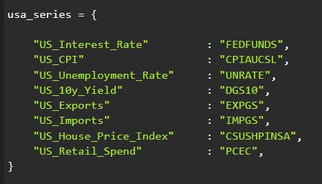
Macroeconomic Features Used
United States:
Interest Rate (FEDFUNDS)
CPI (CPIAUCSL)
Unemployment Rate (UNRATE)
10Y Bond Yield (DGS10)
Exports, Imports
House Price Index
Retail Spending

Slide 7
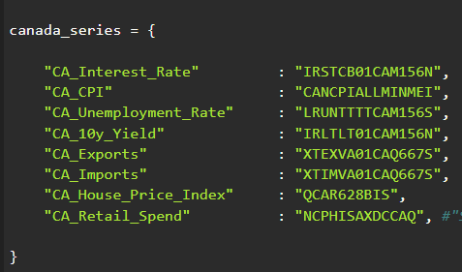
Macroeconomic Features Used
Canada:
Interest Rate
CPI
Unemployment Rate
10Y Bond Yield
Exports, Imports
House Price Index
Retail Spending

Slide 8
Modeling Approaches
Models Trained:
MLP – Multilayer Perceptron (baseline).
LSTM – Long Short-Term Memory for sequences.
TCN – Temporal Convolutional Network.
Seq2Seq – Encoder-decoder LSTM.
Attention-LSTM – With attention mechanism.
Input: Macroeconomic features (with USDCAD during training only).
Output: USD/CAD exchange rate prediction.

Slide 9
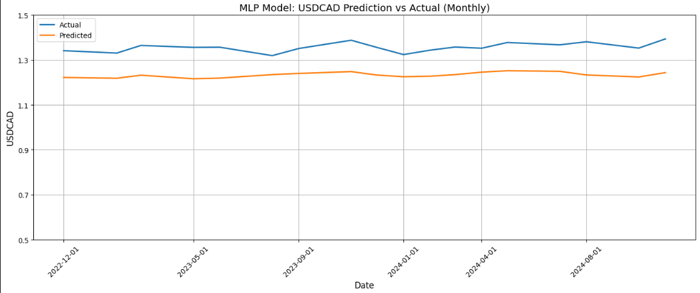
MLP Model
Dense neural network with fully connected layers.
No temporal structure (flat input).
Easy to train and fast to converge.
Used as a baseline to compare advanced models.
Limitations: Ignores time dependencies.

Slide 10
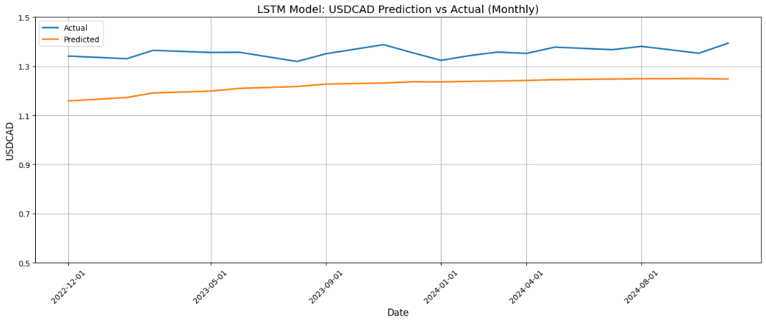
LSTM Model
Recurrent neural network (RNN) for sequential inputs.
Uses sliding windows of 3 months.
Captures economic cycles and delayed policy effects.
Suitable for time-series forecasting.
More complex than MLP, slower to train.

Slide 11
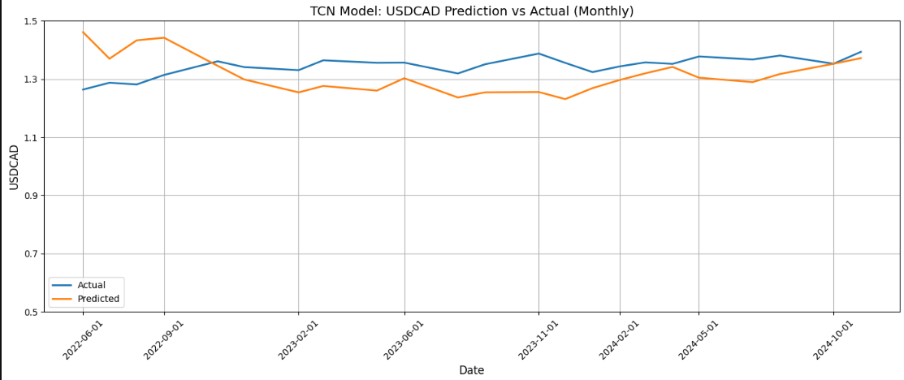
TCN Model
Temporal Convolutional Network.
Uses 1D dilated causal convolutions.
Efficient at learning long-range dependencies.
Outperforms RNNs on many sequence tasks.
Advantage: Better parallelism and scalability.

Slide 12
Seq2Seq & Attention
Seq2Seq Model:
Encoder processes input sequence.
Decoder predicts future sequence.
Useful for variable-length input/output.
Attention-LSTM:
Learns which time steps are most important.
Applies attention weights across time.
Improves learning and interpretability.
Best performing model in this project.

Slide 13
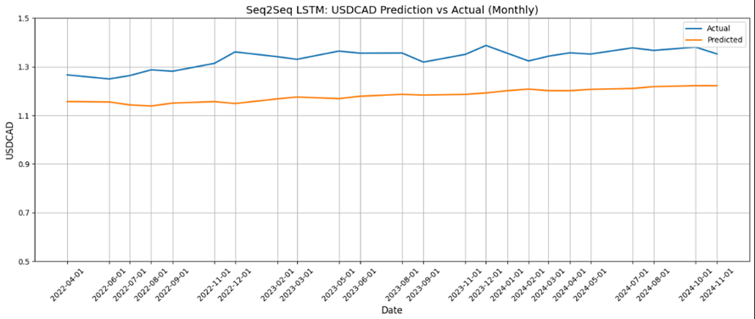

Slide 14
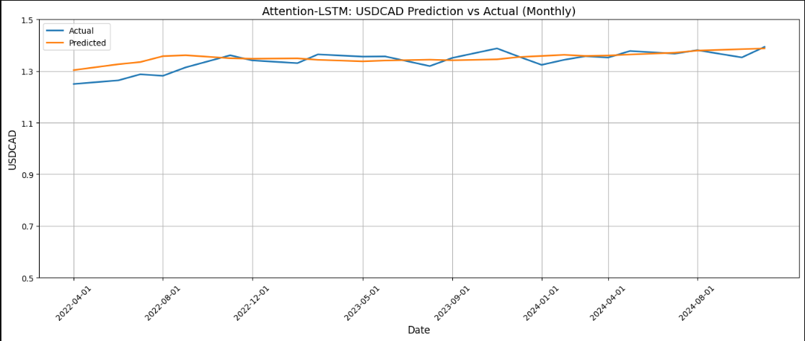

Slide 15
Forecast Visualizations
Each model generated monthly line plots:
Actual vs Predicted USD/CAD
Attention-LSTM produced the most visually accurate match.
Helps interpret how well models learn temporal trends.
Useful for economic forecasting visualization.

Slide 16
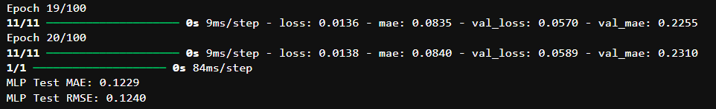
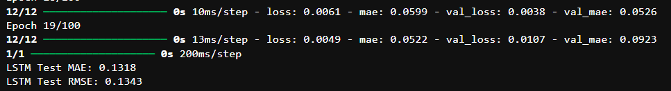
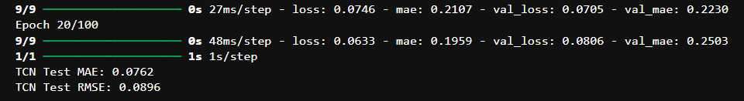
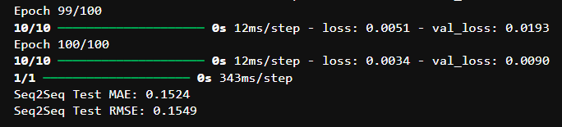


Slide 17
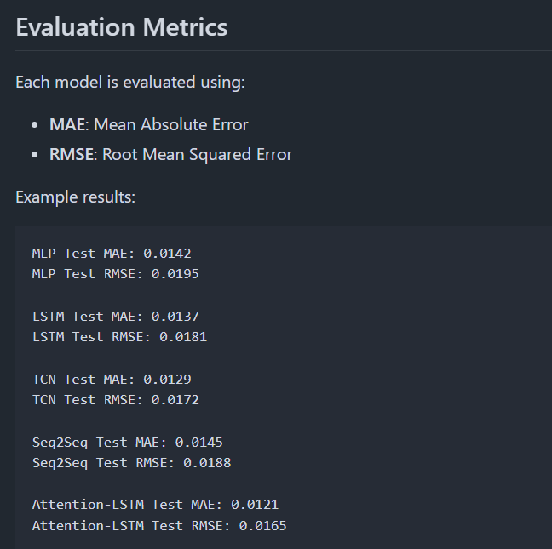

Slide 18
Conclusion & Q&A
Conclusion:
Deep learning models improve exchange rate prediction accuracy.
Attention-based models provide both performance and interpretability.
Macro data is a strong predictor of forex movement when processed well.
Next Steps:
Add lagged indicators and derived features.
Include financial sentiment or geopolitical variables.
Deploy a Streamlit dashboard for live predictions.
Try advanced architectures: TabNet, Transformers.

Slide 19


