Slide 1
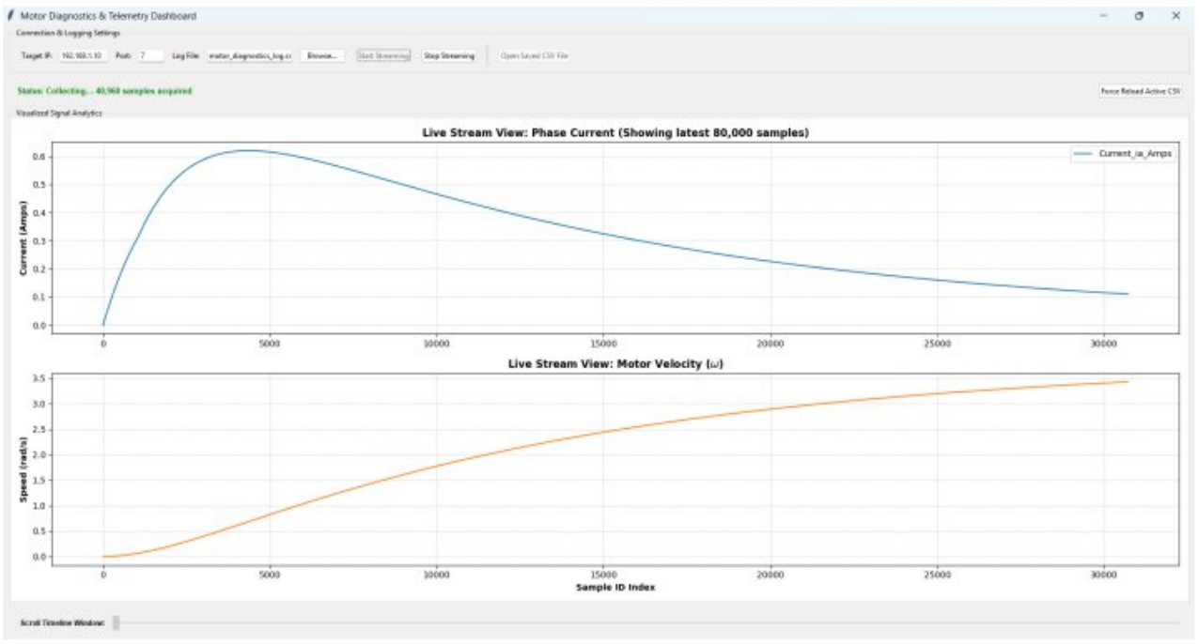
INDUSTRIAL / RESEARCH INTERNSHIP | SUMMER 2026
Real-Time Hardware-in-the-Loop Simulation of a PMDC Motor on the Zynq-7000 SoC
Akasam Harsha Vardhana Ganesh
Roll No. 23BFA04013 | B.Tech ECE (2023 to 2027)
Sri Venkateswara College of Engineering (Autonomous), Tirupati
Internship: Dept. of Electrical Engineering, IIT Palakkad, Kerala
Guide: Dr. KM. Manjunath, Asst. Professor, ECE
Live telemetry dashboard: phase current and motor velocity streamed from the Zybo Z7-20
PL
100 kHz plant model
PS
ARM + lwIP TCP
Notes:
Good morning, respected faculty. I am Harsha Vardhana Ganesh, a third-year ECE student. I will present my summer internship at IIT Palakkad, where I built a real-time Hardware-in-the-Loop simulation platform for a PMDC motor on a Zynq-7000 SoC.

Slide 2



Introduction & Objectives
Background
Problem Statement
Objectives
HIL is core to power electronics, automotive and aerospace control
Testing on live plants risks damage and unsafe failures
FPGA/SoC plant models give safe, repeatable validation
Bridging Simulink/HDL Coder models to FPGA fabric at 100 kHz
Needs precise clocking, RTL wrapping, AXI4-Stream handshakes
Telemetry must leave the fabric without software bottlenecks
Run a PMDC model on the Zybo Z7-20 PL at 100 kHz
Custom Verilog wrapper and 10 kHz PWM generator
FIFO + DMA + lwIP TCP pipeline (Port 7)
Python GUI for filtering and plots
Physical controller
↔
HIL platform: FPGA plant model
↔
Safe, repeatable testing
Notes:
HIL lets us validate controllers against a hardware-hosted plant model instead of risking a real motor. The challenge is bridging high-level modelling tools with low-level FPGA fabric while streaming data at high rates. My objectives covered the whole chain, from the plant model to visualization on the PC.

Slide 3
System Architecture & Methodology
PROGRAMMABLE LOGIC (PL)
pwm_gen.v
10 kHz PWM, 13-bit
PMDC model
HDL Coder RTL, 100 kHz
pmdc_axis_wrapper.v
clock-step + back-pressure
AXIS Data FIFO
depth 1024
AXI DMA
scatter-gather off
PROCESSING SYSTEM (PS): ARM CORTEX-A9, BARE-METAL
lwIP TCP server
customized echo template, Port 7
DDR memory
non-cached ring buffers
HP slave port
PS-PL AXI interface
HOST PC
Ethernet link (TCP)
raw 16-bit telemetry frames
Python GUI (gui.py)
tkinter, scipy.signal, Savitzky-Golay
Tools: MATLAB/Simulink • HDL Coder • Vivado IP Integrator • Vitis • Python
Notes:
The design splits cleanly between fabric and processor. The motor model and the PWM generator run deterministically in the PL. Telemetry flows through a FIFO and DMA into DDR, and the ARM core streams it over Ethernet to my Python dashboard. The block diagram on this slide is drawn from the architecture described in the report.

Slide 4




Core Modules & Implementation
pmdc_axis_wrapper.v
pwm_gen.v
Wrapper interface sketch
Gates clock-stepping on downstream readiness and stall
Packs 16-bit ia and ω into one 32-bit word
13-bit resolution on a 50 MHz clock
Period match gives a precise 10 kHz gate
pmdc_axis
_wrapper
clock-enable gate
+ data packer
clk
tdata[31:0]
PWM duty
tvalid
Vivado + Vitis pipeline
gui.py dashboard
tready
FIFO (1024) to AXI DMA to PS HP port
Rewrote lwIP receive callback; streams DMA buffers
Threaded socket ingest; signed 16-bit unpack
Savitzky-Golay filter (window 31, order 3)
tdata = 16-bit ia + 16-bit ω
Notes:
My main contributions are two custom Verilog modules and the software pipeline around them. The wrapper keeps the 100 kHz simulation honest by pausing when the stream stalls, and the PWM module provides a precise 10 kHz drive. On the software side I adapted the lwIP template and wrote the Python client. The interface panel is a sketch I drew from the report's description.

Slide 5
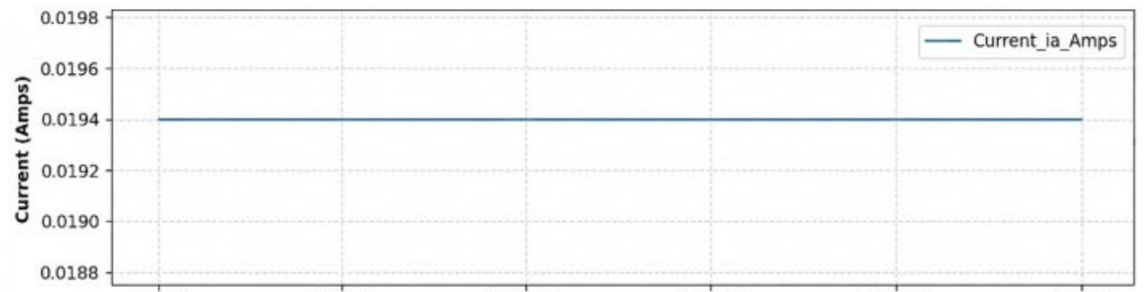
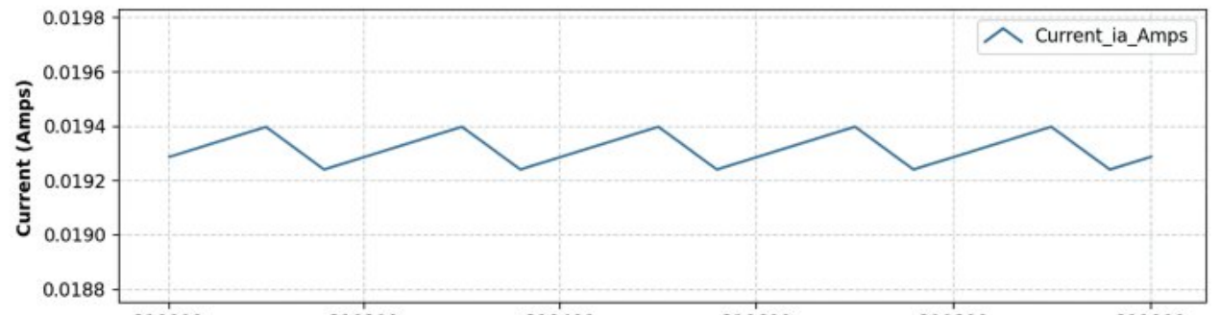
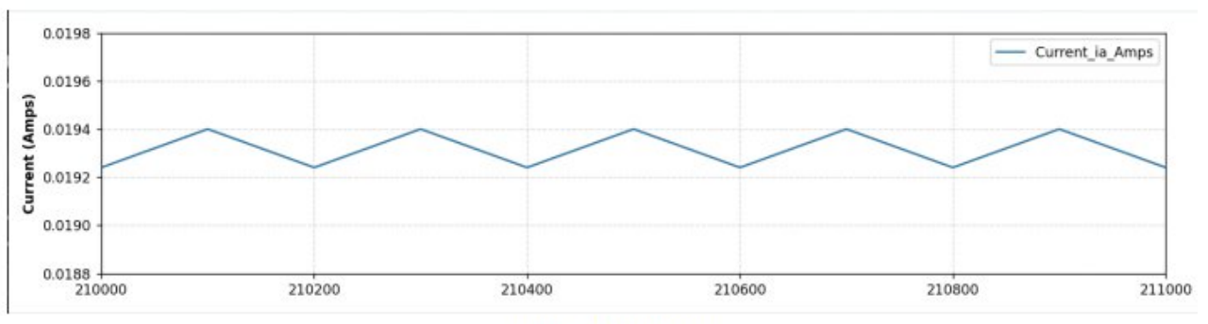
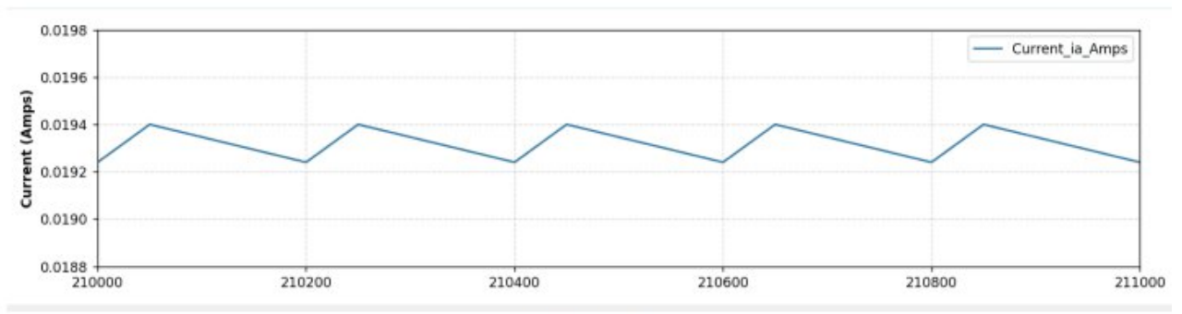
Results & Validation
100% duty, samples 210,000 to 211,000
75% duty, samples 210,000 to 211,000
50% duty, samples 210,000 to 211,000
25% duty, samples 210,000 to 211,000
Duty | Peak inrush | Mean current | Ripple
100% | 0.56 A | 0.194 ± 0.00 A | ±0.00 A
75% | 0.38 A | 0.15 ± 0.04 A | ±0.10 A
50% | 0.27 A | 0.10 ± 0.03 A | ±0.10 A
25% | 0.13 A | 0.05 ± 0.02 A | ±0.10 A
Cold-start transient: phase current (top), motor velocity (bottom)
0.56 A
peak inrush
3 rad/s
steady speed
350 ms
settling time
1,000,000 frames streamed at 100 kHz; no FIFO overflows
Savitzky-Golay filter exposes the DC mean under 10 kHz ripple
Rotor inertia low-pass filters speed
Notes:
These plots come straight from my live dashboard. At start-up the current spikes to about 0.56 amps and then falls as back-EMF builds, while speed settles near 3 rad/s in about 350 milliseconds. Across four PWM duty cycles the ripple pattern changes as expected, and the table summarises the metrics. The pipeline streamed a million samples without FIFO overflow.

Slide 6
Challenges & Solutions
CHALLENGE
SOLUTION
1
Keeping the model real-time when downstream stalls
Clock-stepping gated by AXI4-Stream back-pressure in the wrapper
2
Two variables through a 32-bit DMA path
Packed 16-bit ia and ω into one stream word
3
Software overhead limiting throughput
Bare-metal lwIP, simple DMA transfers, non-cached buffers
4
Bursty data versus network pacing
FIFO (depth 1024) acts as an elastic buffer
5
10 kHz PWM ripple hides the true current trend
Online Savitzky-Golay filter (window 31, order 3)
6
Linking HDL Coder output to Vivado
Custom Verilog wrapper for clock enables and handshakes
Notes:
The main difficulty was keeping a 100 kHz real-time loop deterministic while moving data off-chip. I addressed this with back-pressure-aware stepping in hardware, FIFO buffering, and a lean bare-metal network stack. On the host side, the ripple from the PWM carrier was resolved with an online polynomial filter. Be ready to relate each item to what you personally debugged.

Slide 7

Conclusion & Future Scope
100 kHz
plant model rate
10 kHz
PWM generator
Conclusion
Working end-to-end HIL platform for a PMDC motor
Custom IP: pmdc_axis_wrapper.v and pwm_gen.v
Simulink to Vivado to Vitis to Python co-design flow
1,000,000
frames streamed
0
FIFO overflows
Future Scope
Closed-loop control with hardware PID controllers
PetaLinux + UDP streaming for higher bandwidth, multi-axis
Automated testbenches and CI for Verilog and Python
Project milestones: all completed
Plant model
RTL synthesis
PL integration
DMA + network
Python GUI
Notes:
In summary, I delivered a reproducible HIL platform spanning modelling, RTL, embedded software and visualization. Next steps include closing the control loop with hardware PID controllers, moving to PetaLinux with UDP for higher throughput, and adding automated regression testing. Thank you, I am happy to take questions.

