Slide 1
Crop Prediction using Machine Learning

Slide 2
PROBLEM STATEMENT
Farmers choose the same crop to grow repeatedly instead of trying new varieties of crops.
Overuse of inorganic fertilizers which depletes the land of nutrients and further causes soil acidification and affects the crop yield.
Thus, adopting new agriculture technologies is very important to make the best use of the resources available.

Slide 3
ABSTRACT
We use ML technique to predict the most profitable crop in their current weather and soil conditions.
Various field conditions are taken as input and an appropriate crop that can be grown in these conditions is predicted as output.
Farmers can get to know about the new crops for given environmental conditions.
The farm productivity can be increased by understanding and forecasting crop performance in a variety of environmental conditions.

Slide 4
LITERATURE SURVEY
S. No. | Title of paper & year | Authors | Conclusion
1. | Crop Prediction System using Machine Learning - Dec,2017 | Prof. D.S. Zingade1 ,Omkar Buchade2 ,Nilesh Mehta. | This system suggests number of profitable crops providing a choice directly to the farmer about which crop to cultivate.
2. | Crop Recommendation System Using Machine Learning Techniques-April 2017. | S KRISHNA PRASAD, B SIVA SREEDHARAN, S JAISHANTH | This document proposes a crop recommandation system to predict the yield of a particular crop under a particular weather condition.
3. | Crop Prediction Method using Regression and Machine Learning Technology: Survey - 2014 | Yun Hwan Kima, Dongil Hana , Sung Wook Baik | The methods of prediction used can help farms reduce damages and increase their income and need to be extended as to apply them to various crops.
4. | Crop Recommendation System to Maximize Crop Yield using Machine Learning Technique- Dec,2017. | Rohit Kumar Rajak, Ankit Pawar, Mitalee Pendke. | This study uses support vector machine (SVM) and ANN as learners to recommend a crop for site specific parameter with high accuracy and efficiency.

Slide 5
Machine Learning
Decision Tree - a predictive model and is a mapping of observations about an item, to conclusions about its target value.
Training data - observations in the training set from the experience that the algorithm uses to learn.
Test Data - a set of observations used to evaluate the performance of the model using some performance metric.
CSV : comma-separated values . The most common format of data for ML projects.
Rainfall
<= x
> x
Humidity
rainfall
<= y
> y
<= z
> z
Rice
Wheat
Watermelon

Slide 6
Crop Prediction Using ML
The input conditions considered in this model include -
Temperature (C), humidity (%), pH and rainfall (mm).
Temperature | humidity | ph | rainfall | label
22.70884 | 82.63941 | 5.700806 | 271.3249 | rice
20.27774 | 82.89409 | 5.718627 | 241.9742 | rice
21.86525 | 80.1923 | 5.953933 | 224.555 | rice
45.38353 | 12.81876 | 5.932241 | 45.75234 | millet
43.30668 | 11.77588 | 5.783504 | 39.10973 | millet
41.19184 | 14.4898 | 5.973094 | 38.99785 | millet
24.86561 | 78.22081 | 5.983076 | 79.56866 | Cotton
25.31468 | 77.91757 | 5.907931 | 72.82902 | Cotton
25.53083 | 80.04663 | 5.801048 | 99.39557 | Cotton
17.46779 | 13.39943 | 5.893661 | 45.56541 | Peas
18.55173 | 13.20542 | 5.930024 | 47.4931 | Peas
17.87354 | 13.77714 | 5.832345 | 51.79454 | Peas
29.14459 | 60.76907 | 5.657791 | 270.3862 | Rubber
32.88585 | 66.62275 | 5.698524 | 391.4197 | Rubber
32.78744 | 76.51154 | 5.717627 | 231.9788 | Rubber
https://github.com/Priyabrata017/Crop-prediction-using-Machine-Learning/blob/master/cpdata.csv
The crops considered in this model include -
Rice, wheat, mung bean, tea, millet, maize, lentil, jute, coffee, cotton, groundnut, peas, rubber, sugarcane, tobacco, kidney beans, moth beans, coconut, black gram, adzuki beans, pigeon peas, chickpeas, banana, grapes, apple, mango, muskmelon, orange, papaya, watermelon, pomegranate.

Slide 7
Software Workflow For ML Model
Required libraries for data wrangling, munging and mathematical operations like pandas and numpy are imported.
The database(CSV) contains atmospheric humidity, temperature, soil moisture, soil pH and crop names.
The patterns in train data are analyzed and an ML model is created.
Test values are used for testing the predictions of the model using the decision tree regressor.
CSV File
Notes:
ML Model Creation :
We supplied information of different crop conditions in csv data format. The data contains the working conditions for each type of crop. The CSV data is split into Train & Test data, 70% & 30% respectively. Train data is used to create ML model, by analyzing the patterns in the data. For each type of crop conditions, the fit() function will calculate mean & Standard deviation on Train data and create classified limits for conditions mapping to each crop. Then Test data is used to validate the model and measure the accuracy.
Evaluation : This ML Model can be used to make crop prediction for given field input conditions. Field input is supplied to the model and run the decision tree regression to predict the crop.

Slide 8
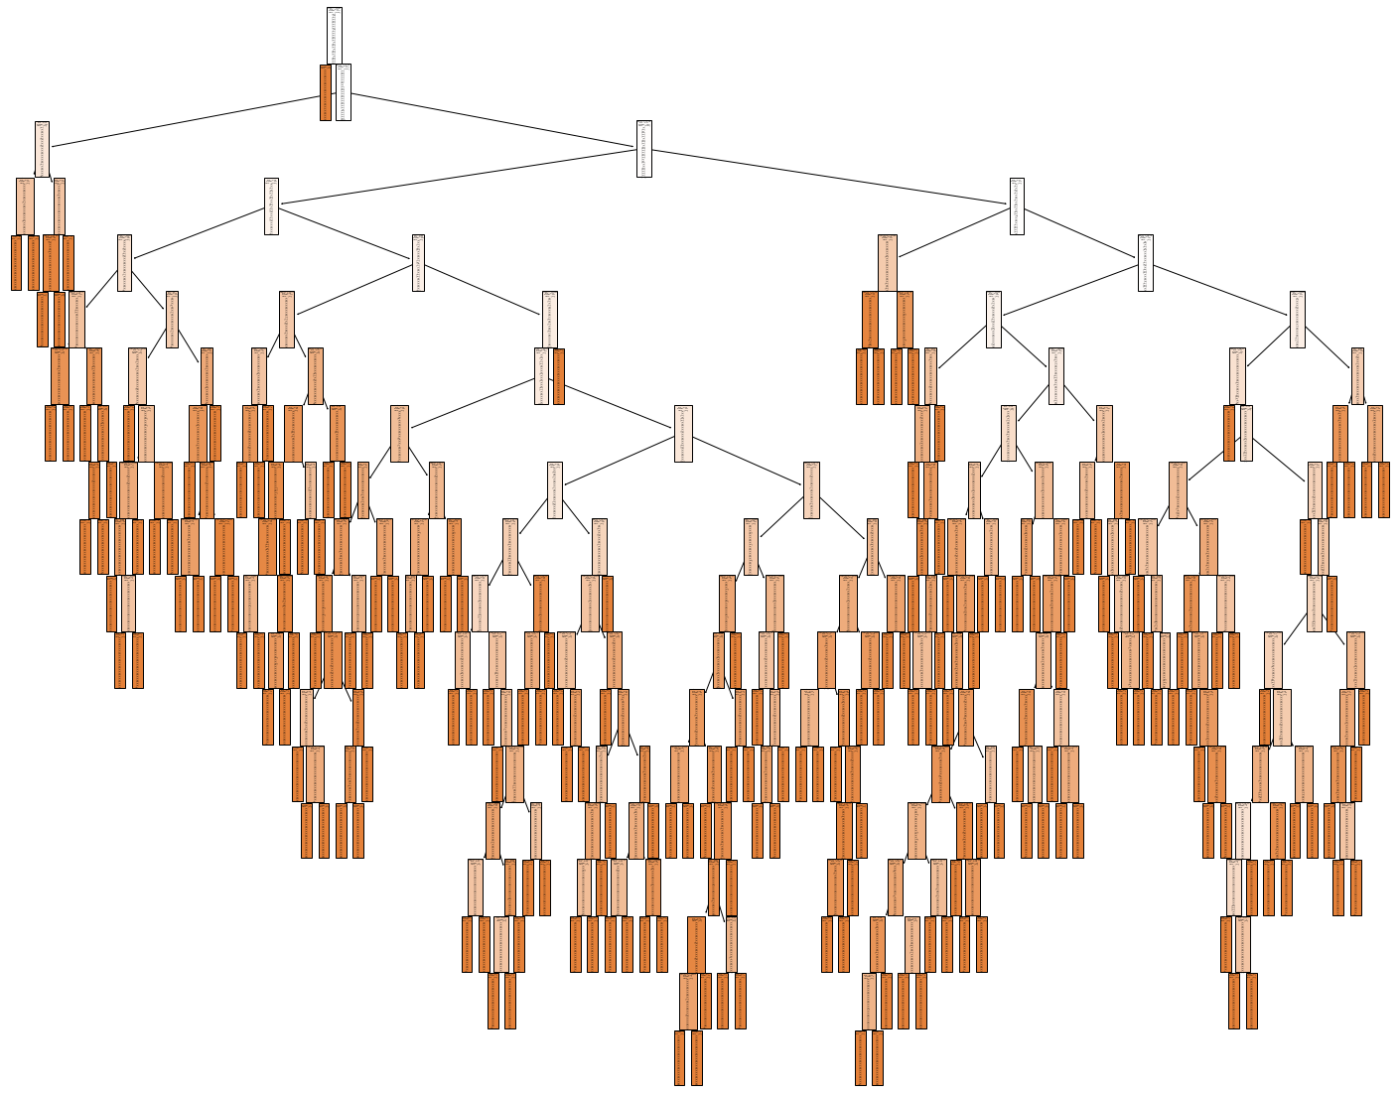
Decision Tree (extract from Code)
fig = plt.figure(figsize=(25,20))
_ = tree.plot_tree(clf,feature_names=features,max_depth = 3,filled=True)
Rainfall <= 30.549
True
False
muskmelon
Humidity <= 27.655
True
False
Rainfall <= 57.565
Humidity <= 74.955
True
True
False
False
Temperature
<= 29.364
pH <= 6.025
Rainfall <= 74.965
Rainfall
<= 60.263
Notes:
About Decision Tree :
We have used Decision tree Regression method to predict Crop for given field condition.
For each type of crop conditions, the fit() function will calculate mean & Standard deviation on Train data and create classified limits for conditions mapping to each crop.
The classified limits from ML model will be used during Decision tree regression.
The decision tree method does each field condition parameter comparison with classified limits created in the ML Model and compares all the parameters and conditions until it finds a predicted Crop.
The picture shows the drawing derived from the implementation code. As per the ML model created based on the train data, Decision tree root starts with Rainfall condition check and then comparing the humidity, Temperature & pH values to determine the predicted crop.

Slide 9
Evaluation Process
Input new field values of humidity, temperature, pH and rainfall conditions to the regressor.
These input values are analyzed with ML model and prediction is evaluated.
Prediction is mapped with label values in the machine learning model to obtain the suitable crop.
ML
Model
Input Conditions
Model Evaluation
(Decision Tree)
Predicted Crop

Slide 10
Algorithm
ML Model creation :
START
Import CSV file(raw data)
Split raw data : train and test data
train_test_split(train ,test,test_size=0.3)
Import clf=DecisionTreeRegressor()
Analyze data pattern using “mse” criteria & create ML model clf.fit(x_train,y_train)
Validate the model with Test data pred=clf.predict(x_test)
Measure a=accuracy_score(y_test,pred)
Print accuracy is ‘a’
Evaluation :
9. Input field evaluation parameters into an array crop_cond : hum, temp, pH & rain
Evaluate prediction : clf.predict(crop_cond)
Display predicted outcome
STOP
Notes:
These are the algorithm steps for Crop Prediction Project.
At first the Air humidity, Air temperature, Soil moisture, Soil pH sensor modules are integrated with the NodeMCU platform into a portable kit. This kit is installed in the farm to gather the respective data of the soil. The data gathered is transferred in real time to firebase database for storage and further processing. The atmospheric humidity, temperature, soil moisture, soil pH are sent as it is to the database. This enables us to collect the rainfall of that place in the previous year.
This database is the raw historical data which is used to develop the model. Hence, import the database as CSV to read the file.
Then, the data in the CSV is split into test and train data. Training data is for the model to learn from. By learning, it will identify patterns and mappings between the input and output values. This database is split as 30% test data and rest as training data.
From the open-source machine learning library, Scikit - Learn, import the decision tree reggressor model function. It is a function to measure the quality the tree. It involves mean squared error and mean absolute error criteria for minimizing loss functions and poisson deviance to find the splits in the tree. This follows variance reduction as the attribute selection criterion for creating the tree.
The training data is given as input to the model function to fit the data to it so that it can learn and create a decision tree. Using the decision tree regressor the training data is analyzed by calculating the mean squared error and an ML model is created.
After the model is created, validation of the model should be performed. This is done using test data. Predictions are made using the input values in test data and they are validated using the already available target values in the test data itself.
Then, the accuracy of the model will be measured. Along with accuracy, many other metrics can also be measured which can tell more about the efficiency and correctness of the model designed.
Now the model is ready to make predictions for unseen data. Entering humidity, pH, temperature and rainfall conditions as given set of input field conditions, the target value, i.e., the best crop for these new conditions is predicted.

Slide 11
Software Implementation
#Creating ML MODEL
import pandas as pd
import numpy as np
from sklearn.model_selection import train_test_split
#Reading the csv file
data=pd.read_csv('Crop_Pred.csv')
my_dummy= pd.get_dummies(data.label).iloc[: , 1:]
data= pd.concat([data,my_dummy],axis=1)
data.drop('label', axis=1,inplace=True)
features=data.iloc[:, 0:4].values
target=data.iloc[: ,4:].values
#Dividing the data into training and test set
X_train,X_test,y_train,y_test=train_test_split(features,target,test_size=0.3,random_state=5)
#Importing Decision Tree classifier
from sklearn.tree import DecisionTreeRegressor
clf=DecisionTreeRegressor()
#Fitting the classifier into training set
clf.fit(X_train,y_train)
pred=clf.predict(X_test)
from sklearn.metrics import mean_squared_error, r2_score
model_score = clf.score(X_train,y_train)
print(‘Coefficient of determination R^2 of the prediction.: ',model_score)
print("Mean squared error: %.2f"% mean_squared_error(y_test, pred))
print('Test Variance score: %.2f' % r2_score(y_test, pred))
from sklearn.metrics import accuracy_score
a=accuracy_score(y_test,pred)
print("The accuracy of this model is: ", a*100)
# Field inputs evaluation for Crop Prediction
ah=76.16151562
atemp=29.16226551
pH=5.816622479
rain=100.0075679
predictcrop=[[ah,atemp,pH,rain]]
# Putting the names of crop in a single list
crops=['wheat','mungbean','Tea','millet','maize','lentil','jute','coffee','cotton','ground nut','peas','rubber','sugarcane','tobacco','kidney beans','moth beans','coconut','blackgram','adzuki beans','pigeon peas','chick peas','banana','grapes','apple','mango','muskmelon','orange','papaya','watermelon','pomegranate']
cr='rice'
#Predicting the crop
predictions = clf.predict(predictcrop)
count=0
for i in range(0,30):
if(predictions[0][i]==1):
c=crops[i]
count=count+1
break;
i=i+1
if(count==0):
print('The predicted crop is %s'%cr)
print()
else:
print('The predicted crop is %s'%c)
print()
Notes:
This is the project implementation working code.

Slide 12
ML Model validation results using Test data
The accuracy of this model is: 90.43
Prediction results using field input data
1. For input conditions of temperature, humidity, pH, rainfall :
[[20.98603693, 74.413489, 5.260838965, 47.54876687]]
The predicted crop is muskmelon.
2. For input conditions of temperature, humidity, pH, rainfall : [[17.1500252, 13.8868387, 6.89091, 52.27762]]
The predicted crop is peas.
3. For input conditions of temperature, humidity, pH, rainfall : [[62.1387382, 22.1749996, 6.410441476, 23.46622584]]
The predicted crop is apple.

Slide 13
THANK YOU

