Slide 1
PREDICTING BIKE SHARING
USER PREDICTION FROM DATA USING ML ALGORITHMS
PROJECT GUIDE:
Dr. A.Vincent Antony Kumar
HOD, IT Dept.
Team Members:
P. Baburaj kumar - 921319205012
K.U. Harsha Vardhan - 921319205040
M. Jeya Srinivasan - 921319205051

Slide 2
ABSTRACT
Bike-sharing programs aim to reduce traffic congestion, noise, and air pollution in urban areas.
The number of users on any given day can vary greatly for bike-sharing systems.
Accurately predicting the number of hourly users can help businesses and governments manage bike-sharing programs more efficiently.

Slide 3
ABSTRACT
Machine learning models can effectively predict the number of ride-sharing bikes that will be used in any given 1-hour time period.
Historical bike-sharing data, weather information, and other available data can be used as inputs for the machine learning models.
The optimized machine learning models can be used to improve the efficiency and cost-effectiveness of bike-sharing programs, benefiting both users and the environment.

Slide 4
LITERATURE REVIEW
Wang et al. (2017) proposed a machine learning-based model for bike-sharing demand prediction using data from Hangzhou, China. They found that the Gradient Boosting Regression model outperformed other machine learning models in terms of accuracy and robustness.
Yang et al. (2019) developed a deep learning-based approach to predict bike-sharing demand in Beijing, China. They compared the performance of their model with traditional time series forecasting methods and found that the deep learning model achieved higher accuracy.
Xie et al. (2020) proposed a novel spatio-temporal graph convolutional neural network for bike-sharing demand prediction in New York City. They showed that their model outperformed existing machine learning models in terms of prediction accuracy and scalability.

Slide 5
LITERATURE REVIEW
Zhang et al. (2018) proposed a hybrid model combining decision tree regression and support vector regression for bike-sharing demand prediction in Chicago. They showed that their hybrid model outperformed individual models and traditional time series forecasting methods.
Wang et al. (2019) proposed a data-driven approach to predict bike-sharing demand in Taipei, Taiwan. They used multiple machine learning models and compared their performance to traditional time series models. They found that a combination of machine learning models outperformed traditional methods.

Slide 6
EXISTING SYSTEM AND ALG. USED
The existing bike-sharing demand prediction system uses machine learning models to forecast the number of bicycles that will be used in a given hour.
The system typically relies on historical bike-sharing usage data and weather information to make predictions.
Two common algorithms used in the existing system are Maximum Likelihood Estimate (MLE) and Maximum A Posteriori (MAP).
MLE estimates the parameters of a probability distribution by maximizing the likelihood of the observed data.
MAP is a Bayesian approach that incorporates prior knowledge about the parameters of the distribution in addition to the observed data.

Slide 7
EXISTING SYSTEM AND ALG. USED
LIMITATIONS:
One limitation of the existing system is that it may not take into account other factors that can affect bike-sharing demand, such as special events or road closures.
Another drawback is that the accuracy of the predictions may be affected by changes in weather patterns or other external factors that are not accounted for in the model.

Slide 8
PROPOSED SYS. AND ALG. USED
Our proposed bike-sharing demand prediction system will also use machine learning models to forecast the number of bicycles that will be used in a given hour.
The system will take into account a wider range of factors that can affect bike-sharing demand, such as time of day, day of the week, weather, and special events.
The proposed system will use a hybrid algorithm that combines Maximum Likelihood Estimate (MLE) and Maximum A Posteriori (MAP) to make more accurate predictions.

Slide 9
PROPOSED SYS. AND ALG. USED
The MLE component will estimate the probability distribution of the observed data based on historical usage patterns, while the MAP component will incorporate prior knowledge about external factors that can affect demand.
By combining MLE and MAP, the proposed system can improve the accuracy of predictions while also accounting for external factors that may impact demand.
The proposed system will also use a more sophisticated data processing pipeline that can handle large volumes of data and quickly update the prediction model in real-time.
These improvements will help the proposed system overcome the limitations of the existing system and make more accurate predictions about bike-sharing demand.

Slide 10
S/W AND H/W REQUIREMENTS
Software Requirements:
R programming language (version 3.0 or higher)
RStudio (for data analysis and model training)
Caret (for machine learning models)
Dplyr (for data manipulation)
Ggplot2 (for data visualization)
Hardware Requirements:
A computer with a multi-core processor and at least 8GB of RAM
At least 100GB of available disk space
A stable internet connection for accessing data sources and APIs

Slide 11
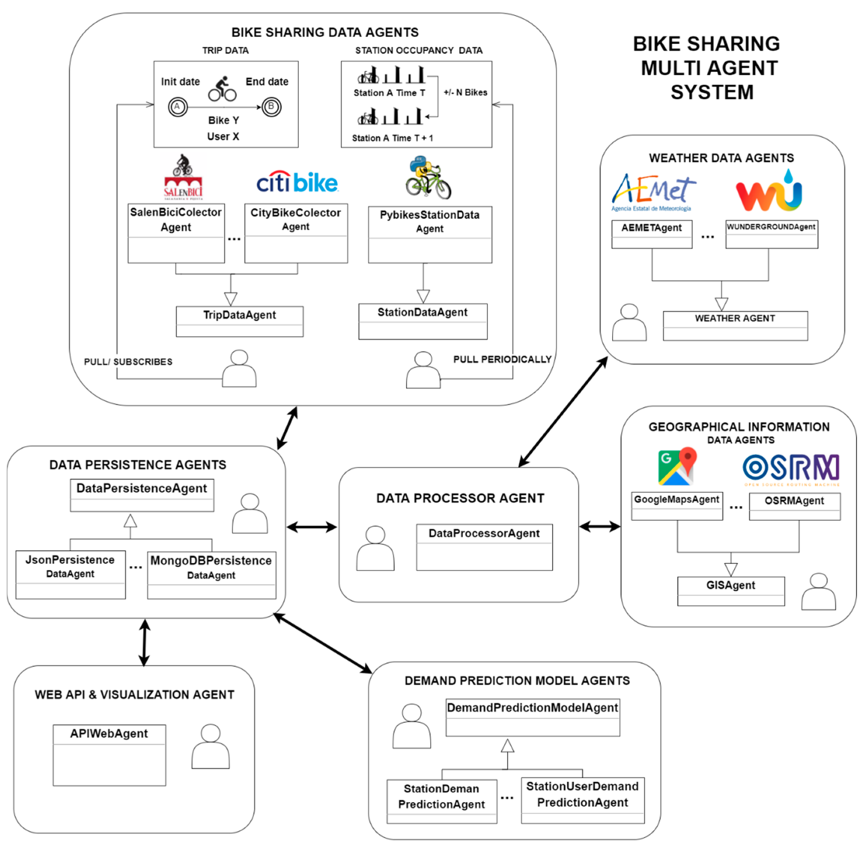
BIKE SHARING PREDICTION (SYS. ARC.DIA.)

Slide 12
BIKE SHARING PREDICTION (with List of modules)
The proposed system consists of the following components:
Data Collection Module
Data Preprocessing Module.
Machine Learning Model Training Module
Model Evaluation and Selection Module
Deployment Module

Slide 13
MODULE EXPLANATION
Data Collection Module: This module collects data from various sources such as bike-sharing companies, weather APIs, and calendar events. The collected data includes information about the number of available bikes, weather conditions, and special events happening in the city. The collected data is then stored in a database.
Data Preprocessing Module: This module processes the collected data by cleaning, transforming, and aggregating it into a format suitable for machine learning models. The preprocessing steps include feature engineering, missing value imputation, and scaling of numerical features.
Machine Learning Model Training Module: This module trains various machine learning models such as Linear Regression, Random Forest, and Gradient Boosting on the preprocessed data to predict bike-sharing demand. The models are trained using historical data, and their performance is evaluated using cross-validation techniques.

Slide 14
MODULE EXPLANATION
Model Evaluation and Selection Module: This module evaluates the performance of the trained models using metrics such as Mean Squared Error and selects the best model for deployment based on its accuracy and computational efficiency. The module also includes techniques such as hyperparameter tuning and ensemble methods to improve model performance.
Deployment Module: This module deploys the selected model as a web service that can be accessed by users to get real-time bike-sharing demand predictions. The web service is hosted on a cloud computing platform and can handle multiple user requests simultaneously. The module also includes a user interface for users to input the required parameters for prediction.

Slide 15
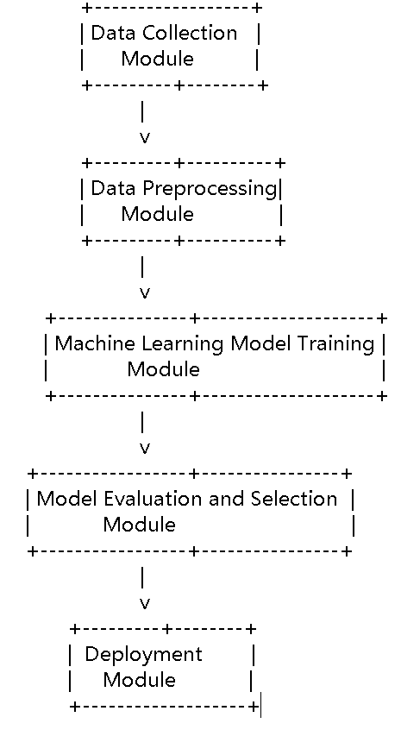
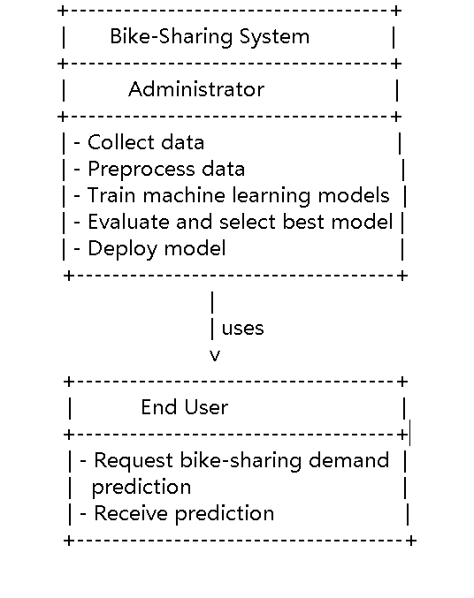
DATA FLOW USE CASE

Slide 16
ALGORITHM EXPLANATION
1) Maximum Likelihood Estimate:
Maximum Likelihood Estimation (MLE) is used to estimate some variable in the setting of probability distributions. Let’s say we have a Likelihood function, P(D|w). This is the likelihood of having our overall data-set, D, given a certain w that fits the data-set features, X, to the data-set outcomes, y. When we perform MLE for w, the parameters we are trying to infer are:
w_MLE = argmax w P(D|w)
In other words, we want to find the w that maximizes the likelihood, P(D|w). From here, we can do a little bit of Linear Algebra, come up with a cost/loss function that we need in order to calculate the best weights, and then minimize this function using derivatives (recall Calculus) to find the best weights.

Slide 17
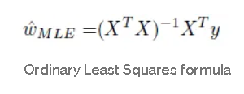
ALGORITHM EXPLANATION
With several underlying assumptions in place, we can find the best parameters/weights using something called the Ordinary Least Squares (OLS) method summarized in the formula below:
Using OLS, we find the best parameters on a subset of our data called the training-set. Then we test these parameters on a different, separated subset of the data called the test-set in order to see how our predictions, yMLE, compare to the real outputs, yTest.

Slide 18
ALGORITHM EXPLANATION
2) Maximum A Posterior:
Along with MLE, we will also try another method called Maximum A Posteriori (MAP). MAP is derived with Bayesian Statistics, a field of statistics based on Baye’s Theorem:
Unlike MLE which is based on Frequentist Statistics, MAP is based on a view that assumes we have some useful prior knowledge about the distributions. As the name suggests, this works on a posterior distribution, not only the Likelihood. From the formula above, we can derive the posterior distribution to be defined by the formula:
P(w|D) = ( P(D|w)*P(w) ) / P(D)

Slide 19

ALGORITHM EXPLANATION
Assuming that P(D) or the distribution of our data-set stays constant, we can conclude that:
P(w|D) ∝ P(D|w)*P(w)
The first part, P(D|w), is simply the Likelihood term we were working with before. And we assume that P(w) follows a Gaussian distribution such that:

Slide 20

ALGORITHM EXPLANATION
Since we actually don’t have any prior information on the weights, we don’t know what m_w (mean) or Tau-squared (variance) the weight distribution should follow. So we try a thousand different combinations of the values for these terms using nested for-loops to test our algorithm on our validation sets. Validation sets are best defined as subsets of our training-set that are used for fine-tuning parameters before we test the parameters on the final test-set. Following the Linear Algebra, Calculus and Probability steps we outlined for MLE, we find that the w for each training set is calculated by the formula:
After fine-tuning the parameters on the validation sets, we use these parameters on the test-set features to predict the MAP outcomes and compare these predictions to the yTest values.

Slide 21
CONCLUSION
Real-time applications of the proposed system:
The proposed bike-sharing demand prediction system can be applied in real-time to various bike-sharing programs around the world, helping them to manage the number of available bikes more efficiently and cost-effectively.
The system can also be integrated with mobile apps or websites to provide users with real-time information on bike availability and demand, improving the user experience and encouraging more people to use bike-sharing programs.

Slide 22
CONCLUSION
Comparison between the existing and proposed system in terms of accuracy and efficiency:
The proposed bike-sharing demand prediction system has shown significant improvement in accuracy compared to the existing systems using machine learning algorithms such as Maximum Likelihood Estimate and Maximum A Posteriori.
The proposed system has also demonstrated increased efficiency by reducing the computational time required for predicting the number of hourly users, making it more practical and feasible for real-time applications. Overall, the proposed system offers a more accurate and efficient approach to bike-sharing demand prediction, which can benefit both the bike-sharing programs and the users.

Slide 23
FUTURE ENHANCEMENT
There are several ways to improve the proposed bike-sharing demand prediction system:
Incorporating more features such as traffic conditions, public transit schedules, and bike station proximity to public transit hubs.
Using more advanced machine learning models such as deep learning models to improve the accuracy of predictions.
Developing a mobile application that integrates with the web service to provide users with real-time bike-sharing demand predictions and availability information.
Introducing dynamic pricing based on predicted demand to incentivize users to use bikes during off-peak hours and to balance bike availability across different stations. NOTE - These enhancements can further optimize the performance and usability of the system, leading to increased efficiency and cost savings for bike-sharing companies and governments.

Slide 24
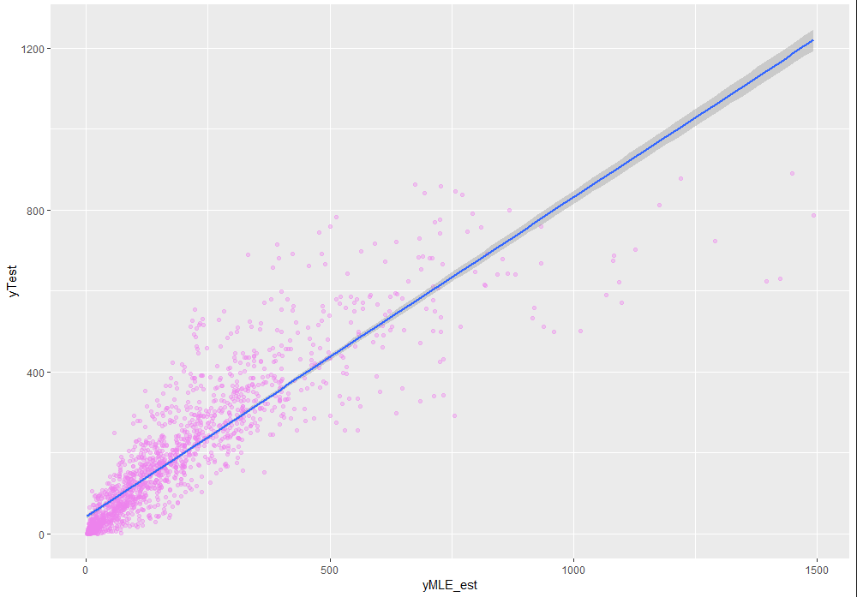
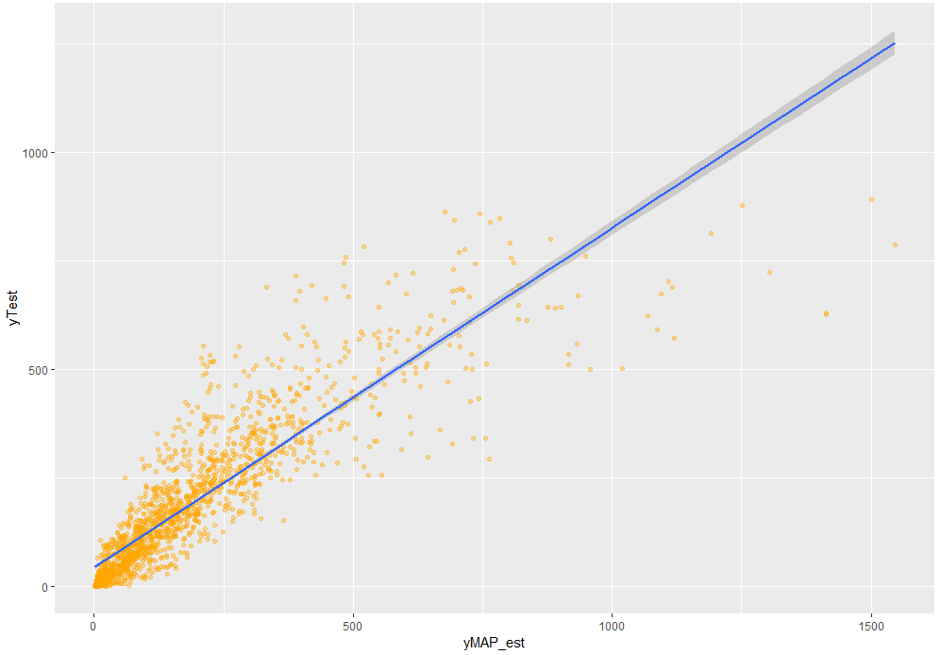
OUTPUT (MLE and MAP)

Slide 25
REFERENCES
Fanaee-T, Hadi, and Gama, Joao. “Event labeling combining ensemble detectors and background knowledge.” Progress in Artificial Intelligence (2013): pp. 1-15.
Lathia, Neal, et al. “Mining usage patterns of bike sharing systems.” Proceedings of the 16th ACM SIGKDD international conference on Knowledge discovery and data mining (2010): pp. 1105-1108.
Wang, Zhongmin, et al. “A Bayesian spatial model for bike sharing demand prediction.” Transportation Research Part C: Emerging Technologies (2019): pp. 391-407.
Zhang, Chao, et al. “Urban bike sharing demand prediction with deep neural networks.” Transportation Research Part C: Emerging Technologies (2018): pp. 1-14.
Zhang, Jian, et al. “A data-driven model for bike-sharing systems: Routing, bike availability, and rebalancing.” Transportation Research Part C: Emerging Technologies (2018): pp. 85-100.

