Slide 1
AUTOMATED EVALUATION OF DYNAMIC TOPIC MODELS USING LLMs.
A COMPARATIVE STUDY WITH HUMAN JUDGEMENT AND TEMPORAL METRICS.
DATE-06.04.2026
[ Confidential ]

Slide 2
AGENDA
1
MOTIVATION AND PROBLEM STATEMENTS
4
RESULTS OF MODELS /FEW SS ATTACHED
Slide 03
Slide 07
2
DATASET AND MODELS
5
COMPARISONS AND KEY FINDINGS
Slide 04
Slide 14
3
METHODOLOGY AND ARCHITECTURE
6
CODE,CONCLUSION
Slide 05
Slide 15

Slide 3
MOTIVATION AND PROBLEM
Why Automated Evaluation of DTMs?
Dynamic Topic Models (DTMs) capture how topics evolve over time in large corpora
Evaluating them is challenging:
Topics change across time slices → need coherence + temporal consistency
Human evaluation is expensive and hard to scale
Traditional metrics (NPMI, TTS, TTC) may not reflect true interpretability
Gap: LLMs have been used for static topic model evaluation but never systematically tested on dynamic models
This project fills that gap.
RESEARCH QUESTIONS:
1.How well do LLM-based evaluations correlate with human annotations of dynamic topic models?
2.Do LLM scores better approximate human judgments than automated metrics (NPMI)?
3.In what cases do LLMs overestimate or underestimate topic quality?
4.Can LLMs serve as a proxy for human evaluation in DTM assessment?

Slide 4
DATASETS AND MODELS : EXPERIMENTAL SETUP
DTM MODELS EVALUATED:
1.DLDA (Dynamic Latent Dirichlet Allocation)
2.DETM (Dynamic Embedded Topic Model)
DATASETS:
1.NeurIPS papers (1987–2019)
2.New York Times (NYT)
3.UN General Debates (unDebates)
LLMs USED VIA OPENROUTER/HUGGING FACE API:
1.Llama 3.1-8B
2.Qwen 2.5-7B
3.Mistral-7B
4.DeepSeek R1 Distill 8B

Slide 5
EVALUATION TASKS-METHODOLOGY- AS PER PDF
Task 1 — Temporal Topic Coherence And Smoothness:
Show LLM top words at time t-1, t, t+1
Rate word relatedness (1-3) and transition smoothness (1-3)
Mirrors exactly what human annotators rated on Prolific
Task 2 — Temporal Intrusion Detection:
Insert one intruder word from a different topic
Ask LLM to identify the odd word out
Measures topic coherence at a single time step
Task 3 — Topic Evolution Quality:
Show topic word evolution across 3 time windows
LLM classifies: Meaningful evolution / Minor drift / Incoherent change
Captures semantic shift quality

Slide 6
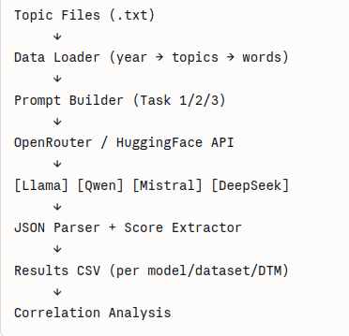
PIPELINE ARCHITECTURE
Input: Topic word files (.txt) — one file per year, one line per topic
Prompt Builder: Constructs Task 1/2/3 prompts using top-10 words per topic
API Call: Sends prompts to 4 LLMs via OpenRouter and Hugging Face Router
Parser: Extracts JSON scores, handles reasoning model outputs
Output: CSV files per model/dataset/DTM combination

Slide 7
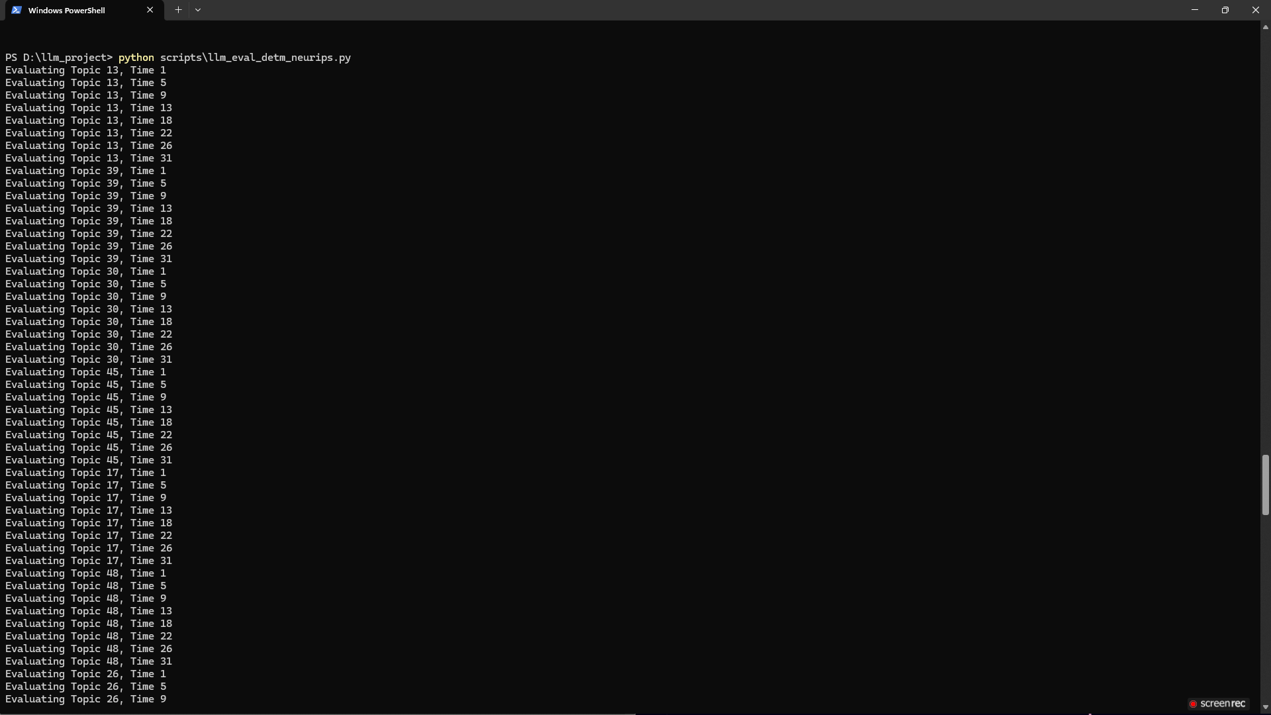
MODEL RESULTS-FEW execution samples
MISTRAL 7B -RAN IN CPU
Temporal Coherence and Smoothness Evaluation By Mistral 7B.

Slide 8
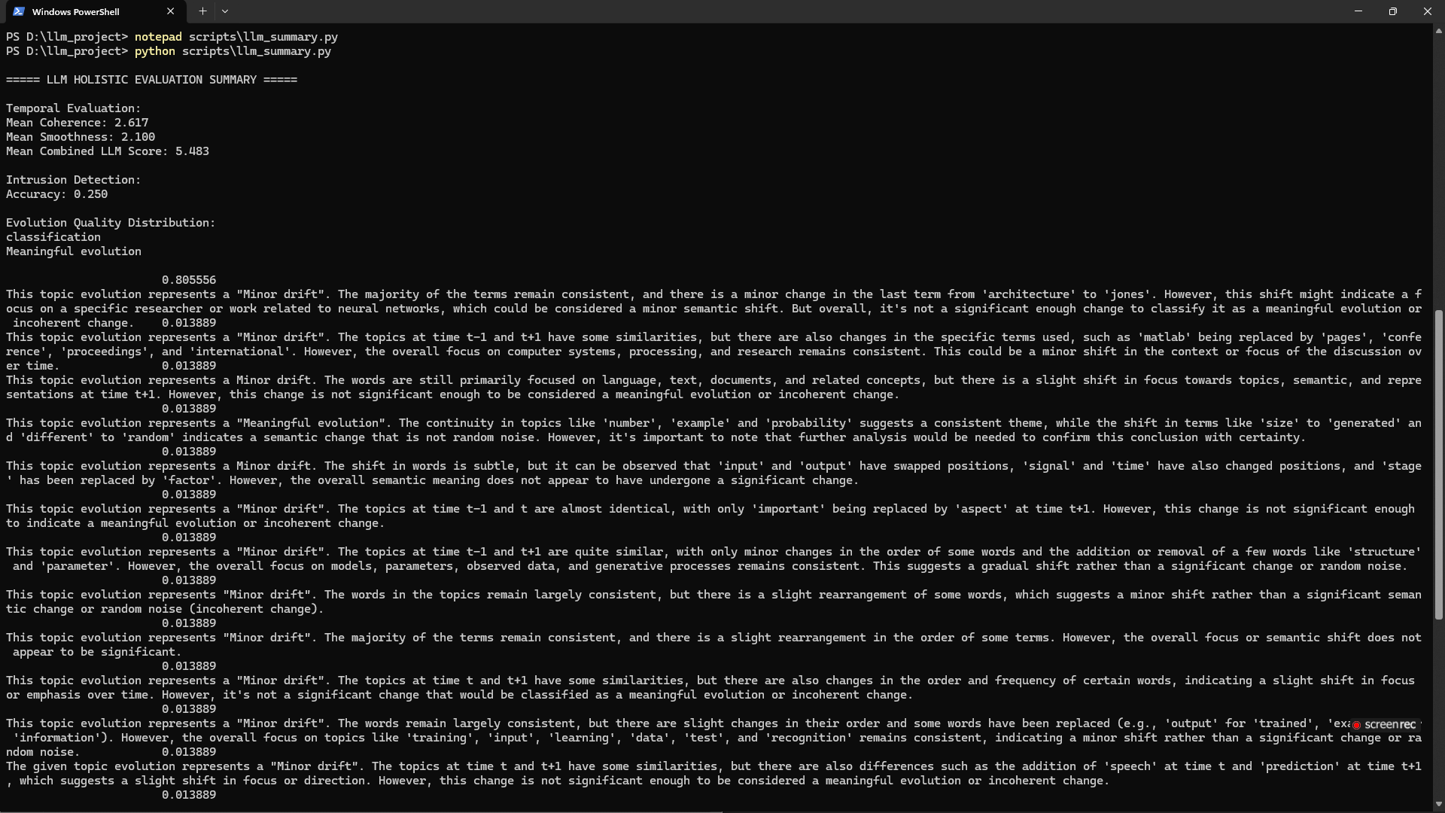
RESULTS
1
Name a challenge
2
Name a challenge
List any challenges, issues, or setbacks the company encountered during this period.
List any challenges, issues, or setbacks the company encountered during this period.
3
Name a challenge
4
Name a challenge
Evaluation Summary by LLM-MISTRAL 7B

Slide 9
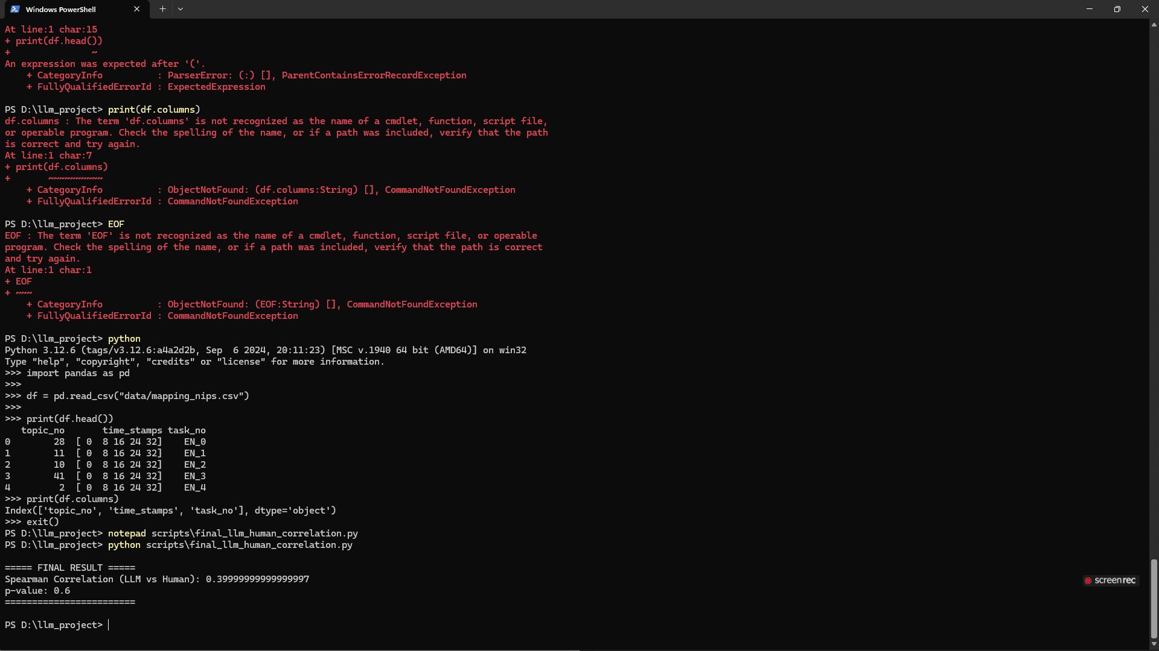
CORRELATION RESULTS FOR MISTRAL
Add challenge here
Analyze the impact of this external industry challenge on the business, and discuss potential solutions.
LINK TO RESOURCE
Overall Correlation Summary of Mistral 7B

Slide 10
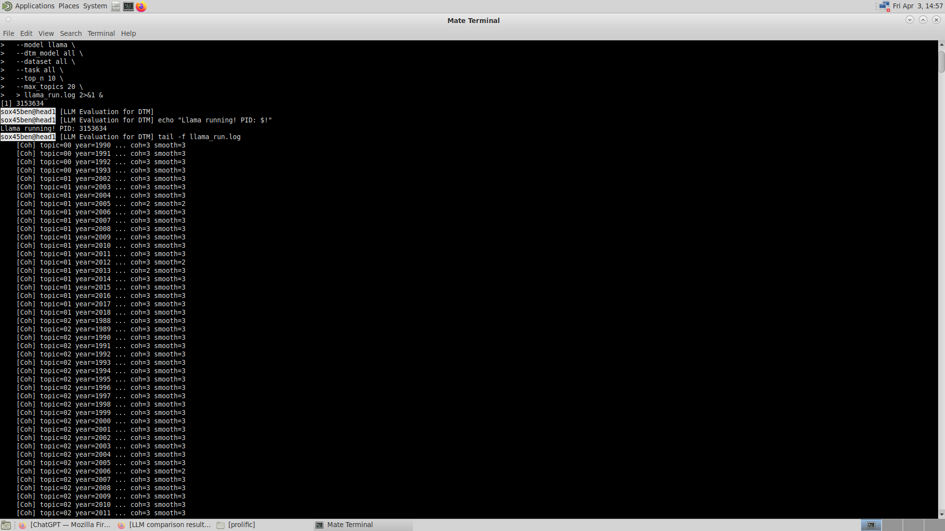
2.LLAMA RESULTS-task 1
Add challenge here
Give a project overview, including roadblocks, root causes of underperformance, and potential solutions for next quarter.

Slide 11
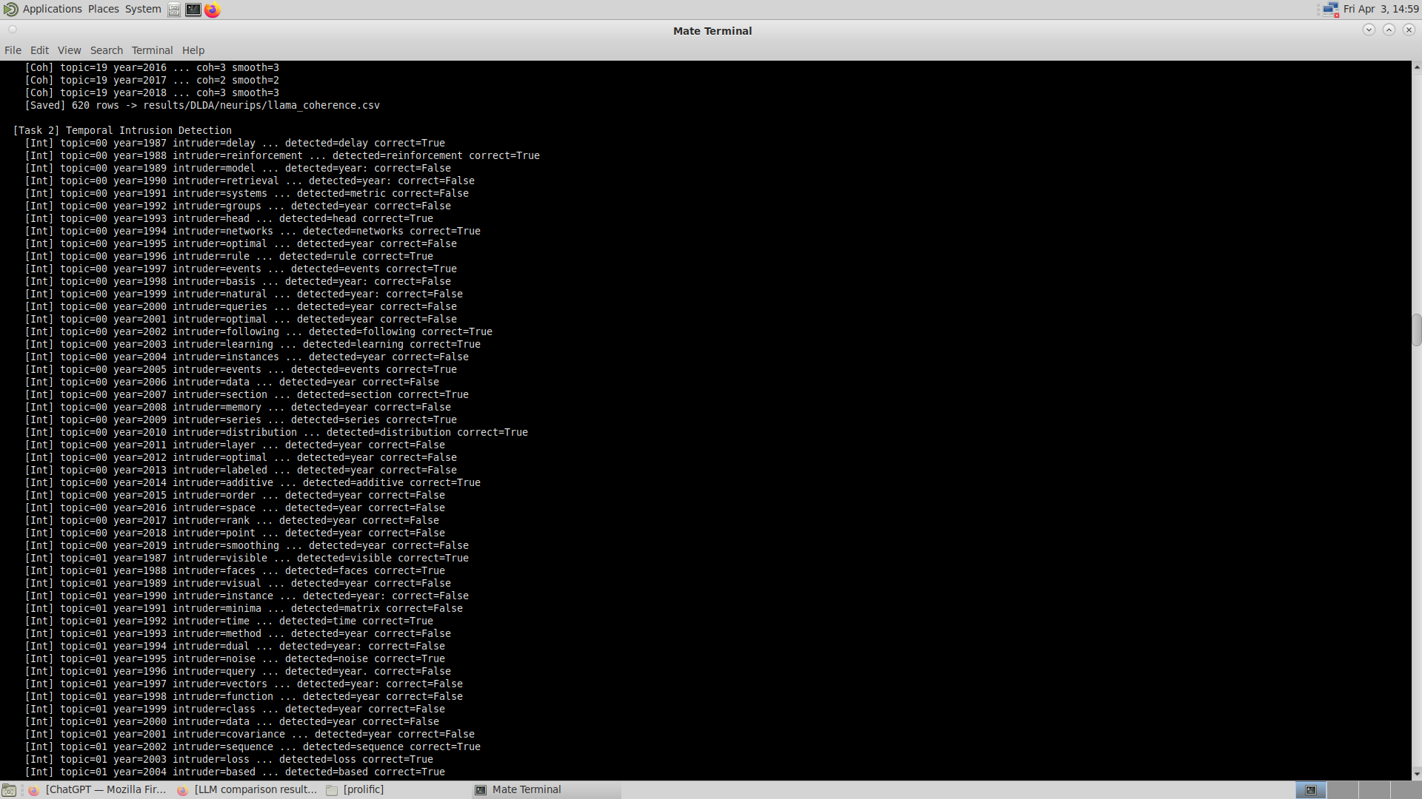
RESULTS-task 2
Add challenge here
Summarize the internal setback, its causes, and lessons learned.
Recommend preventative measures.
STEP 1
STEP 2
STEP 3
Explain how you’ll address this challenge. Make sure it’s clear what needs to be done.
Specify who or which teams will be responsible for implementing each step in the action plan.
Add specific deadlines or milestones for each step.

Slide 12
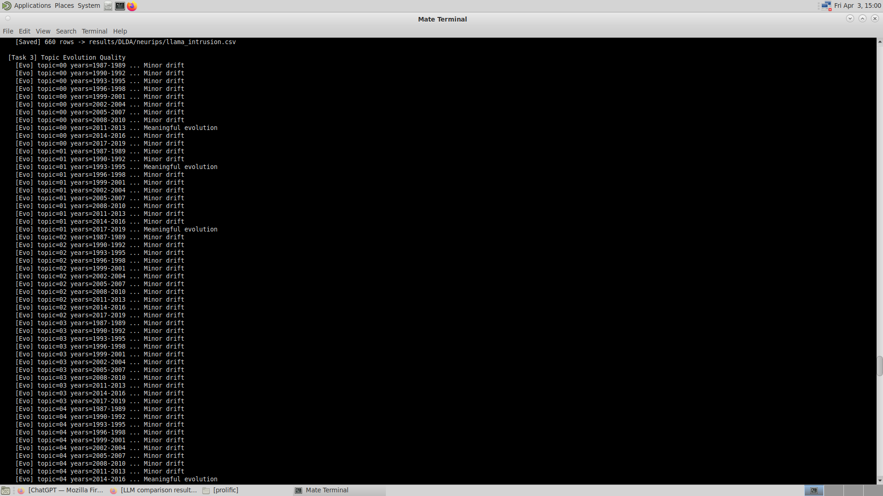
RESULTS-task 3
00%
00%
00%
Customer retention
Growth rate
User growth

Slide 13
QWEN ,DEEP SEEK - These Models also ran and all their CSVs are Attached in Repo.
Qwen 2.5 7B:
Completed: DLDA × neurips, nyt, unDebates (all 3 tasks)
Coherence scores: mostly 3/3 (strong positivity bias)
Smoothness: more variance than Llama
Limitation: Free tier credit exhaustion on some combinations
DeepSeek R1 Distill 8B:
Completed: DLDA × neurips, nyt (coherence + intrusion + evolution)
Uses chain-of-thought reasoning before scoring
More nuanced scores due to reasoning approach
Limitation: Hugging Face free tier credits exhausted mid-run

Slide 14
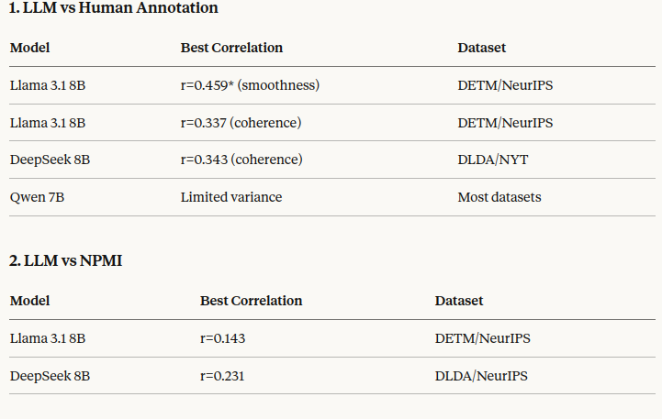
COMPARISONS AND KEY FINDINGS

Slide 15
3 KEY FINDINGS
1.LLMs can evaluate DTMs — scores correlate meaningfully with human annotations
2.Llama and Qwen perform best — MODERATE correlation with human judgments
3.LLMs outperform NPMI — better proxy for human evaluation than traditional metrics
4.DLDA vs DETM — LLM evaluation reveals quality differences between models
5.Evolution task — most unique contribution, captures temporal dynamics NPMI cannot
GITHUB AND CODE:
https://github.com/Harshavardhan-2001GIT/DTM-LLM-EVALUATION-

Slide 16
CONCLUSION
LLM-based evaluation is a viable and scalable alternative to human annotation for DTMs.
4 open-source 8B models tested across 2 DTMs and 3 datasets.
Moderate but Meaningful Correlation with human judgments, especially for coherence.

Slide 17
THANK YOU
PRESENTED BY - HARSHAVARDHAN KASTHURI UMASHANKAR

