Slide 1
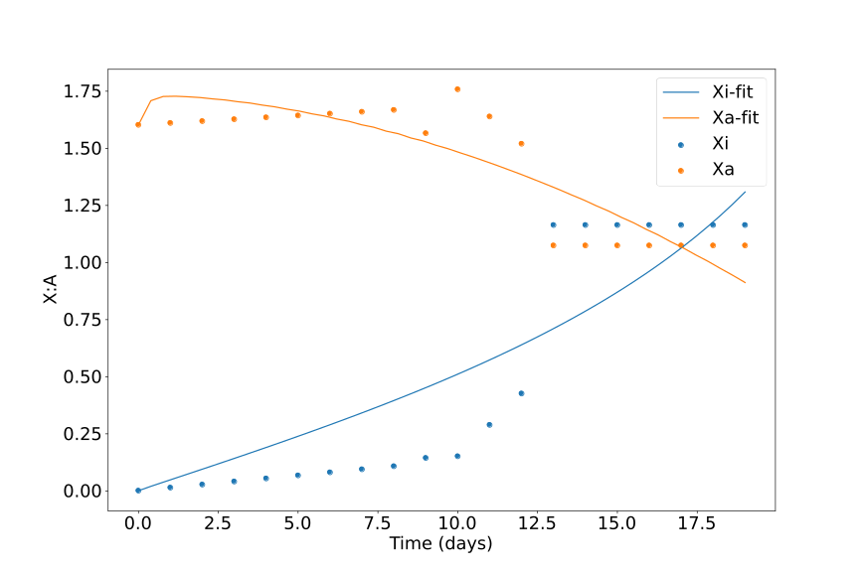

iPSC data Double Inhibition
n=1.7806488041608826
Inhibition
K1=0.15436828977537623
K2=1.3555427469456476
a1=3.474394518518872
a2=7.491216060888568
Decay
c1=0.0
c2=4.321399022523138

Slide 2
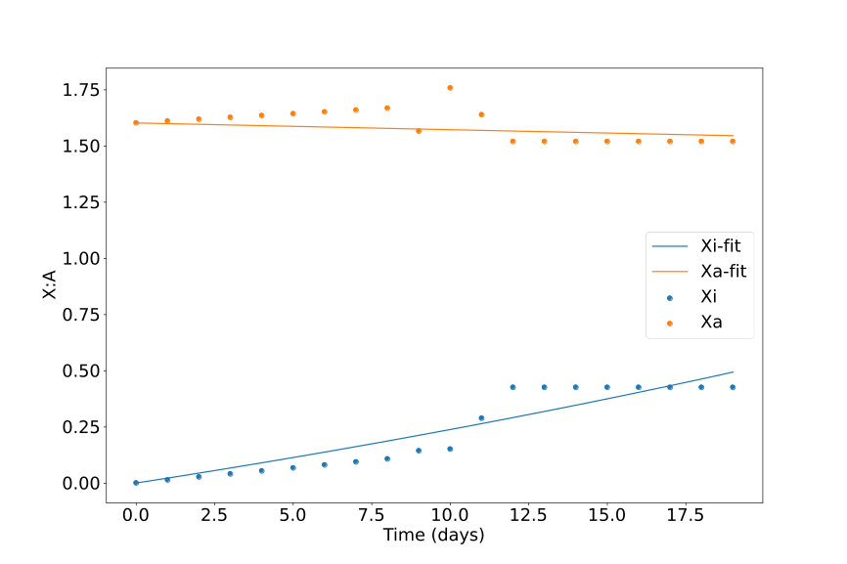
Partial reactivation data Double Inhibition
n=9.843351973287819
Inhibition
K1=0.9256863441846341
K2=9.755170993000133
a1=4.829799812516538
a2=0.0
Degradation
c1=0.0
c2=0.001892904066171693

Slide 3
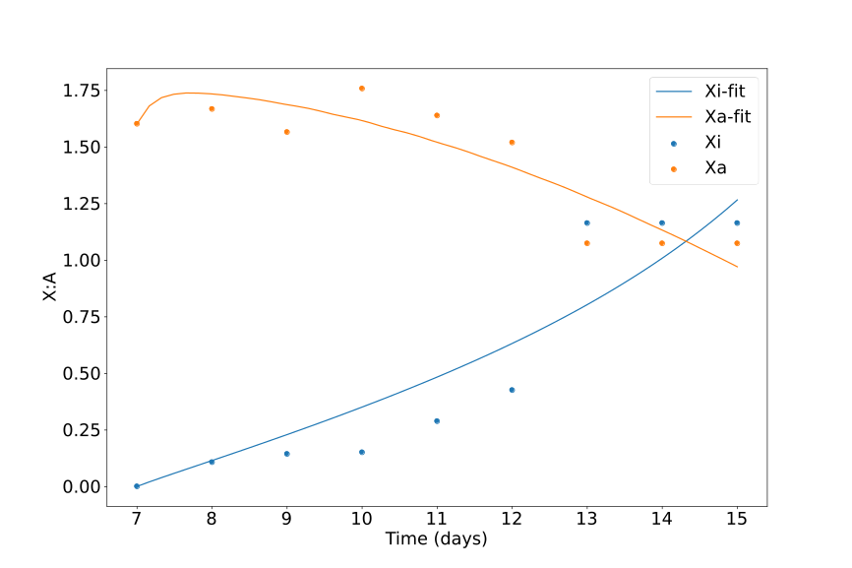
Timeshifted iPSC data Double Inhibition
n=1.7110686077237123
Inhibition
K1=0.18367378724485392
K2=1.3668742245022558
a1=5.343001186944124
a2=7.9815966289970675
Degradation
c1=0.0
c2=4.551173815185701

Slide 4
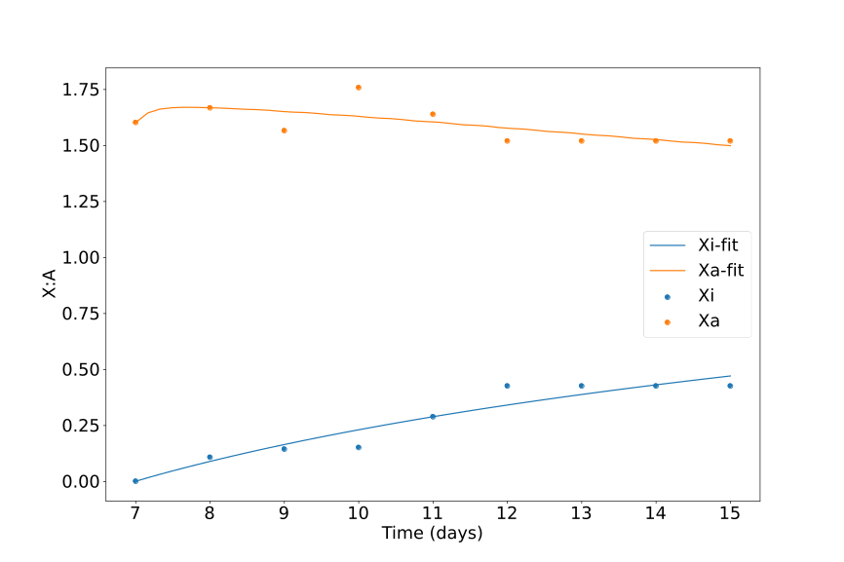
Timeshifted Partial reactivation data Double Inhibition
n=1.9274497627204683
Inhibition
K1=0.43887097108237
K2=1.41772834331741
a1=1.3503910043606726
a2=9.246664659620482
Degradation
c1=0.16431424220204188
c2=5.521082066995819

Slide 5
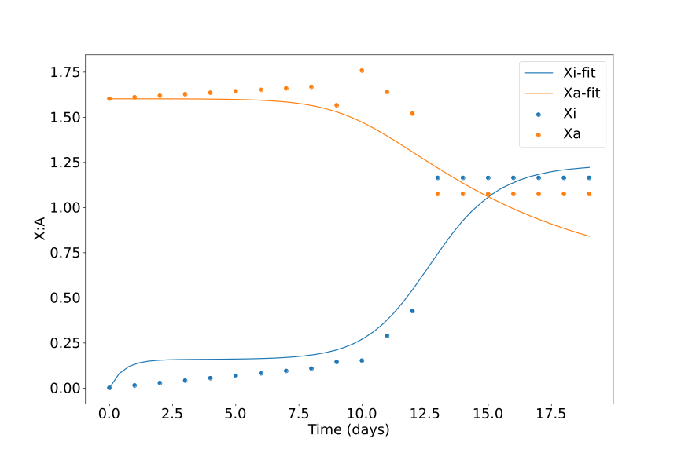

iPSC data Double Inhibition with Self Activation
n=9.908577440673385
Inhibition
K1=1.3202768951435337
K2=8.023636119560424
a1=2.263908486472142
a2=0.08579519387345196
Self Activation
K3=5.1991840732221055
K4=2.3843611794611004
b1=0.47127906055955743
b2=8.11436082478825
Degradation
c1=1.8228761558547175
c2=0.15049866025289754

Slide 6
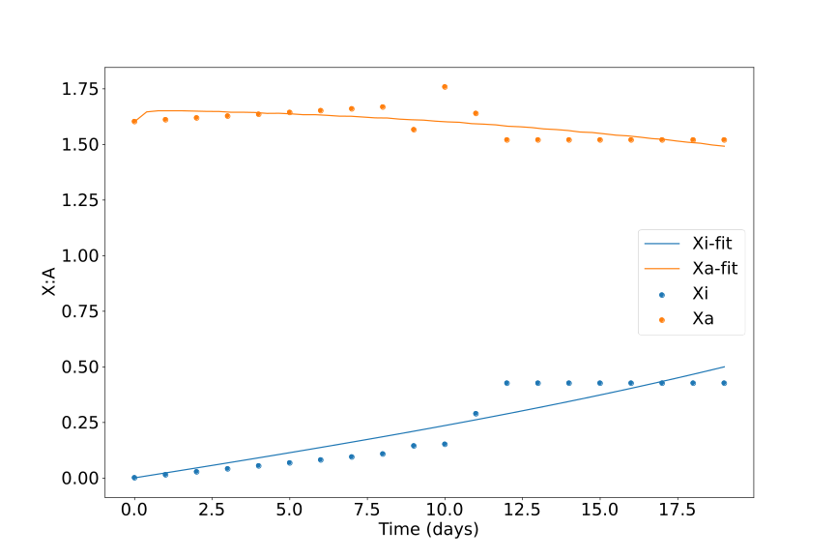
Partial reactivation data Double Inhibition with Self Activation
n=1.6270240975684624
Inhibition
K1=1.0368215068658908
K2=1.9469553012622942
a1=0.06972094779892697
a2=9.185363358632113
Self Activation
K3=8.40752698585176
K4=2.849551348574139
b1=0.9064195003986512
b2=0.20604241177561264
Degradation
c1=0.0
c2=5.592975997282622

Slide 7
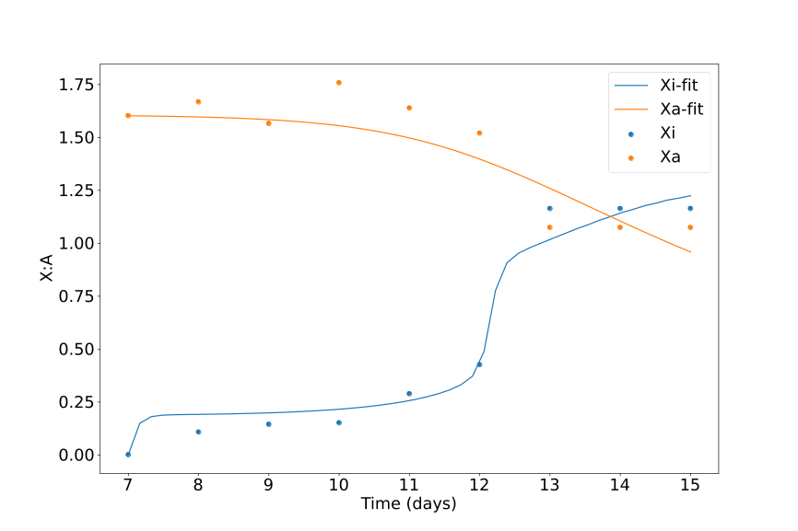
Timeshifted iPSC data Double Inhibition with Self Activation
n=6.51317324751705
Inhibition
K1=1.3702788380329984
K2=4.338077059157671
a1=6.910338679888934
a2=0.06553578566401476
Self Activation
K3=0.4875556971656061
K4=2.3384837318727834
b1=5.725071109042663
b2=3.659815019759642
Degradation
c1=9.751289202647108
c2=0.2226964772664459

Slide 8
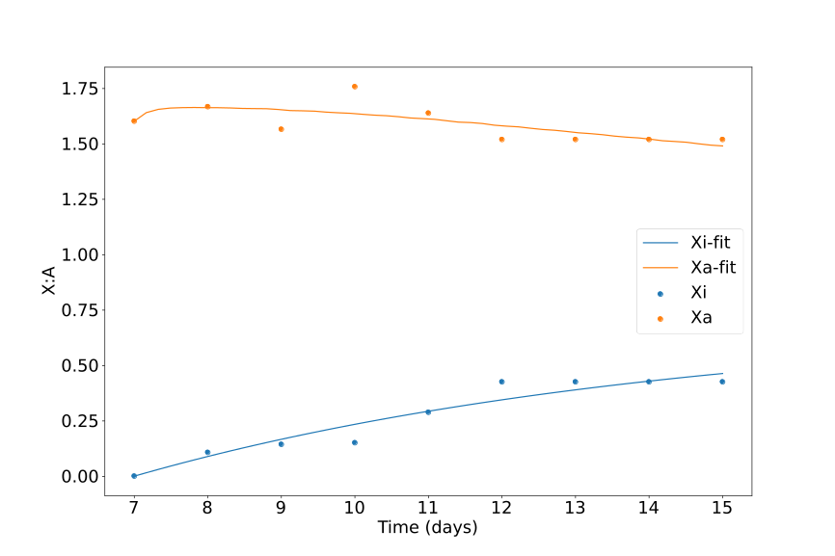
Timeshifted partial reactivation data Double Inhibition with Self Activation
n=2.6087147920170066
Inhibition
K1=7.583092702831625
K2=1.0534274262897234
a1=0.09704133644587162
a2=9.721554224340244
Self Activation
K3=6.279908231067063
K4=5.671162688508528
b1=0.18993415588459342
b2=3.802480754129812
Degradation
c1=0.1372736264289212
c2=5.924834370548845

Slide 9
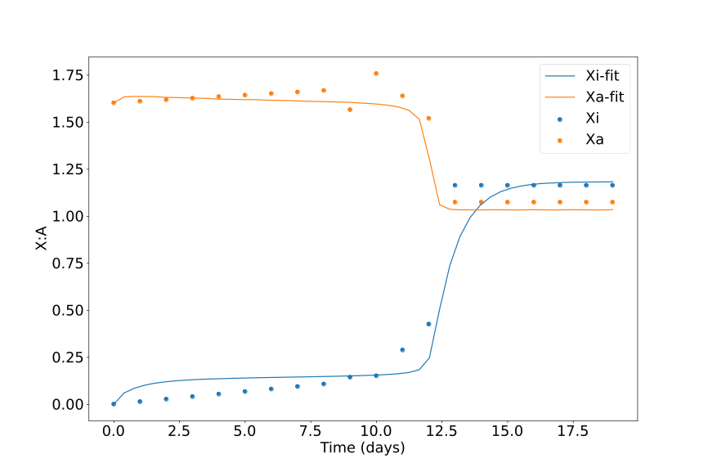

iPSC data Double Inhibition with Self Inhibition
n=8.934699882771397
Inhibition
K1=1.2744645912671497
K2=0.20799671710950615
a1=1.5054952492317206
a2=3.8685994750280317
Self Inhibition
K3=6.279908231067063
K4=6.989142530955676
b1=3.6946726229327544
b2=6.6325679334297005
Degradation
c1=1.102140449686889
c2=6.414595765178472

Slide 10
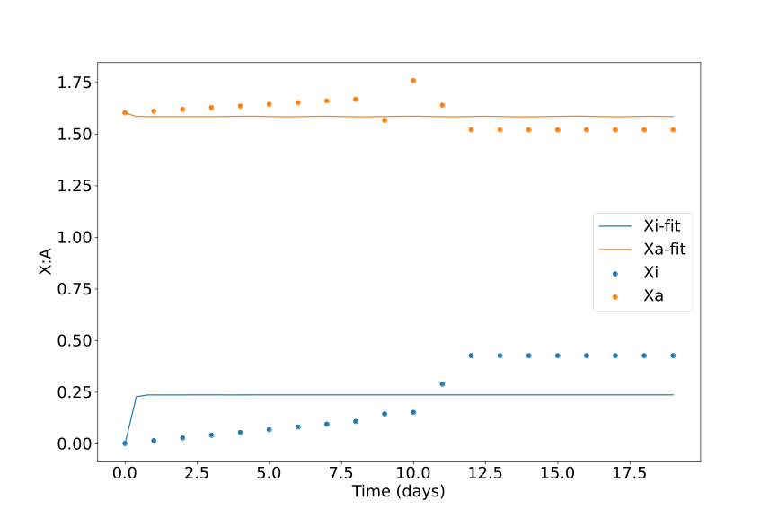
Partial reactivation data Double Inhibition with Self Inhibition
n=7.11571284125255,,,,,,,,,,
Inhibition
K1=0.4560846496871047
K2=5.674872137377883
a1=7.040032083647233
a2=8.479222810130448
Self Inhibition
K3=8.904512270574493
K4=5.83245898085965
b1=2.007216053148987
b2=6.906203268097633
Degradation
c1=8.466747935163625
c2=9.705502768690057

Slide 11
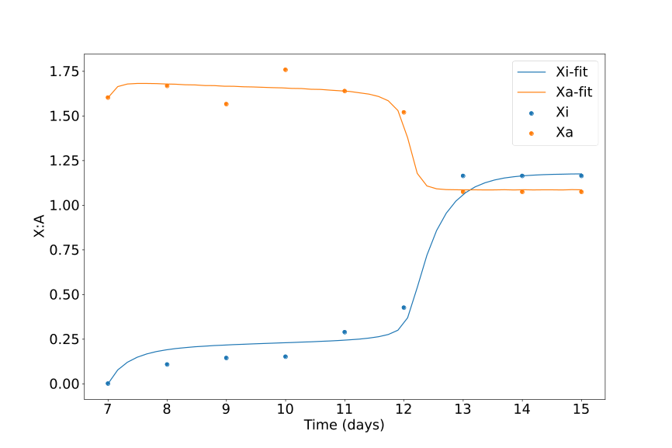
Timeshifted iPSC data Double Inhibition with Self Inhibition
n=8.936981219947606
Inhibition
K1=1.3990992305195387
K2=0.3221065014216531
a1=2.9266333841920447
a2=5.308039050047207
Self Inhibition
K3=7.376528051381408
K4=4.702799241585233
b1=0.0005739605106166236
b2=2.252582943610238
Degradation
c1=9.654362711087279
c2=8.887035691770519

Slide 12
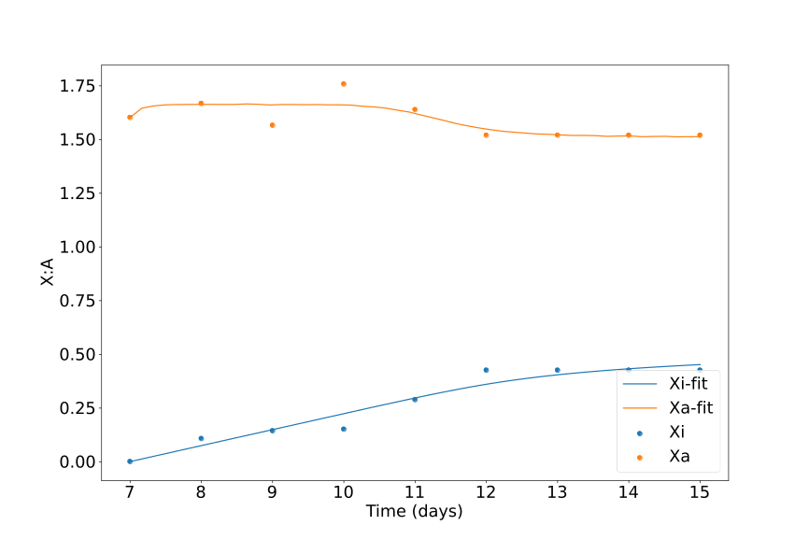
Timeshifted partial reactivation data Double Inhibition with Self Inhibition
n=9.991241732052561
Inhibition
K1=0.3768879392783617
K2=0.31675724987644216
a1=3.7651204168974264
a2=1.0611964730603667
Self Inhibition
K3=0.3995827660983693
K4=2.661440658309128
b1=0.07443192229442008
b2=9.771065476377958
Degradation
c1=0.0003004469998941772
c2=6.458176929231091

