Slide 1
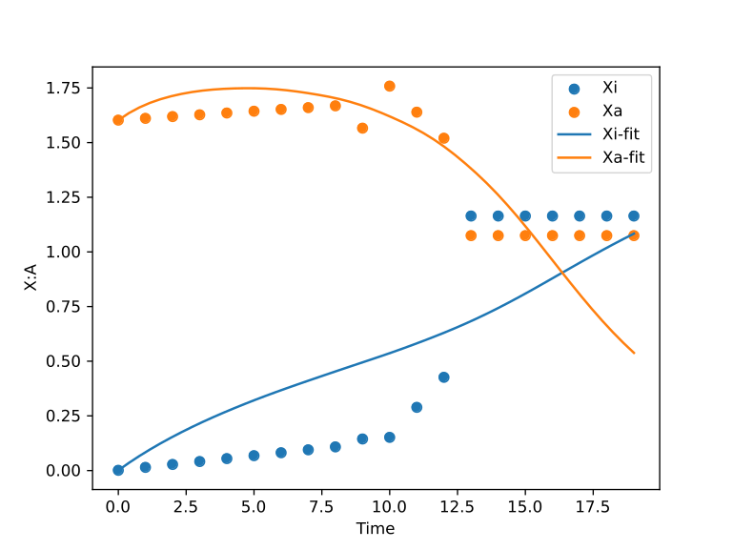

iPSC data Double Inhibition
n=4.69061130681539
Inhibition
K1=1.72729230379343
K2=0.794575299477114
a1=2.00572478753676
a2=0.333975361561726
Decay
c1=0.0843418204370419
c2=0.555318768459067

Slide 2
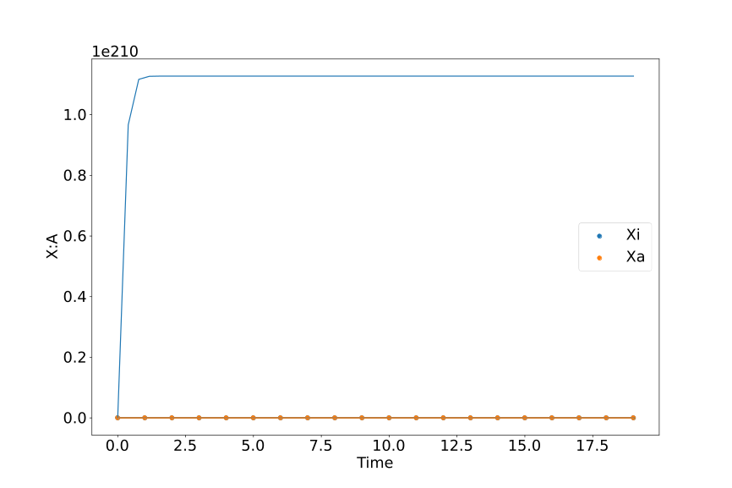
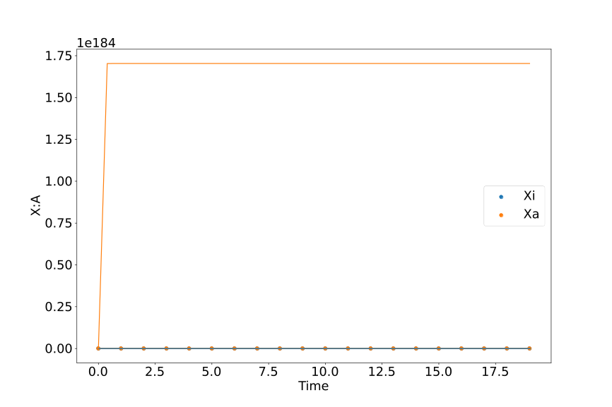
Double Inhibition
iPSC
Partial

Slide 3
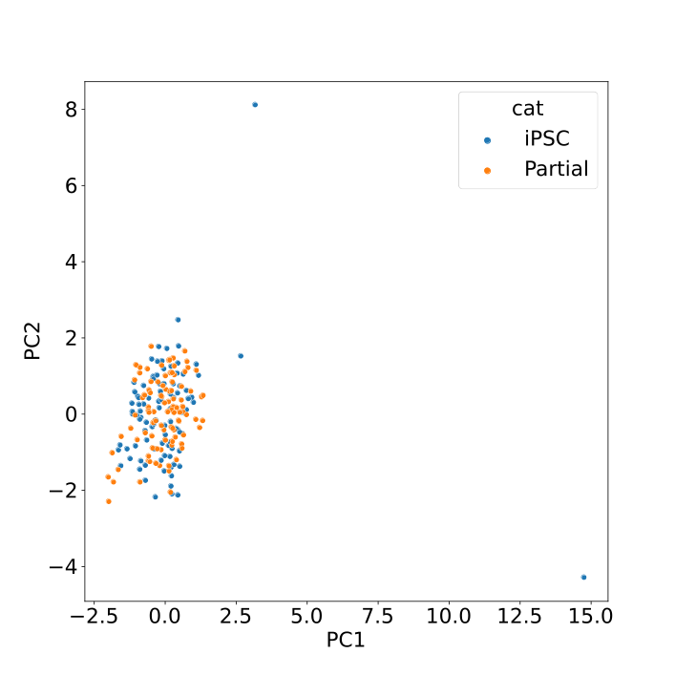
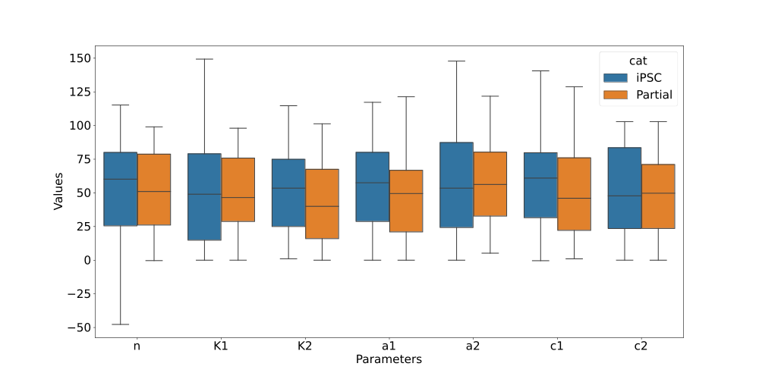
Double Inhibition

Slide 4
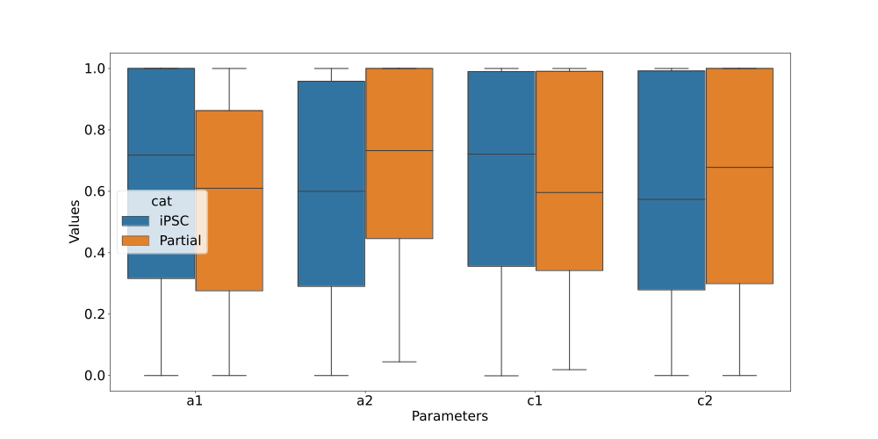
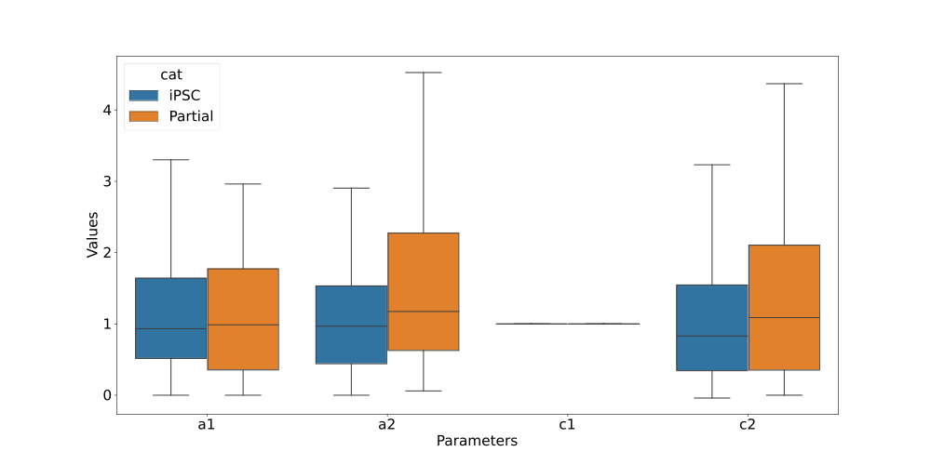
Double Inhibition
Max Normalized
c1 Normalized

Slide 5
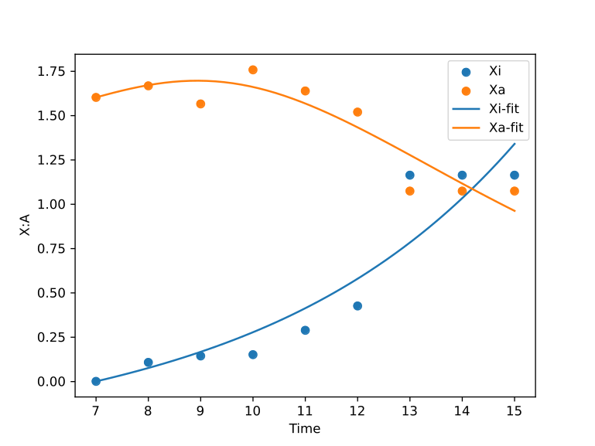
Timeshifted iPSC data Double Inhibition
n=1.84988897410296
Inhibition
K1=3.81123671763214
K2=0.383429769905525
a1=0.980266701390861
a2=0.0656044399948125
Degradation
c1=-0.194956476670639
c2=0.189441530837799

Slide 6
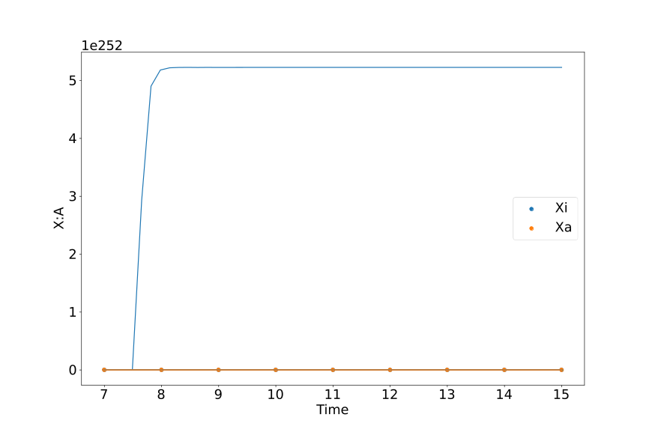
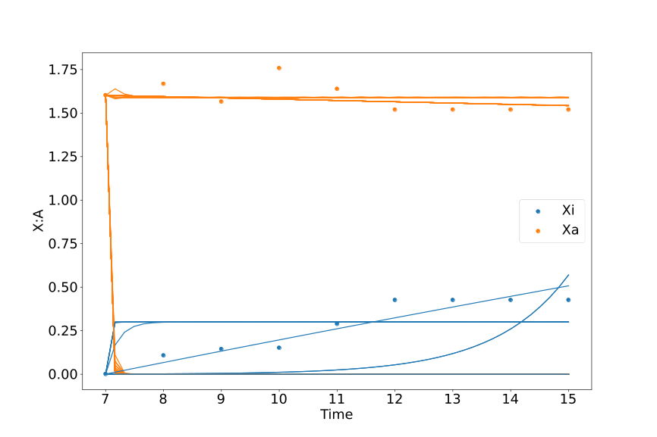
Timeshifted Double Inhibition
iPSC
Partial

Slide 7
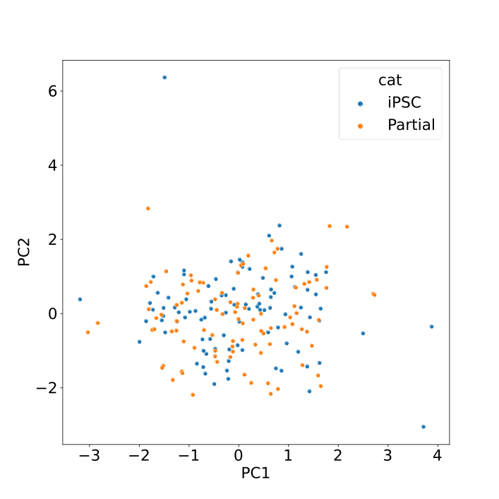
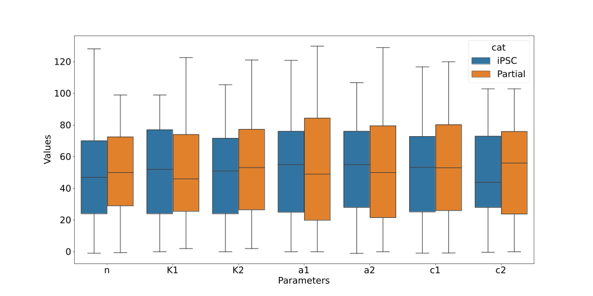
Timeshifted Double Inhibition

Slide 8
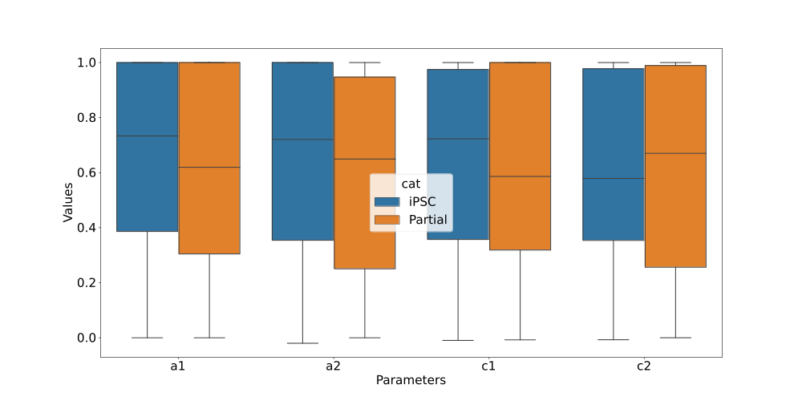
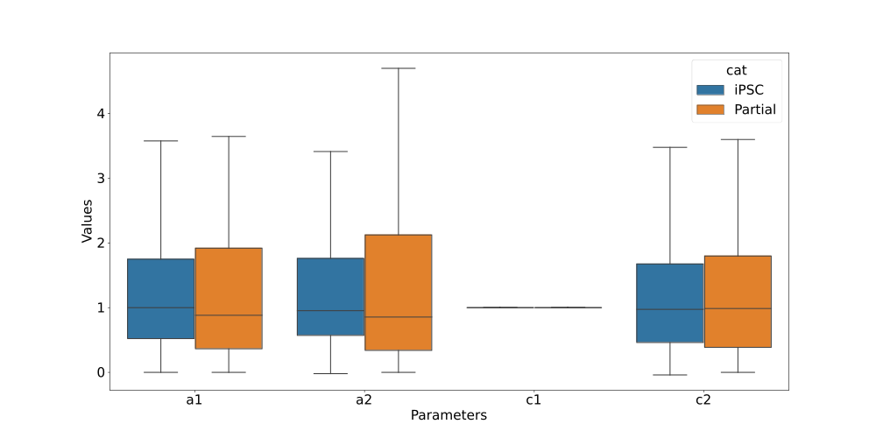
Timeshifted Double Inhibition
Max Normalized
c1 Normalized

Slide 9
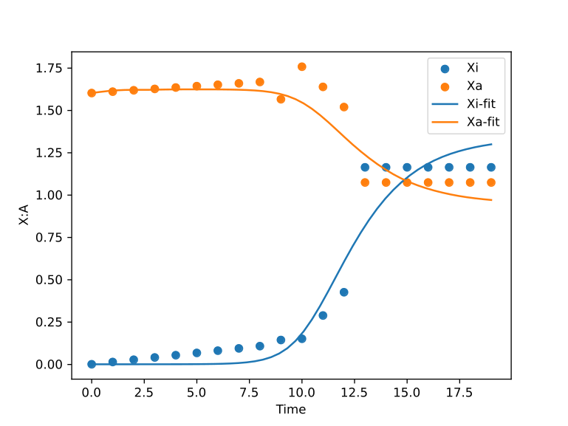

iPSC data Double Inhibition with Self Activation
n=1.01091589490725
Inhibition
K1=1.33329237813302
K2=1.21287390737187
a1=-0.00355669919350192
a2=1.3019762210339
Self Activation
K3=0.748865082336979
K4=0.840387187585119
b1=1.46858712145292
b2=0.789435817527975
Degradation
c1=0.702960911703544
c2=0.979435201878159

Slide 10
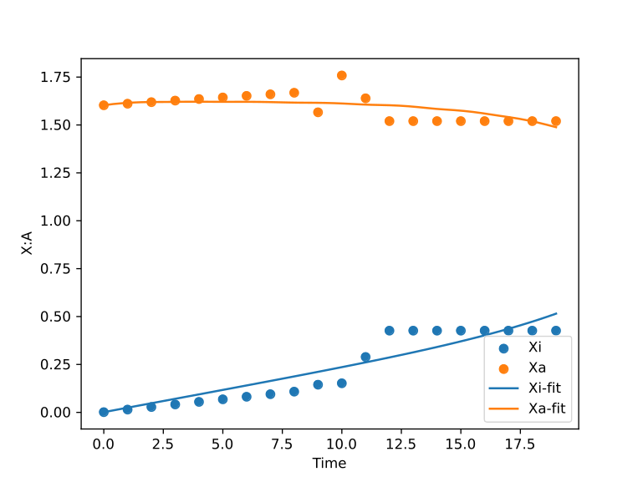
Partial reactivation data Double Inhibition with Self Activation
n=3.34689563529546
Inhibition
K1=1.96264416276486
K2=0.985313537429607
a1=0.338361549168242
a2=1.66146563911895
Self Activation
K3=1.26926281819144
K4=1.23770303858757
b1=0.417740210930793
b2=-0.779094014516749
Degradation
c1=0.00075763797466554
c2=0.734433144640917

Slide 11
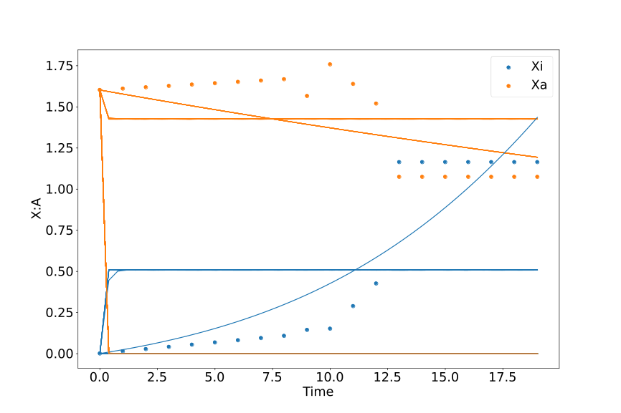
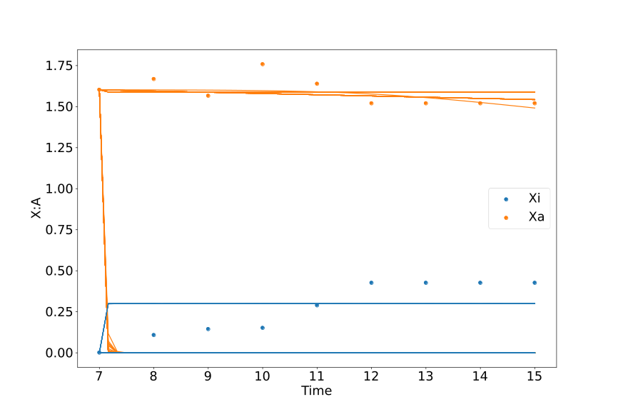
Double Inhibition with Self Activation
iPSC
Partial

Slide 12
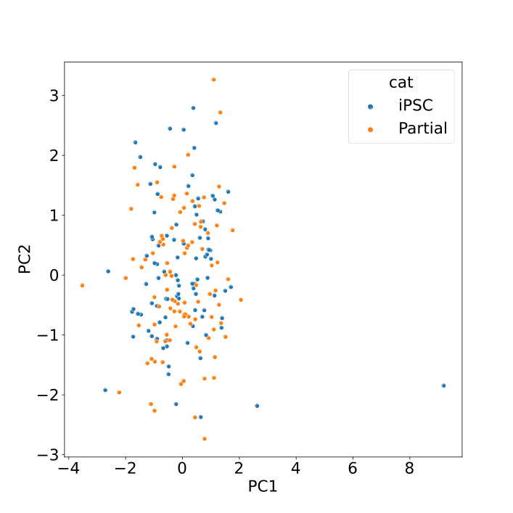
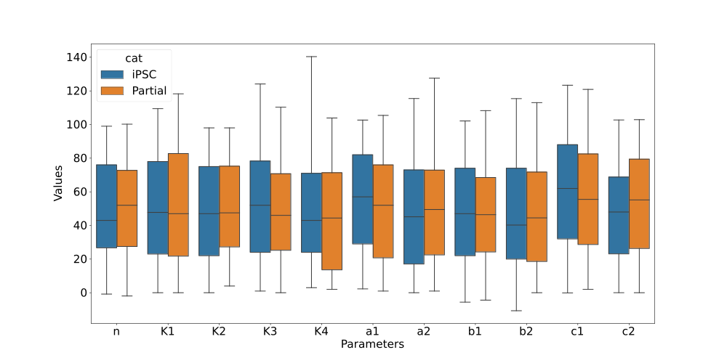
Double Inhibition with Self Activation

Slide 13
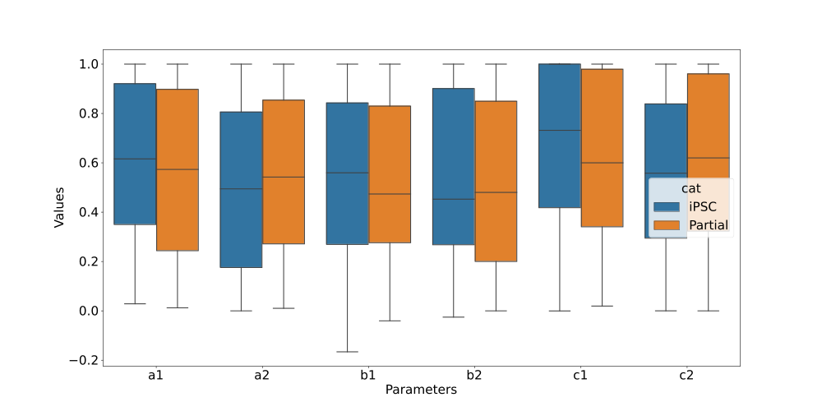
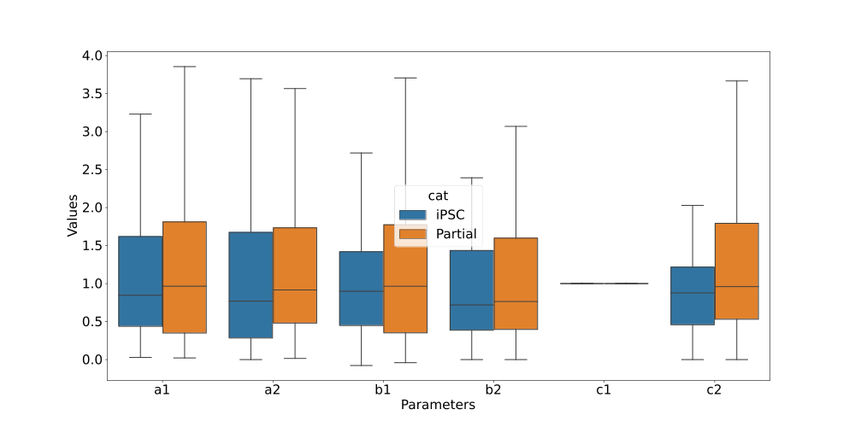
Double Inhibition with Self Activation
Max Normalized
c1 Normalized

Slide 14
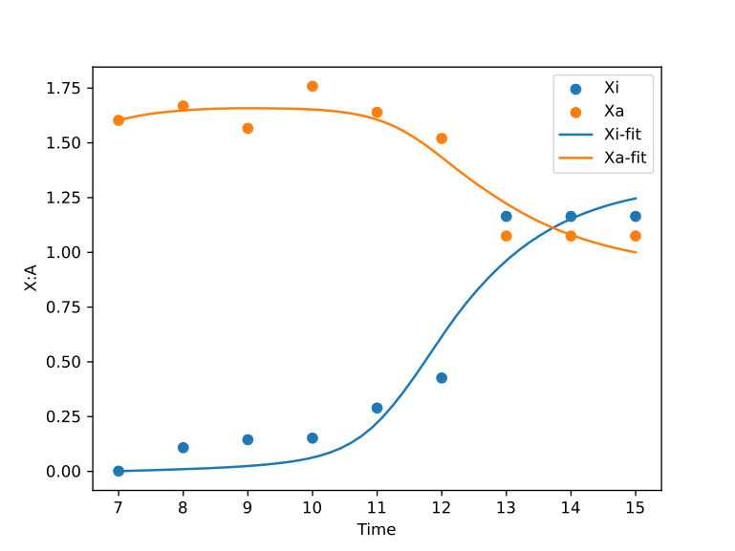
Timeshifted iPSC data Double Inhibition with Self Activation
n=1.36139248810483
Inhibition
K1=0.940142426288465
K2=0.942462863579184
a1=0.0273229213611089
a2=1.31116202195172
Self Activation
b1=1.56147781097103
b2=1.16542417722904
K3=0.383871047857515
K4=0.597844738843681
Degradation
c1=1.00385302470685
c2=1.41279166325019

Slide 15
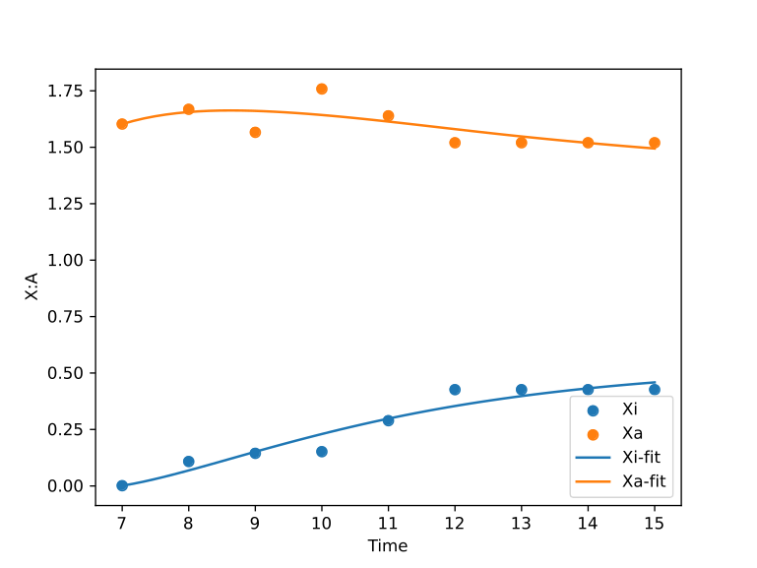
Timeshifted partial reactivation data Double Inhibition with Self Activation
n=0.675139240455651
Inhibition
K1=0.928551200211794
K2=1.43723115706515
a1=0.0937499553753753
a2=0.622856400010469
Self Activation
K3=3.32821547671623
K4=0.972808311888188
b1=1.16786026994376
b2=0.297732431685754
Degradation
c1=0.569632641498224
c2=0.352385337715491

Slide 16
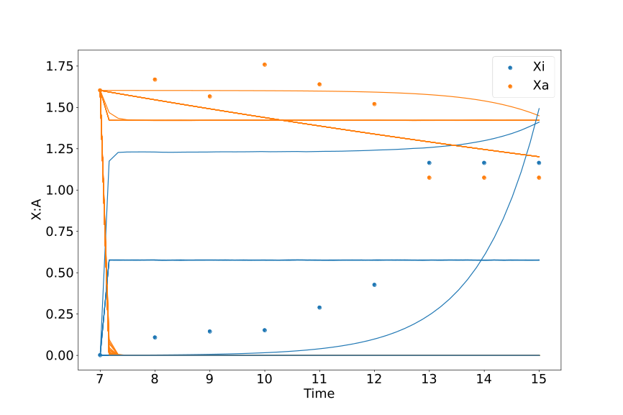
Timeshifted Double Inhibition with Self Activation
iPSC
Partial

Slide 17
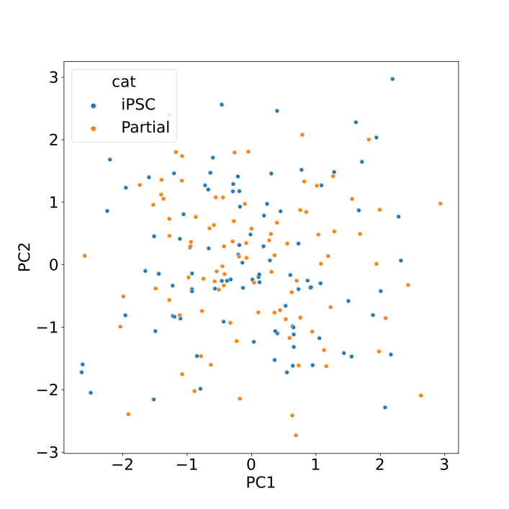
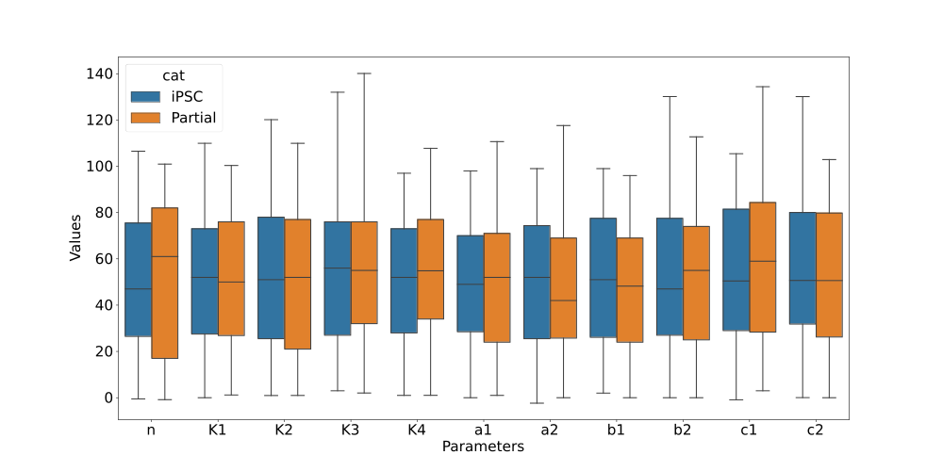
Timeshifted Double Inhibition with Self Activation

Slide 18
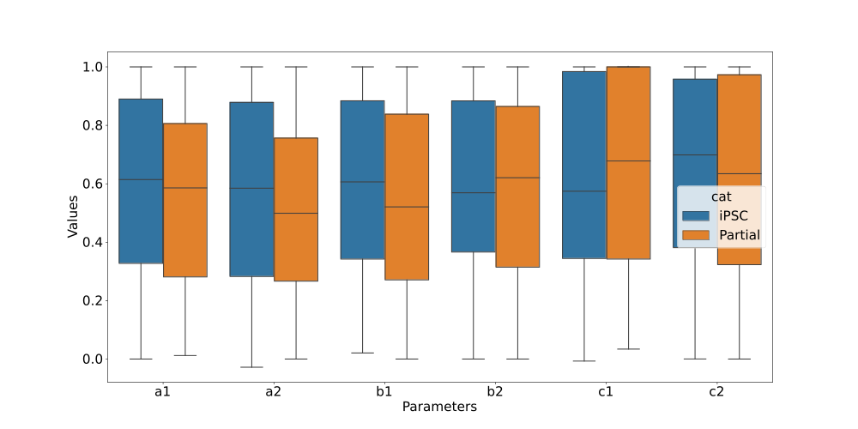

Timeshifted Double Inhibition with Self Activation
Max Normalized
c1 Normalized

Slide 19
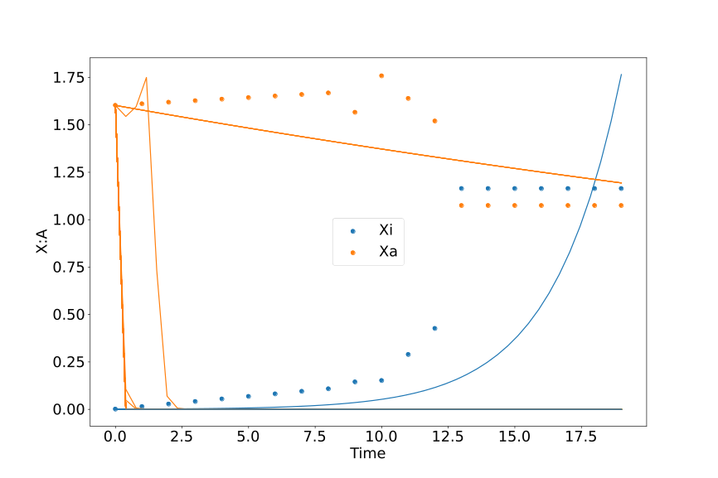
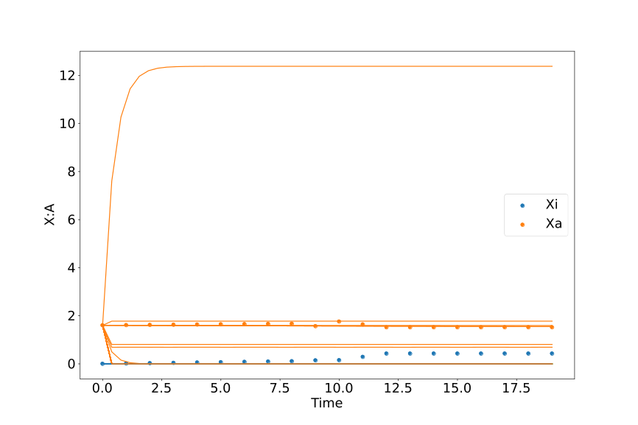
Double Inhibition through decay with Self Activation
iPSC
Partial

Slide 20
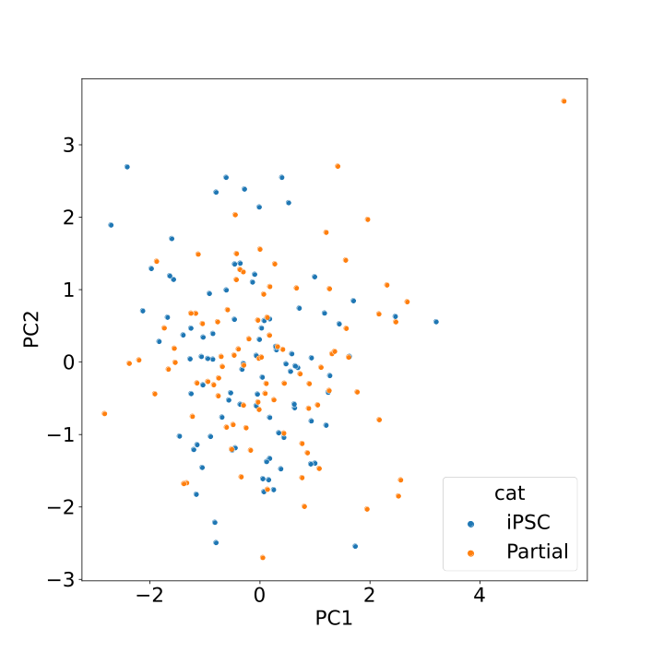
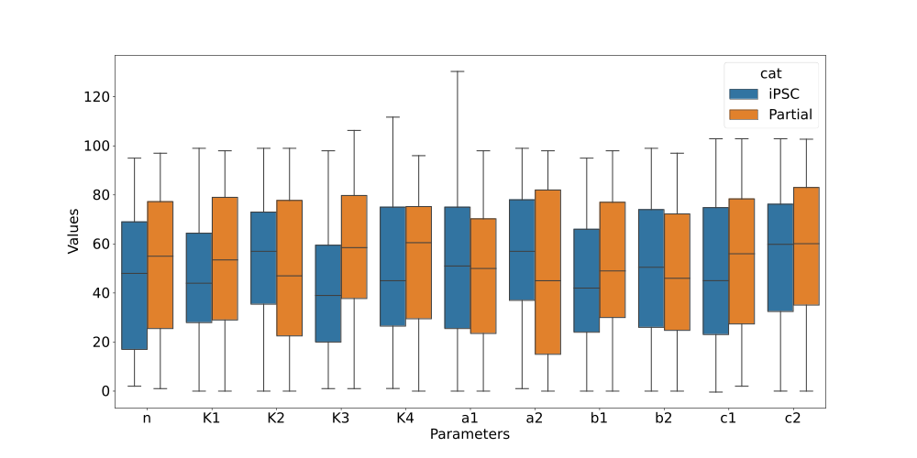
Double Inhibition through decay with Self Activation

Slide 21
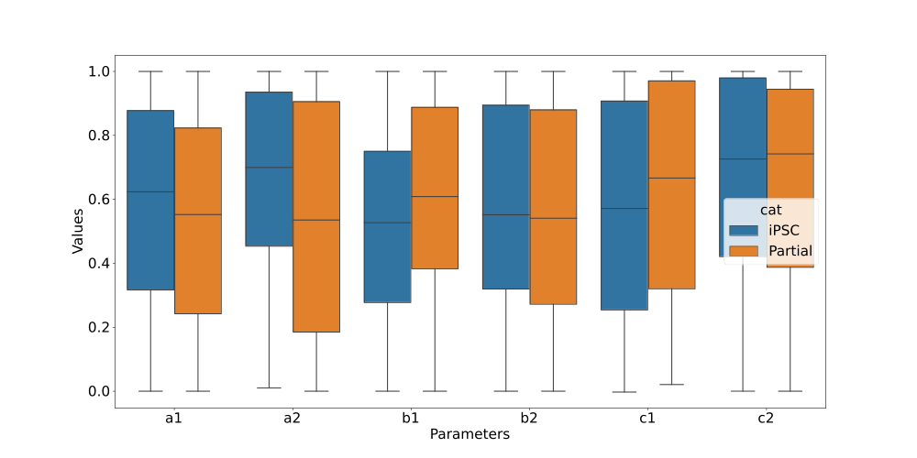
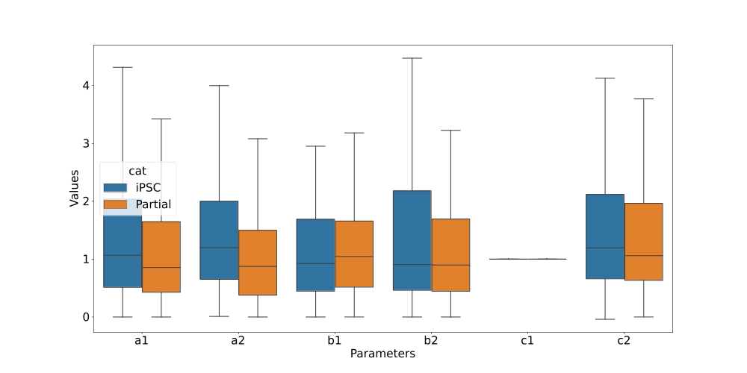
Double Inhibition through decay with Self Activation
Max Normalized
c1 Normalized

Slide 22
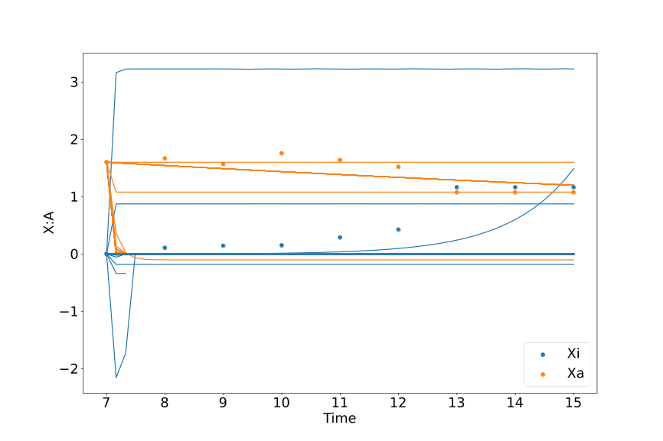
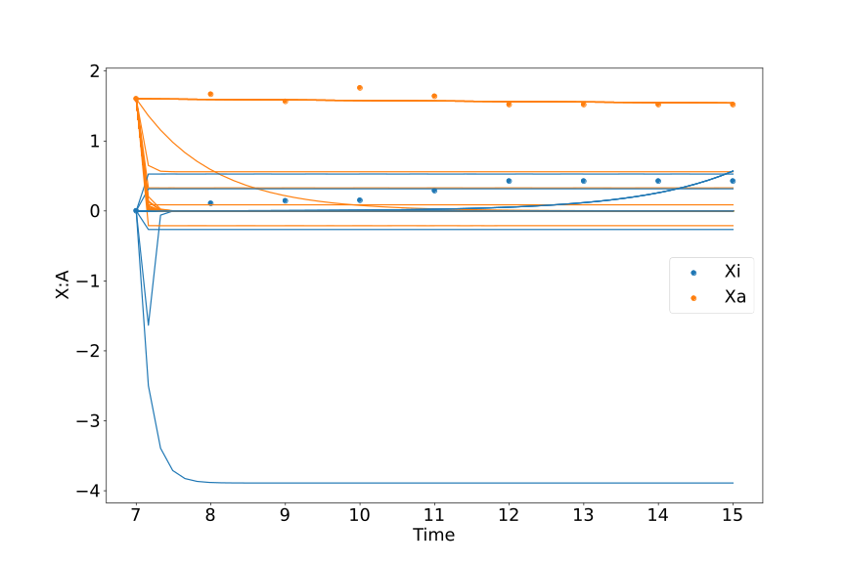
Timeshifted Double Inhibition through decay with Self Activation
iPSC
Partial

Slide 23
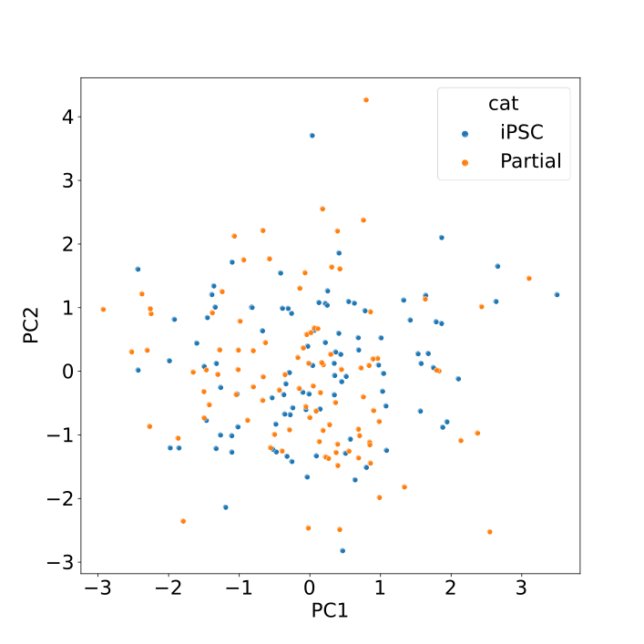
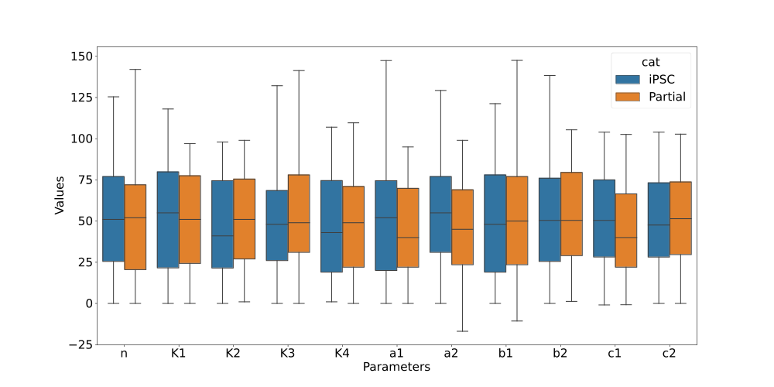
Timeshifted Double Inhibition through decay with Self Activation

Slide 24
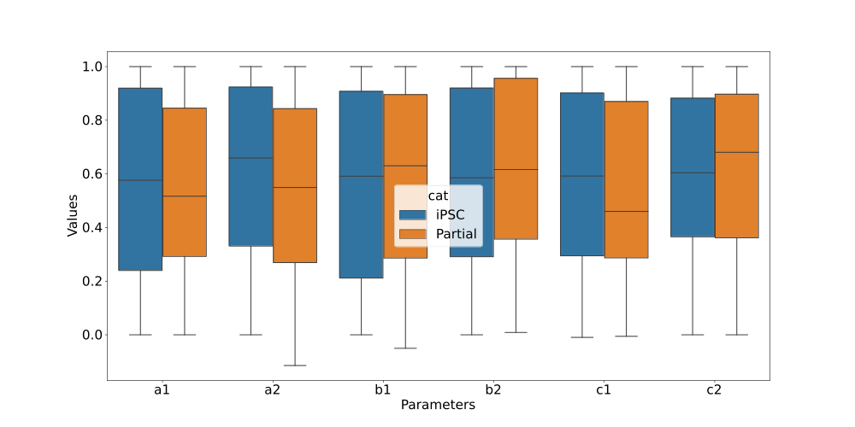
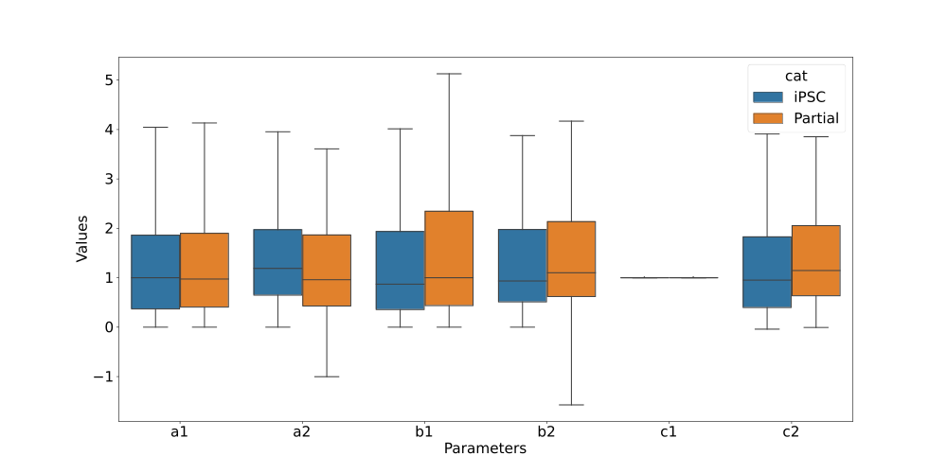
Timeshifted Double Inhibition through decay with Self Activation
Max Normalized
c1 Normalized

Slide 25
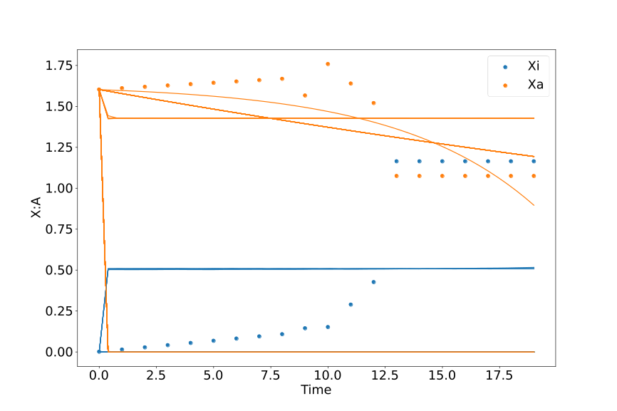
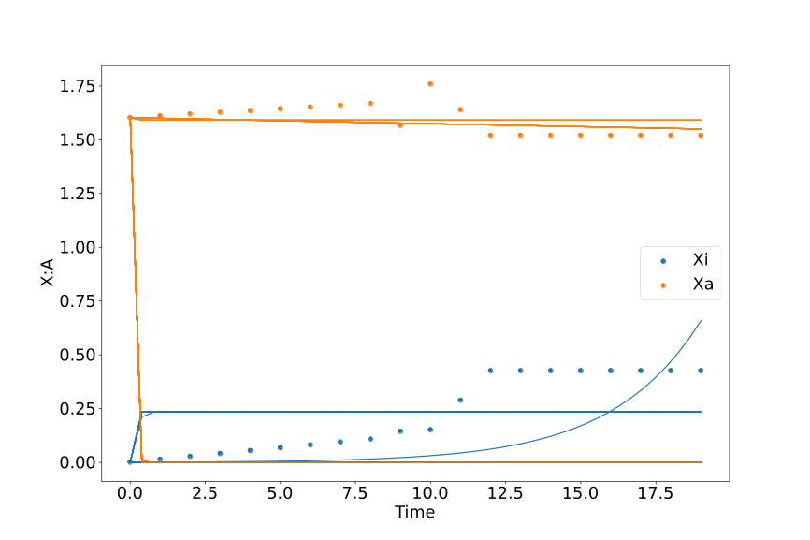
Double Inhibition with Self Inhibition
iPSC
Partial

Slide 26
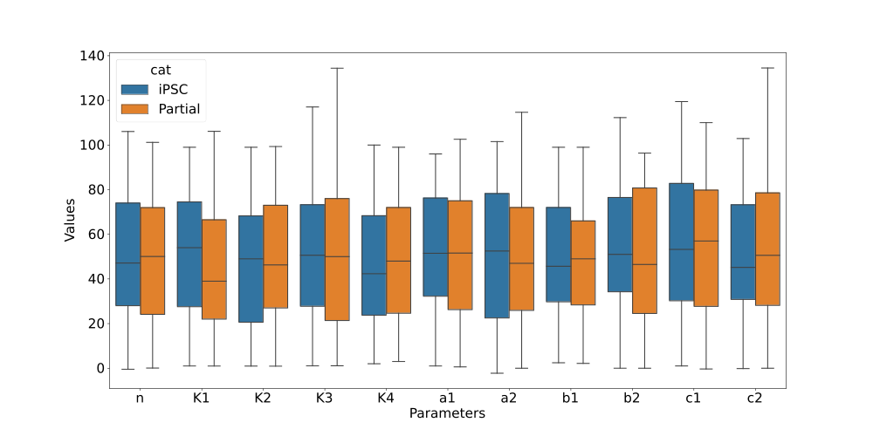
Double Inhibition with Self Inhibition

Slide 27
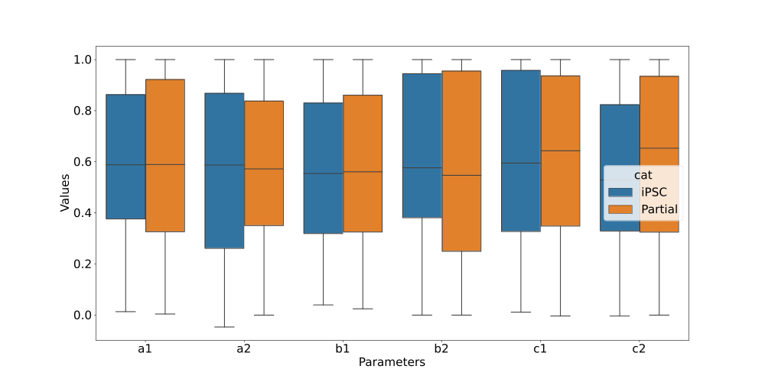
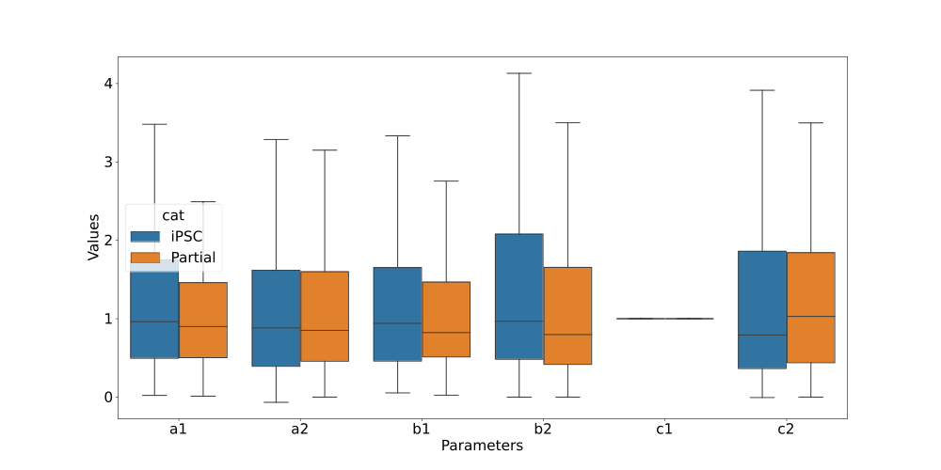
Double Inhibition with Self Inhibition
Max Normalized
c1 Normalized

Slide 28
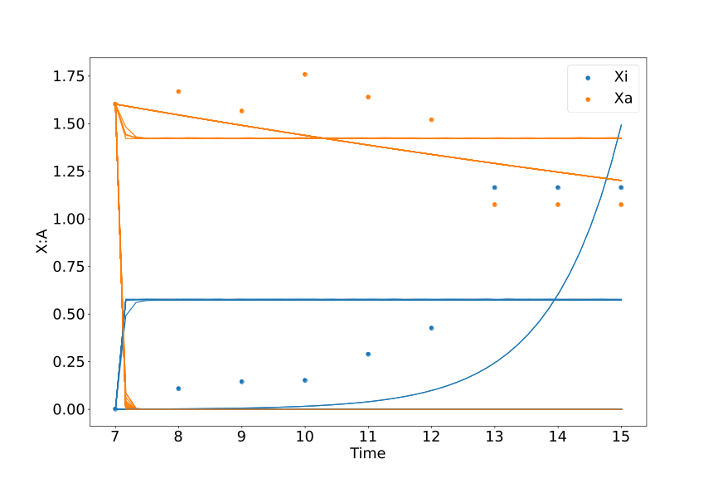
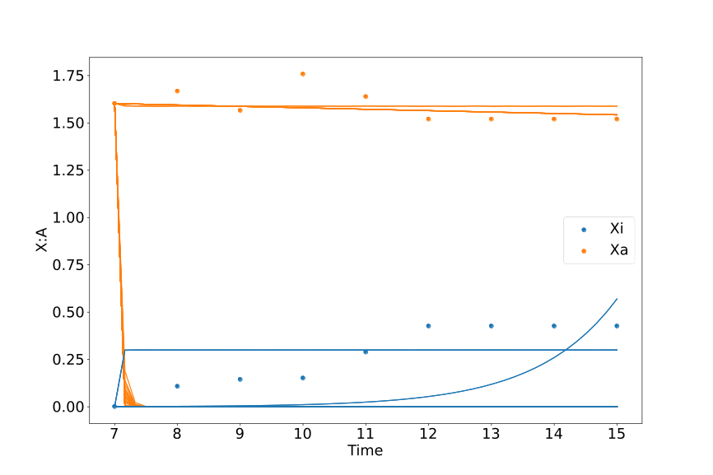
Timeshifted Double Inhibition with Self Inhibition
iPSC
Partial

Slide 29
Timeshifted Double Inhibition with Self Inhibition

Slide 30
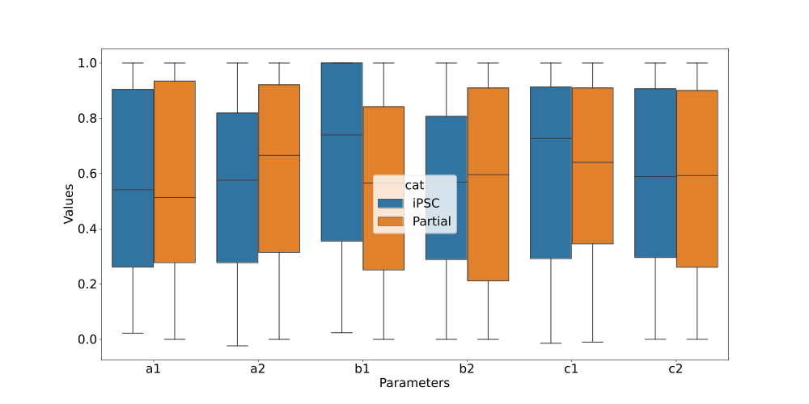
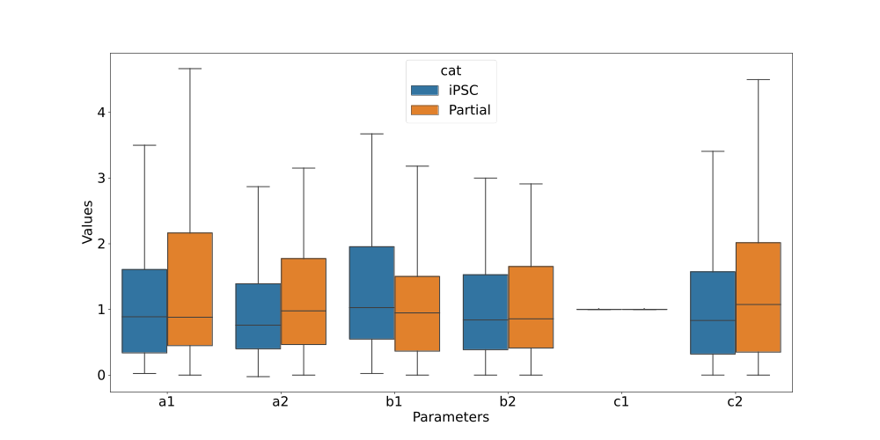
Timeshifted Double Inhibition with Self Inhibition
Max Normalized
c1 Normalized

