Slide 1

UE19CS204 – Web Technologies Mini Project
Project Title – Online Shopping Platform for Local Shops
Section - C
Harshavardhan V N : PES1UG19CS182
Janardhana BV Reddy : PES1UG19CS193
Github Repository Link: https://github.com/Harshavardhan-V-N/Local-Online-Shopping-Web-Application.git

Slide 2
The FrontEnd of the Web Application
For the front-end perspective of this project we have used a lot of different tools.
The animations were added so that the web page doesn’t feel monotonous.
Svg were also used to create icons.

Slide 3
Tools used in making the frontend
html
Bootstrap
React
External css
Animations
Buttons…

Slide 4


Bootstrap
We have used bootstrap functions to render css automatically.
Used many inbuilt bootstrap functions like btn, btn-primary , mr and many others.
Using bootstrap we don’t need to add many css components as the basic rendering is already done.

Slide 5
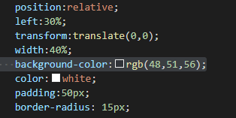

External CSS
External css has been added to make sure that the divs and other buttons match the colour scheme.
Animations have been used to make the page lively as well as making the UI interface better(bounce rotate….)

Slide 6
Positioning done but using absolute and relative modes.
To get the components in the right place so that the end result looks good.
All this is done using external css only and not bootstrap.

Slide 7
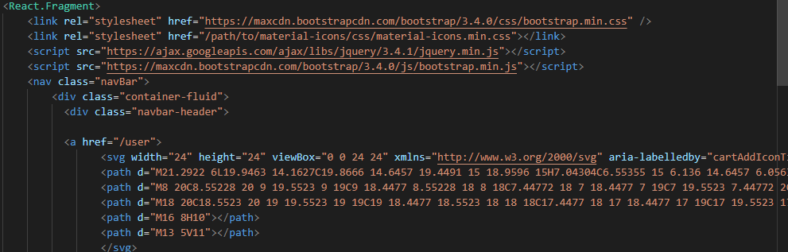
React
For connecting the front-end html to the data base react, components as well as express has been used.
In react – react components, fragments,

Slide 8
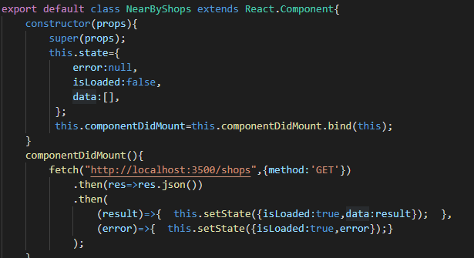
All the basic parts of react like componentdiMount, this.state… , are also used.

Slide 9
Sources
Bouncejs
Bootstrap
W3schools
Mozilla Firefox mdn
Ikonate
Streamline icons

Slide 10
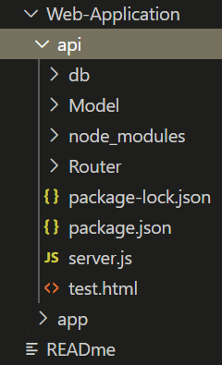
The Backend of the Web Application
The API(REST Stye)
The API uses ,
MonogoDB for database related operation
Nodejs for setting up the server.
Backend(API)
- - - - Server(NodeJS)
- - - - - - - - Express Server
- - - - - - - - - - - - Express Routes
- - - - Database(MongoDB)
- - - - - - - - -Mongoose
- - - - - - - - - - - - Models
- - - - - - - - - Validators

Slide 11
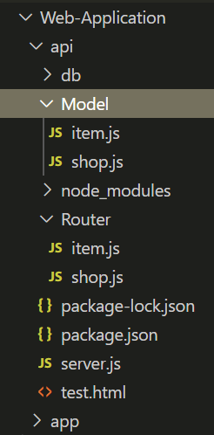
NodeJS
We use the Nodejs Express framework in order to run the server.
We use express router to serve the reponse based on the request type and request uri.(For requests for the REST style API , ie. post, patch , delete , get , etc.)
Since We have 2 collections in our database , we use 2 router files to handle requests on each one of them separately.

Slide 12
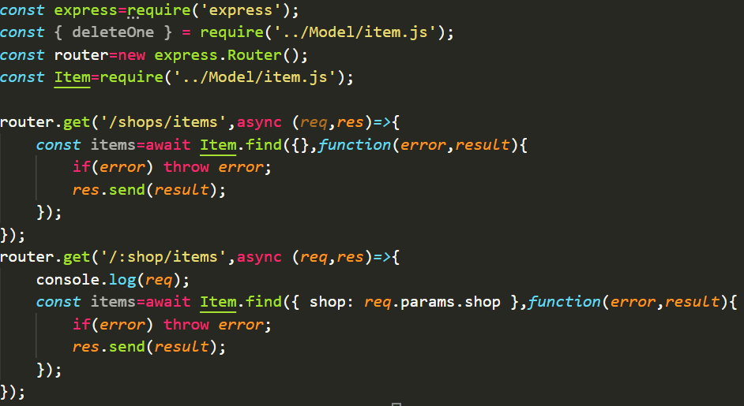
Code Snippet from the router file for item collection

Slide 13
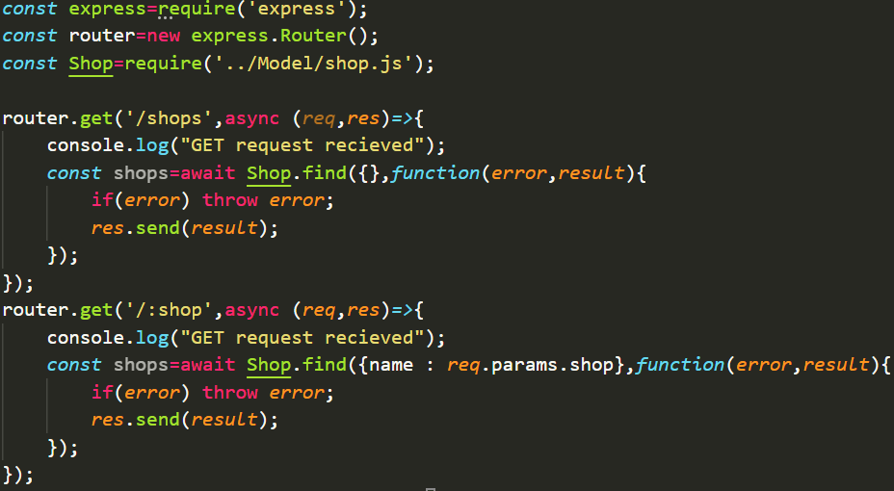
Code Snippet from the router file for shop collection

Slide 14
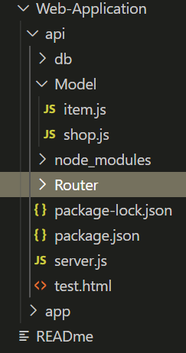
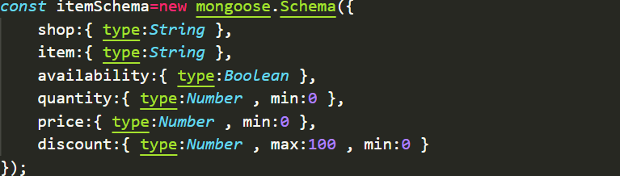
MongoDB
We use Mongoose npm package in order to use Mongoose in Nodejs. Using mongoose , we make the server to interact with the MongoDB database.
Using mongoose we set up the schema for each of our database and create models.

Slide 15
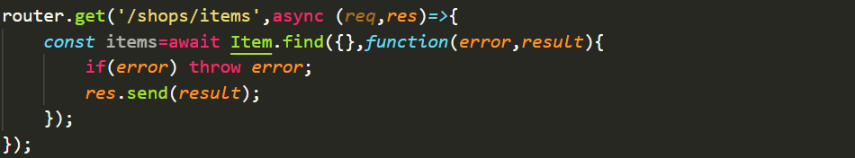
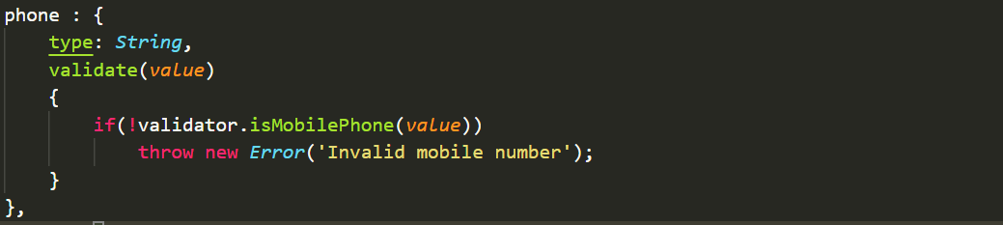
Using the instances of these Models we perform the operations to the database in our express routers.
We also use the validator module from npm inoder to validate the request body so that the request is inline with the collection schema. And to generate specific error outputs in case of any mismatch with the schema.

Slide 16
Sources
Pro MERN Stack – Vasan Subramanian
Pro REST API development with REST API - Doglio, Fernando

Slide 17
Member Contributions
Janardhana BV Reddy :
Harshavardhan V N : Backend(REST API , Mongoose , Express , Some React Components)

