Slide 1
hospital management system
PRESENTED BY:-
P HARSHAVaRDHAN: UNDER THE GUDIENECE
2200520261 OF N. VENKATARAMANA
D.V.LOKESH: SIR
2200520260
K.DEVI PRASAD:
2200520212

Slide 2

Hospital management:
A Hospital Management System (HMS) is a software designed to handle electronic medical records, laboratory tests and their results, radiology images, pharmacy records etc. It helps in managing patient data efficiently so that hospitals can provide better care and services. The hospital management system was introduced in 1960. They manage the data related to all departments of healthcare such as:
. Clincial
Financial
Laboratory
Inpatient
Outpatient
Operation theater
Materials
Nursing
Pharmaceutical
Radiology
Pathology

Slide 3
Features of Hospital Management System :-
. Appointment Management
Billing Management
Prescription Management
Discharge Summary
Operation Theatre Management
Pharmacy Management
Lab Management
Master Information Systems
Manage Multiple Locations

Slide 4
LIST OF CLASSES AND METHODS IN HMS:-
CLASSES:-
PERSON
DOCTOR
HOSPITAL
PATIENT
METHODS ARE USED IN THE FOLLOWING CLASSES:
PERSON:- getName(), getAge(), getGender(), getAddress()
DOCTOR:- getSpecialization(), getDoctorId()
HOSPITAL:-addDoctor(),addPatient(),displayDoctor(),displayPatient(), scheduleAppointment()
PATIENT:- addAppointment(),getName(),getAge(),getAddress(),getGender(),getAppointments(),getPatientId()

Slide 5
KEYWORDS AND PACKAGES :-
KEYWORDS:-
Packages:-
Class
Public
Private
Void
New
If
For
Else
Switch
While
Case
default
return
Import java.utill.*;

Slide 6
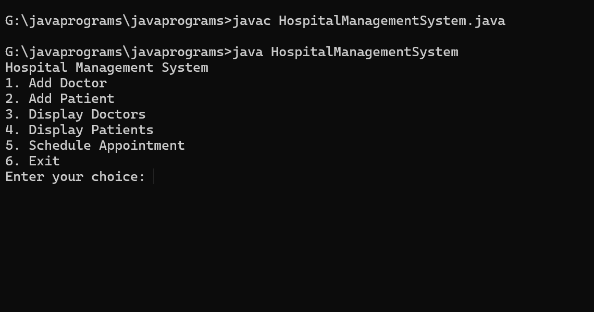
MAIN MENU OF THE SOURCE CODE:-

Slide 7
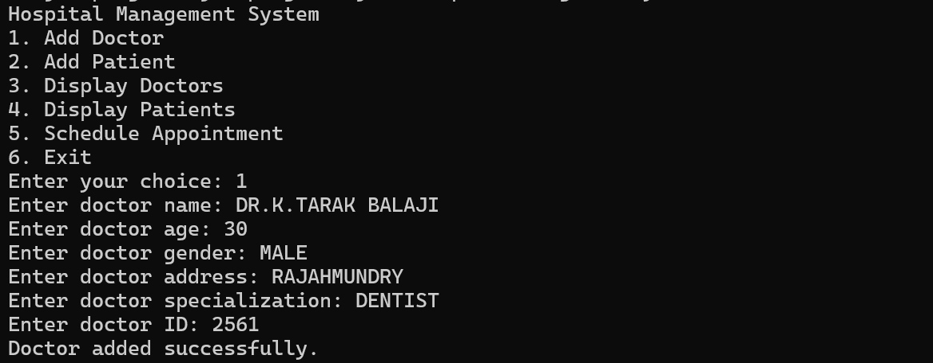
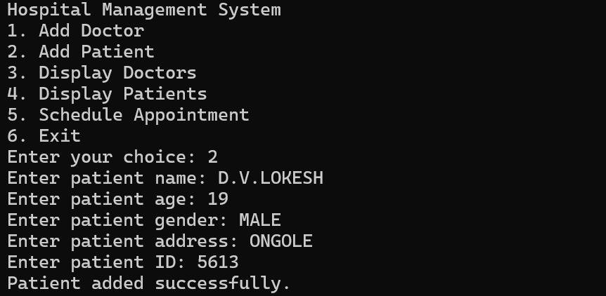
1.ADD DOCTOR:-
2.ADD PATIENT:-

Slide 8
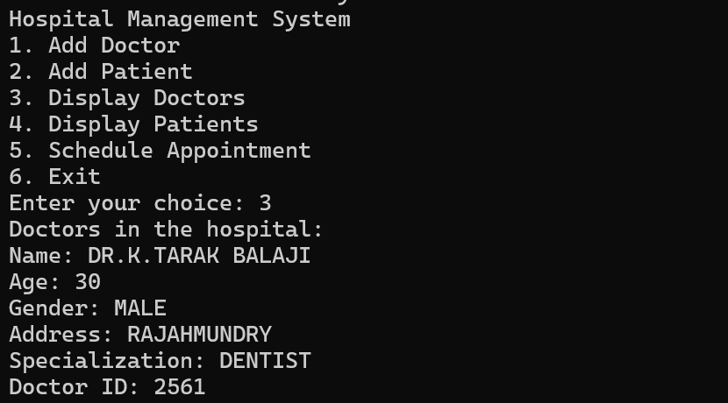
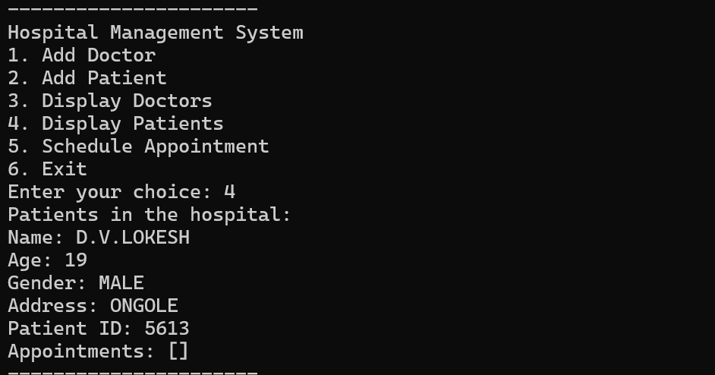
3.DISPLAY DOCTORS:-
4.DISPLAY PATIENT:-

Slide 9
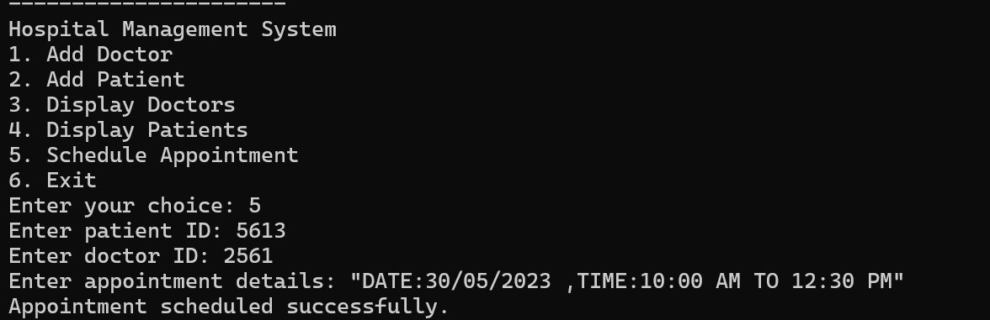
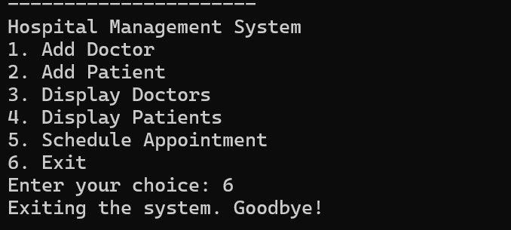
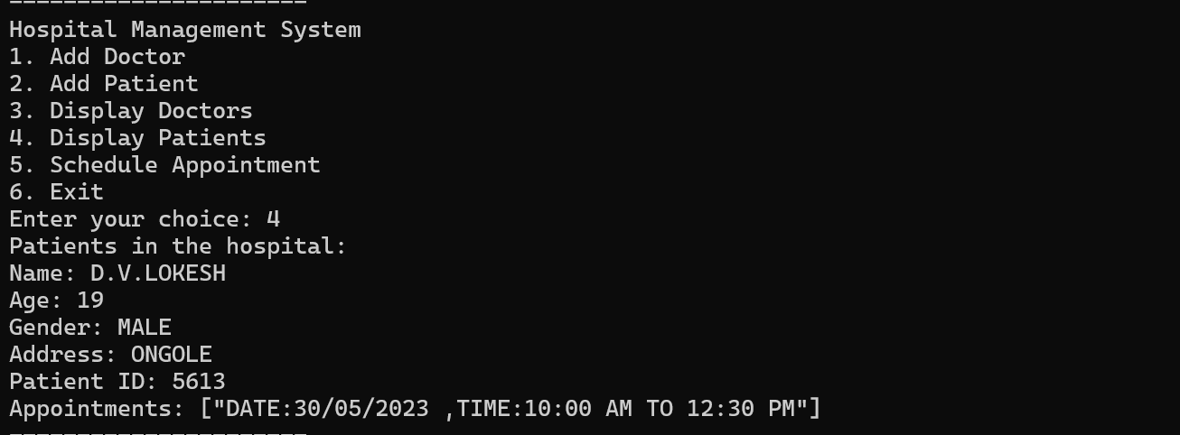
5.SCHEDULE APPOINTMENT:-
6.EXIT:-

Slide 10
Roles and responsibilities:
On a project team, each member has certain responsibilities or specific tasks that help contribute to the success of the project. That’s why it is important to have varying roles on the project team.
P.HARSHA VARDHAN(TEAM LEAD):
Create overall project vision.
Create the project plan.
In-depth knowledge of performance metrics.
Assigning tasks to project team members.
Carrying ultimate responsibility for the project.
D.V.LOKESH:
Communicate with project lead on roadblocks.
Solve project objectives.
Complete tasks in areas of expertise.
Determining the methodology used on the project.
Documenting the process.
K.DEVI PRASAD:
Assisting in defining the project.
Gathering the requirements.
Testing the code to validate the objectives.
Completing individual deliverables

Slide 11


