Slide 1
SoundScape: Music That Remembers You
UI/UX Design Handoff | [GOVINDHA RAJULU]

Slide 2
Project Goals & Problems Solved
Problem Statements:
"Music apps prioritize trends over personal memories."
"No adaptation to my current emotional state."
"Forgotten songs stay buried forever."
Solutions:
AI Timeline (Life-event playlists)
Emotional Remastering (Real-time audio adjustments)
"Echoes From Your Past" (Rediscovery algorithm)
Visual: Before/after comparison (Spotify vs. SoundScape).

Slide 3
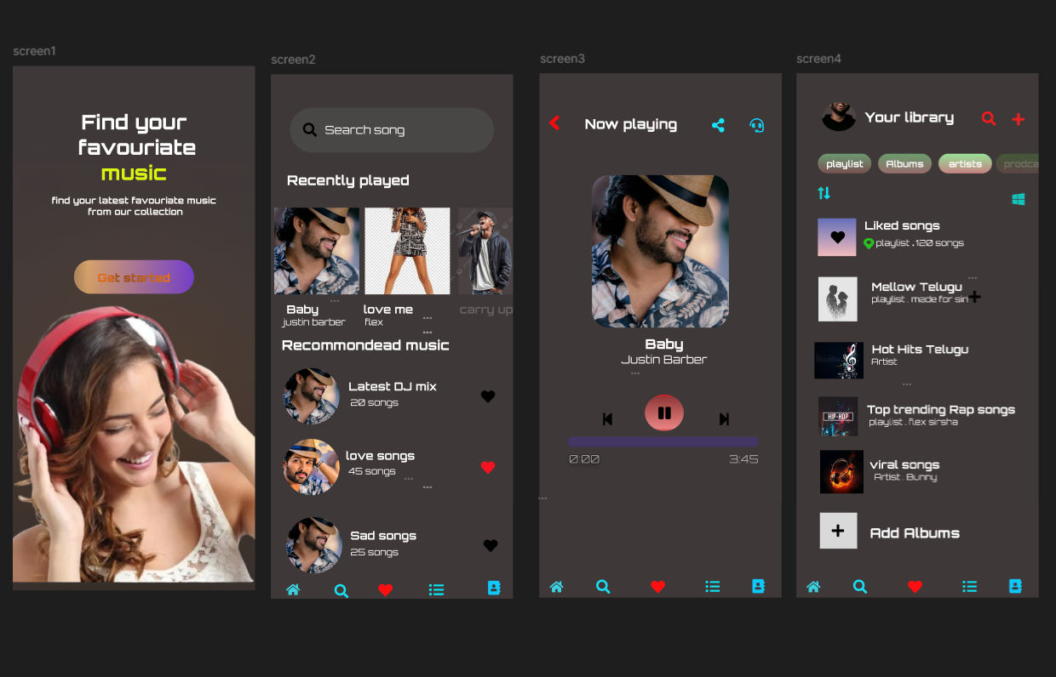
Template Design

Slide 4
Key Research Insights
User Insights:
78% organize songs by life events, not genres (Card sorting).
62% manually adjust EQ when stressed (Biometric testing).
Design Impact:
Timeline replaced library view.
Mood slider responds to ambient noise.
Visual: Quote + heatmap: "I need to feel my music, not just play it."

Slide 5
Handoff Deliverables
Figma Files:
Interactive prototype (Gesture testing link).
UI Kit (Auto-layout components).
Style Guide:
Colors(#04D68=Trust),Fonts(Poppins/Courier prime).
Developer Specs:
On-device AI constraints.
Animation physics (Spring damping values).
Visual: File structure screenshot.

Slide 6
Known Issues & Future Iterations
Top 3 Improvements:
Timeline Clutter → AI summarization (P1).
Mood Slider Visibility → Voice hints (P2).
Tag Editing → Swipe-to-edit (P1).
Roadmap:
2024: "Duet Mode" (Shared nostalgia).
2025: Haptic lyrics for deaf users.
Visual: Priority matrix (P1-P3).

Slide 7
Post-Handoff Refinement Plan
Methods:
Bi-Weekly A/B Tests: Swipe gestures vs. buttons.
"Goosebump Button" (In-app sentiment tracking).
Quarterly Ethnography: Home observation studies.
Metrics:
Nostalgia Score (↑ emotional engagement).
30-day retention (↑ 5% quarterly).
Visual: Feedback loop diagram.

Slide 8
Conclusion & Q&A
Key Takeaway: "SoundScape turns music into an emotional diary—not just a playlist."
Call to Action:
Developers: Start with Now_Playing.fig
Stakeholders: Review roadmap milestones.
Visual: App screenshot + team logo.

