Slide 1
Cloud Deployment Project
Internship – Gourishetti Harsha Vardhini

Slide 2
Problem Statement
Deploy a containerized web application on AWS using EC2, Docker, S3, and CloudWatch.

Slide 3
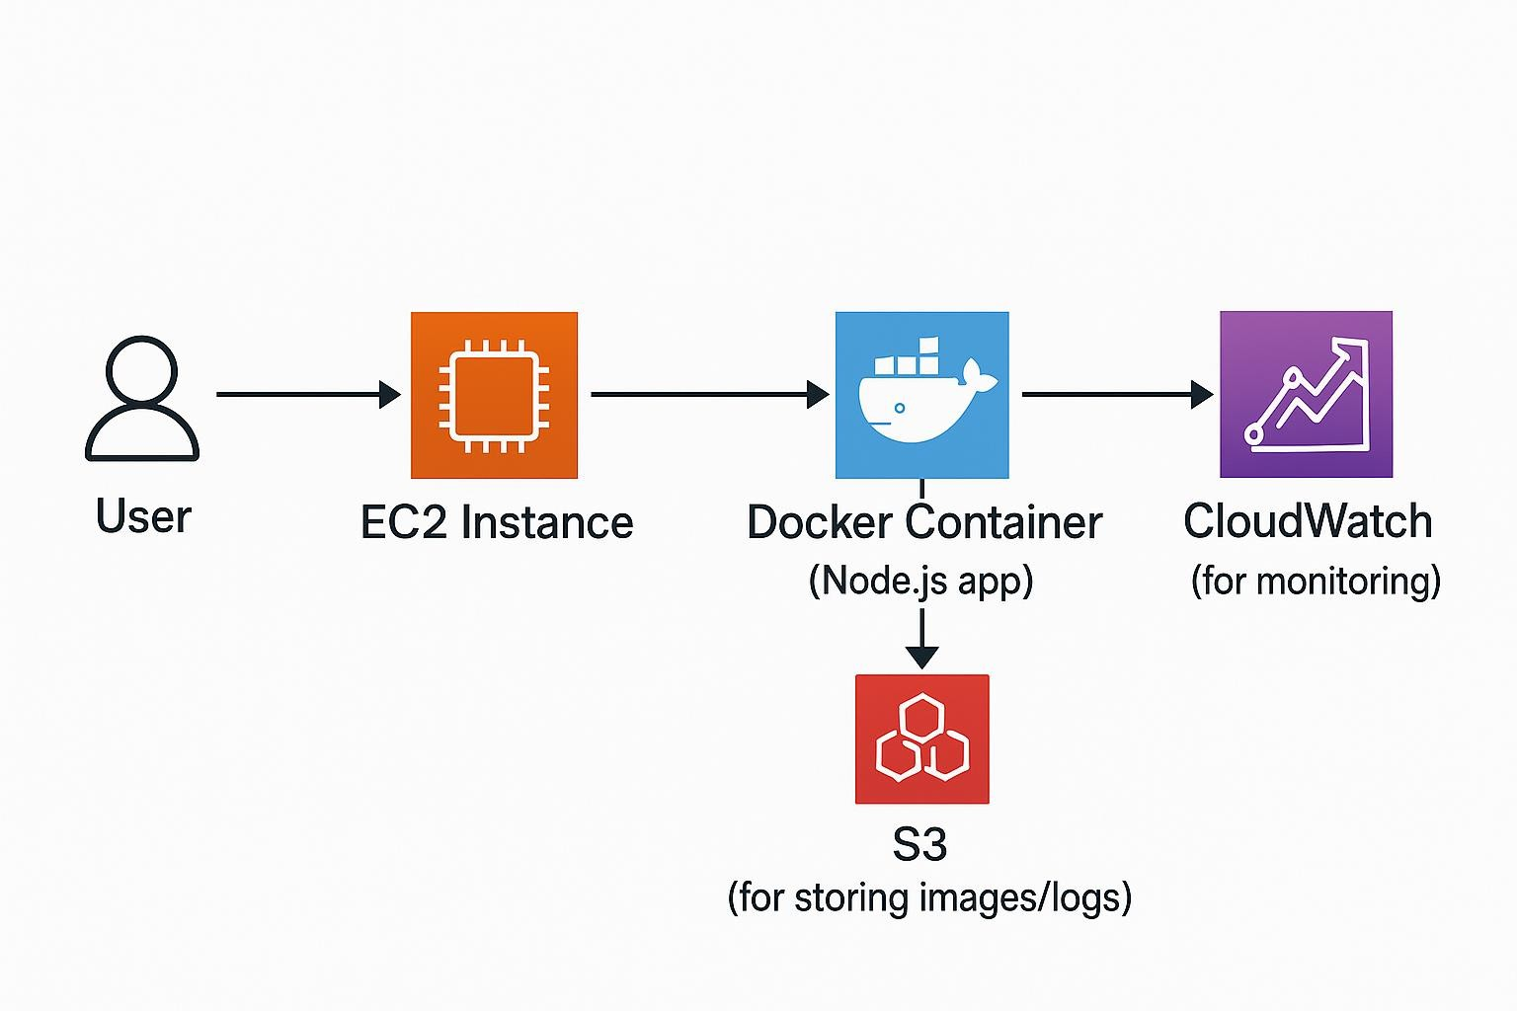
Architecture Diagram

Slide 4
AWS Services Used
EC2 (Compute Instance)
Docker (Containerized App)
S3 (Storage)
CloudWatch (Monitoring)
IAM Roles
Security Groups

Slide 5
Steps Performed
1. Created EC2 instance.
2. Installed Docker & ran container.
3. Connected app to S3.
4. Configured IAM role.
5. Enabled CloudWatch monitoring.
6. Deployed and tested application.

Slide 6
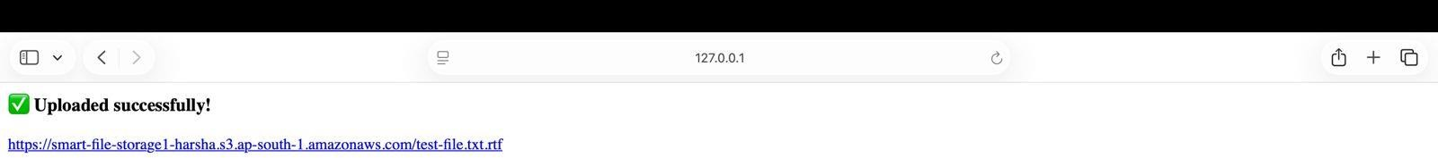
Output
Application deployed successfully and accessible via EC2 Public IP.

Slide 7
Conclusion
Successfully deployed a Dockerized web app on AWS using EC2, S3 and CloudWatch.

Slide 8
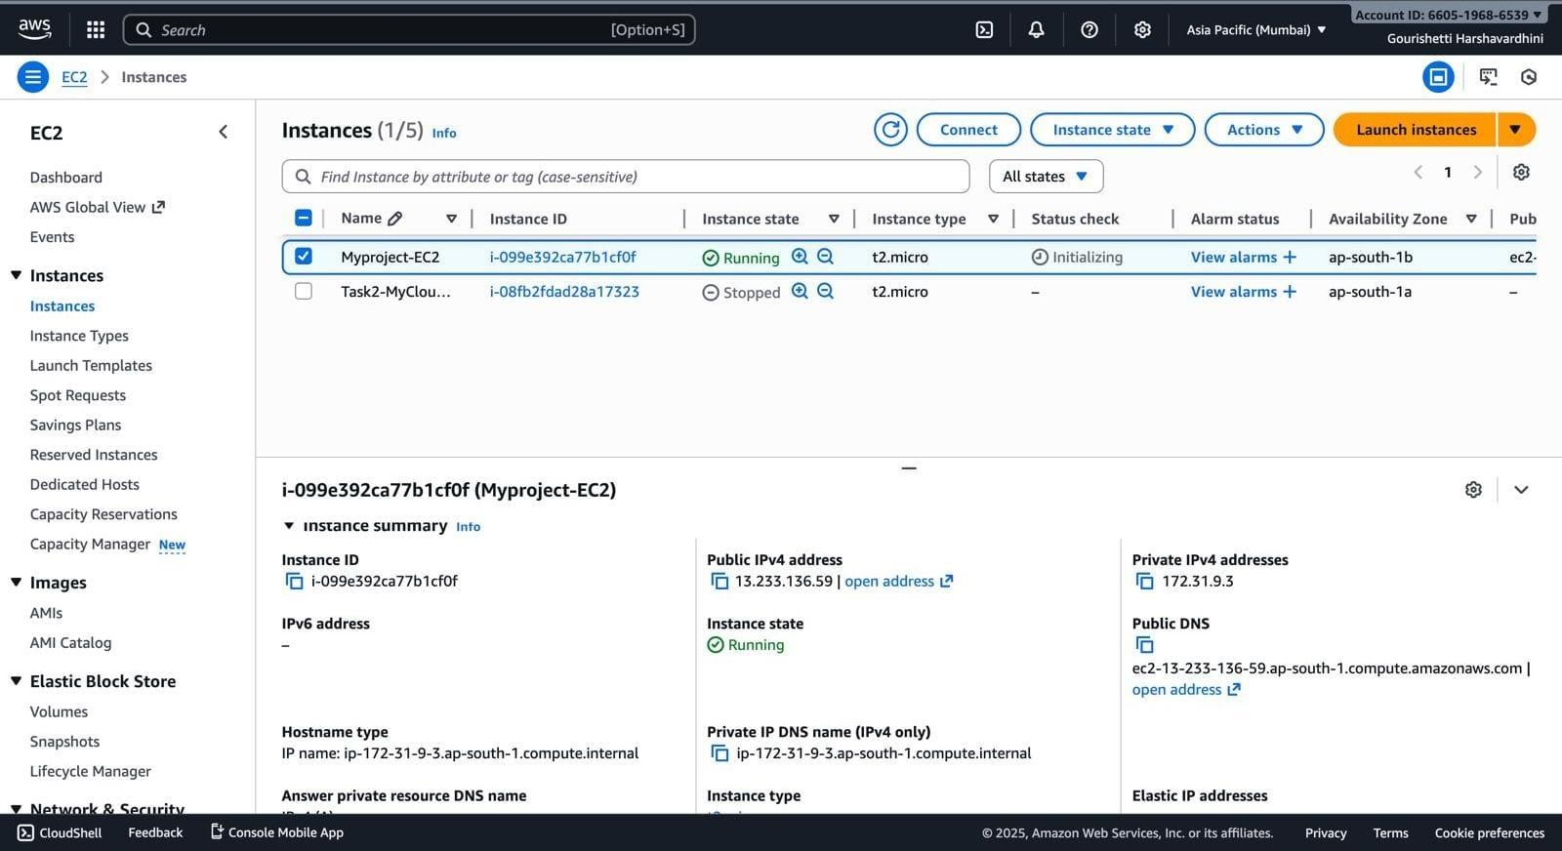
EC2 : Instance List

Slide 9
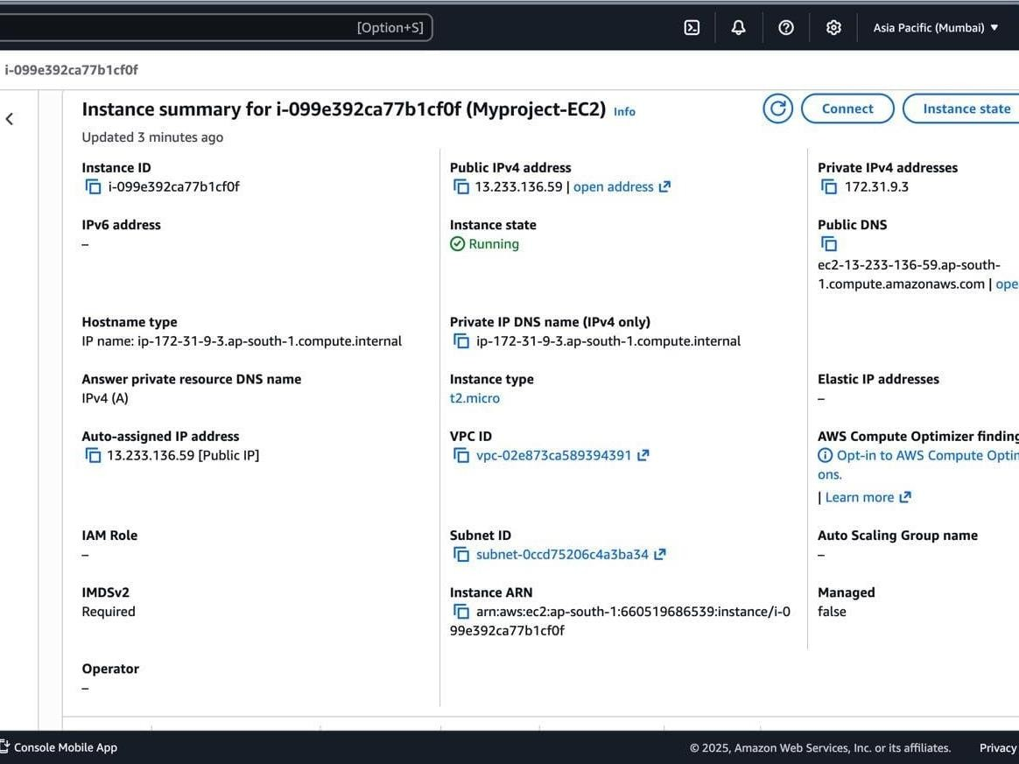
EC2 – Instance Details
Screenshot 2

Slide 10
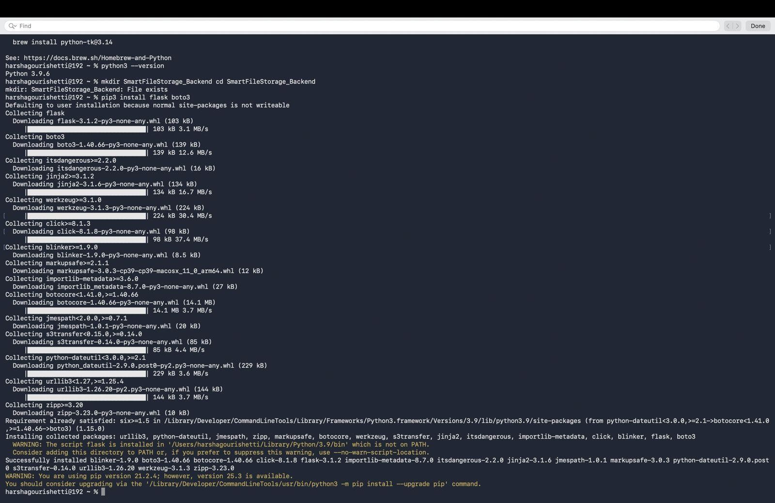
Docker- Build – Screenshot 3

Slide 11
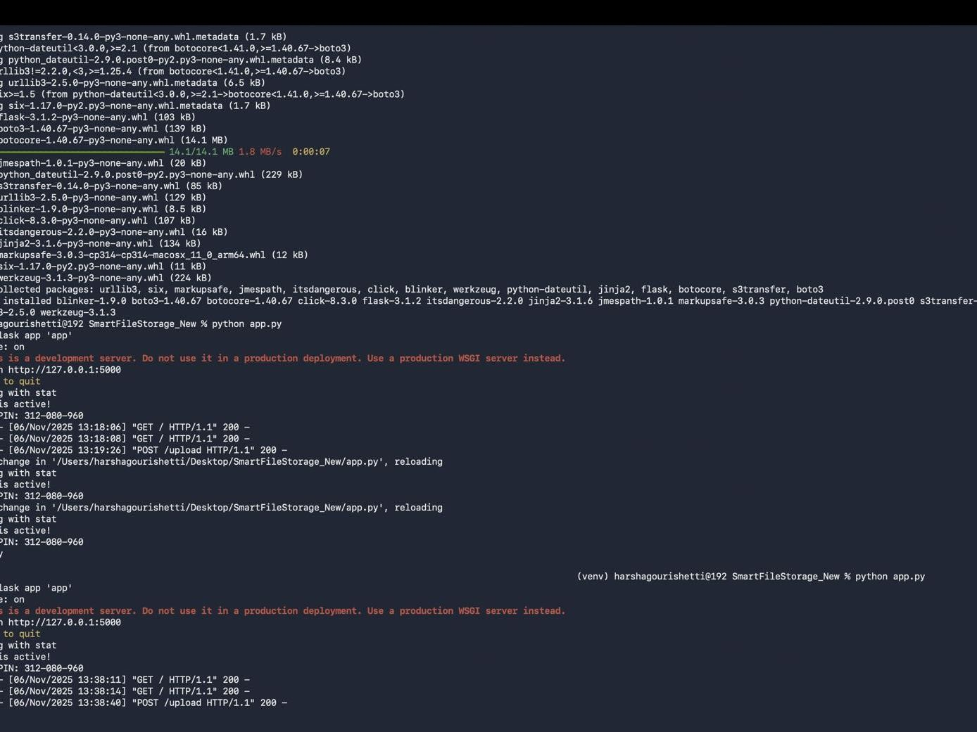
Docker - PS
Screenshot 4

Slide 12
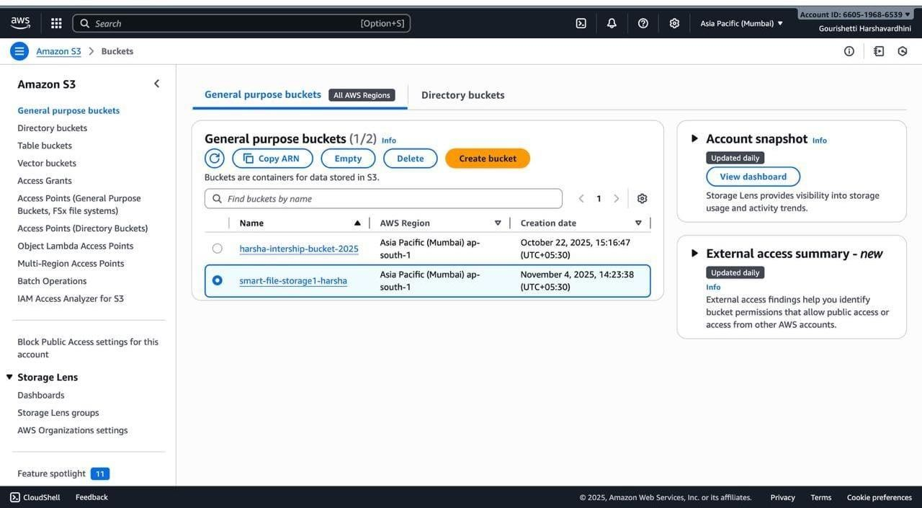
S3- Bucket- Screenshot 5

Slide 13
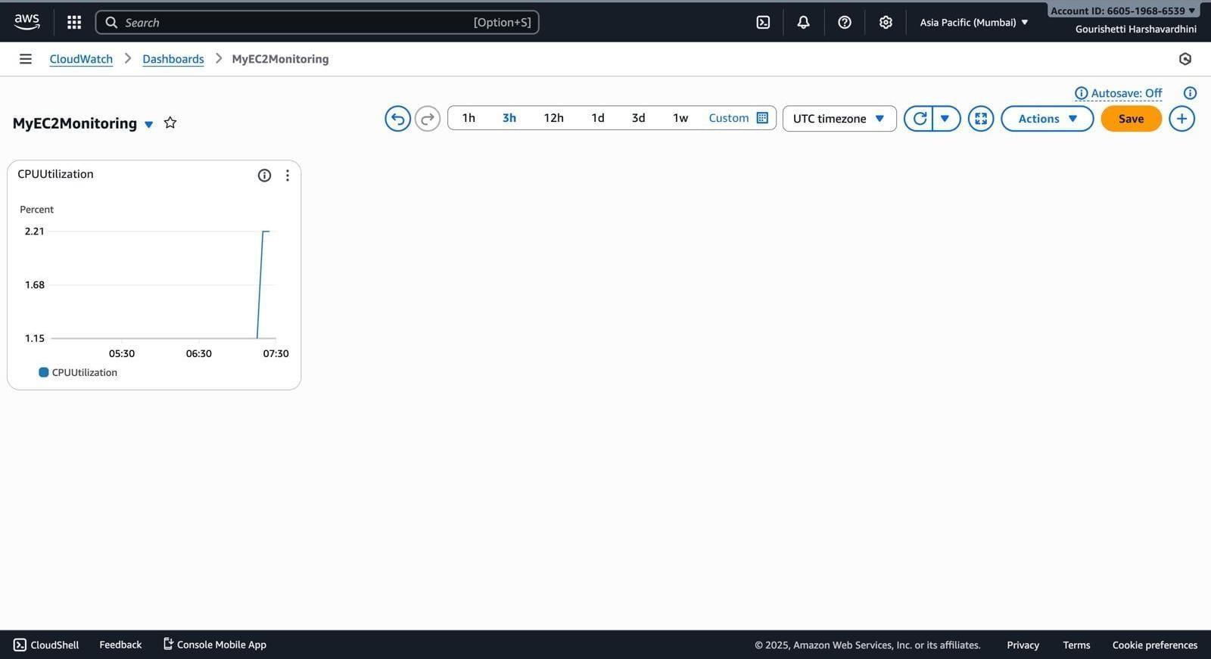
Cloud Watch- Dashboard- screenshot 6

