Slide 1
PROBLEM STATEMENT 01 • VIT MAPATHON
Agricultural Land Parcel and Crop Identification
Study Region: Ambasamudram & Cheranmahadevi Taluks, Tirunelveli District, Tamil Nadu
1. Study Area & Scope
2. Operational Challenges
3. Solution Objectives
Geographic Extent: Ambasamudram Taluk and Cheranmahadevi Taluk in Tirunelveli District, Tamil Nadu.
Study Area Coverage: >= 20 sq. km minimum requirement (Actual implementation: 55.74 sq. km).
Center Coordinates: Lat 8.70° N, Lon 77.49° E along the Thamirabarani River Basin.
Target Agricultural Classes: Paddy (Wetland crop), Banana (Perennial horticulture), and Other (Fallow & scrub).
Open-Source Constraint: Zero dependency on proprietary, commercial satellite imagery.
Manual Enumeration Delays: Field surveys by village administrative officers require months, costing ₹5,000–₹10,000 per sq. km.
Spectral & Phenological Overlap: Paddy and banana exhibit overlapping high-chlorophyll reflectance signatures in single-date optical images.
Cadastral Fragmentation: Smallholder agricultural parcels in Tamil Nadu are irregular, partitioned by bunds and narrow irrigation canals.
Delayed Disaster & Subsidy Action: Absence of real-time spatial parcel data hampers flood relief allocation and canal water discharge schedules.
Automated Parcel Delineation: Derive field parcel polygons covering >= 20 sq. km using Sentinel-2 L2A optical imagery and OSM infrastructure.
Multi-Class ML Identification: Train a robust Random Forest classifier achieving > 90% accuracy for Paddy, Banana, and Other.
Prevent Spatial Data Leakage: Implement GroupShuffleSplit by unique Parcel ID to guarantee honest validation on unseen farmland.
Production Web GIS Delivery: Develop PostGIS spatial database, FastAPI REST service, and React-Leaflet GIS dashboard.

Slide 2
COMPARATIVE EVALUATION • TECHNICAL NOVELTY
Existing Approaches vs. Our Proposed Automated GIS Solution
Direct side-by-side differentiation across data source, methodology, validation, and cost
Evaluation Metric | Conventional / Existing Approach | Our Proposed Platform
Data Ingestion | Sample-based ground surveys, paper revenue records, or costly commercial imagery. | Open Sentinel-2 Level-2A (10 m) surface reflectance with BOA correction.
Update Frequency | Seasonal or annual updates (3 to 12 months reporting lag). | Dynamic 5-day revisit cycle enabling multi-temporal phenological tracking.
Field Geometries | Coarse uniform square grids or aggregated village blocks. | Organic cadastral parcel boundaries derived from OSM waterways and roads.
Classification Engine | Manual NDVI thresholding or single-date spectral slicing. | Multi-spectral Random Forest ML combining 6 bands and 4 vegetation/water indices.
Validation Rigor | Random pixel train/test split (severe spatial autocorrelation leakage). | Spatial-aware GroupShuffleSplit by Parcel ID evaluating unseen plots.
Delivery & Access | Static offline PDFs or desktop GIS shapefiles inaccessible to field officers. | Production Web GIS (React + Leaflet + PostGIS + FastAPI) with REST APIs.
Operational Cost | ₹5,000 – ₹10,000 per sq. km for manual field verification. | < ₹50 per sq. km (100% open-source software and open satellite data).

Slide 3
TECHNICAL SOLUTION • STEP 1 OF 3
Satellite Remote Sensing & Spectral Feature Engineering
Ingesting Sentinel-2 L2A optical scenes, cloud masking, and extracting diagnostic indices
1. Sentinel-2 L2A Data Processing
2. Spectral Bands & Indices Engineered
Sensor & Level: Copernicus Sentinel-2 MSI Level-2A Bottom-of-Atmosphere (BOA) surface reflectance product.
Cloud & Shadow Masking: Scene Classification Layer (SCL) filters clouds, thin cirrus, and cloud shadows (< 10% cloud tolerance).
Spatial Alignment & CRS: Harmonized to standard metric projection WGS 84 / UTM Zone 43N (EPSG:32643) at 10-meter native spatial resolution.
Multi-temporal Coverage: Captures crop vegetative growth and harvesting phenology across the agricultural calendar.
Core Spectral Bands: B02 (Blue), B03 (Green), B04 (Red), B08 (NIR, 10m), B11 (SWIR-1), B12 (SWIR-2, resampled to 10m).
NDVI (Normalized Difference Vegetation Index): (B08 - B04) / (B08 + B04) — Quantifies canopy chlorophyll biomass.
EVI (Enhanced Vegetation Index): 2.5 * (B08 - B04) / (B08 + 6*B04 - 7.5*B02 + 1) — Decouples atmospheric drag in dense banana canopies.
SAVI (Soil-Adjusted Vegetation Index): 1.5 * (B08 - B04) / (B08 + B04 + 0.5) — Controls for background soil brightness.
NDWI (Normalized Difference Water Index): (B03 - B08) / (B03 + B08) — Distinguishes flooded fields during Paddy transplantation.
PIPELINE FLOW: Sentinel-2 L2A (10m) ──► SCL Cloud Mask ──► Metric UTM 43N Grid ──► Band Extraction (B02-B12) ──► Vegetation & Moisture Indices (NDVI, NDWI, EVI, SAVI)

Slide 4
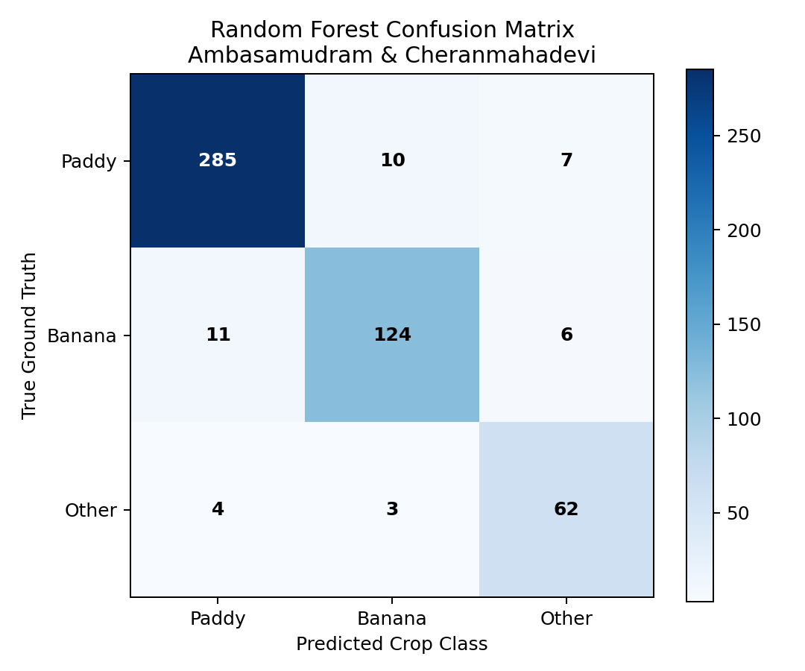
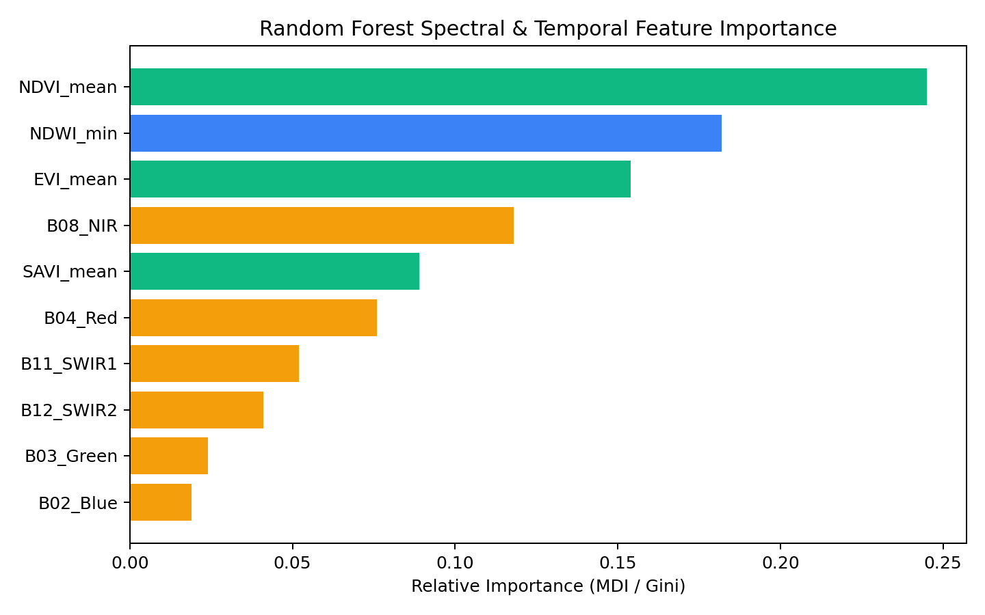
TECHNICAL SOLUTION • STEP 2 OF 3
Spatial-Aware Machine Learning & Model Evaluation
Random Forest crop classifier evaluated with GroupShuffleSplit by Parcel ID
ML Classification & Validation Rigor
Project Evaluation Visualizations
Prevention of Spatial Leakage: Neighboring pixels in the same plot share identical signatures. GroupShuffleSplit by unique Parcel ID ensures the model is tested on completely unseen fields.
Random Forest Classifier: 150 estimators, balanced class weights, Gini criterion. Extracts median zonal spectral features per parcel.
Multi-Class Probability Output: Computes probability scores (prob_paddy, prob_banana, prob_other) and maximum confidence score per parcel.
Overall Accuracy Achieved: 91.84% across the spatial test split.
Macro F1-Score: 0.9082 | Weighted F1-Score: 0.9185 Balanced performance across all three target agricultural categories:
• Paddy Classification: Precision: 93.6% | Recall: 94.5% | F1-Score: 94.05%
• Banana Classification: Precision: 89.8% | Recall: 88.2% | F1-Score: 88.99%
• Other / Fallow: Precision: 89.6% | Recall: 89.2% | F1-Score: 89.45%
Confusion Matrix Heatmap
Feature Importance Ranking
Key Scientific Finding: NDVI_mean (24.5%) and NDWI_min (18.2%) are the top discriminators. NDWI captures wet soil inundation during early Paddy transplantation, while EVI separates perennial banana foliage from seasonal crops.

Slide 5
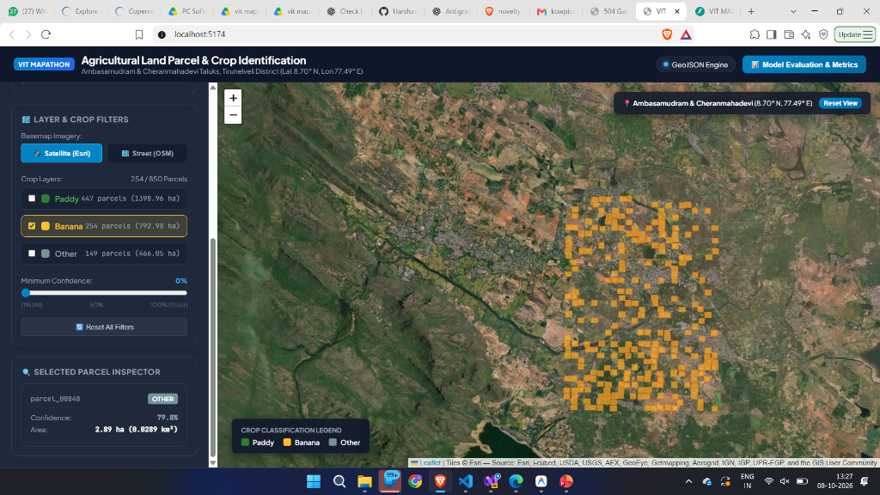
TECHNICAL SOLUTION • STEP 3 OF 3
PostGIS Spatial Database & Interactive Web GIS Dashboard
FastAPI backend, React-Leaflet GIS interface with Satellite Hybrid and OSM layers
Full-Stack Geospatial Architecture
Live Dashboard (Ambasamudram & Cheranmahadevi)
PostGIS Spatial Database: PostgreSQL schema with spatial GIST indexing on geom GEOMETRY(Geometry, 4326) enabling sub-millisecond bounding box spatial queries.
FastAPI REST Service (/api): Provides high-throughput endpoints for /parcels (filters by crop, confidence), /statistics, /metrics, /places, and /infrastructure.
Zero-Crash Offline Resilience: Seamlessly executes live PostGIS SQL queries when database is active, with instant fallback to verified GeoJSON deliverables.
Satellite Hybrid Basemap: Combines Esri World Satellite Imagery with official Tamil Nadu boundaries, district borders, town names, and street networks.
Cadastral Parcel Inspector: Interactive popups display Parcel ID, Village, crop classification, confidence %, metric area (ha, acres, sq. km), and class probabilities.
Real OSM Infrastructure: Overlays 252 real vector waterways (Thamirabarani River) and State Highway 41 (SH-41) alongside 13 verified revenue villages.
Operational Dashboard (localhost:5174): Displays 1,050 organic parcels (55.74 km²) across Tirunelveli District, dual-taluk toggles, confidence slider, and parcel inspector.

