Slide 1



zomatodelivery
View in Power BI
Last data refresh:
4/6/2022 4:06:05 PM UTC
Downloaded at:
4/6/2022 4:20:01 PM UTC

Slide 2
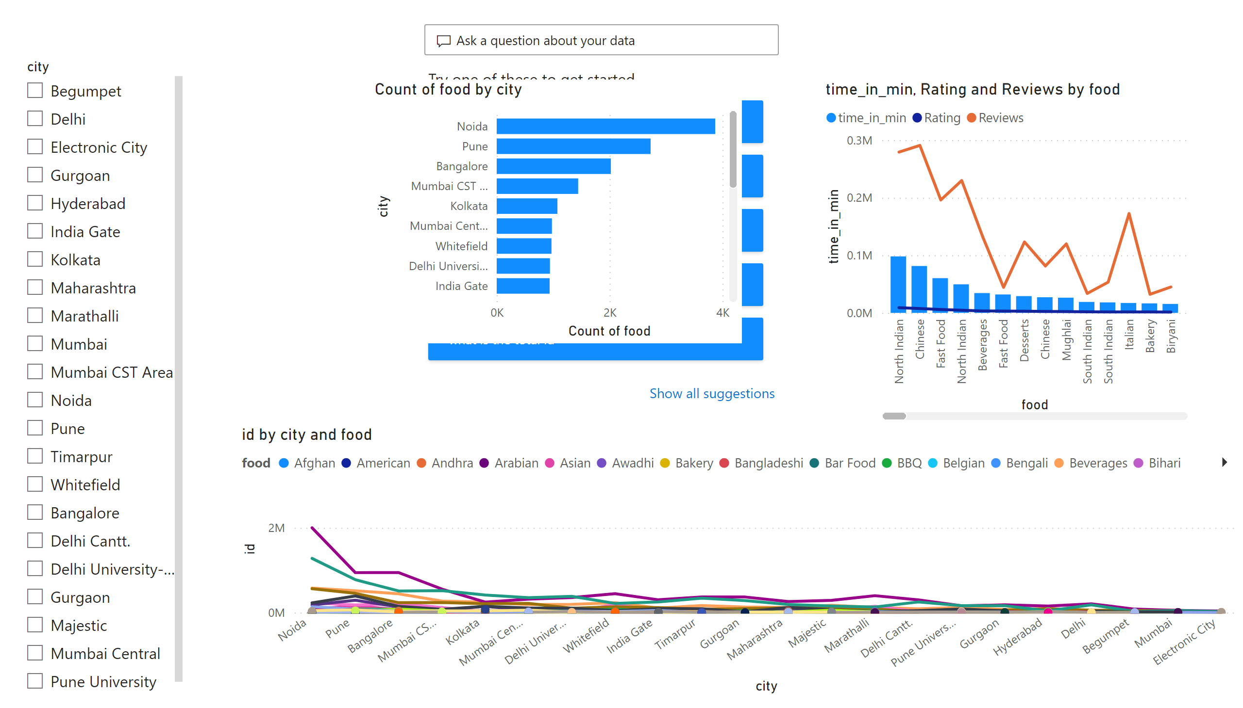
overview
Notes:
qnaVisual
No alt text provided
clusteredBarChart
No alt text provided
lineChart
No alt text provided
lineClusteredColumnComboChart
No alt text provided
slicer
No alt text provided

Slide 3
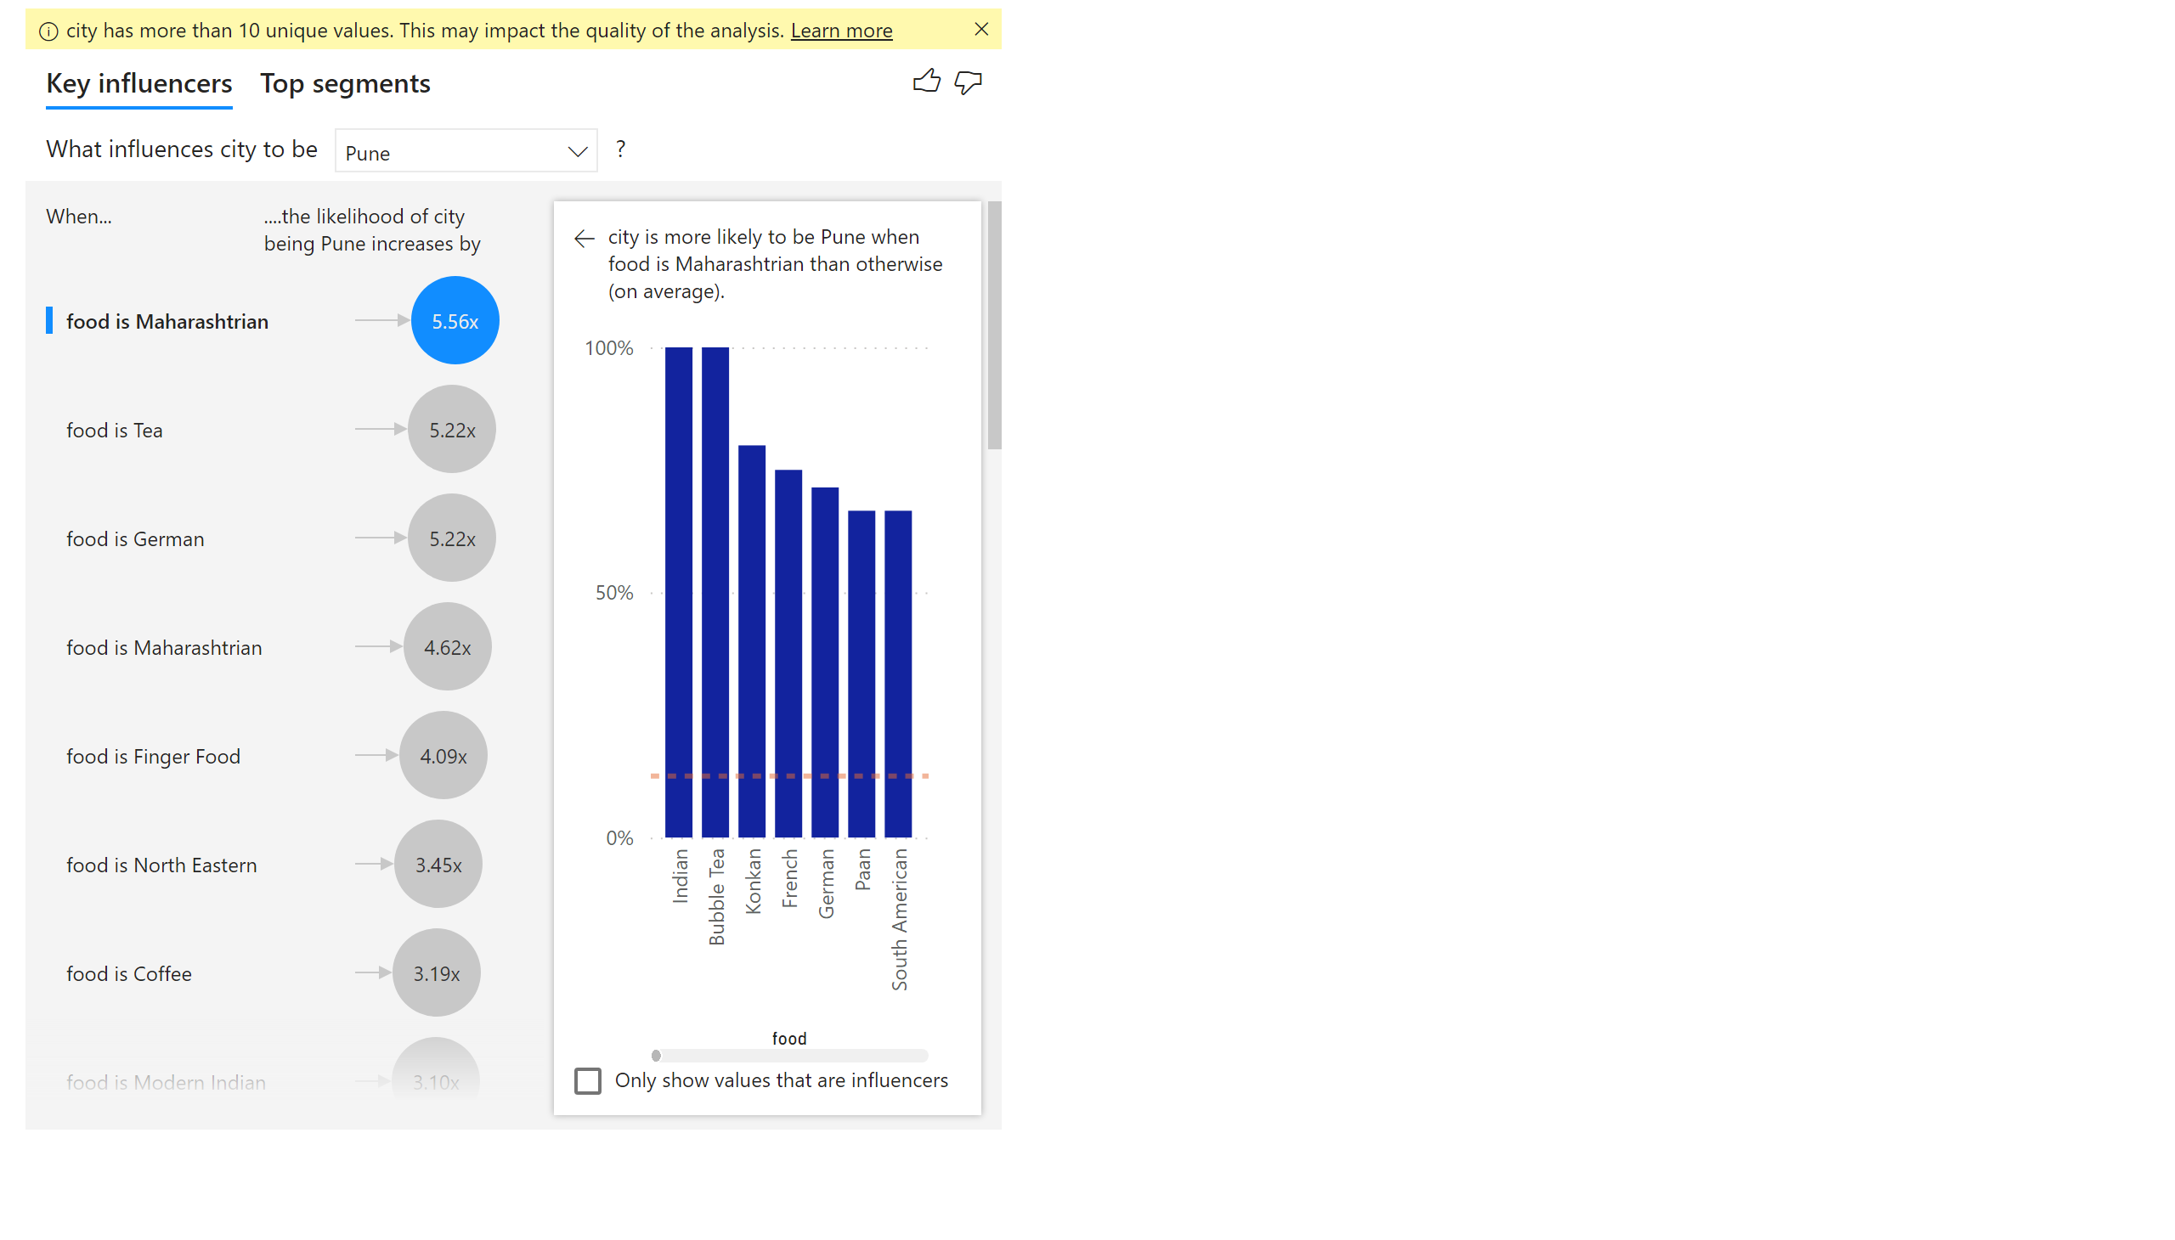
kpi
Notes:
keyDriversVisual
No alt text provided

Slide 4
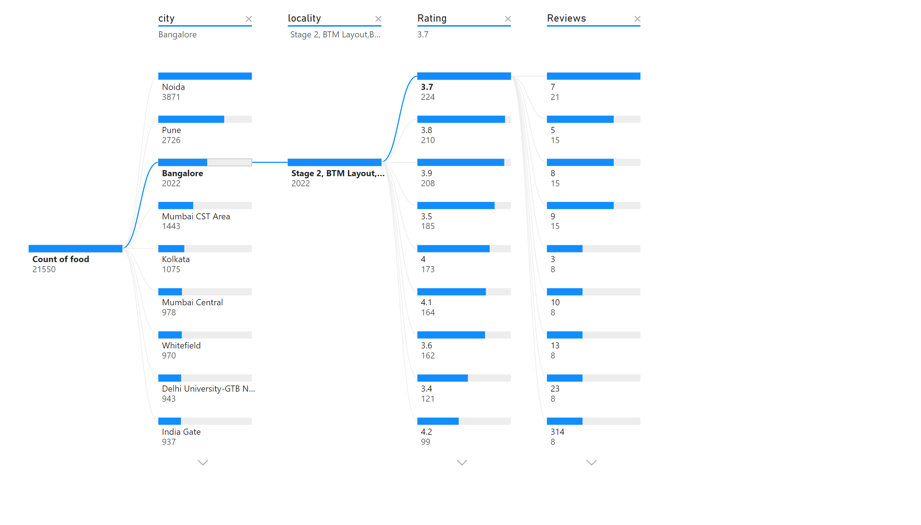
root analysis of food
Notes:
decompositionTreeVisual
No alt text provided

Slide 5
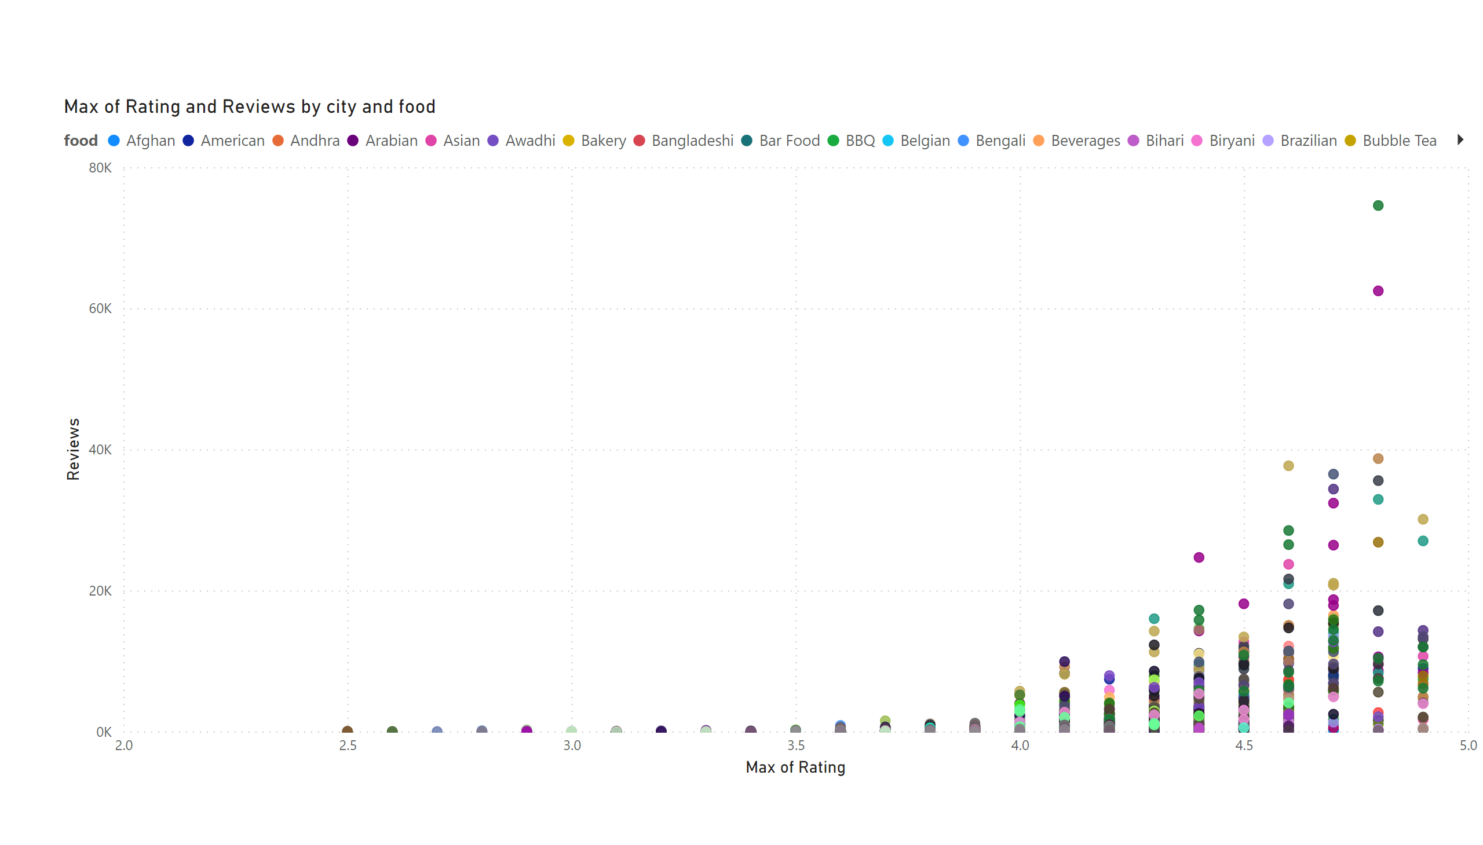
rating &review
Notes:
scatterChart
No alt text provided

