Slide 1


Slide 2


Slide 3


Slide 4


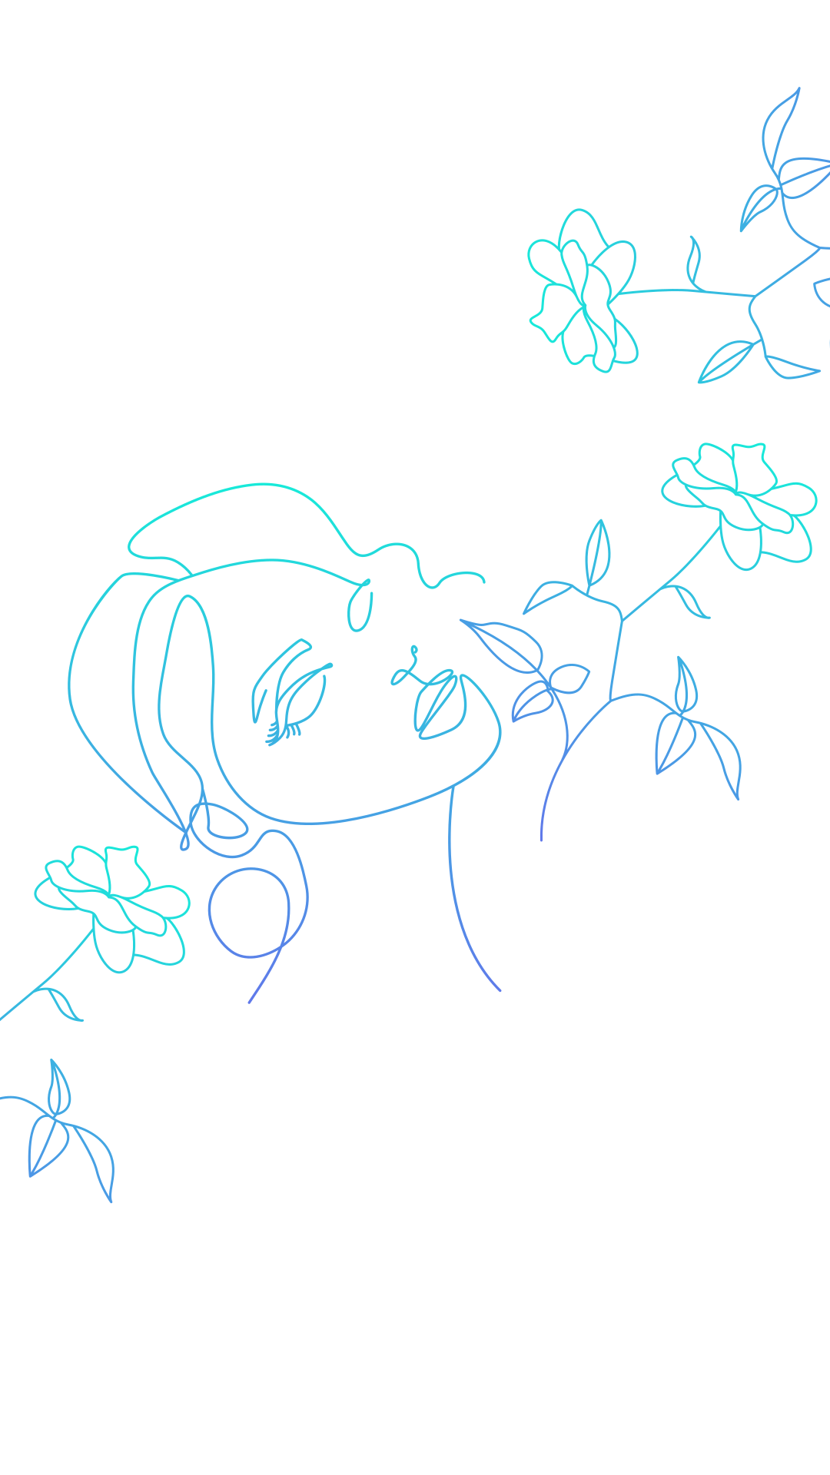

My Dear Women,
Thanks for
The life you gave
being there every time we fall
taking care of us when we get sick
feeding us all the time
being our first love
beautiful bedtime stories
not giving up on every stage we fail
unconditional and infinite love
As a token of love, Please consider this #WomenEmpowerment program from us
If you ever dreamt about having a career (or)
achieving your goals and ambitions (or)
a career comeback
We are here to help you, Please register at https://forms.gle/du3QBHSf9h7iqxht7
or use QR code
From
A son to a loveable mother
A brother to a loveable sister

