Slide 1

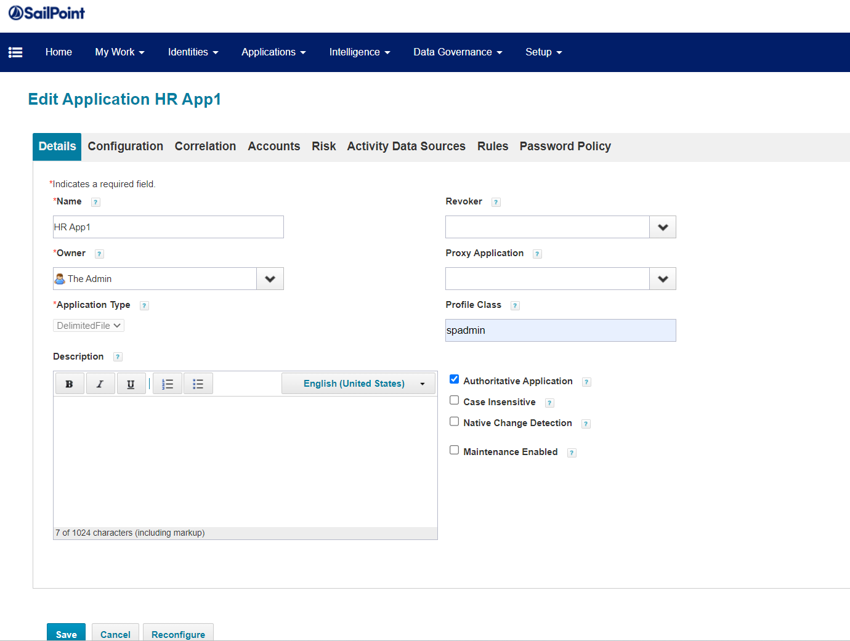
Application
We onboard applications including HR and Target Applications
HR Application aka Authoritative Source – used to create Identities
Target Applications to provision/create accounts/access for identities in that specific app
Application Definition looks as from UI
Login to IdentityIQ
Applications
Application Definition
Select App
Please note that you should have Administrator capability
Table name for Application is
spt_application

Slide 2
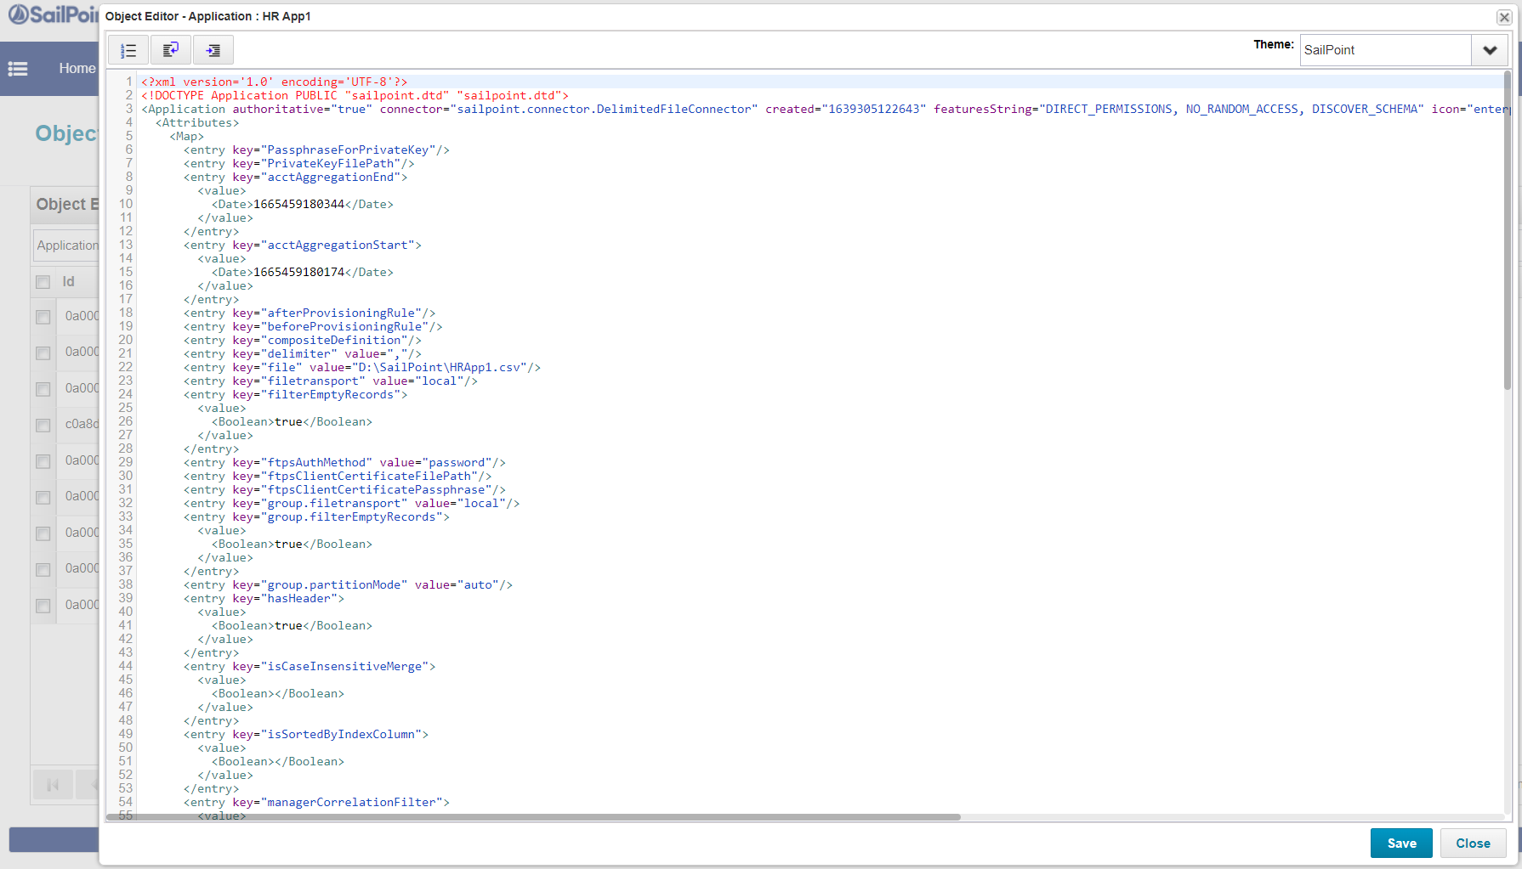
Same Application you can view in Debug as an XML
Please note that you should have Administrator capability
You can edit the app definition and can be saved.
You can create duplicate of this object to create one more application with necessary changes, but you need to remove all id values as it should be unique
You can use this XML object to create same application in other environments like SIT/UAT/PROD
No need to create app from scratch again.
Saves a lot of time.
Access Debug page
Object Type: Application
Select App

Slide 3
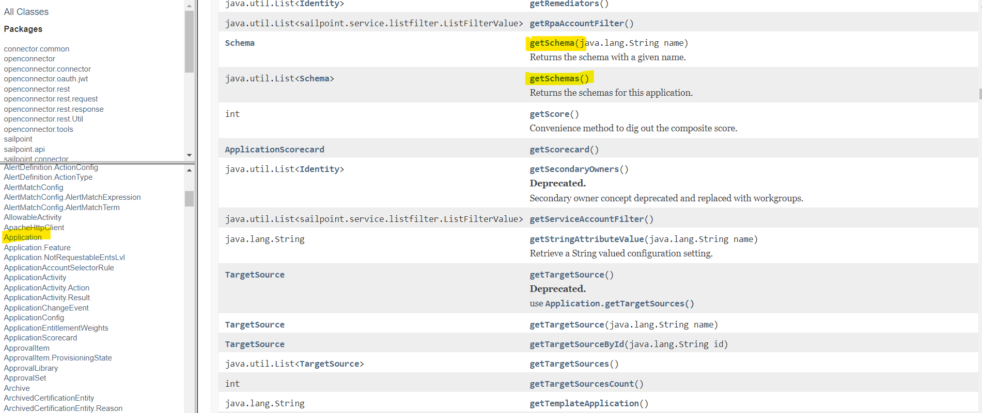
Coding on Application Object
→ Remember you learnt how to create Identity object, which was
goByName : Identity idObj = context.getObjectByName(Identity.class, “HR App1”);
goById : Identity idObj = context.getObjectById(Identity.class, “0a0000057dae1f95817dae34a9d7001f”);
Similarly for application
goByName : Application appObj = context.getObjectByName(Application.class, “123456”);
goById : Application appObj = context.getObjectById(Application.class, “0a0000057dae1f95817dae3313520011”);
You can find the methods available for Application object from Java doc

Slide 4
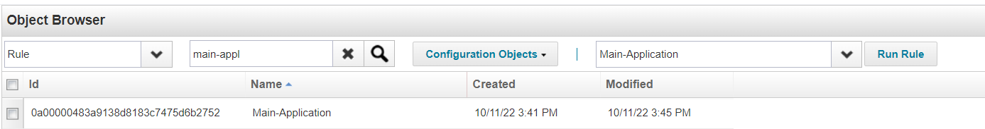
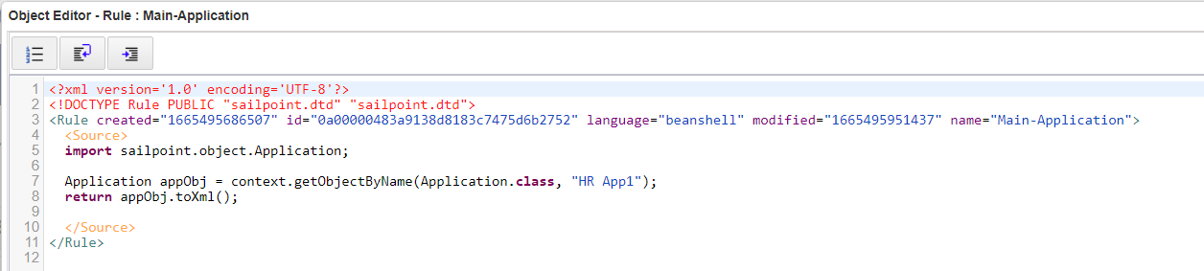
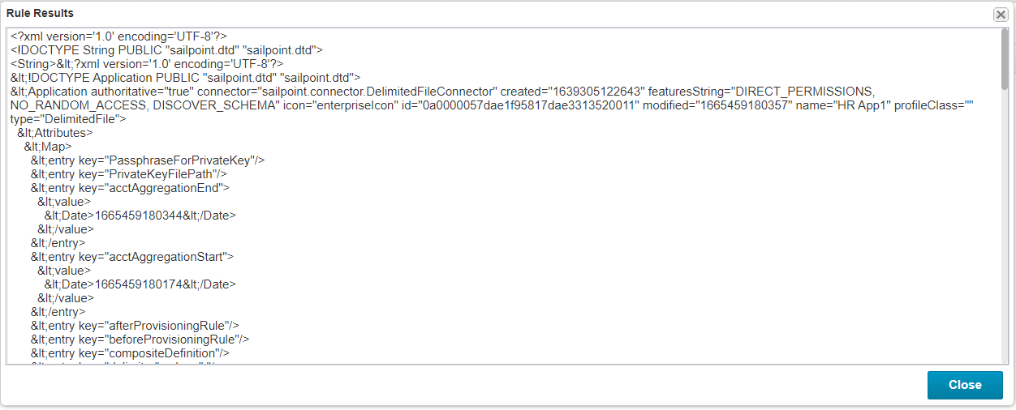
Coding on Application Object

Slide 5
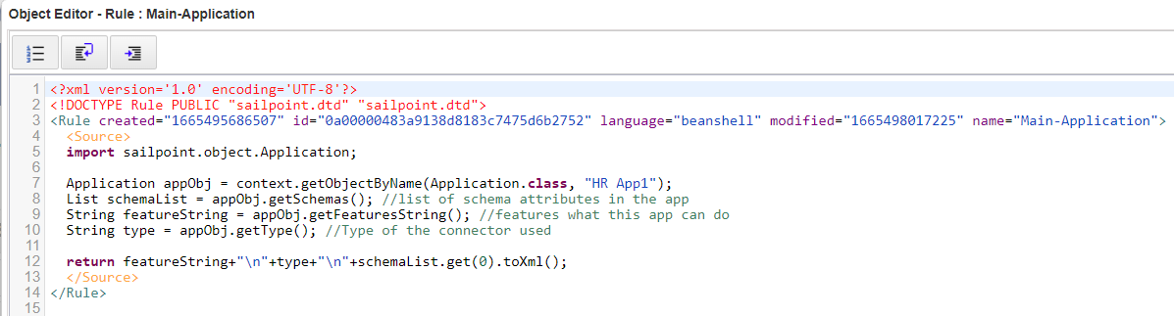
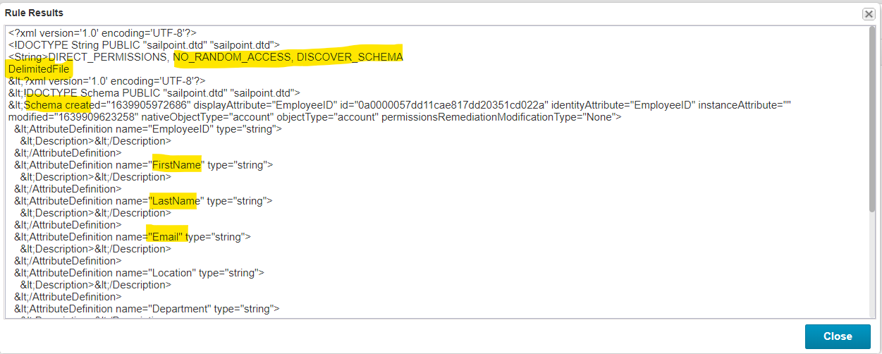
Coding on Application Object

Slide 6
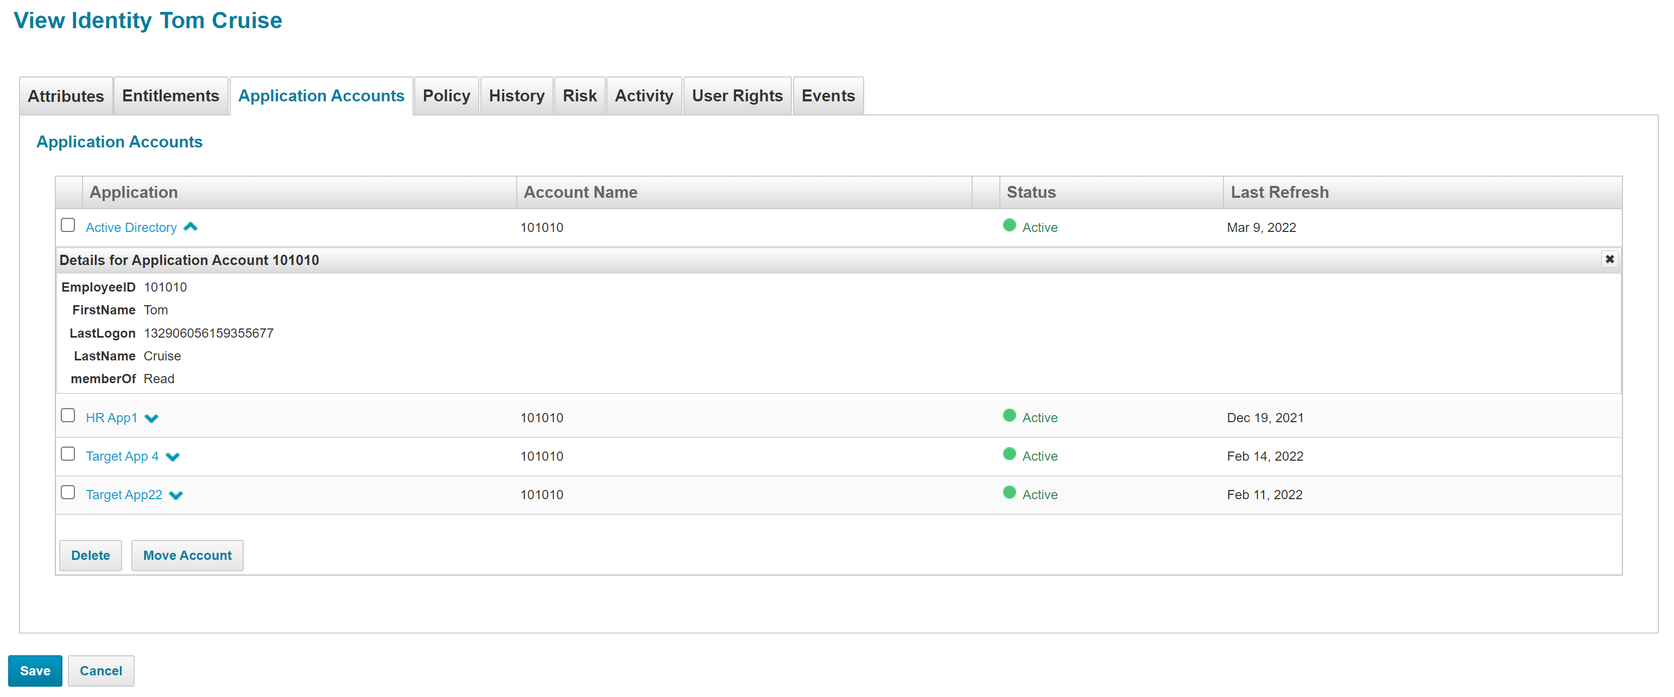
Link
Identity – user object
Account – user details in an application which is called as Link in technical terminology
You can see user accounts in Identity cube for any user (or in other words)
You can see what are all applications user has account/access
If by any mistake some other user account is tagged, then you can simply move to different identity just by selecting the checkbox and click on Move account which will ask you to select the identity
Table name for link object is spt_link

Slide 7
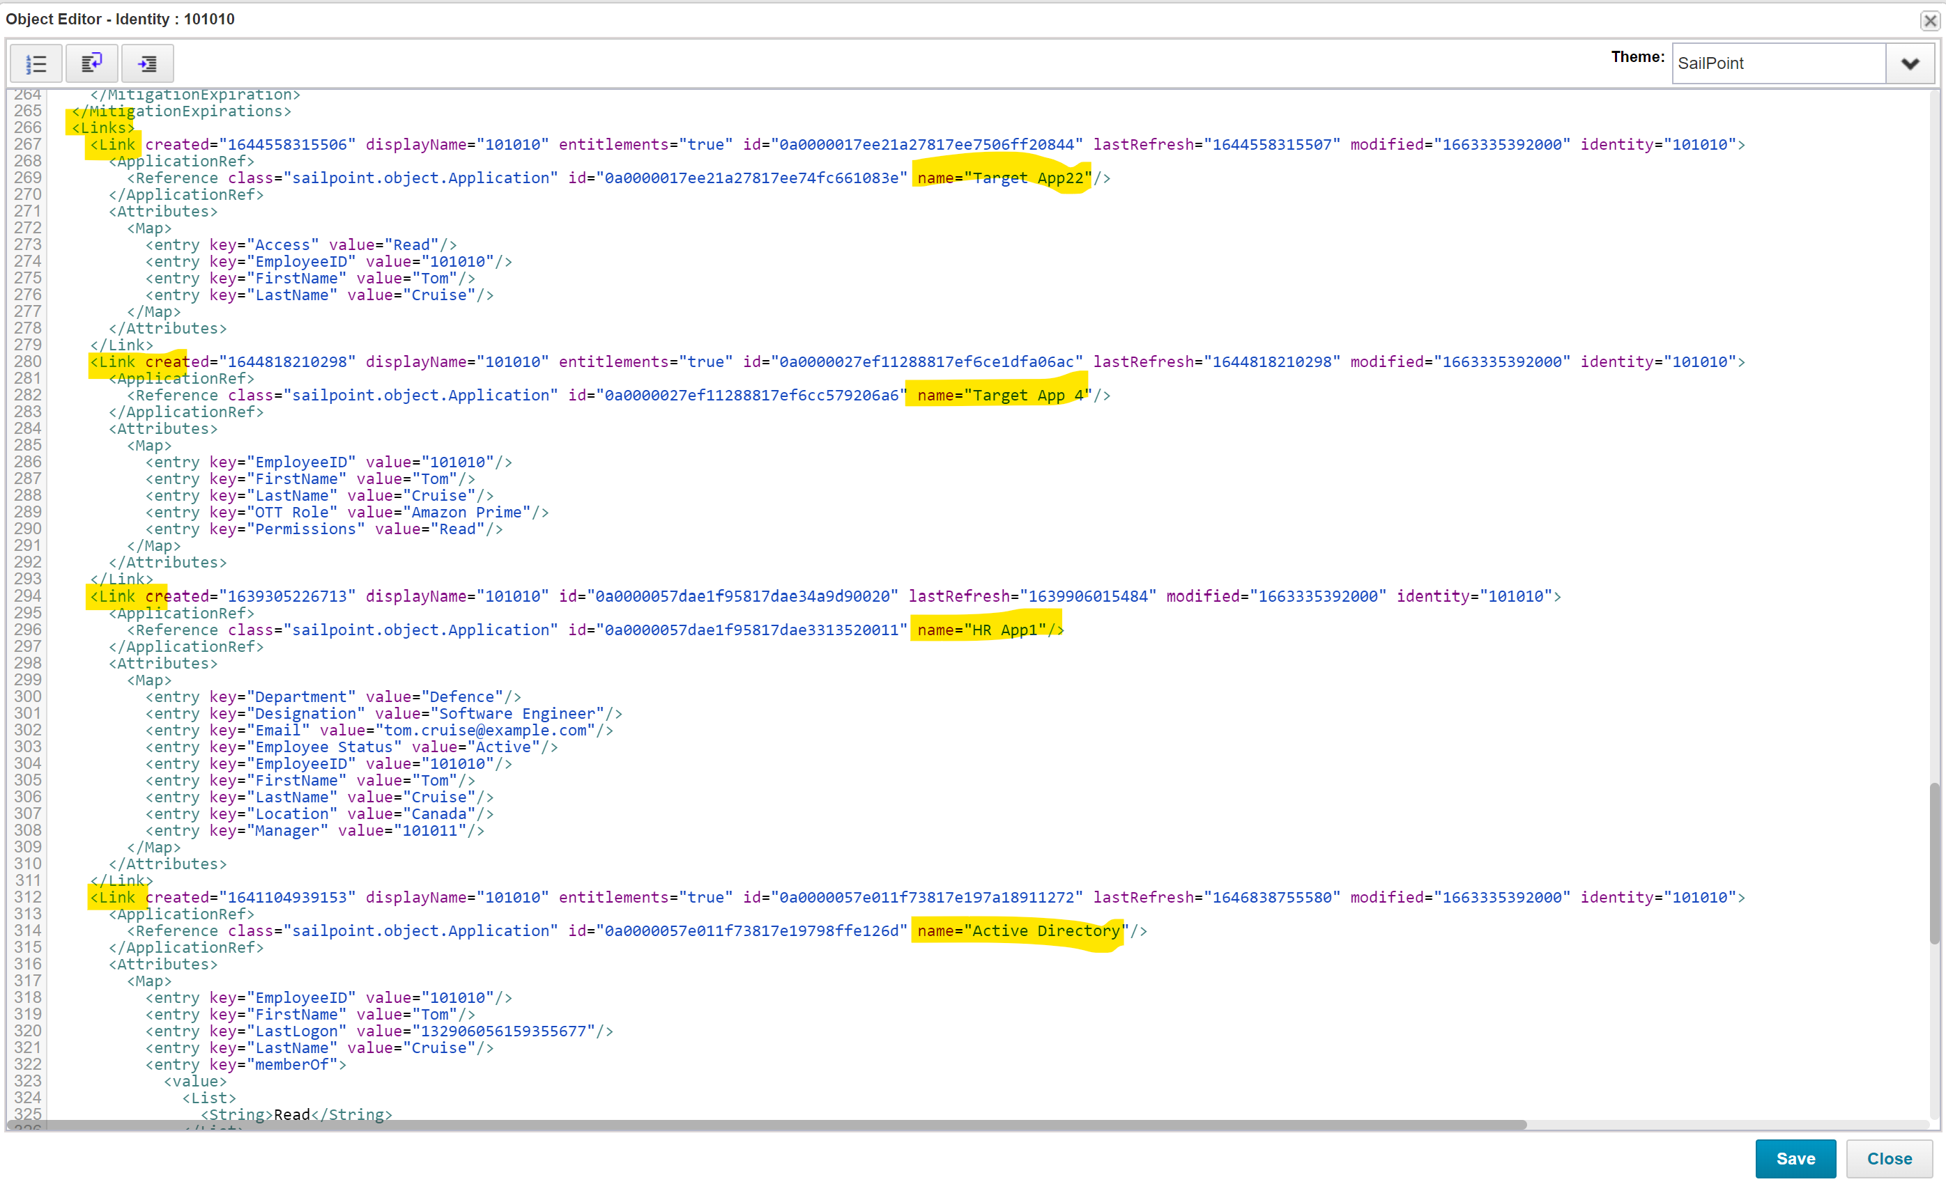
Link object in Debug
There is no separate object representation for link
You can view link in Identity object itself.

Slide 8
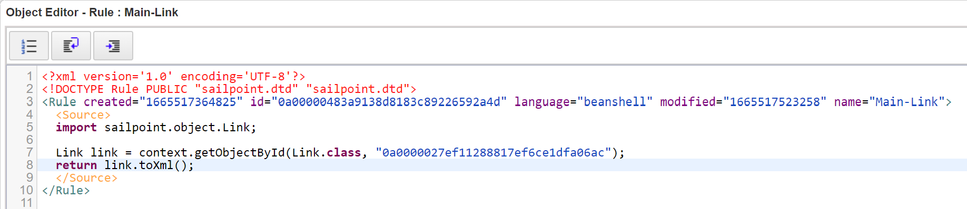
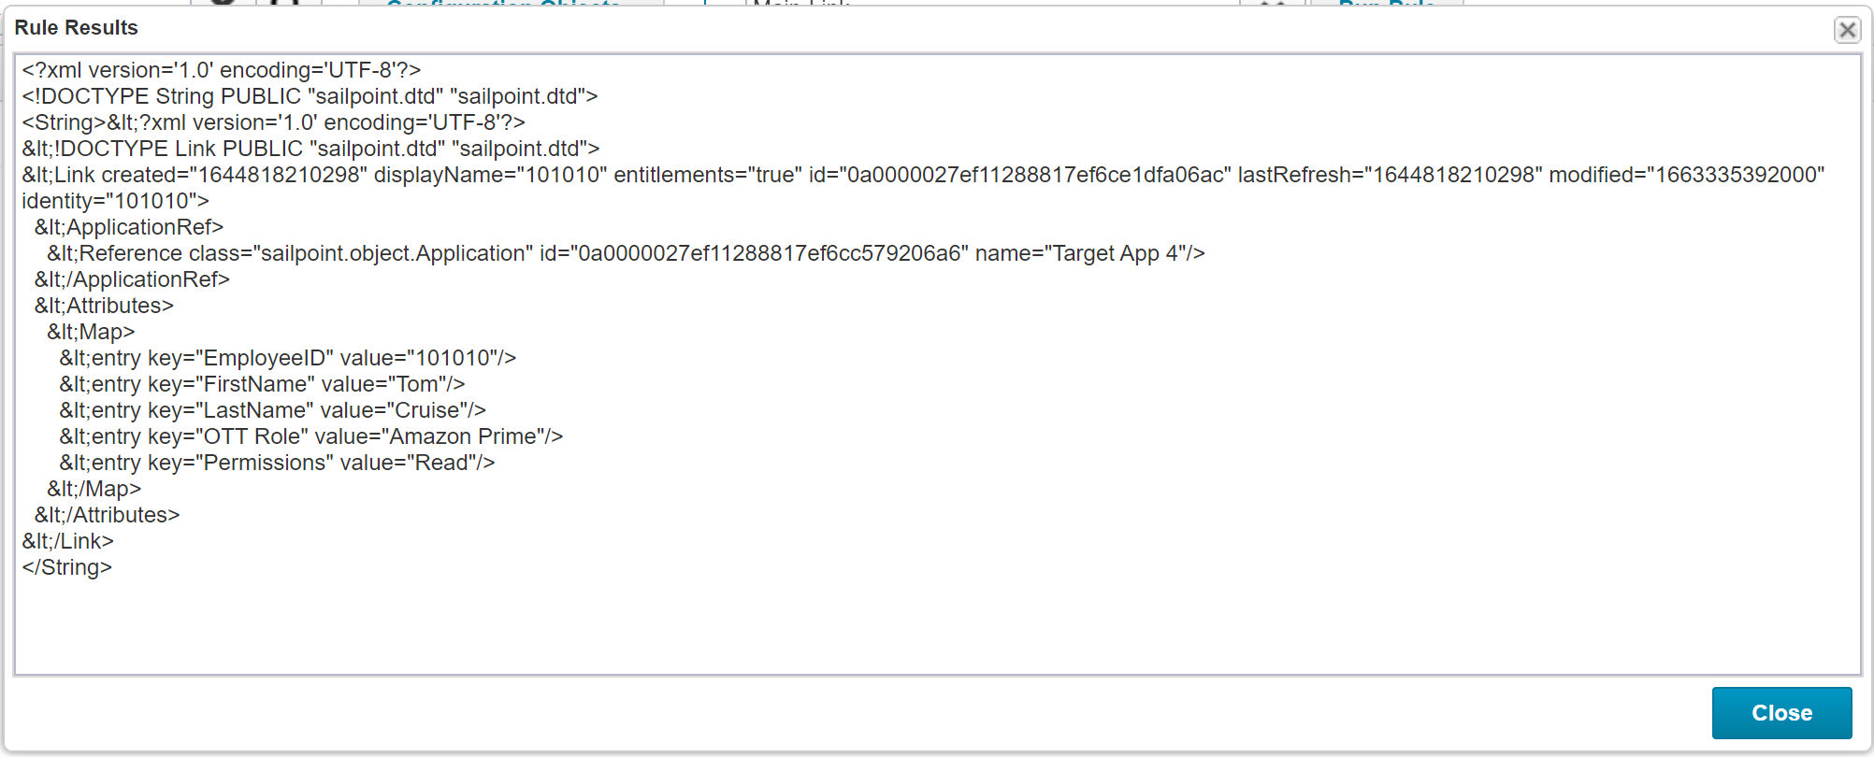
Coding for Link object
Unlike creating Identity/Application object, we don’t create link object.
We fetch link object from an identity
But in case you need to create a link object, then you need to know the id of that link
You will come across this when you are dealing with link objects in Custom forms
Since there is no name for link object, we can’t use goByName method

Slide 9
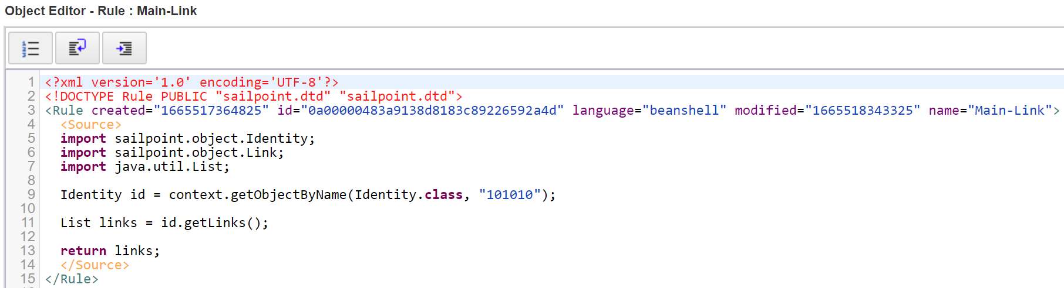
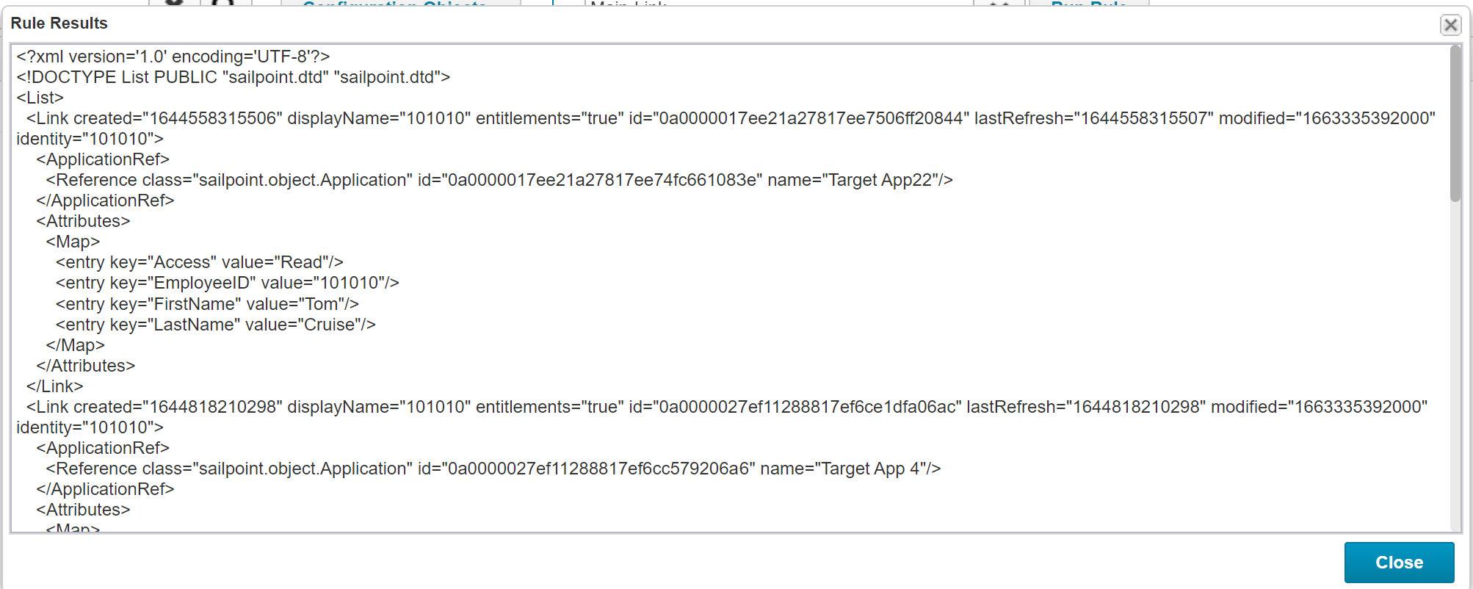
Coding for Link object
We can fetch all the links(accounts) for a user

Slide 10
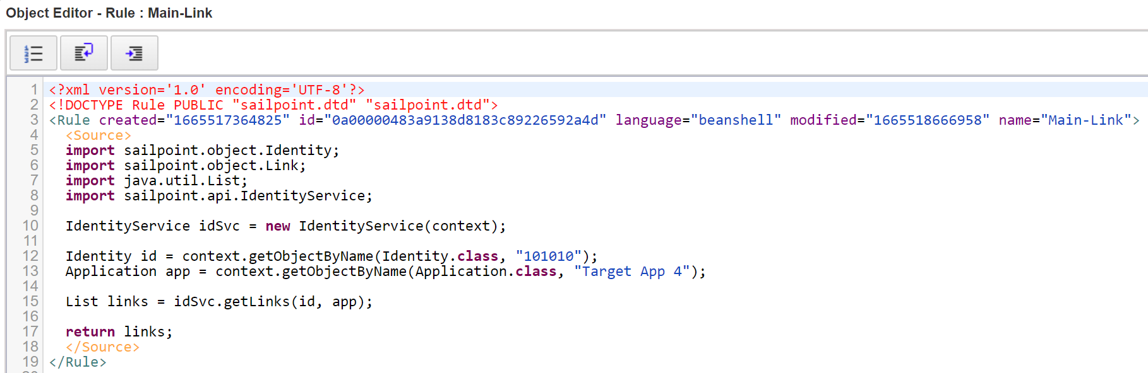
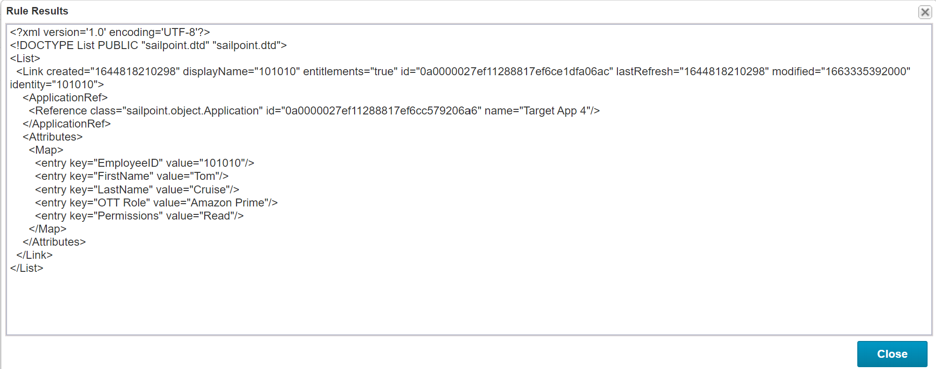
Relationship between Identity, Application and Link object
We can fetch link(account) for user on a specific application

Slide 11
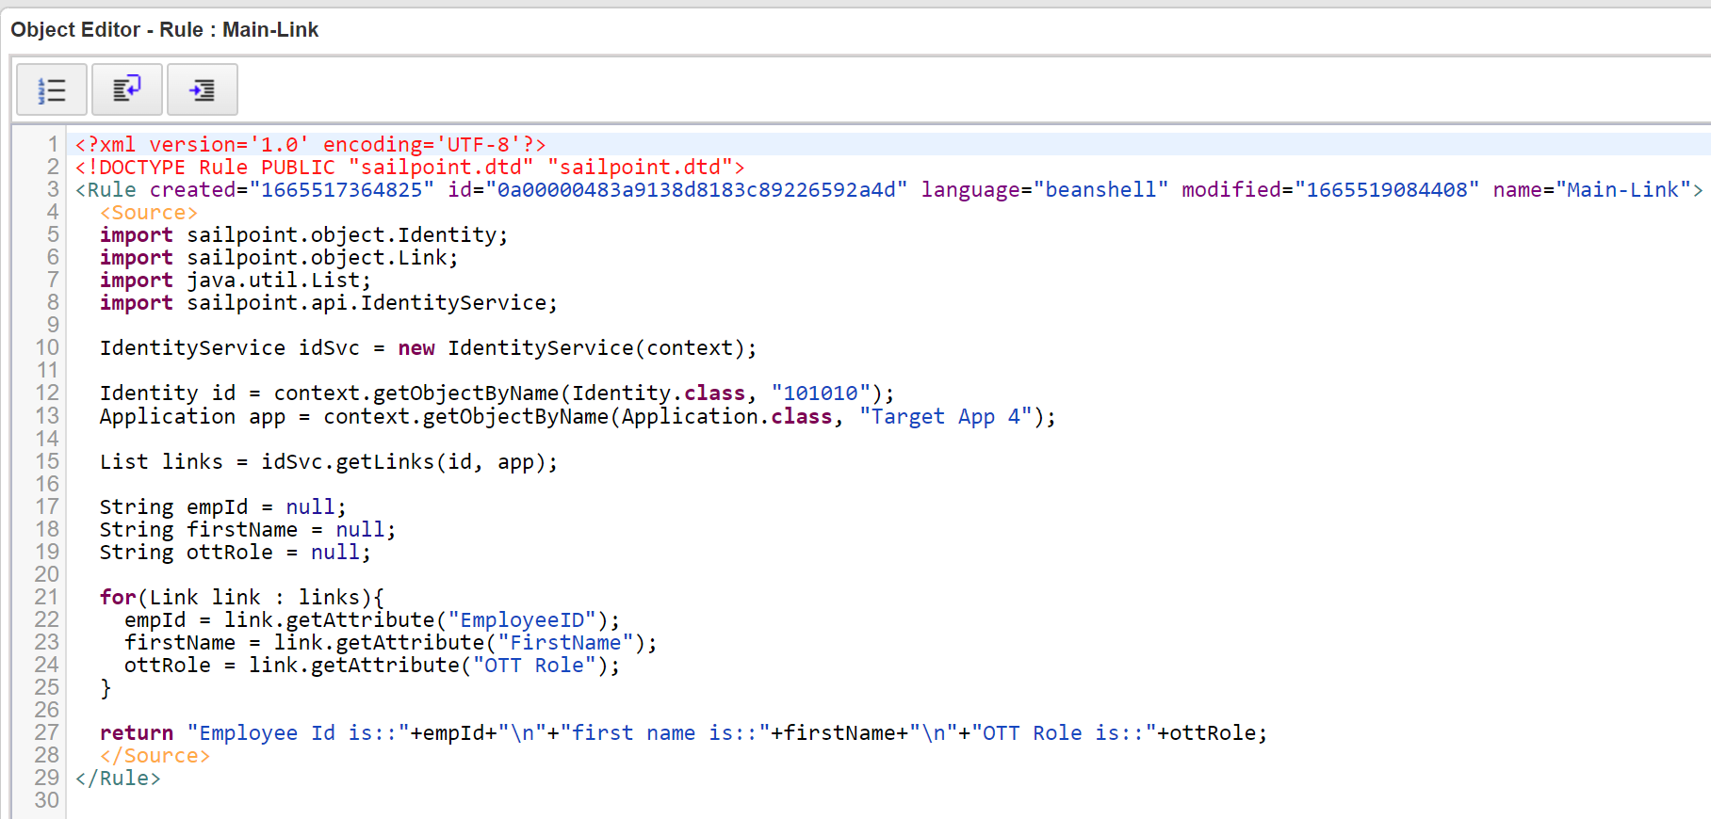
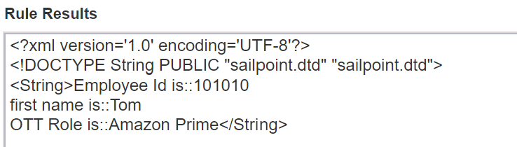
Coding for Link object
Once you fetch a specific link object, you can use SailPoint API to extract specific attributes from link object same as we have seen in Identity/Application

Slide 12
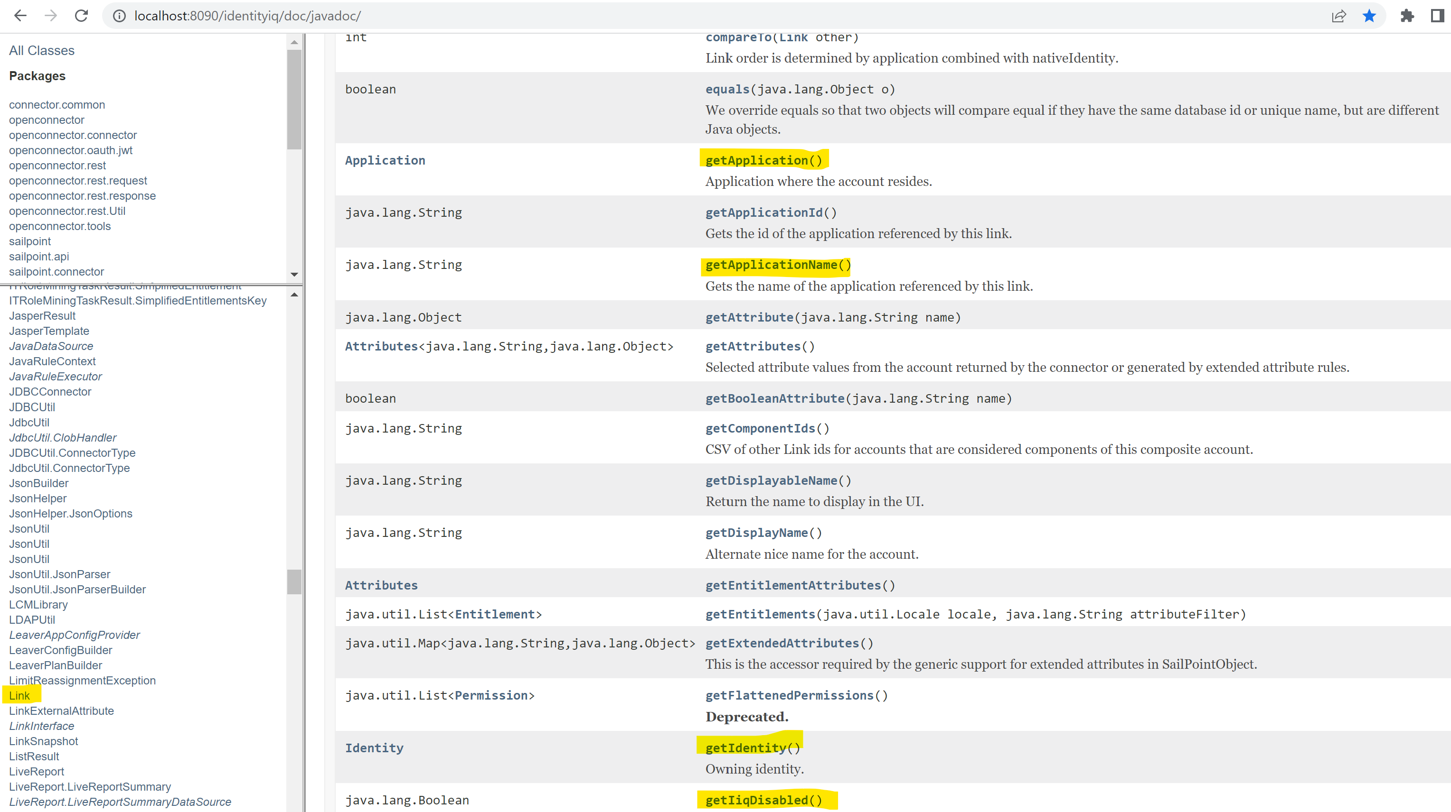
Link object methods in Javadoc
Check Get and Set methods available for Link object in Javadoc also known as SailPoint API
Use the methods as per your requirements

Slide 13
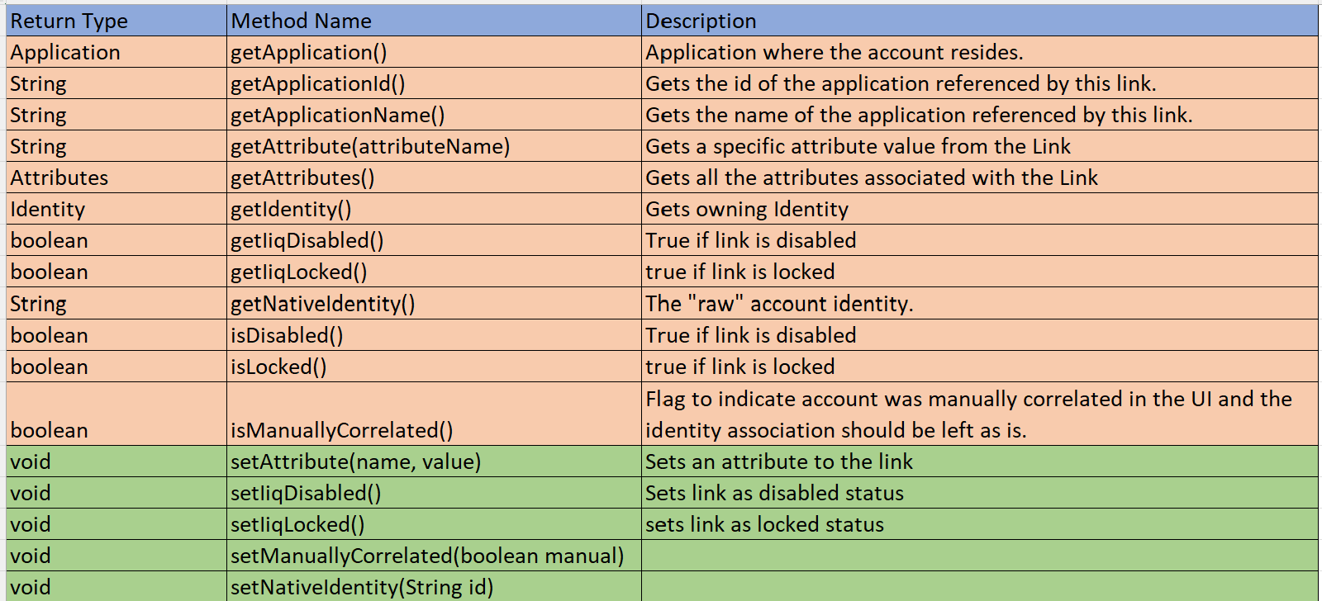
Link object methods in Javadoc
Below are the methods that are widely used in day to day activities on Link object
Please note that Application object is used mostly to get specific link associated with Identity, so you don’t need to know much about methods available for application object.
But every object has almost similar get and set methods, if you understand one object, its not a big deal to understand other objects, as it’s basically SailPoint API is about getters and setters

