Slide 1
WEATHER PREDICTION
Team Name/No: 8
Gurpreet Singh 2210990347
Harsh Bansal 22100990376
Harsh Chauhan 2210990377
Harsh Dhiman 2210990378

Slide 2
Index
Objective
Introduction
Methodology, Approach & Techniques
Algorithm
Flow Chart
Conclusion
Reference

Slide 3
Objective
.
The primary objective of this project is to develop a weather prediction system using machine learning techniques. Specific objectives include:
Exploratory data analysis of historical weather data.
Preprocessing the data to handle missing values and encode categorical variables.
Training and evaluating machine learning models for weather prediction.
Saving the trained model for future use.

Slide 4
Introduction
Understanding and predicting weather patterns is crucial for various aspects of our daily lives. Whether it's planning outdoor activities, agricultural decisions, or even preparing for extreme weather events, having accurate weather forecasts is essential.
However, traditional methods of weather prediction rely heavily on manual observation and numerical models, which can sometimes be limited in accuracy and scalability. There's a growing need for more efficient and accurate methods of weather forecasting, especially with the increasing complexity of climate change and its impact on weather patterns.
So we made a project of weather prediction using machine learning.
"In an era inundated with information from various sources, the proliferation of fake news has emerged as a critical challenge undermining the integrity of public discourse and decision-making processes. To address this pressing issue, our fake news detection program leverages advanced technologies and methodologies to identify, verify, and combat misinformation circulating across digital platforms. By combining cutting-edge algorithms, machine learning techniques, and collaborative efforts with reputable fact-checking organizations, our program aims to empower users with the tools and knowledge necessary to discern credible information from deceptive content. Through a multifaceted approach encompassing detection, verification, education, and prevention, we endeavor to safeguard the integrity of news dissemination and promote informed civic engagement in the digital age."

Slide 5
Methodology , Approach & Techniques
The methodology for fake news detection encompasses data collection, preprocessing, and feature extraction to prepare the data for analysis. Machine learning models are trained and evaluated using labeled datasets, with techniques like ensemble methods and cross-validation enhancing their accuracy. Human-in-the-loop approaches, user behaviour analysis, and real-time monitoring are employed for ongoing refinement and adaptation to combat evolving misinformation.
Approach :
Fake news detection programs utilize diverse approaches, including content and source analysis, user engagement scrutiny, and machine learning. These methods aim to discern misinformation by examining text, source credibility, and user interactions, thereby enhancing accuracy. Integration of cross-referencing, semantic analysis, and network evaluation further bolsters these programs' efficacy in identifying and mitigating fake news dissemination.
Techniques :
Fake news detection programs utilize content, source, and user engagement analysis alongside machine learning to discern misinformation. Cross-referencing and semantic analysis verify claims, while network analysis identifies influential nodes in misinformation dissemination. These techniques collectively bolster the efficacy of fake news detection systems in combat.
1. Data Exploration: We start by importing necessary libraries such as Matplotlib, Seaborn, and pandas for data visualization and manipulation. The dataset, "seattle-weather.csv," is loaded into a pandas DataFrame for analysis. Initial exploration includes examining the shape of the data, visualizing the distribution of weather types, and exploring key numerical features through histograms and violin plots.
2. Data Cleaning: Before diving into modeling, it's crucial to address missing data. The Missingno library helps us visualize missing values in the dataset. Additionally, we perform basic data cleaning tasks such as dropping unnecessary columns like 'date' if present.
3. Feature Encoding: Categorical variables like 'weather' are encoded using LabelEncoder to prepare the data for machine learning algorithms.
4. Data Preprocessing and Splitting: The dataset is divided into features (X) and target labels (y). Then, the data is split into training and testing sets using the train_test_split function.

Slide 6
METHODOLOGY
5. Model Training and Evaluation: We employ four different machine learning algorithms for weather prediction:
K-Nearest Neighbors (KNN)
Support Vector Machine (SVM)
Gradient Boosting Classifier (GBC)
XGBoost Classifier (XGB)
Each model is trained on the training set and evaluated for accuracy on the testing set.
6. Prediction: Finally, we demonstrate the model's predictive capability by inputting sample data and predicting the corresponding weather type.
7. Model Saving: The trained XGBoost Classifier model is saved using pickle for future use.

Slide 7
Algorithm
Data Loading and Exploration:
Import necessary libraries.
Read the CSV file ("seattle-weather.csv") into a pandas DataFrame.
Display the first few rows of the dataset to understand its structure.
Explore the shape of the dataset.
Data Visualization:
Visualize the distribution of weather types using seaborn's countplot.
Calculate the percentage of each weather type and print the results.
Visualize key numerical features (precipitation, temp_max, temp_min, wind) using histograms and violin plots.
Data Cleaning:
Suppress warnings to improve code readability.
Visualize missing values using Missingno library's bar chart.
Drop the 'date' column if present in the dataset.

Slide 8
4. Feature Encoding:
Use LabelEncoder to encode the 'weather' column (categorical) into numerical values.
5. Data Preprocessing and Splitting:
Separate features (X) and target labels (y) from the dataset.
Split the data into training and testing sets using train_test_split function.
6. Model Training and Evaluation:
Train and evaluate four different machine learning models:
K-Nearest Neighbors (KNN)
Support Vector Machine (SVM)
Gradient Boosting Classifier (GBC)
XGBoost Classifier (XGB)
Print the accuracy of each model on the testing set.
7. Prediction:
Demonstrate the model's predictive capability by providing sample input data and predicting the corresponding weather type.
8. Model Saving:
Save the trained XGBoost Classifier model using pickle for future use.

Slide 9
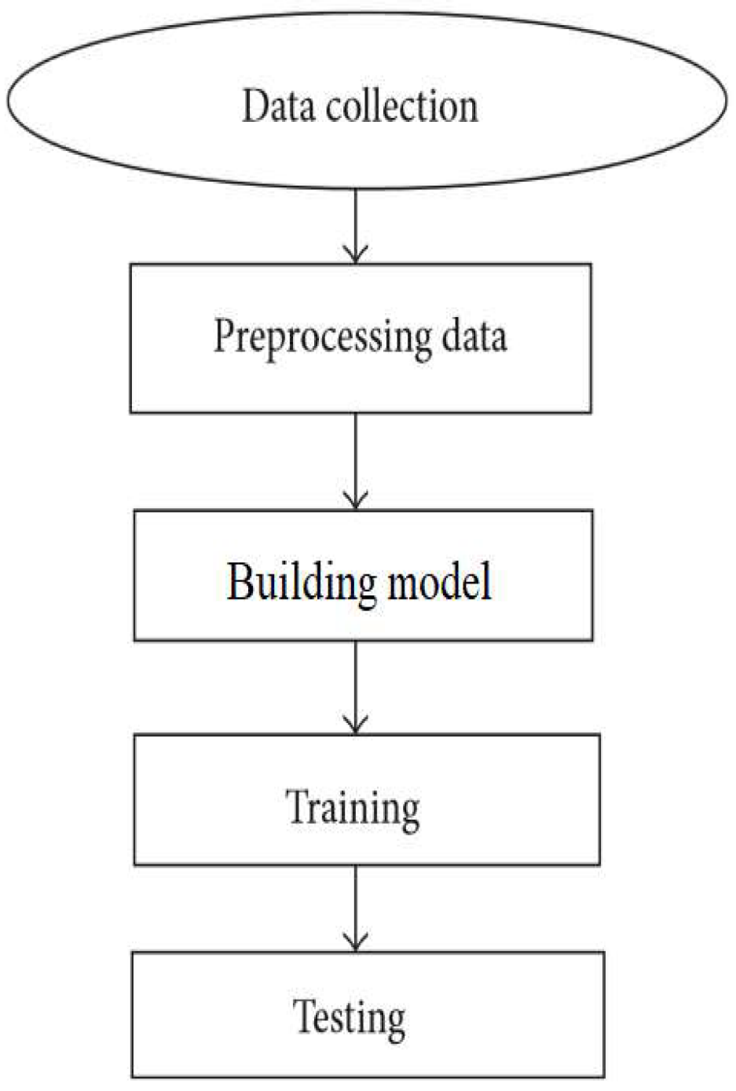
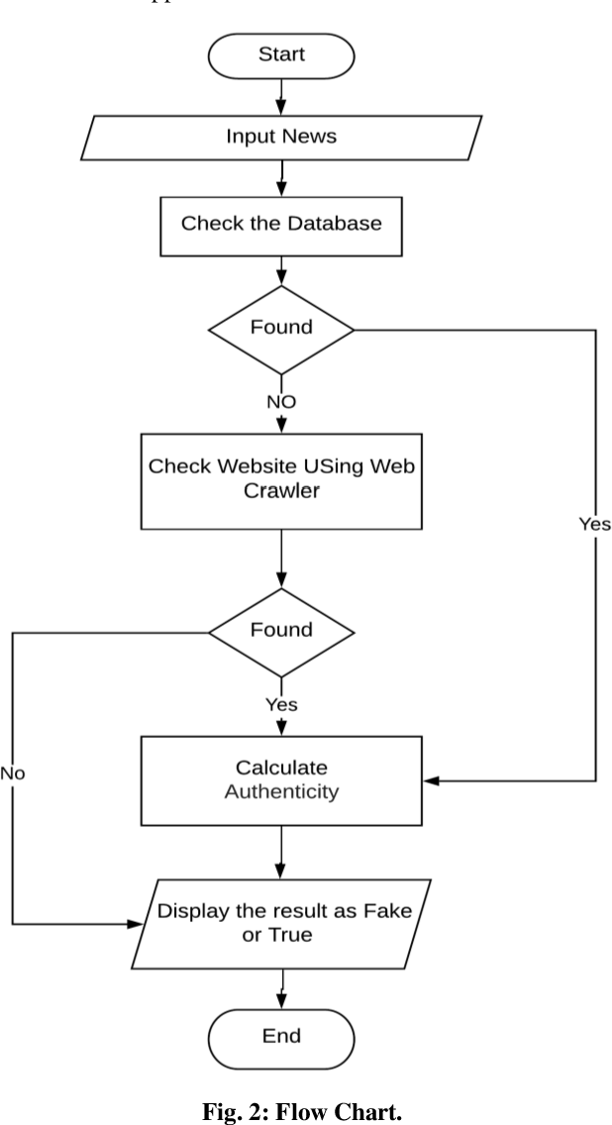
Flowchart

Slide 10

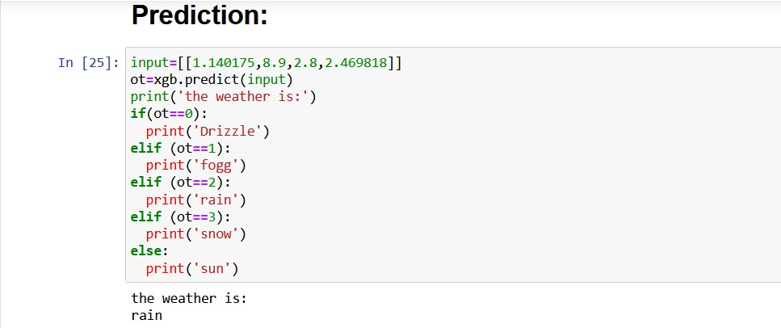

Result

Slide 11
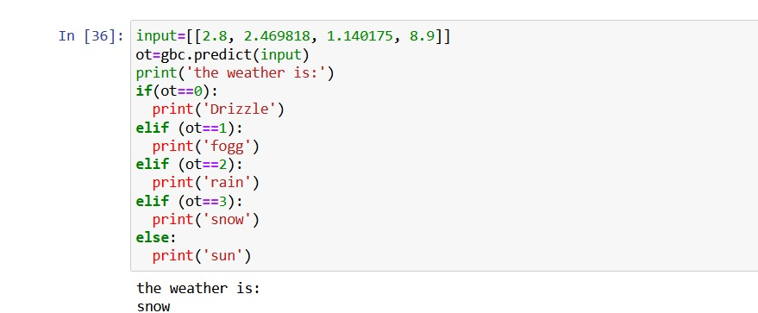
Result
22CS016

Slide 12
Conclusion
Conclusion
The project successfully develops a weather prediction system using machine learning techniques. The trained model demonstrates good accuracy in predicting weather conditions based on historical data. The project highlights the importance of data preprocessing, feature engineering, and model selection in improving prediction performance.

Slide 13
The End
Thank you

