Slide 1
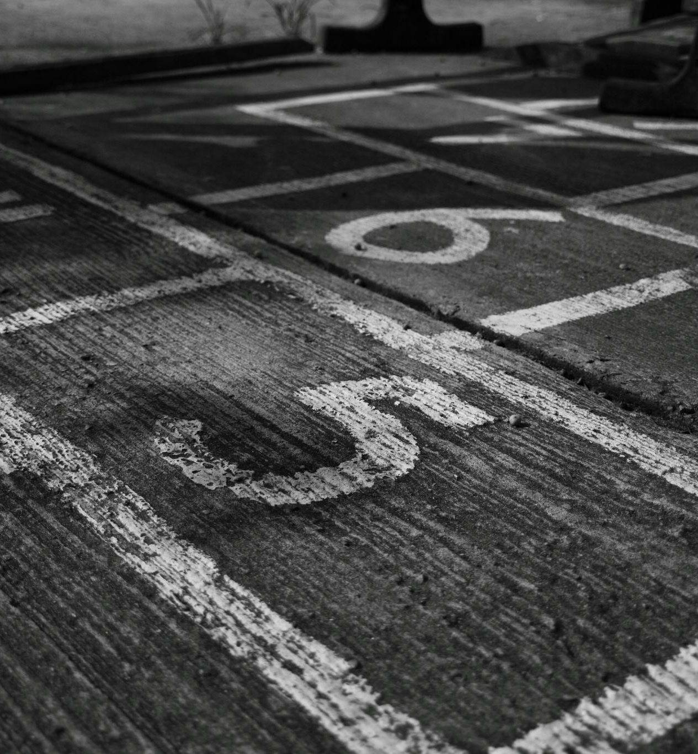
Team-31 Ctrl+Alt+Defeat
-Harsh Chaudhari
-Shivdatt Jangam
-Ankush Yamkar
-Aryan Gurav

Slide 2
Domain – AI/ML PS-2 Disaster Management System
Natural and man-made disasters pose significant threats to communities worldwide, leading to loss of lives, property, and resources. Traditional disaster management systems often face challenges in timely response, resource allocation, and decision making. There is a need for an advanced AI/ML-based disaster management system that can enhance preparedness, response, and recovery efforts.

Slide 3
Technologies Stack
MERN (MongoDb, ExpressJs, ReactJs, NodeJs)
Machine Learning (Python , Tensorflow)
Natural Language Processing
Image Processing
Web Scrapping

Slide 4
Features
Disaster Classification Through Images.
Infrastructure Vulnerability Classification.
Resource Allocation.
Social Media Classification.

Slide 5
Features
Awareness and Planning.
Post-Disaster Data Analysis and Recovery Planning.
Notification Alerts.

Slide 6
Thank You!!

