Slide 1
Stock Sentiment Analysis
MCA Major Project
Harsh – O23MCA110262
Chandigarh University

Slide 2
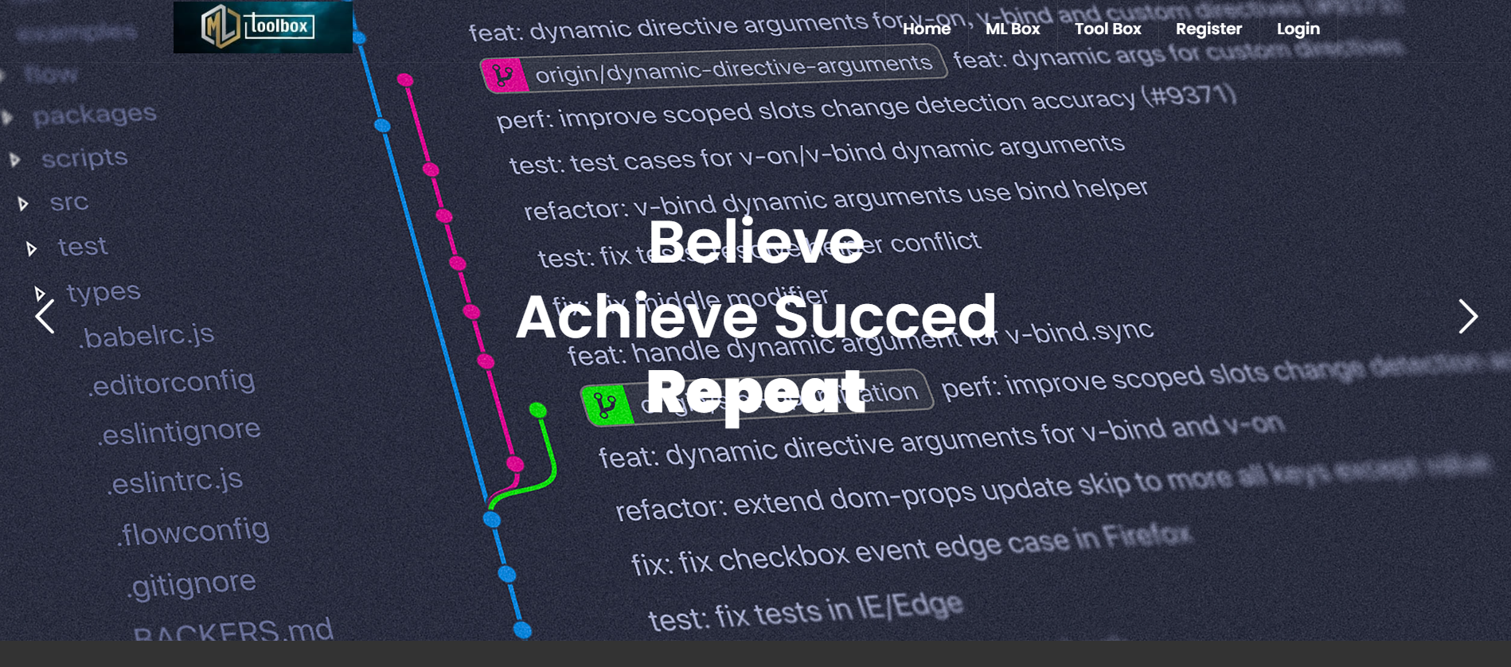
Objective
- Classify financial sentiment (positive, negative, neutral).
- Explore sentiment vs. stock price correlation.
- Build and deploy a web-based sentiment analysis system.

Slide 3
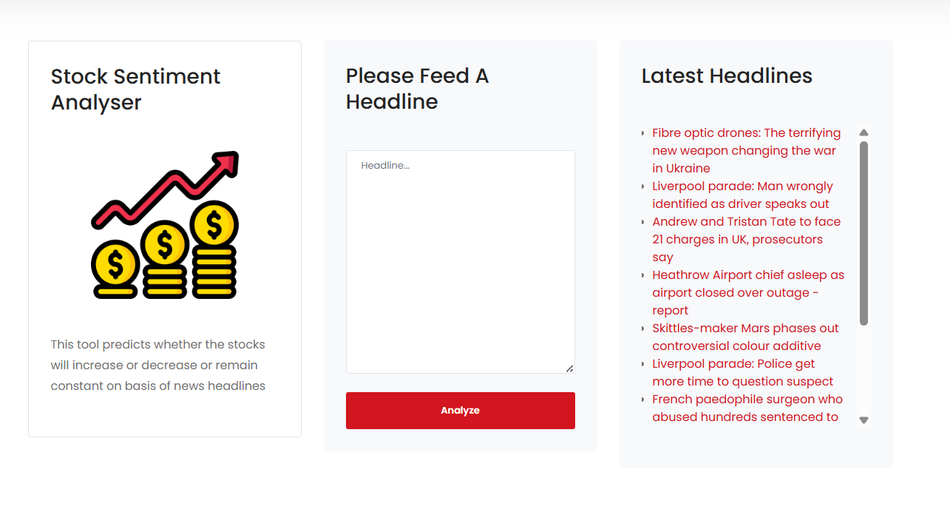
Introduction
- Stock market influenced by public sentiment.
- NLP helps extract sentiment from text.
- Real-time analysis offers actionable insights.

Slide 4
SDLC – Overview
- Requirement Analysis
- System Design
- Implementation
- Testing
- Deployment
- Maintenance

Slide 5
System Requirements
- Frontend: HTML, CSS, JS
- Backend: Django (Python)
- ML: NLTK, TensorFlow, Scikit-learn
- Storage: SQLite, PyDrive
- APIs: Twilio, Python-Decouple

Slide 6
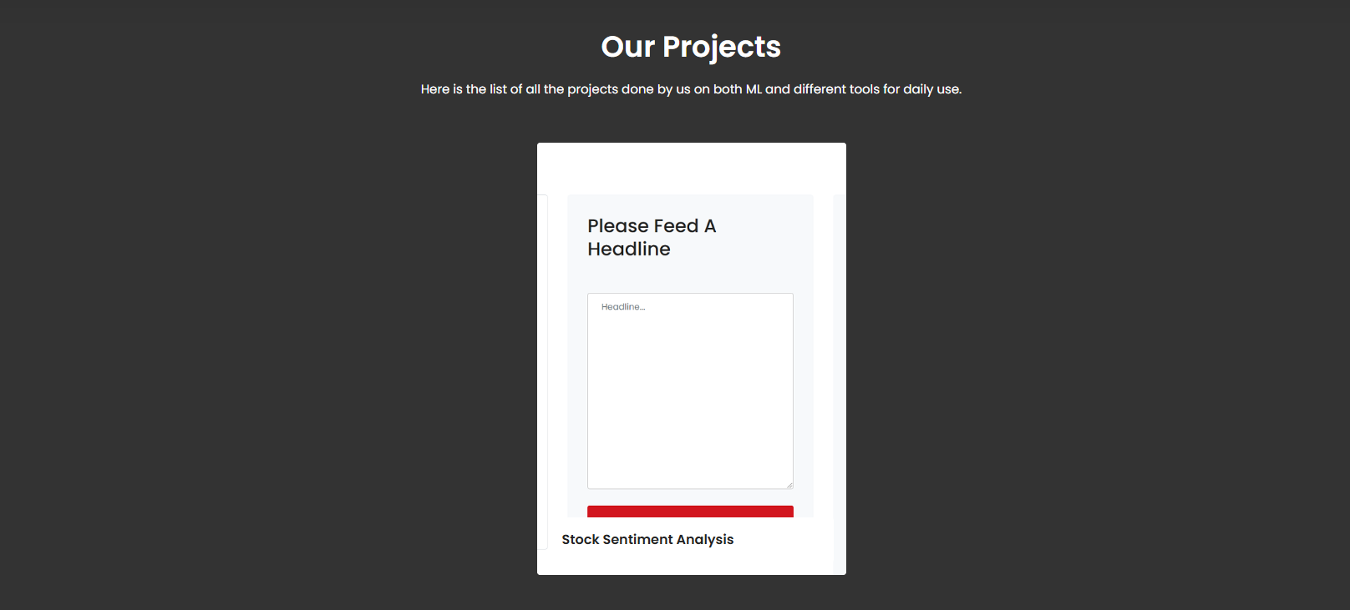
System Architecture
Include a visual of system architecture diagram
Layers: Frontend → Backend → ML/NLP → Database/File Storage

Slide 7
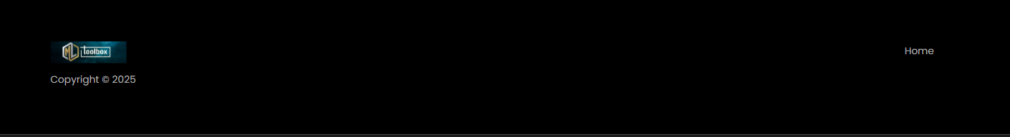

Slide 8


Slide 9


Slide 10
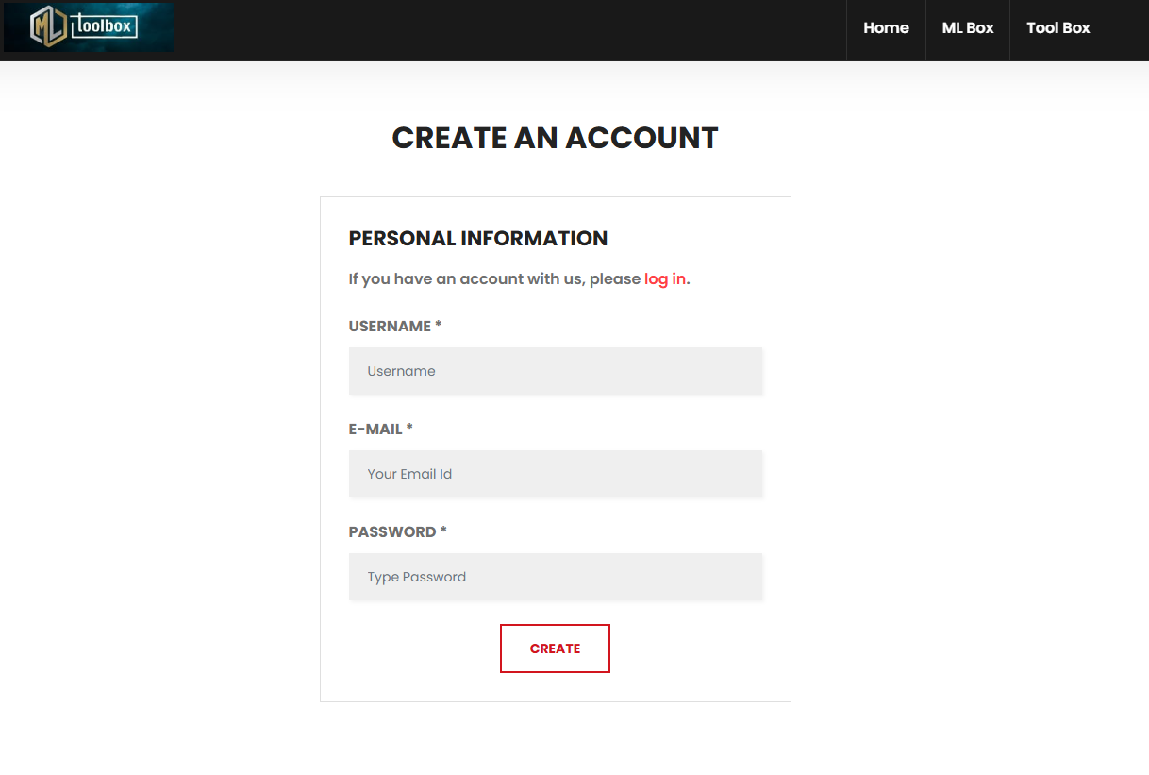

Slide 11
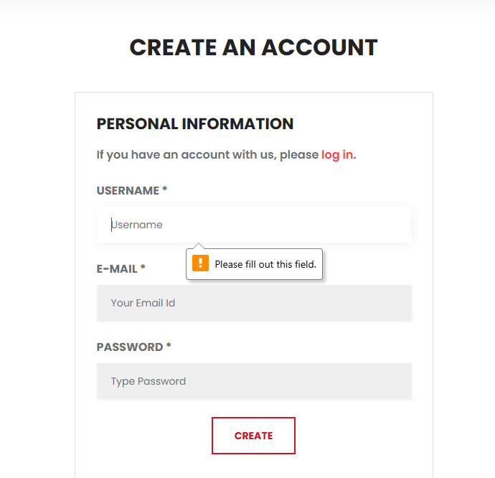

Slide 12
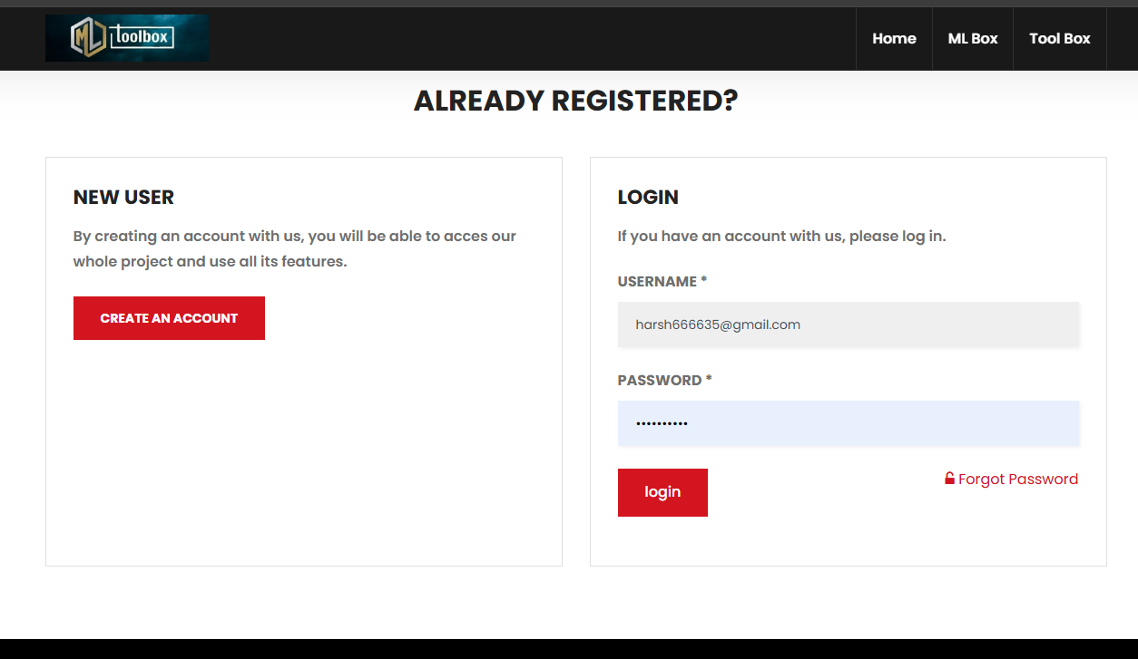

Slide 13
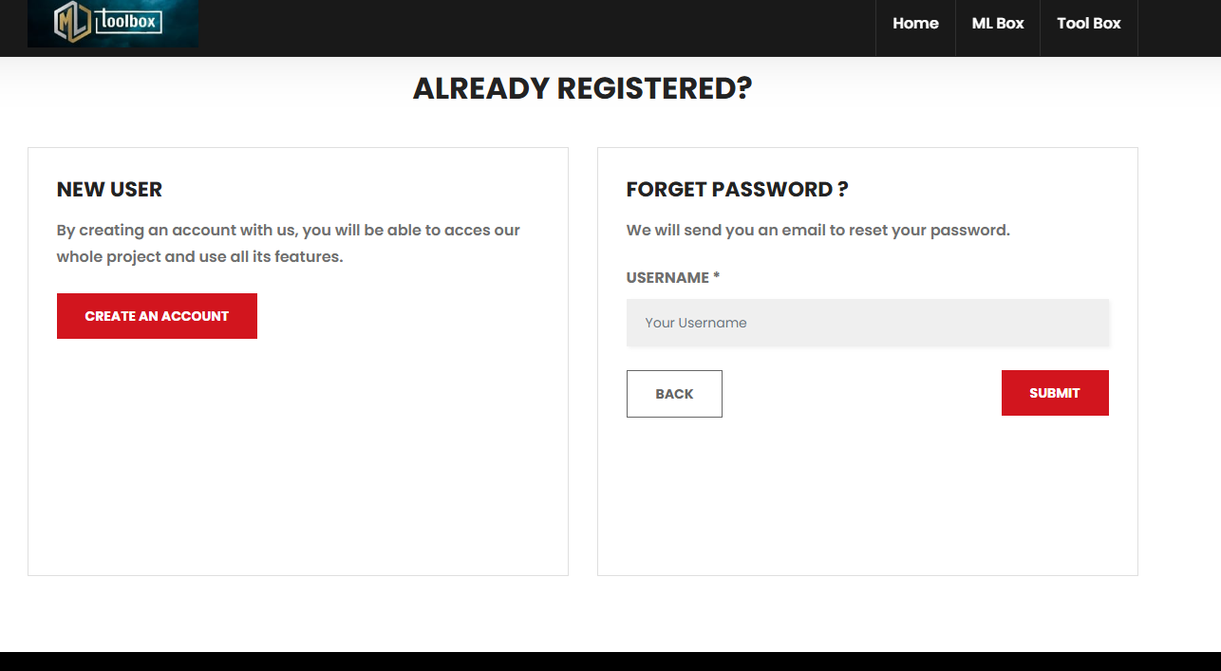

Slide 14
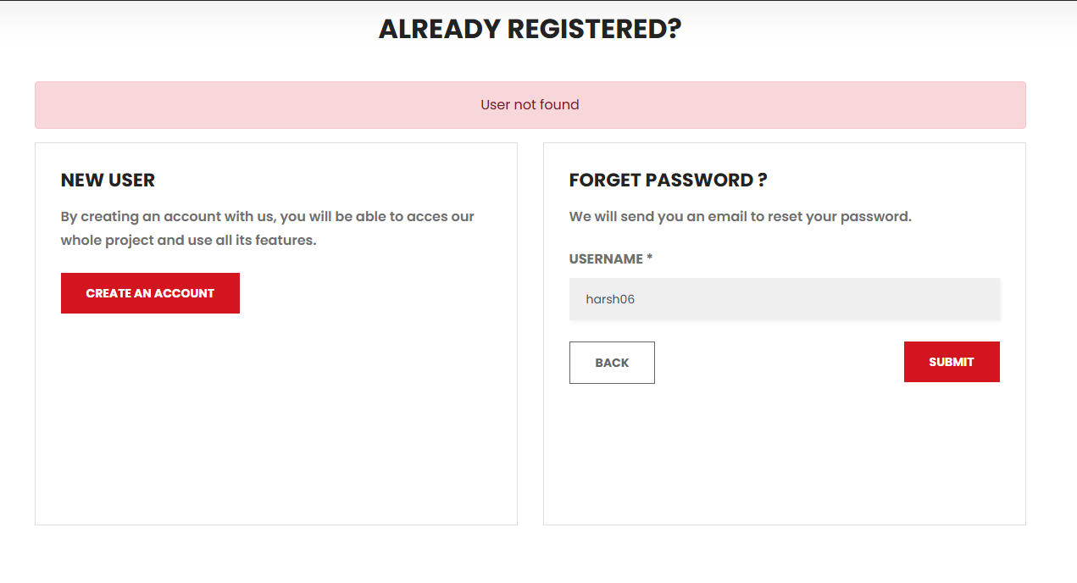

Slide 16
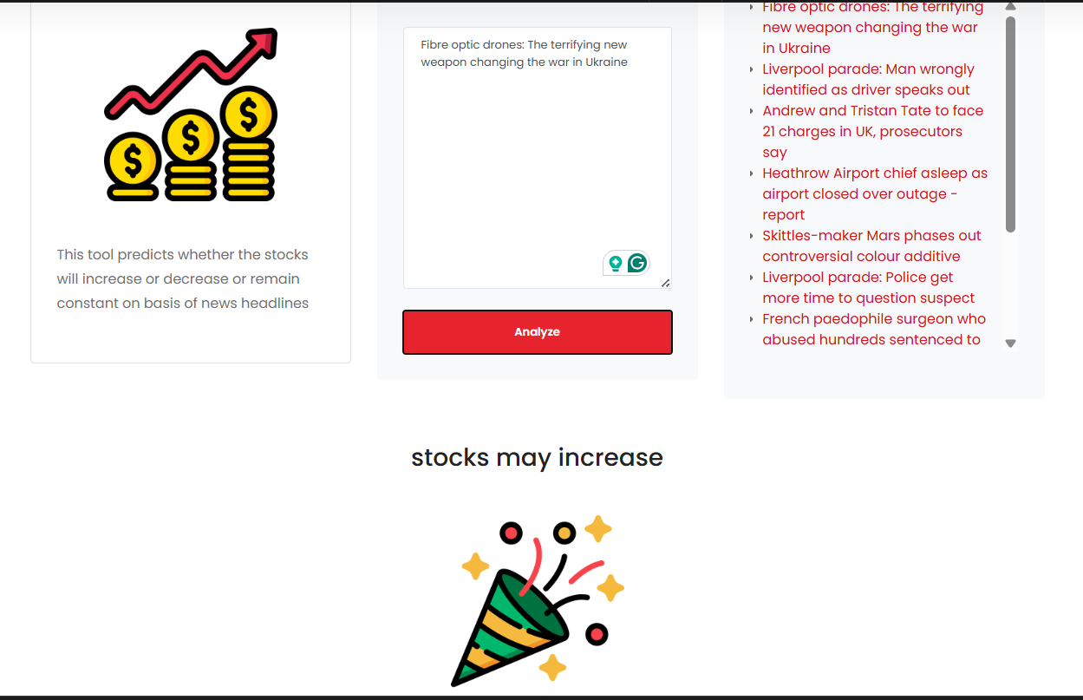

Slide 17
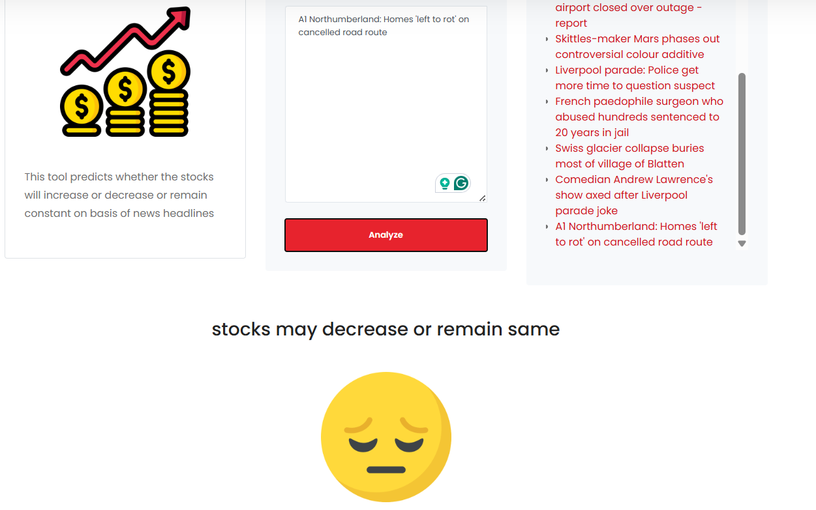

Slide 18
Implementation
- Django-based modular structure
- ML model integration for sentiment
- Preprocessing using NLTK
- Real-time user interaction

Slide 19
ML Pipeline
1. Text Input
2. Preprocessing (tokenization, stopwords)
3. Sentiment Prediction
4. Output to User

Slide 20
Testing
- Unit Testing
- Integration Testing
- Functional Testing
- Sample Cases:
- “Stocks are going up today” → Positive ✅

Slide 21
Challenges & Fixes
- Biased sentiment output → Retrained with balanced data
- UI didn’t show empty input error → Added validation
- Large inputs crashing → Added length limit

Slide 22
Results
- High accuracy with real data.
- Effective UI integration.
- Real-world applicability validated.

Slide 23
Applications
- For traders/investors to make data-backed decisions.
- Can evolve into a real-time sentiment dashboard.
- Foundation for automated trading systems.

Slide 24
Future Work
- Real-time streaming from news/social media.
- Integration of advanced models (RNNs, transformers).
- Mobile app version.
- Deeper financial data sources.

Slide 25
Conclusion
- Demonstrated NLP/ML in stock sentiment analysis.
- Practical system built and tested.
- Foundation for further research in financial analytics.

Slide 26
Thank You
Questions?
Submitted by: Harsh
Enrollment No: O23MCA110262

