Slide 1
AgroVeda
E-Commerce Platform for Agricultural Products
Submitted By:
ZOYA IBRAHIM
Enrollment No: 0210CA241134
4th Semester MCA | Session 2025-26
Under the Guidance of:
Prof. Sachin Dubey
Department of MCA
Shri Ram Institute of Technology, Jabalpur

Slide 2
Agenda
• Project Introduction & Domain Overview
• Problem Statement & Project Objectives
• Analysis of Existing vs. Proposed System
• System Architecture, Workflows & Tech Stack
• Database Design & UML Activity Modeling
• Core Code Algorithms & Security Implementations
• Admin Order & Sales Registry (Dashboard Demonstration)
• Advantages, Future Scope & Conclusions
AgroVeda MCA Major Project

Slide 3
Project Introduction
• Agriculture is the backbone of the Indian economy, employing over 50% of the workforce, but digital input procurement remains highly unstructured.
• Traditional channels rely on local physical retail dealers, leading to long travel distances, lack of inventory selection, and high pricing markups.
• AgroVeda is a full-stack agricultural e-commerce platform designed to bridge this digital divide.
• Enables farmers and cooperatives to purchase quality pesticides, fertilizers, growth regulators, and crop boosters directly from their mobile devices.
• Designed with a dual-language (Hindi/English) catalog interface to ensure high accessibility for rural farmers.
AgroVeda MCA Major Project

Slide 4
Problem Statement
• Middlemen Inefficiencies: Complex retail dealership networks result in high markup prices for vital chemicals/boosters.
• Asymmetric Information: Farmers lack transparent pricing and have no direct way to compare product ingredients and specifications.
• Language Barrier: Most commercial e-commerce portals are in English, excluding the major demographic of Hindi-speaking rural farmers.
• Logistical Overhead: Farmers travel multiple kilometers to towns without guarantee of stock availability, leading to wasted time and labor.
• Trust & Payment Issues: Absence of cash-on-delivery options or simplified, secure local digital billing gateways (e.g. Razorpay UPI QR simulation).
AgroVeda MCA Major Project

Slide 5
Project Objectives
• Develop a responsive, full-stack, mobile-friendly agricultural input e-commerce portal.
• Implement a bilingual interface (English and Hindi) for seamless navigation and product catalogs.
• Create a secure, JWT-authenticated User Registration and Login system.
• Integrate Razorpay payment gateway simulation for UPI, debit/credit cards, alongside a Cash on Delivery (COD) workflow.
• Construct a secure Admin Dashboard enabling product CRUD operations (Add, delete, update pricing) and a real-time Orders & Sales Summary monitor to track who purchased, order timestamps, and items summary.
AgroVeda MCA Major Project

Slide 6
Existing System & Drawbacks
Current Traditional System
• Procurement through local village or town shops.
• Rely on word-of-mouth recommendations from shop owners.
• Manual bookkeeping (paper invoices) with no transaction histories.
• Cash-only transactions with high markup commissions.
Key Critical Drawbacks
• Limited catalog variety based on shop keeper's preferences.
• Lack of pricing transparency (varying prices across different shops).
• Wasted labor and transportation costs traveling to local dealers.
• No digital bills, order tracking, or verification receipts.
AgroVeda MCA Major Project

Slide 7
Proposed System Solution
• Centralized E-Commerce Hub: Direct platform connecting farmers with catalog listings.
• Hindi/English Support: Easy-toggle language context supporting titles and descriptions.
• Secure Cart & Order Lifecycles: Full workflow covering add-to-cart, quantity updates, order summary validations, and automated billing details.
• Simulated Payment Gateways: Integration with Razorpay API (with instant QR scan/simulate-success testing modal).
• Interactive Admin CRM Dashboard: Real-time Order Registry logging customer mobile, timestamp of purchase, shipping address, total sales revenue statistics, and order items summary.
AgroVeda MCA Major Project

Slide 8
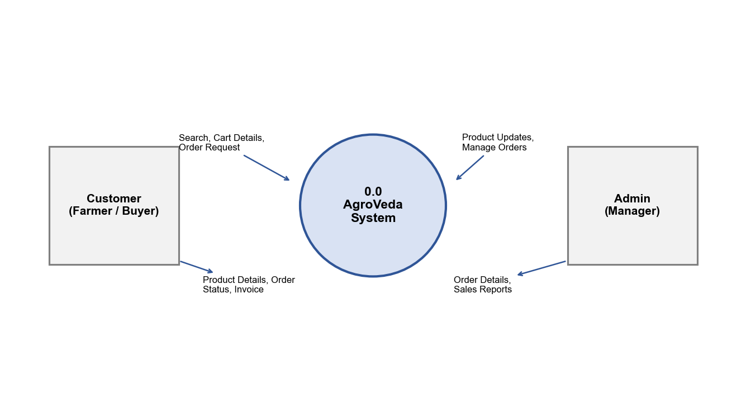
System Architecture
• Model-View-Controller (MVC) architectural design pattern deployed.
• Client-Side View: Single Page Application (SPA) built using React 18, TypeScript, and Vite for fast builds and components render.
• Server-Side Controller: Express.js (Node.js) serving REST endpoints (/api/products, /api/orders, /api/cart_items) deployed as serverless functions.
• Database Layer: Relational PostgreSQL database managed with an active connection pool, utilizing a local file-based JSON database engine fallback for offline local testing.
• Security Shield: Cross-Origin Resource Sharing (CORS) configurations, bcrypt password salting, and JSON Web Token (JWT) header authorization check.
AgroVeda MCA Major Project

Slide 9
Methodology & Development Workflow
• Agile Scrum Methodology implemented, divided into 6 distinct sprints over 20 days:
• Sprint 1 (Days 1-3): Project Setup & DB Schema Design. Setup Vite frontend scaffolding and local Express API route definitions.
• Sprint 2 (Days 4-7): UI Design & Bilingual Integration. Implemented homepage slides, product list filters, and English/Hindi language toggle.
• Sprint 3 (Days 8-10): Auth Shield. Built JWT signup, login, password encryption, and role-based route guards.
• Sprint 4 (Days 11-14): Cart & Checkout. Added shopping cart store, quantity managers, and address validation forms.
• Sprint 5 (Days 15-17): Razorpay Payments. Deployed backend order generation and signature HMAC-SHA256 checking.
• Sprint 6 (Days 18-20): Admin Panel, Orders Monitor & Vercel deployment.
AgroVeda MCA Major Project

Slide 10
Technologies Used
Frontend Stack
• React 18 & TypeScript (Type-safe components)
• Vite (Next-generation bundle tool)
• TailwindCSS & Shadcn UI (Custom layout styling)
• React Router DOM (Routing)
• Lucide React (Modern iconography)
Backend & Database Stack
• Node.js & Express.js (REST API server)
• PostgreSQL (ACID-compliant Database)
• JSON Web Tokens (JWT) (Authentication)
• Bcrypt.js (Password encryption)
• Razorpay SDK (Payments gateway integration)
• Vercel (Production hosting platform)
AgroVeda MCA Major Project

Slide 11
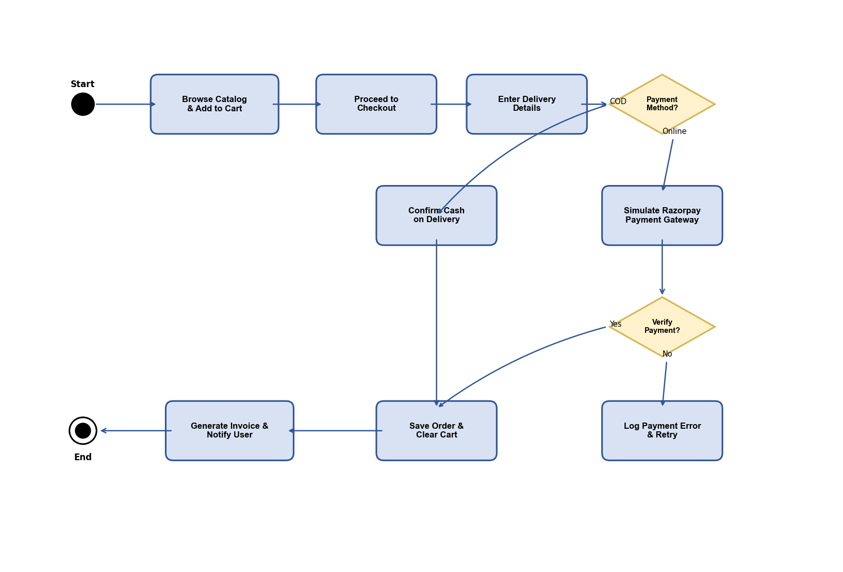
UML Diagrams - Activity Diagram
• This Activity Diagram outlines the execution flow of the Customer checkout and order confirmation process.
• Flow triggers on 'Checkout' request.
• Validates stock availability by querying Products DB.
• Fork Decision: Cash on Delivery (COD) vs. Razorpay Online Payment.
• Online payment initiates Razorpay API Order token creation and launches the UI payment widget.
• Upon signature verification, order data is committed to the database, cart items are cleared, and invoice receipt notifications are fired.
AgroVeda MCA Major Project

Slide 12
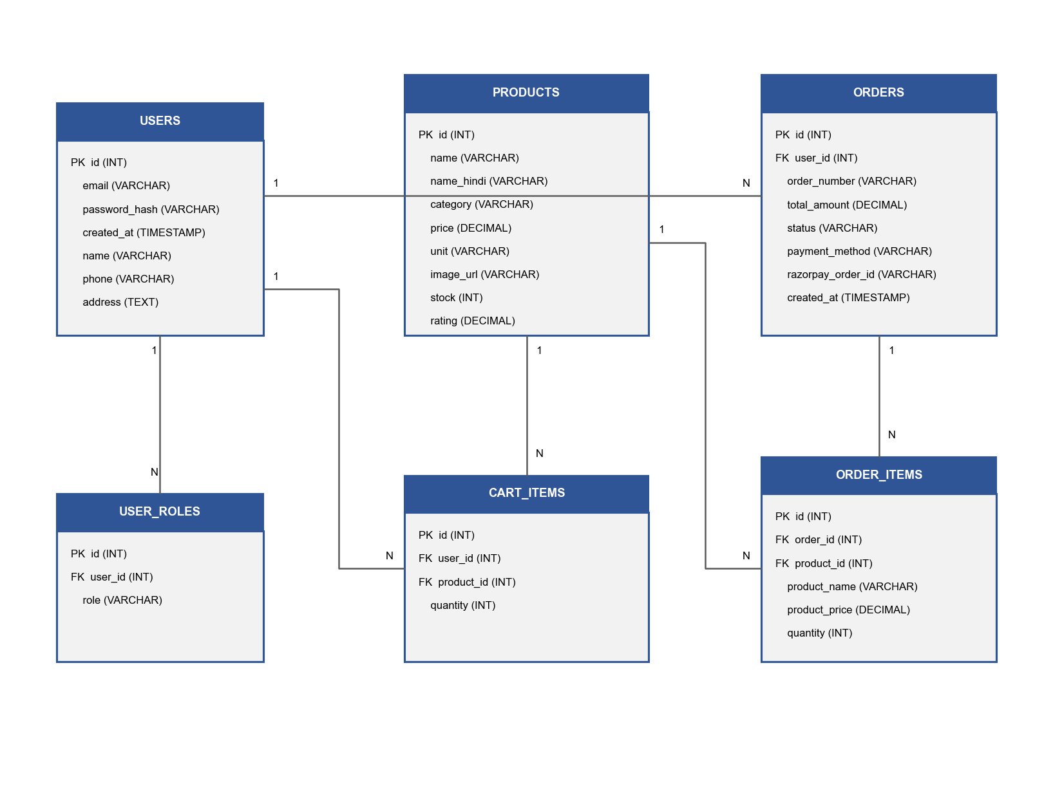
Database Design (ER Diagram)
• Our database schema consists of six core relational tables:
• USERS: Holds registration emails, passwords hashes, and metadata.
• USER_ROLES: Handles role permissions (admin vs. customer).
• PRODUCTS: Holds product detail metadata (prices, units, usage, names in Hindi/English).
• CART_ITEMS: Maps user shopping baskets (product reference, quantities).
• ORDERS: Logs final checkout transactions (customer phone, address, timestamp, status, amounts).
• ORDER_ITEMS: Captures product snapshot details inside orders.
AgroVeda MCA Major Project

Slide 13
Core Backend Algorithms
• 1. Authentication & Security (JWT Flow):
• - Customer password hashed on signup using bcryptjs with a work factor of 10.
• - On successful login, server creates a JWT payload containing { userId, email, role } signed using HMAC-SHA256 with a private key, returning an authorization token.
• - Auth Middleware intercepts private routes, decodes headers Bearer tokens, and sets context parameters.
• 2. Razorpay Signature Verification Algorithm:
• - When Razorpay completes a transaction, it returns: razorpay_order_id, razorpay_payment_id, and razorpay_signature.
• - The server computes the expected signature using HMAC-SHA256:
• signature = HMAC_SHA256(order_id + '|' + payment_id, secret_key)
• - If expected signature matches razorpay_signature, order is verified.
AgroVeda MCA Major Project

Slide 14
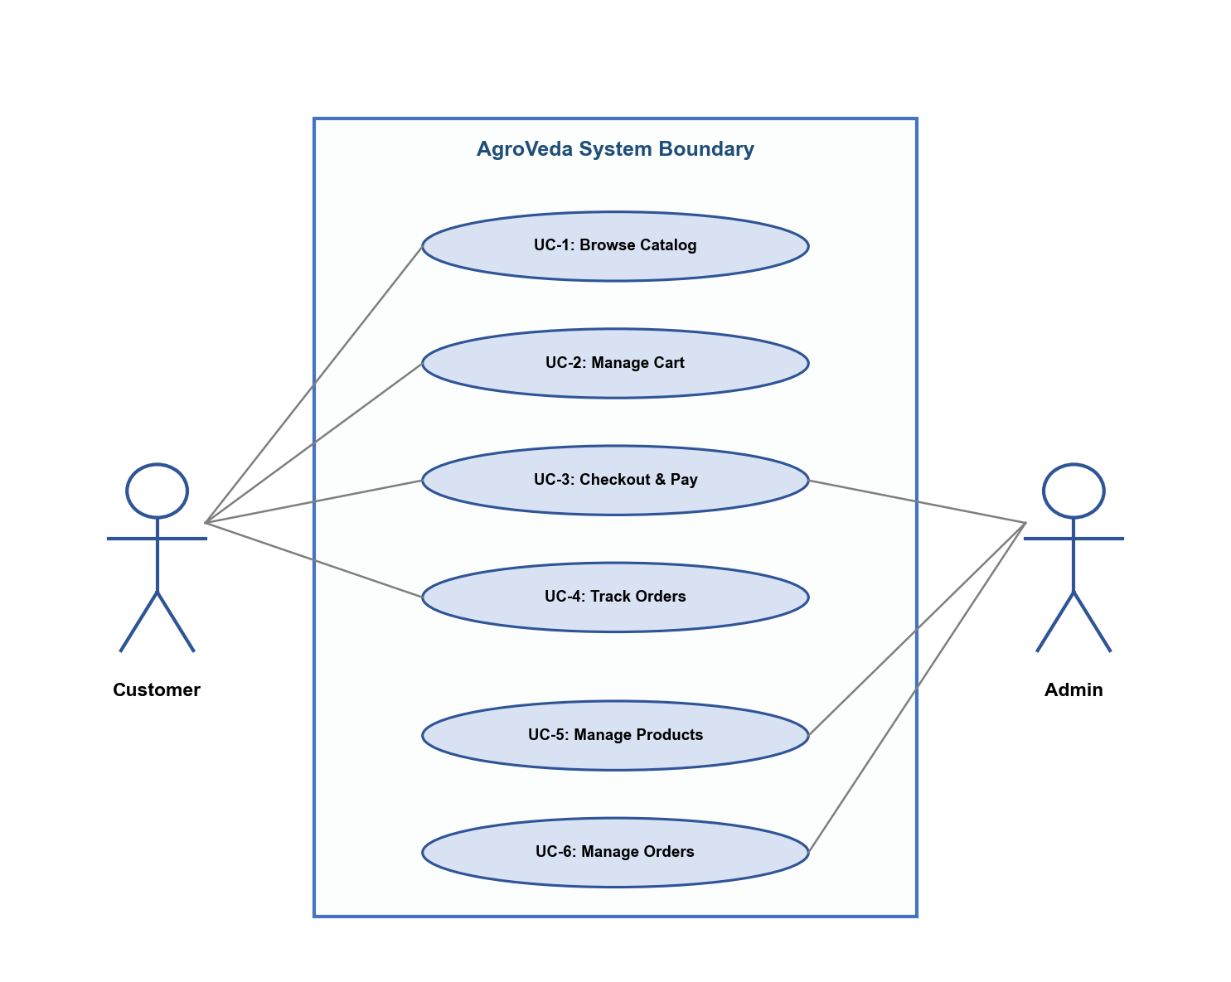
User Interface Modules
• Homepage Module: Features a bilingual sliding banner showing seasonal recommendations, and a category grid to filter fertilizers and fungicides.
• Product Catalogue: Dual-language support toggle. Displays crop usage descriptions, ratings, pricing, and bulk offers (e.g. Buy 5 Get 1 Free).
• Cart & Checkout: Address entry validation using Zod schemas, mobile validation (Indian mobile structure check), and payment mode selection.
• Order Confirmation Screen: Simulates Razorpay transaction receipt rendering invoice items and details.
AgroVeda MCA Major Project

Slide 15
Admin Order & Sales Registry
• Admin Dashboard now supports a dual-panel layout:
• 1. Product Inventory Manager: Admin can create new items (names, category, price, Hindi description) and delete existing ones.
• 2. Order & Sales Summary Registry: Displays key sales statistics (Total Revenue, total orders counts, completed/COD counts).
• 3. Full Buy Summary: Lists all orders dynamically. Each record contains:
• - Order number and purchase timestamp (formatted to Indian Standard Time).
• - Customer credentials: Name, Phone Number, and complete shipping address.
• - Detailed bill calculations: Subtotals, discount deductions, and final paid values.
• - Interactive Order Status manager dropdown (Change order from pending -> processing -> delivered -> cancelled).
AgroVeda MCA Major Project

Slide 16
Advantages & Future Scope
Key Advantages
• Direct Procurement: Removes retail agent layers, reducing input purchase cost by 15-20%.
• Accessibility: Simple bilingual layout works smoothly on mobile browsers.
• Transparency: Fixed pricing with instant invoice summaries.
• Security: Safe role-based admin panels and verified payment gateway check.
Future Scope & Enhancements
• AI Crop Advisor: Recommendation engine based on local soil health test details.
• Voice Search: Multi-lingual voice recognition queries for illiterate farmers.
• WhatsApp API Integration: Automated dispatch alerts sent directly to phone numbers.
• Multi-Vendor Marketplace: Allow verified local manufacturers to sell directly.
AgroVeda MCA Major Project

Slide 17
Conclusion & References
• Conclusion:
• - AgroVeda successfully delivers a scalable, type-safe e-commerce solution for agricultural distribution.
• - Demonstrated the practical application of React, Node.js, Express, and PostgreSQL/In-Memory DB.
• - Bridged the rural digital gap using bilingual catalog design and interactive Razorpay/COD flows.
• - Empowered administrators with dynamic sales tracking and order status monitoring dashboards.
• References:
• - React 18 and Vite Documentation: https://react.dev | https://vite.dev
• - Express.js Node Routing API Reference: https://expressjs.com
• - PostgreSQL client driver documentation: https://node-postgres.com
• - Razorpay Web checkout integration APIs: https://razorpay.com/docs
AgroVeda MCA Major Project

