Slide 1
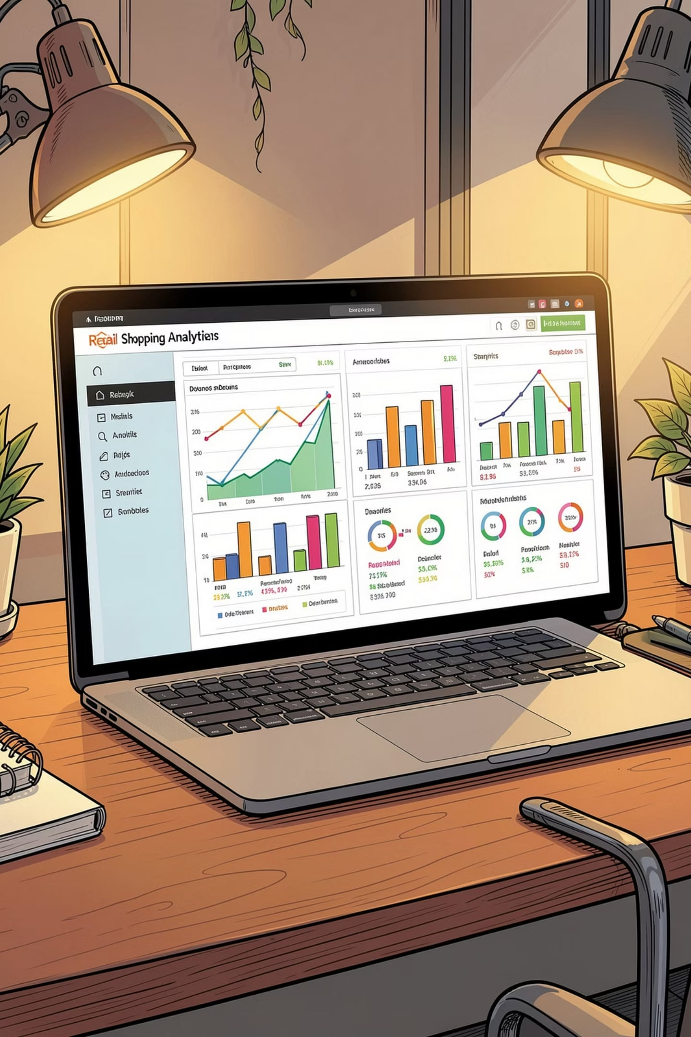
Customer Shopping Behavior Analysis
End-to-End Retail Analytics — Python · MySQL · Power BI
HARSHDA SHIRODKAR

Slide 2

Business Objective
~3,900 Transactions
3-Stage Workflow
18 customer & purchase attributes
Python → MySQL → Power BI
Key Questions
Revenue, segments, ratings, discounts

Slide 3
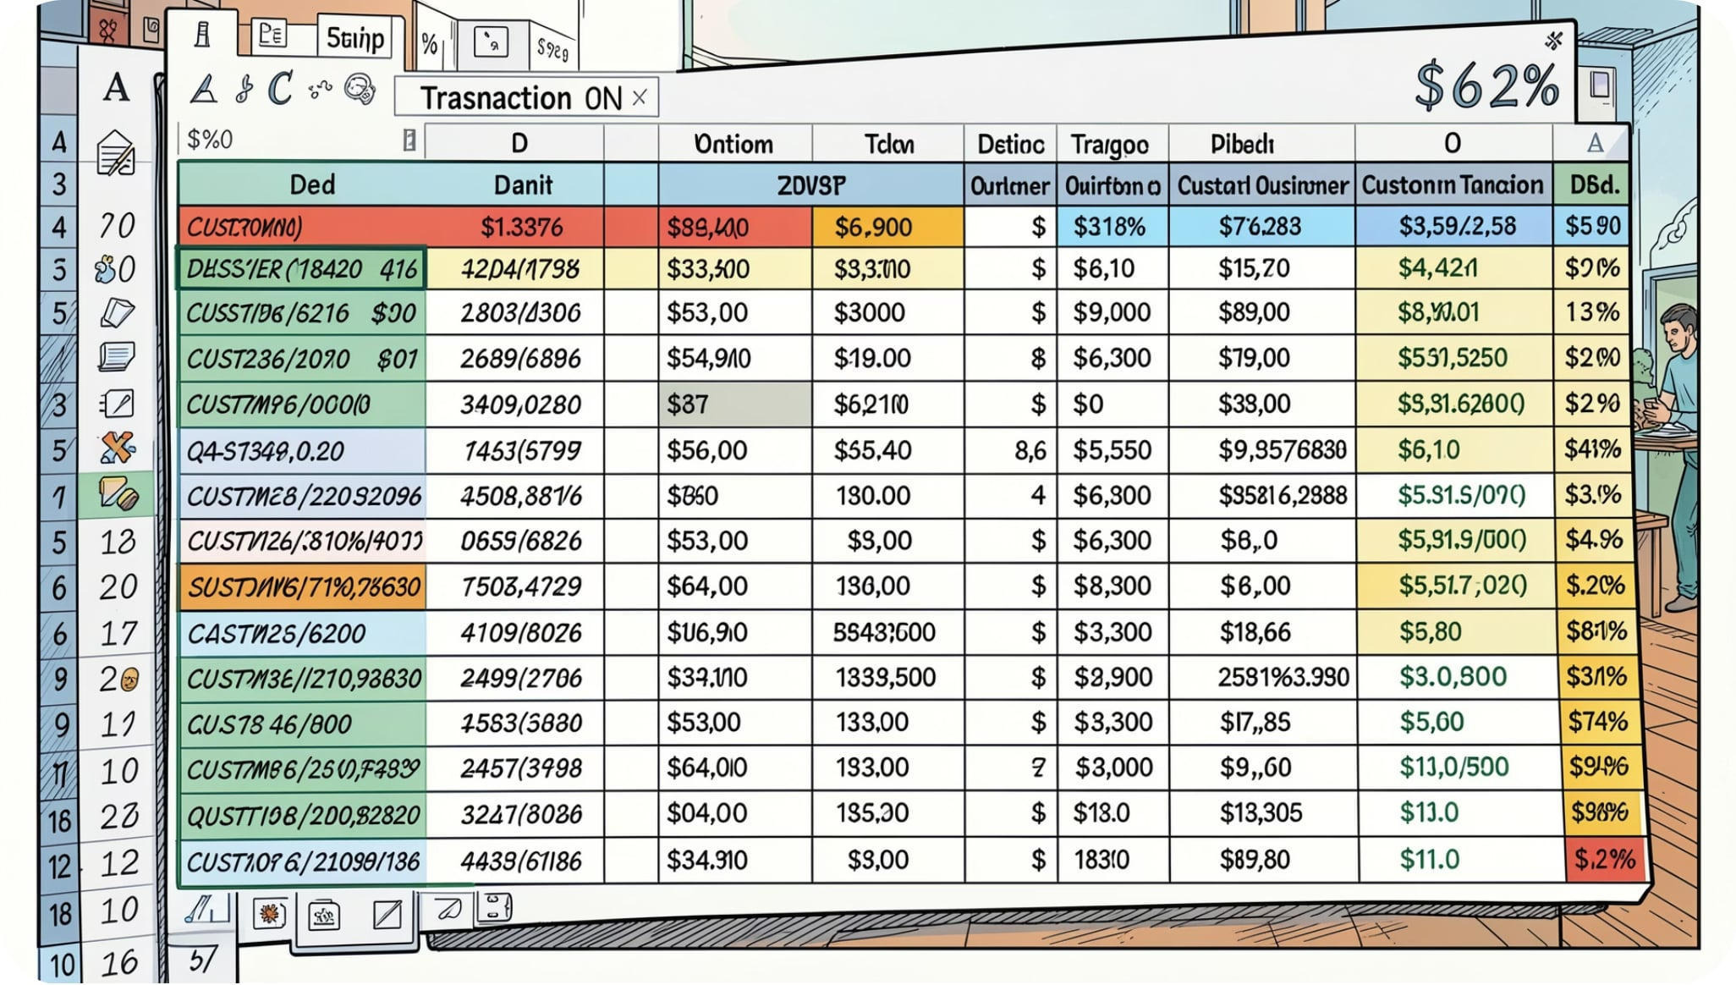

Dataset Overview
Customer Info
Customer ID, Age, Gender
Location, Subscription Status
Purchase Info
Category, Item, Amount
Season, Shipping, Discount
Review Rating, Previous Purchases
Missing Review Ratings imputed using category-wise median

Slide 4
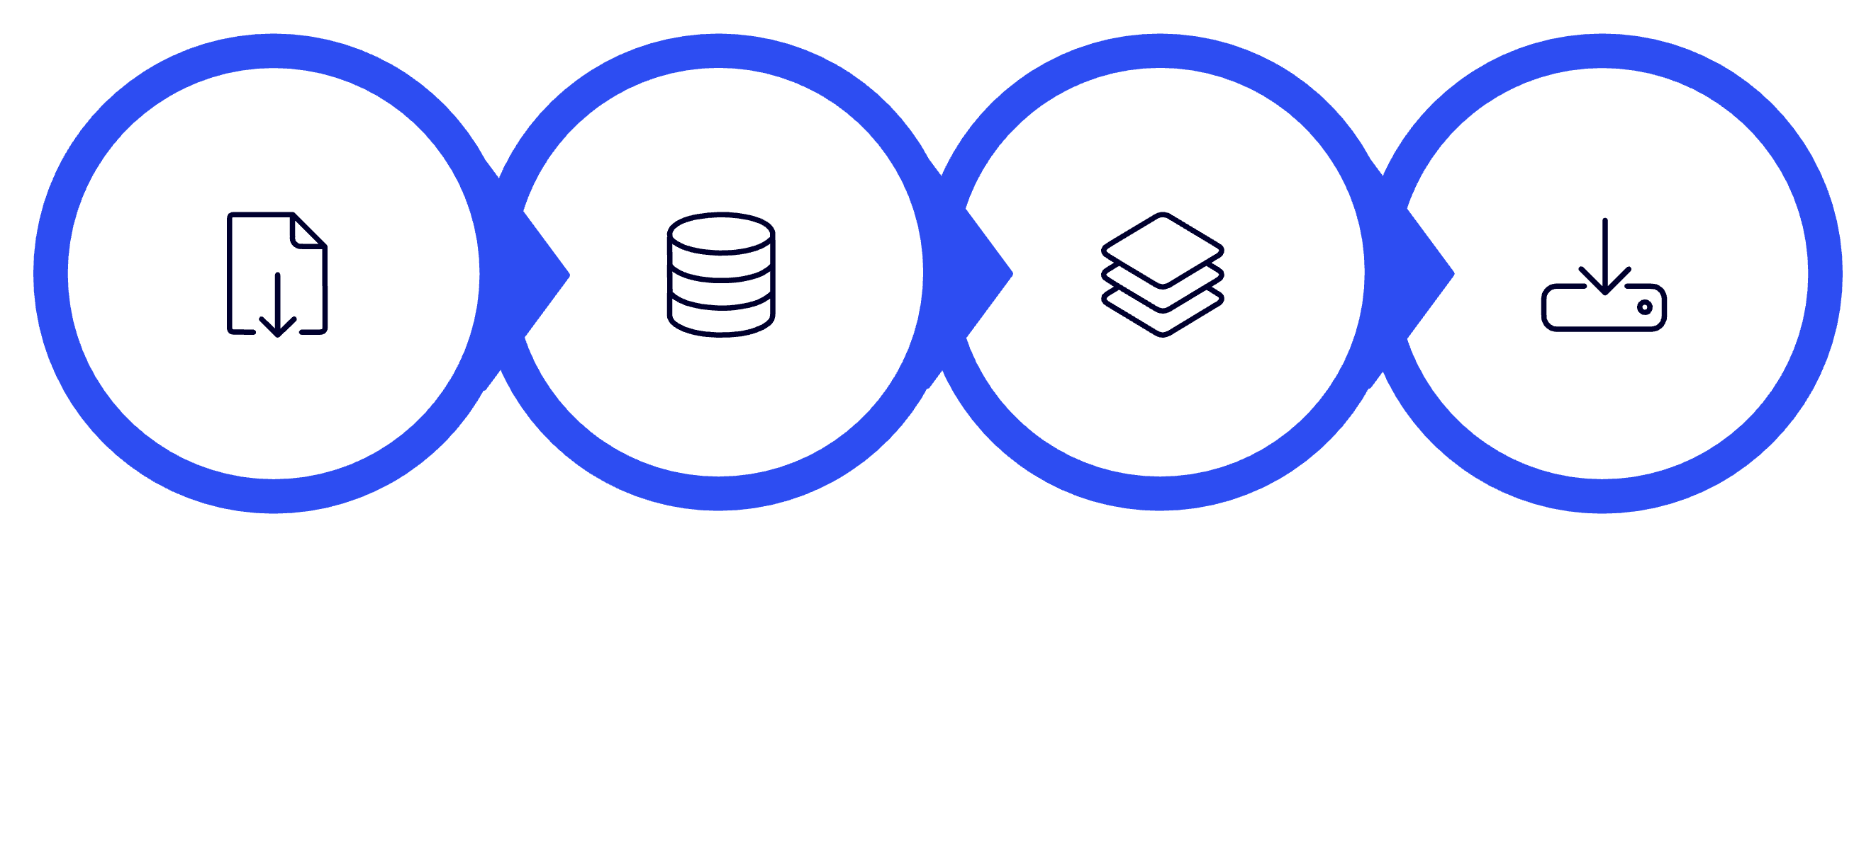
Stage 1: Data Cleaning (Python)
Import & Inspect
Handle Missing
Rename & Feature
Export Cleaned
Used Pandas & NumPy for preprocessing; created Age Group and Purchase Frequency features for downstream analysis.

Slide 5



Stage 2: SQL Analysis (MySQL Workbench)
Analyses Performed
SELECT
CASE
WHEN previous_purchases <=1 THEN 'New'
WHEN previous_purchases BETWEEN 2 AND 5 THEN 'Returning'
ELSE 'Loyal'
END AS customer_segment,
COUNT(*) AS customers
FROM customer
GROUP BY customer_segment;
Revenue by Gender
Top-Rated Products
Customer Segmentation
Subscriber vs. Non-Subscriber
Revenue by Age Group

Slide 6
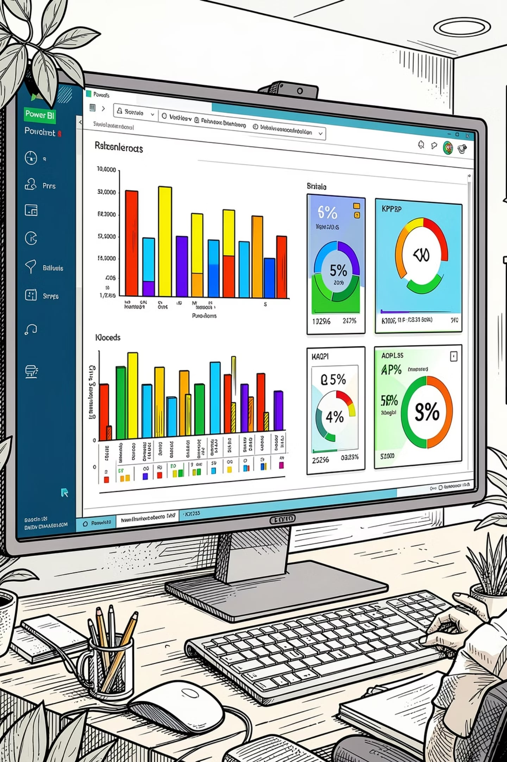
Stage 3: Power BI Dashboard
KPI Cards
Interactive Filters
Customers · Avg Purchase · Avg Rating
Subscription · Gender · Category · Shipping
Visualizations
Revenue & Sales by Category & Age Group

Slide 7
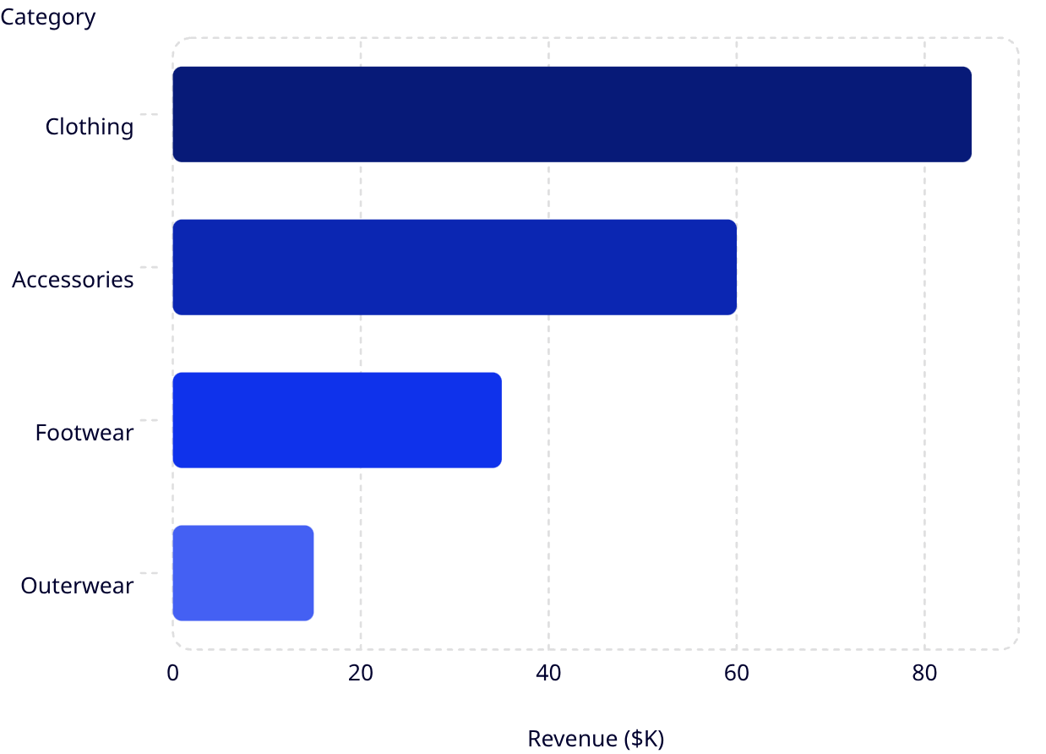
Dashboard: Key Metrics
3K
$59.71
Total Customers
Avg Purchase
3.75
72.89%
Avg Review Rating
Non-Subscribers
vs. 27.11% subscribers
Revenue by Category
Clothing leads with ~$85K, followed by Accessories (~$60K), Footwear (~$35K), and Outerwear (~$15K).

Slide 8
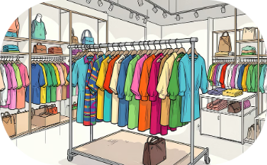


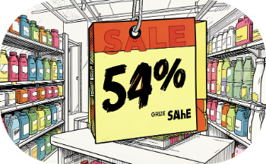
Key Findings
Clothing Leads Revenue
Young Adults Top Revenue
Loyal Customers Dominate
Discount Dependency
Some products rely heavily on promotions
Highest revenue category across all segments
Largest revenue share by age group
Largest customer segment by purchase history

Slide 9



Business Recommendations
Improve Loyalty
Optimize Discounts
Target High-Value Customers
Strengthen subscription benefits & retention programs
Reduce reliance on discounts for high-demand products
Personalize campaigns for top-revenue age groups
Promote Top-Rated Products
Enhance Monitoring
Use dashboards for real-time behavior tracking
Highlight high-rated items to boost engagement

Slide 10

Skills & Conclusion
Tools & Skills
Project Takeaway
End-to-end analytics workflow transforming raw retail data into actionable business insights — from Python cleaning to SQL analysis to Power BI visualization.
Python
MySQL
Pandas, NumPy, EDA
SQL, CTEs, Window Functions
Supports retail organizations in improving engagement, optimizing marketing, and making informed decisions.
Power BI
Dashboards, KPIs, Storytelling

