Slide 1

EduManage
School & Institute Management Software

Slide 2
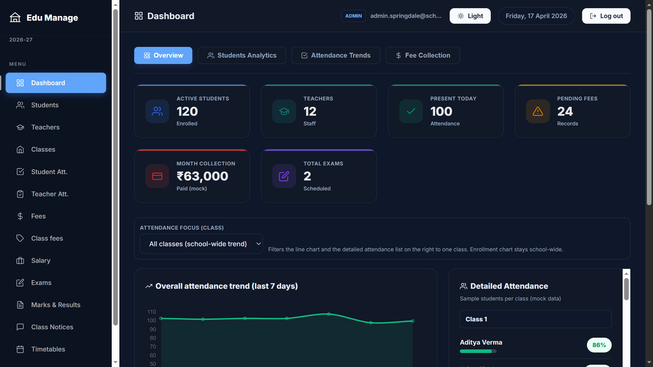
Overview
A unified platform for daily school operations
Student & teacher records
Classes, schedules, and timetables
Attendance (students & teachers)
Fees, exams, marks & report cards
Announcements + parent alerts (demo)
Dashboard analytics + offline sync

Slide 3
Key Modules
Admin + teacher workflows
Dashboard & analytics
Students / Teachers / Classes
Attendance and summaries
Fees and class fee settings
Exams, marks, results, exports (CSV/PDF/ZIP)
Timetables and schedules
Announcements (school-wide + class)
Salary management
Settings: audit log, data snapshot, WhatsApp queue (demo)

Slide 4
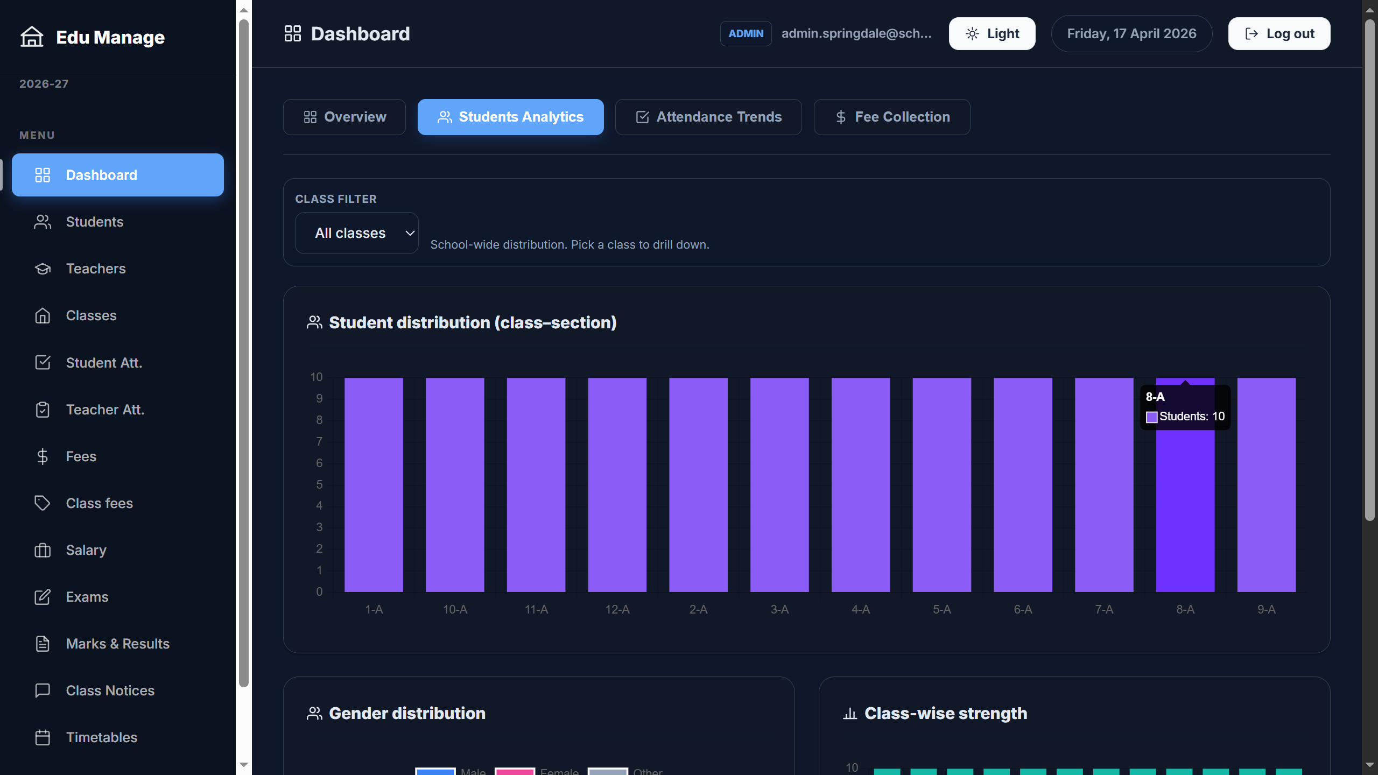
Login & Role-Based Access
Screens from the EduManage project
EduManage • School Management Software

Slide 5
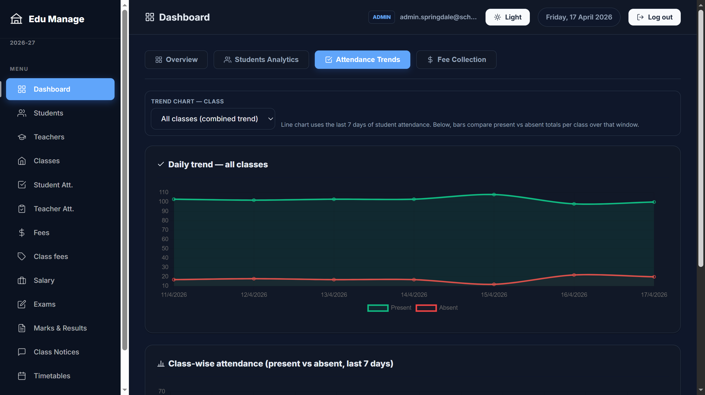
Dashboard & Analytics
Screens from the EduManage project
EduManage • School Management Software

Slide 6
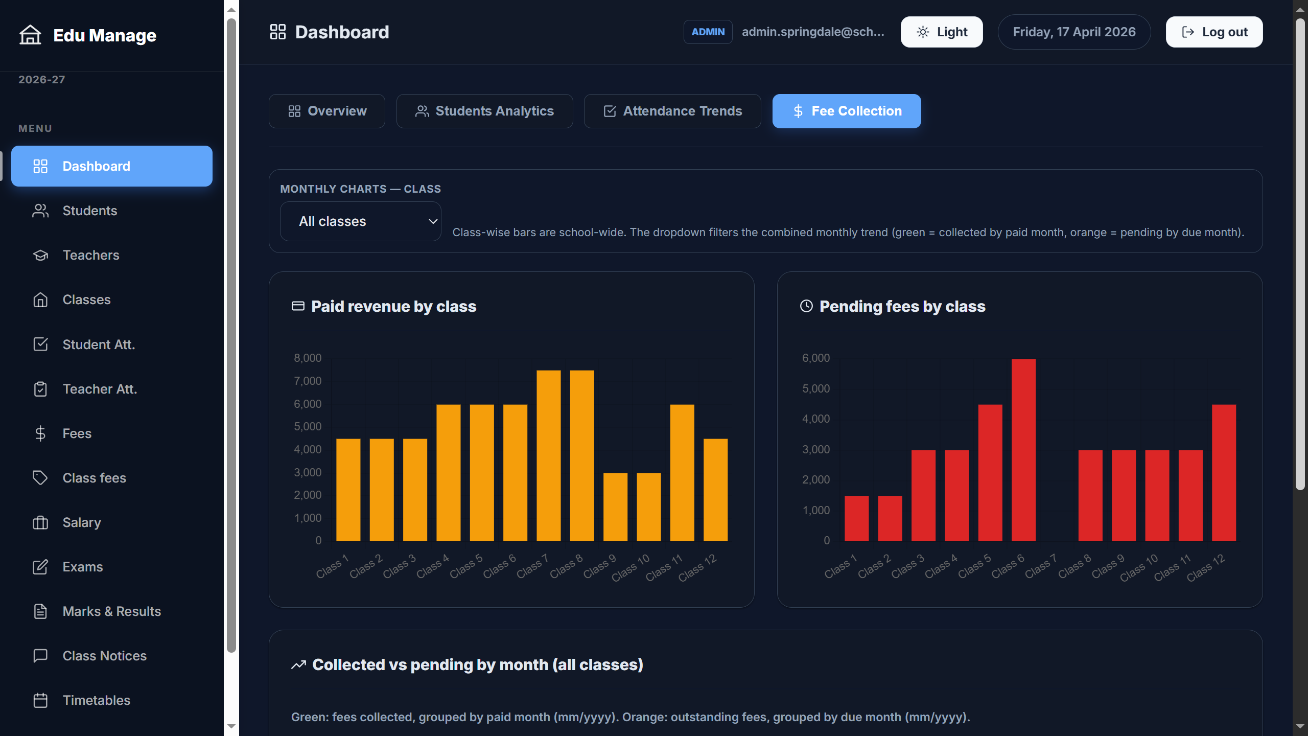
Student Management
Screens from the EduManage project
EduManage • School Management Software

Slide 7
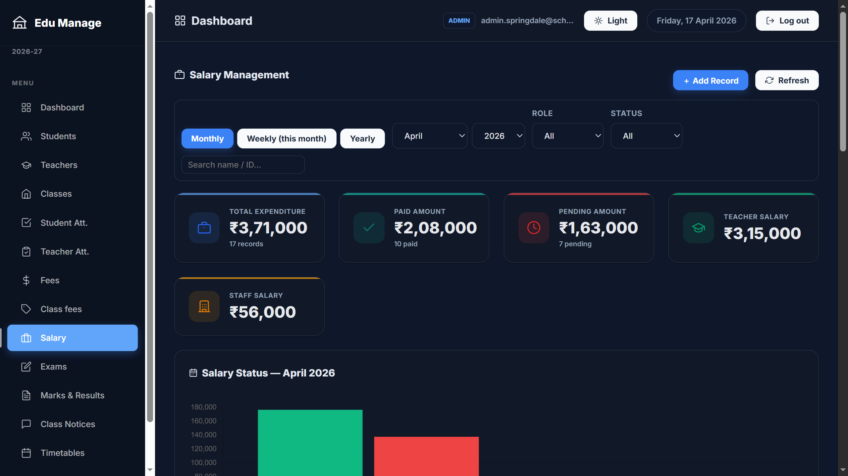
Teacher Management
Screens from the EduManage project
EduManage • School Management Software

Slide 8
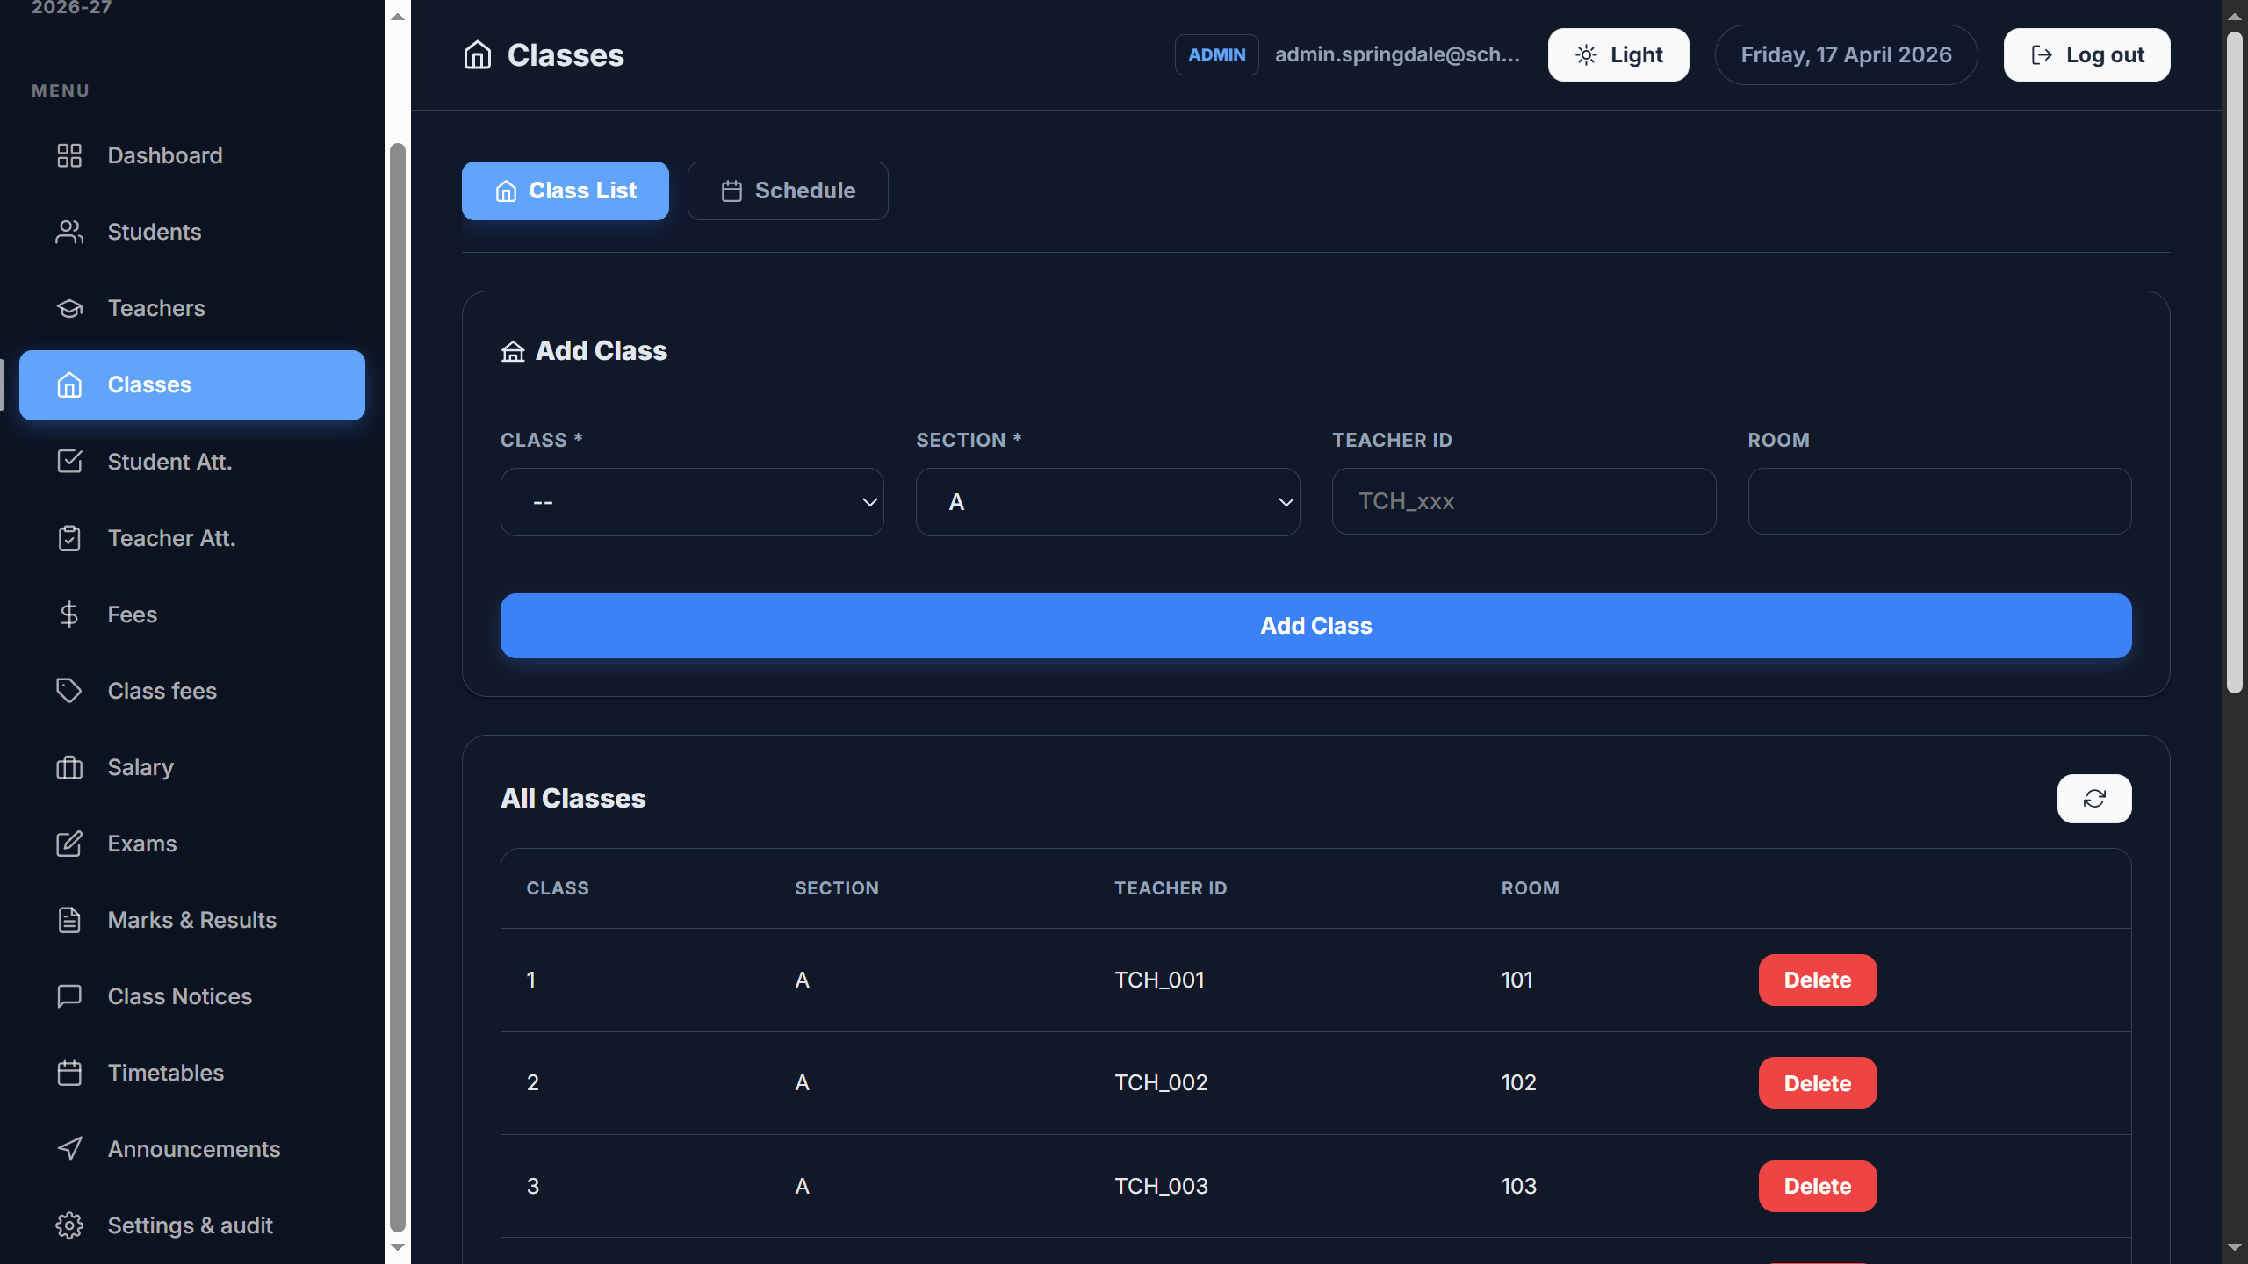
Classes & Schedule
Screens from the EduManage project
EduManage • School Management Software

Slide 9
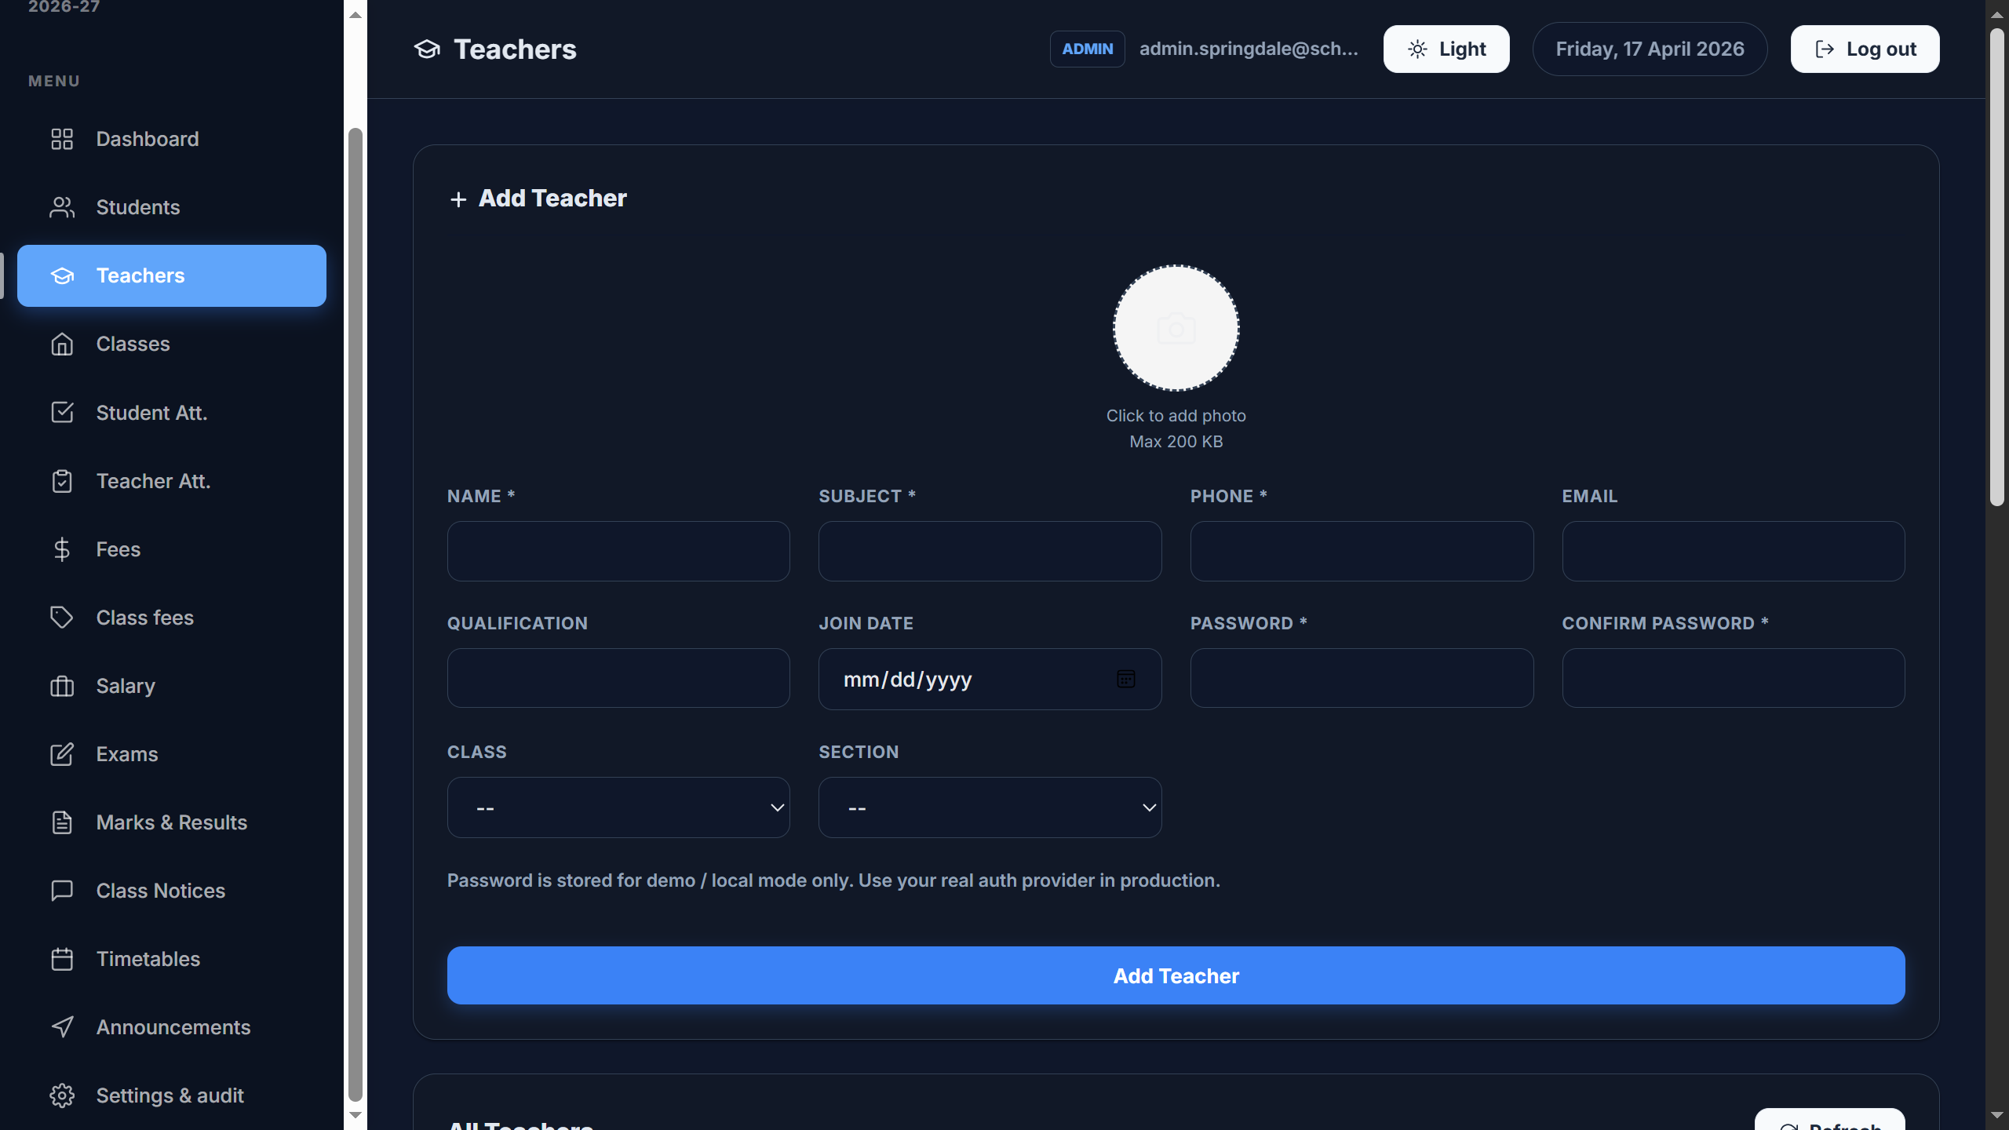
Attendance / Results
Screens from the EduManage project
EduManage • School Management Software

Slide 10
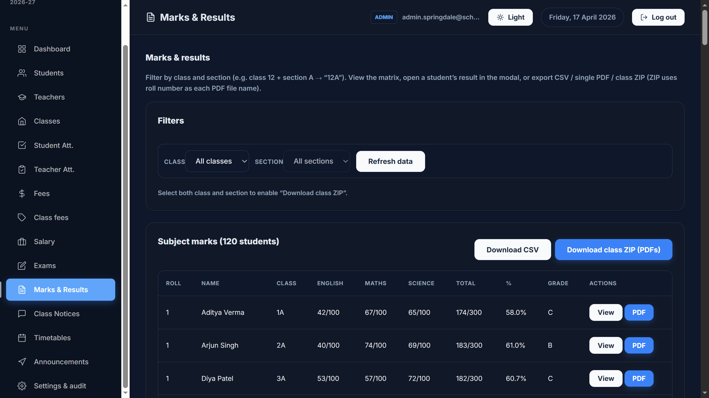
Settings / Announcements
Screens from the EduManage project
EduManage • School Management Software

