Slide 1
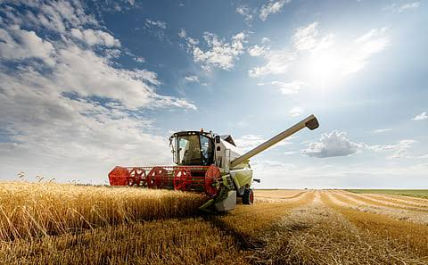
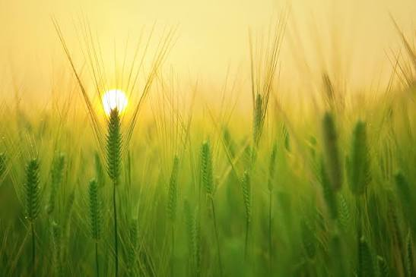
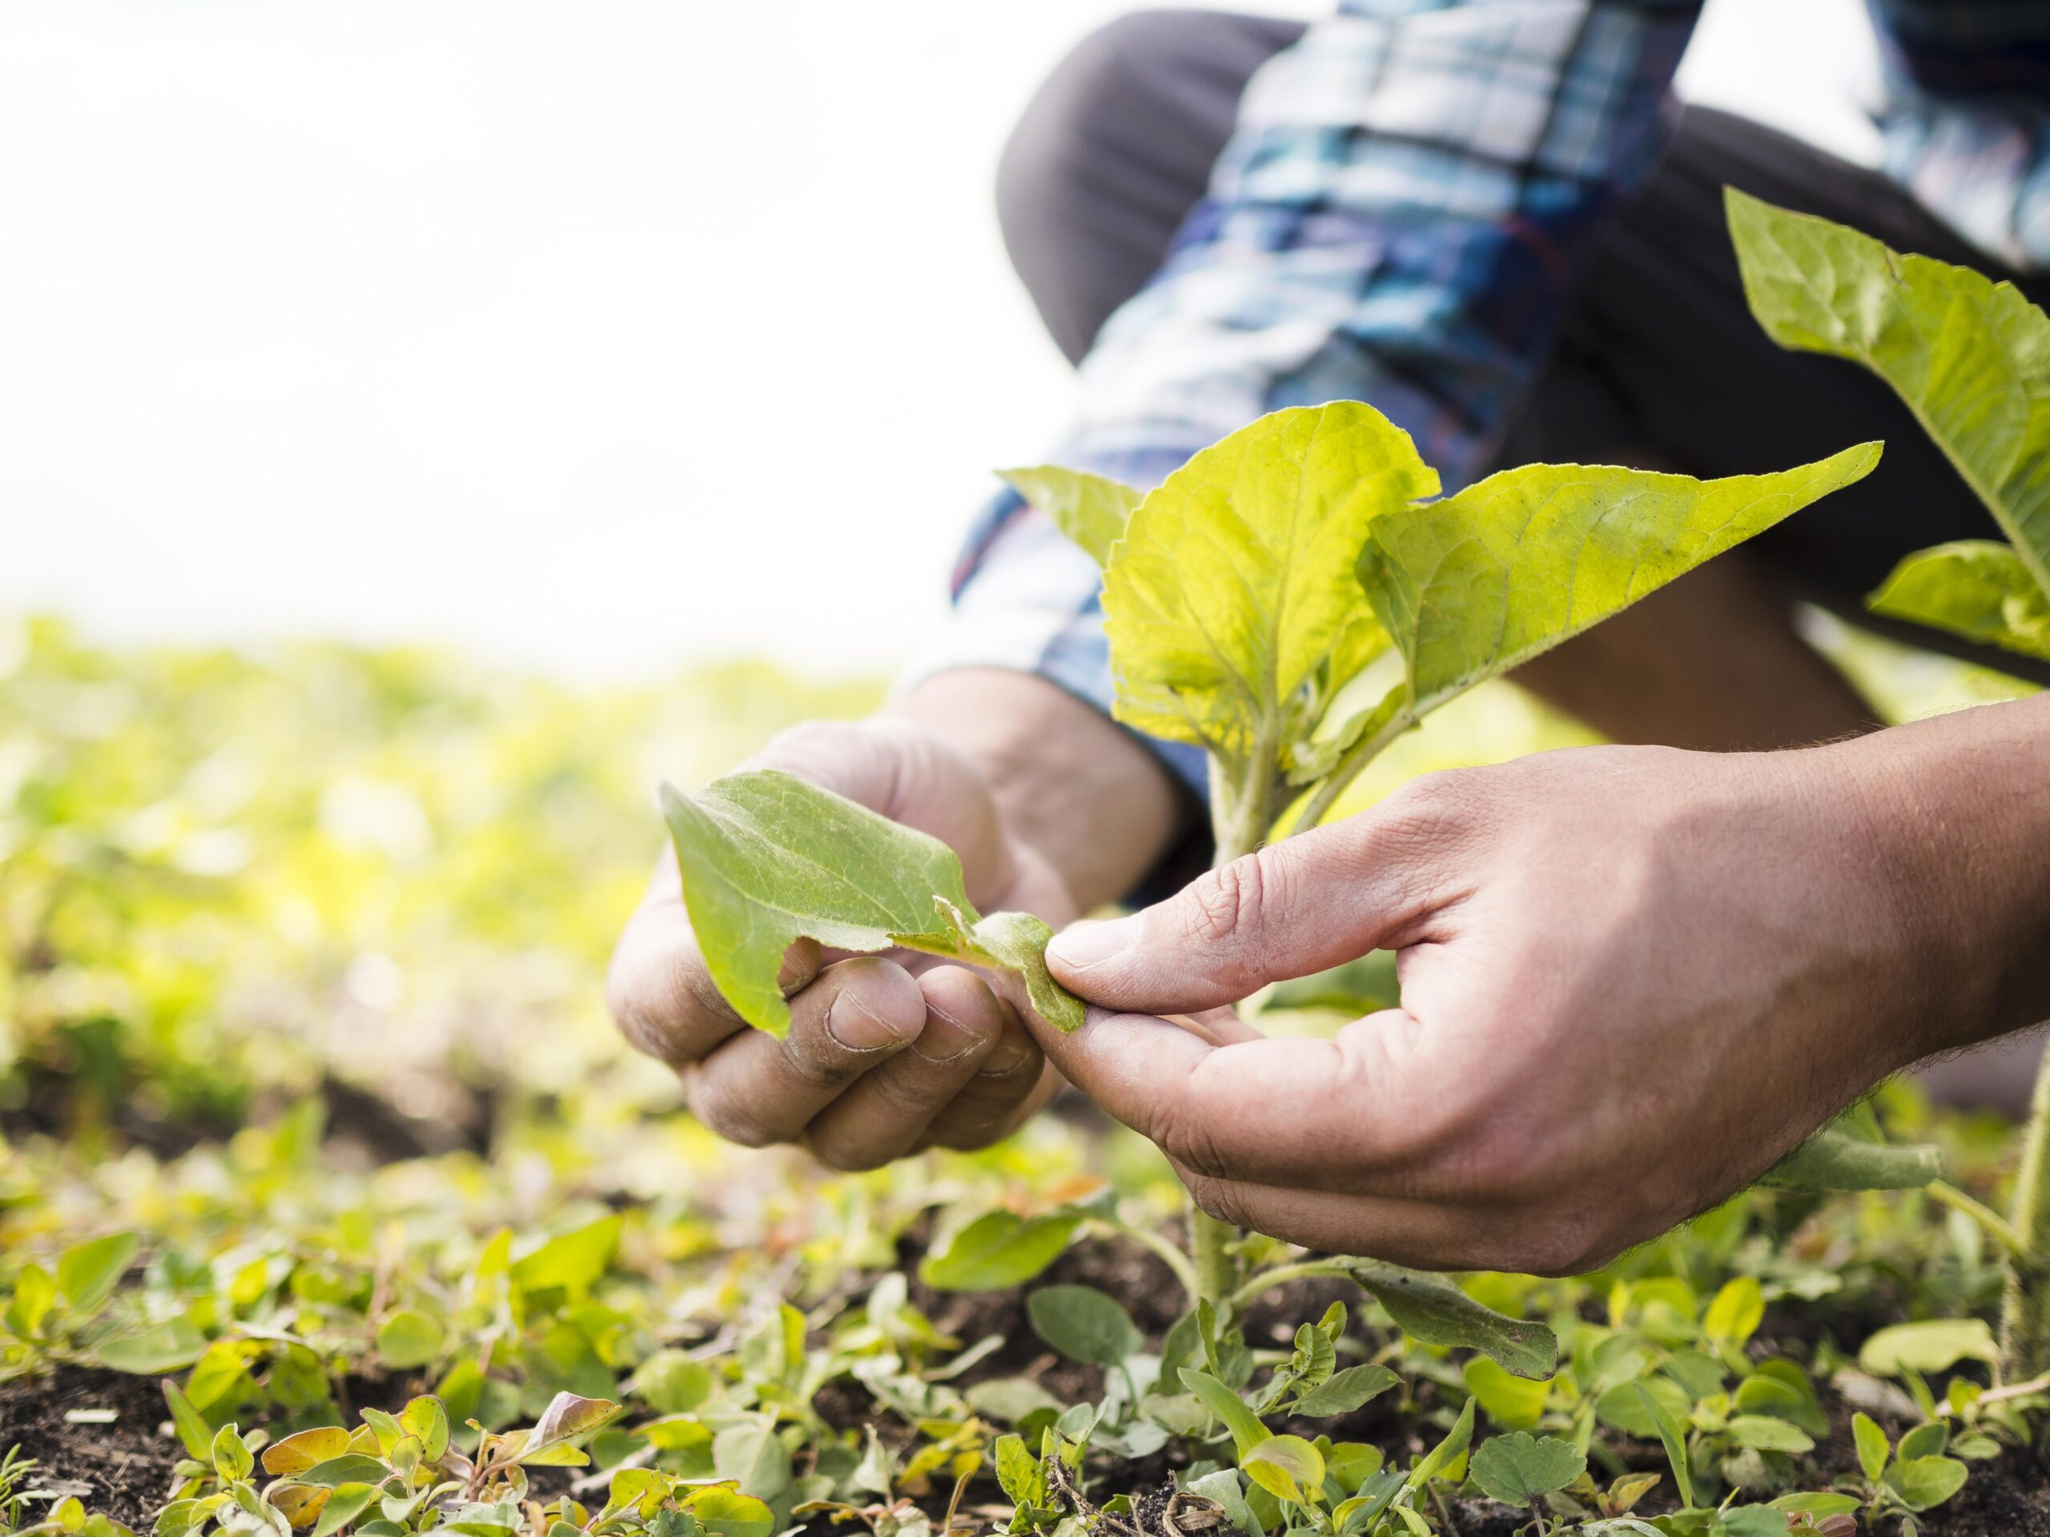
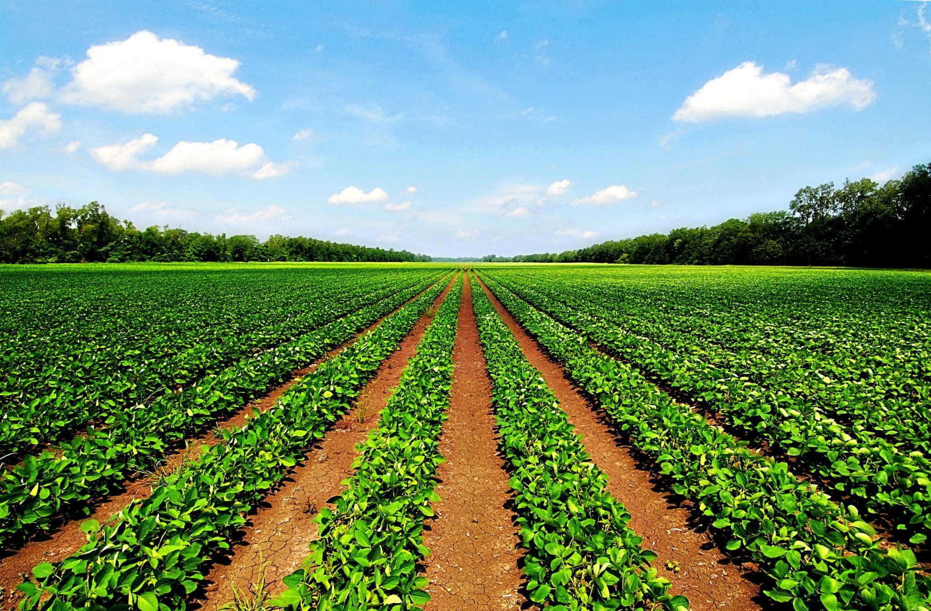
Agri-Vision
Analysis
Name: Harshdeep Kaur
Roll no: 2425635
Stream: B.Tech(Ai&Ml)

Slide 2


Certification: ISO 9001:2015 Certified
Specializations:
- Web Development
- Mobile Application Development
- Custom Software Development
- UI/UX Design
- Hosting Services
- Digital Marketing
Services:
- Advanced IT solutions supporting the entire business
- Consulting to system development
- Deployment
- Quality Assurance
- 24x7 Support
Headquarters: Jalandhar
Branch Office: Hoshiarpur

Slide 3
Table of contents
Introduction
Problem statement
Objectives of the Project
Features of the Project
Requirement
Project workflow
Thinking of the project
Collection of datasets
Cleaning and preprocessing
Visualization
Analysis & Visualization of Project
Future Scope of Project
Conclusion

Slide 4
Project Introduction
Agri is a short form of Agriculture.
Vision stands for visualized the things
Agri-Vision means analysis the things in the agriculture field
This project focuses on analyzing agricultural data to understand different factors affecting crop production.
It examines factors such as rainfall, temperature, soil type, irrigation, fertilizers, and pesticides.
Various graphs and charts are used to present the data clearly and make the results easy to understand.
The main objective of this project is to gain useful insights that can help improve agricultural productivity and support better farming decisions.

Slide 5
Problem Statement
Agriculture is the backbone of the India’s economy.
Traditional methods cannot accurately predict future prediction.
Farmers often do not have an easy access to data driven insights for better decision-making.
There is a need for a single platform that can analyze agricultural data and present it in an easy to understand way.

Slide 6
Objectives of the Project
To identify factors affecting crop yield
To support better farming decisions using data
To analyze agricultural data effectively
To study soil,weather and irrigation patterns

Slide 7
Features of the project
State wise and Region wise crop analysis
Data visualization using charts and graphs
Cleaned and organized dataset for accurate analysis
Irrigation and fertilizers usage insights
Easy to understand reports and findings

Slide 8
Requirements
Python: It is the main programming language to develop the entire project.
Visual Studio Code: It is used as the code editor to write ,run, and debug the Python code.
Python Libraries:
Pandas: Used for loading,cleaning,filtering and analyzing the agriculture dataset.
Seaborn: Used to create attractive and statistical visualizations with better styling
Numpy: Used for numerical operations and efficient for data visualization.
Streamlit: used to build an interactive web dashboard .
Plotly: Used to create interactive charts, allowing users to zoom ,hover and explore the date.
Matplotlib: Used to create basic charts and graphs for data visualization.

Slide 9
Project workflow
Idea Thinking
Choose agriculture as the project domain.
Data collection
Collected the agriculture dataset from Kaggle website.
Downloaded the Dataset in CSV format
Data Visualization
Data Cleaning and preprocessing
Handle missing values and removed duplicate records by Pandas.
Prepared the dataset for analysis by checking data types
Identified the need to analyze agriculture data
Visualized the data to compare crop yield, rainfall and irrigation patterns
created a bar chart, pie chart ,histogram and scatter plots

Slide 10
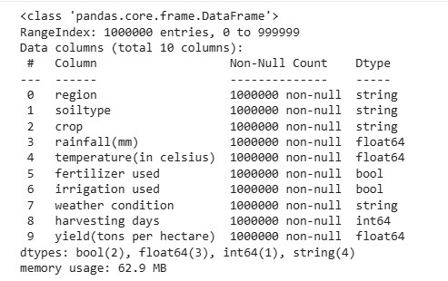
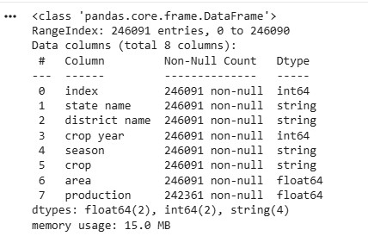
Data Analysis of the Project
Region-wise Analysis data
State-wise Analysis data

Slide 11
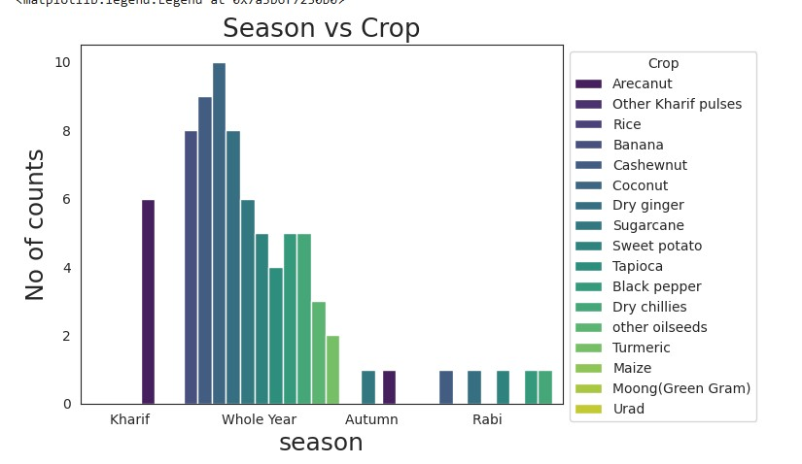
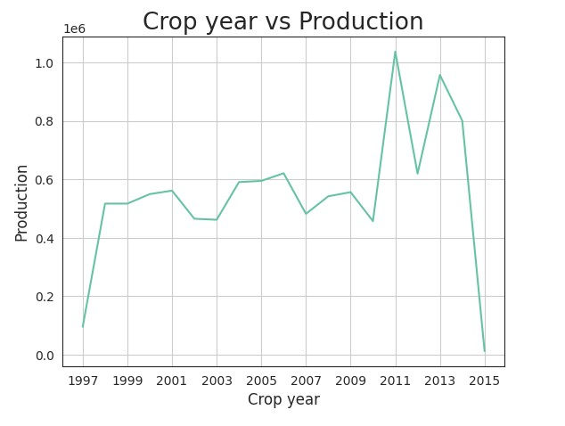
Data Visualization of the project

Slide 12
Future Scope of this Project
Help farmers make better decisions using data-driven insights.
Improved crop yield prediction using advanced AI and machine learning.
Support smart farming and precision agriculture technique.
Provide personalized recommendations for irrigation and fertilizers usage.
Analyze the impact of climate change on agriculture.
Help government and policymakers in agriculture planning.

Slide 13
Conclusion
This project helped analyze agricultural data and identify important farming patterns.
Data visualization made the information easy to understand and compare.
The analysis showed how factors like rainfall, temperature, soil type, and irrigation affect crop yield.
The insights from this project can help support better farming decisions.
Overall, this project demonstrates the importance of data analysis in improving agricultural productivity and promoting sustainable farming.

Slide 14
Thank You

