Slide 1

JAVA PROGRAMMING OVERVIEW
By Harshdeep Sharma

Slide 2
Table of Contents
01
02
03
04
Java Platform Overview
Core Java Basics
Object-Oriented Programming in Java
Java Web Components
05
06
07
08
JDBC (Java Database Connectivity)
Project Architecture
Key Features
Conclusion & Learnings

Slide 3
JDK, JRE, JVM
•JDK: Java Development Kit – tools for developing Java programs
•JRE: Java Runtime Environment – runs Java apps, includes JVM
•JVM: Java Virtual Machine – executes bytecode on different platforms

Slide 4



.
JDK
Development tools+javac+JRE
JRE
JRE
Libraries+JVM
JVM
JIT Compiler+Interpreter

Slide 5
DATA TYPES
VARIABLES
LITERALS
Java has two main categories:
PRIMITIVE: int,char,byte,
boolean,float,short,double.
NON-PRIMITIVE: String,
Array etc.
Containers to store data
Must be declared with a
data type
Example: int age = 25;
Constant values.
Types of literals:
Integer: 10, -5
Floating-point: 3.14, -0.99
Character: 'A', '%'
String: "Hello"

Slide 6
ARRAYS
Fixed-size data structure for same-type elements
Syntax: int[] arr = new int[5];
Supports indexed access: arr[0] = 10;
Can be iterated using for, foreach, or Streams
Arrays.sort(), Arrays.toString() – utility methods

Slide 7
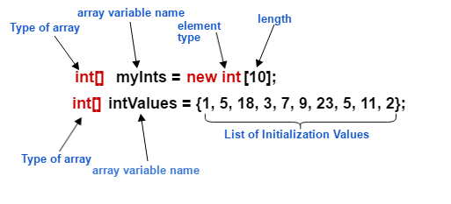
ARRAYS

Slide 8
STRINGS
Immutable objects to handle text
Created using "text" or new String("text")
Useful methods: length(), substring(), equals(), toUpperCase()

Slide 9
STRINGBUILDER & STRINGBUFFER
StringBuilder: Faster, non-thread-safe
StringBuffer: Slower, thread-safe
Methods: append(), insert(), reverse()
Both avoid creating multiple immutable String objects
Ideal for string concatenation in loops

Slide 10
CONSTRUCTOR, THIS, SUPER
Constructor: Initializes objects when created
this: Refers to current instance
super: Access parent class constructor or fields
Constructor overloading allows multiple ways to initialize
Can use this() or super() to call other constructors

Slide 11
CONSTRUCTOR, THIS, SUPER
public User(String userId, String userName, String password, String email) {
this.userId = userId;
this.userName = userName;
this.password = password;
this.email = email;
}

Slide 12
CLASS, OBJECTS, OOP FEATURES
Class: Blueprint for object
Object: Instance of class

Slide 13
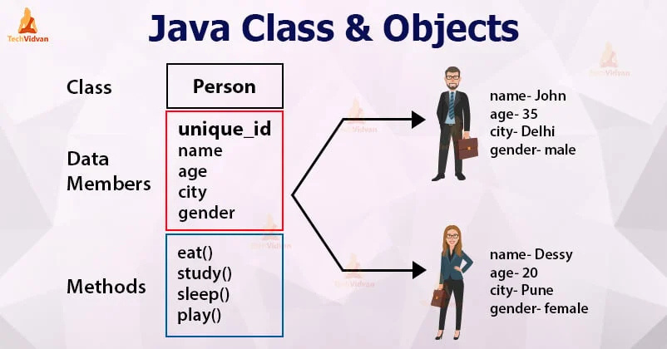

Slide 14
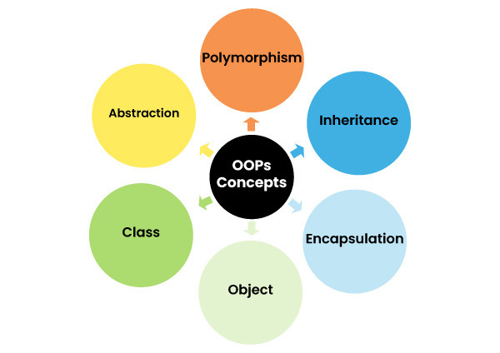

Slide 15
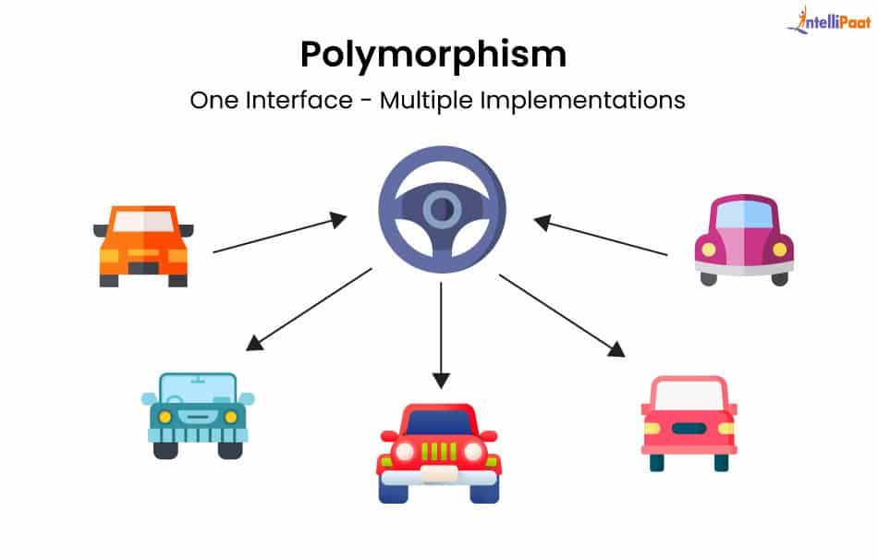

Slide 16
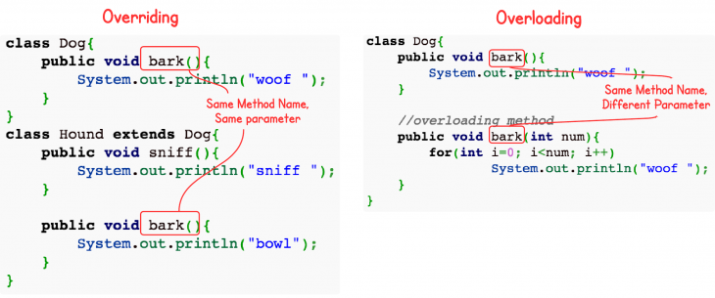
•Overloading: Same method, different params (Compile time)
•Overriding: Subclass redefines parent method (Runtime)

Slide 17
INTERFACE & ABSTRACT CLASSES
Interface: Blueprint of a class with abstract methods
Supports multiple inheritance of type
All methods are public and abstract by default
Abstract Class: Cannot be instantiated; has abstract methods
Used to achieve reusability & structure

Slide 18
INTERFACE
public interface UserDao {
User getUserById(String userId) throws Exception;
void save(User user) throws Exception;
public class UserDaoImpl implements UserDao {
@Override
public void save(User user) throws Exception { }

Slide 19
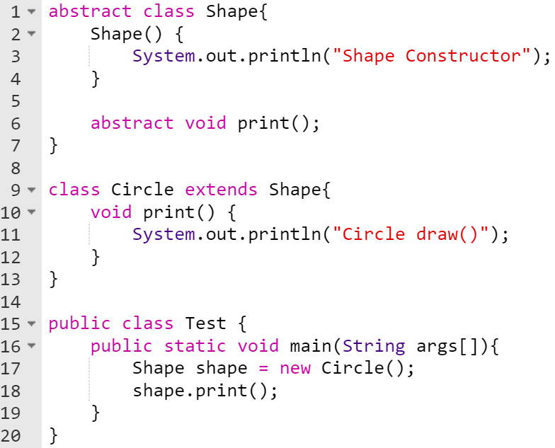
ABSTRACTION

Slide 20
EXCEPTION HANDLING
Handles runtime errors using try, catch, finally, throw, throws
Types: Checked & Unchecked exceptions
Custom Exception: Create class extending Exception or RuntimeException

Slide 21
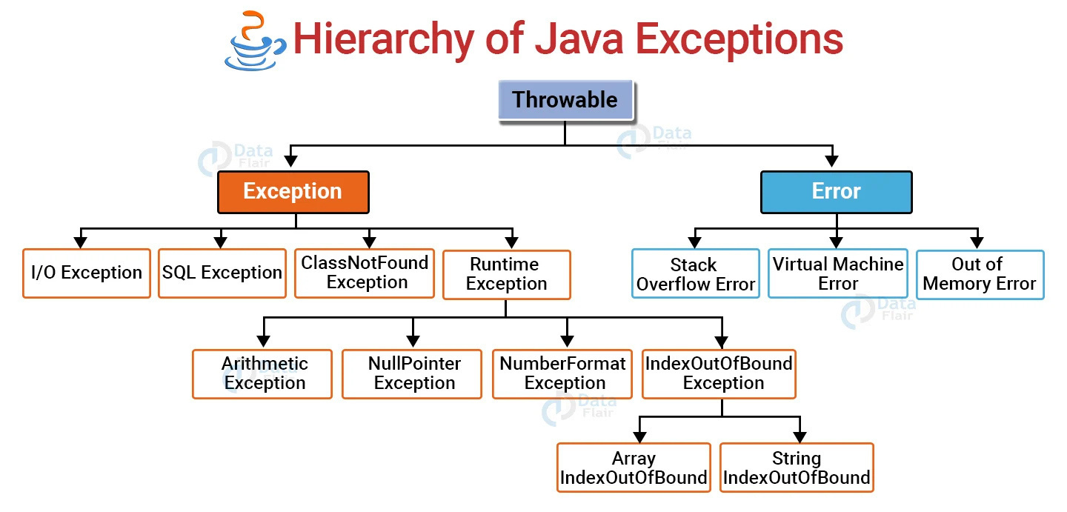

Slide 22
MULTITHREADING
Concurrent execution of two or more threads
Thread creation: Thread class or Runnable interface
Methods: start(), sleep(), join(), synchronized

Slide 23
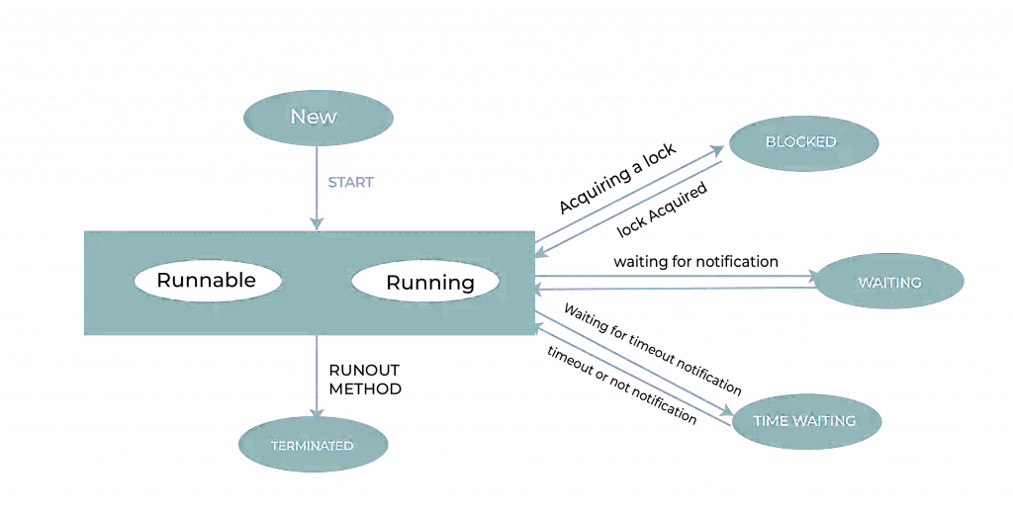
MULTITHREADING

Slide 24
COLLECTION FRAMEWORK
Unified architecture for storing/manipulating objects
List: Ordered, allows duplicates (ArrayList, LinkedList)
Set: No duplicates (HashSet, TreeSet), Map: Key-value (HashMap, TreeMap)

Slide 25
SERVLET
Java class that handles HTTP requests/responses
Lifecycle: init(), service(), destroy()
Uses web.xml or annotations (@WebServlet)

Slide 26
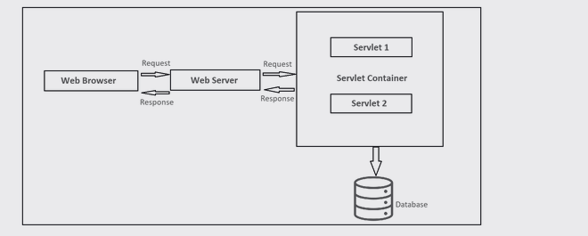
SERVLET
Handles form data via doGet() or doPost()
Access request data: request.getParameter("name")

Slide 27
JSP
Java + HTML for dynamic content generation
Lifecycle: Translation → Compilation → Execution
Implicit Objects: request, response, session, application, out
Ideal for view layer in MVC
Supports JSTL & Expression Language (EL)

Slide 28
SESSION
Maintains user state across requests
Managed using HttpSession object
Methods: setAttribute(), getAttribute(), invalidate()
Session is server-side and temporary
Can store user data like name, ID, preferences

Slide 29
COOKIES
Small files stored on client browser
Used for remembering user login/info
Created with Cookie class and added via response.addCookie()
Read using request.getCookies()
Used when client-side persistence is required

Slide 30
JDBC
•Connect Java to databases (MySQL, Oracle)
•Steps: Load driver → Connect → Query → Close
•API: Connection, Statement, PreparedStatement, ResultSet
Connection con = DriverManager.getConnection(url, user, pass);
PreparedStatement ps = con.prepareStatement("SELECT * FROM users");
ResultSet rs = ps.executeQuery();
con.close();

Slide 31
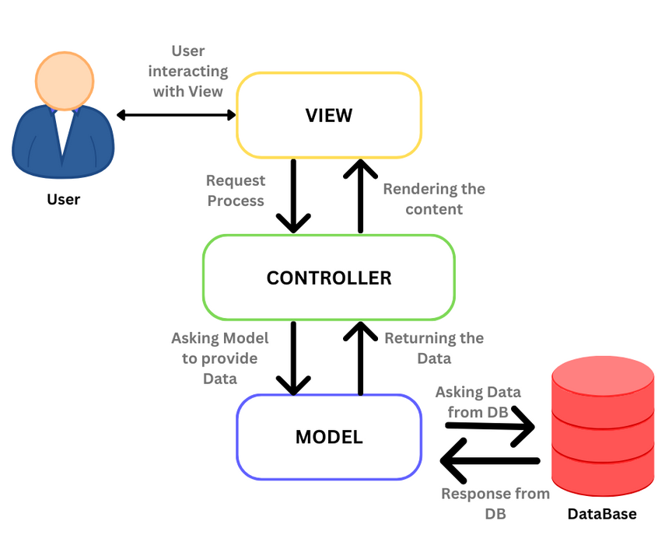
FLOW

Slide 32
TECHNOLOGIES 🛠️
Programming Language: Java
Web Technologies: JSP (JavaServer Pages), HTML, CSS,Javascript
Server-Side Component: Servlets
Database: MySQL
Database Connectivity: JDBC (Java Database Connectivity)
Application Server: Apache Tomcat
IDE Used: Intellij
Version Control: Git & GitHub (for code management and collaboration)

Slide 33
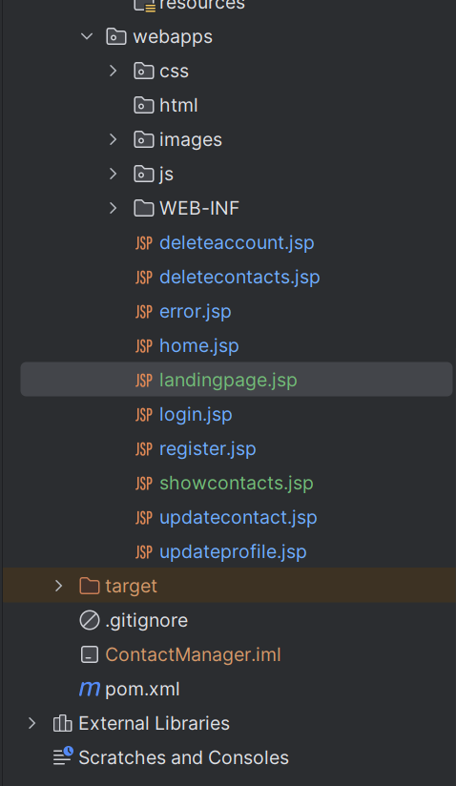
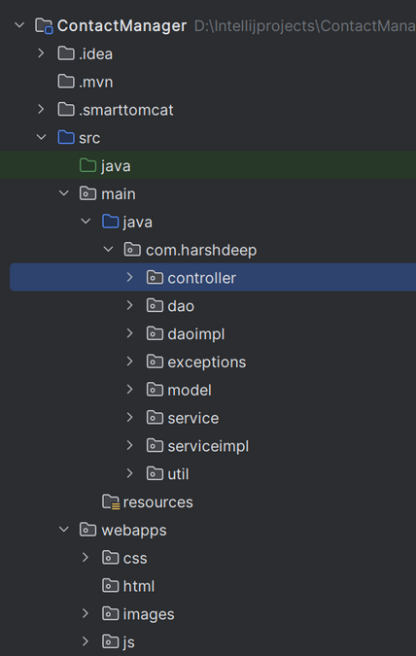
PROJECT STRUCTURE

Slide 34
KEY FEATURES 💡
Add / Edit / Delete Contacts: Seamless CRUD operations via form-based input.
Search Functionality: Instantly locate contacts using keywords or filters.
Responsive Interface: Clean UI built with HTML, CSS, and JSP for smooth navigation.
Database Integration: MySQL-powered storage ensures reliable data management.

Slide 35
KEY FEATURES 💡
Session Handling: Maintains user sessions for secure and personalized interactions.
Form Validation: Ensures accurate data entry using both client-side and server-side checks.

Slide 36
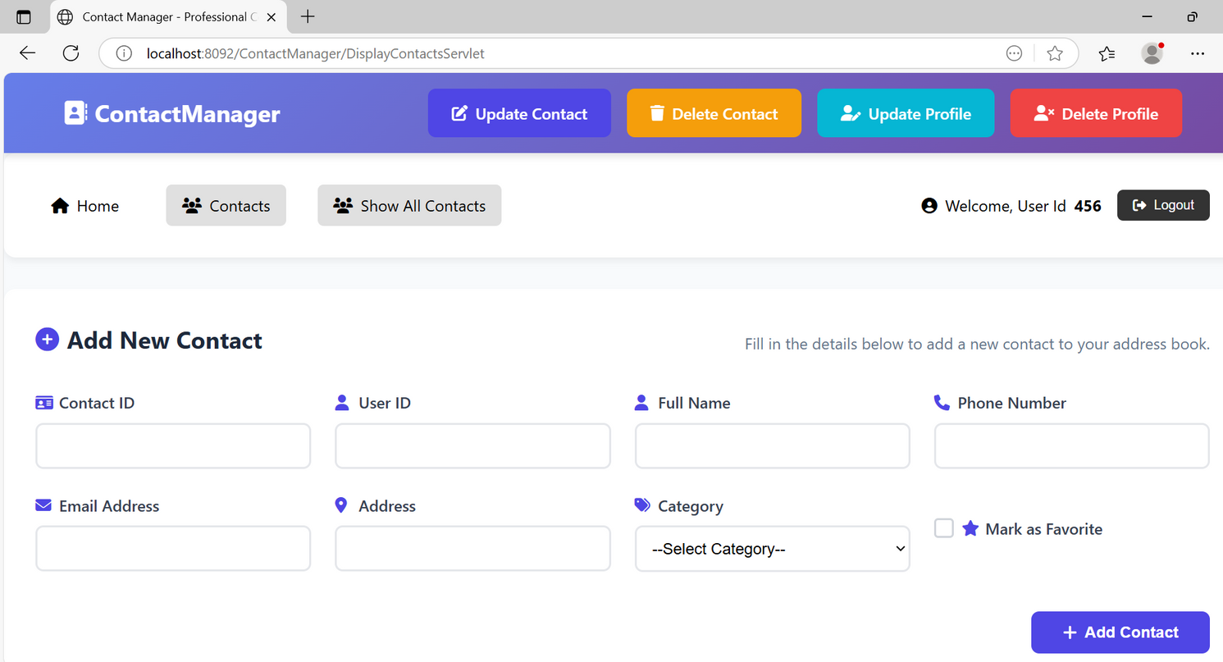

Slide 37
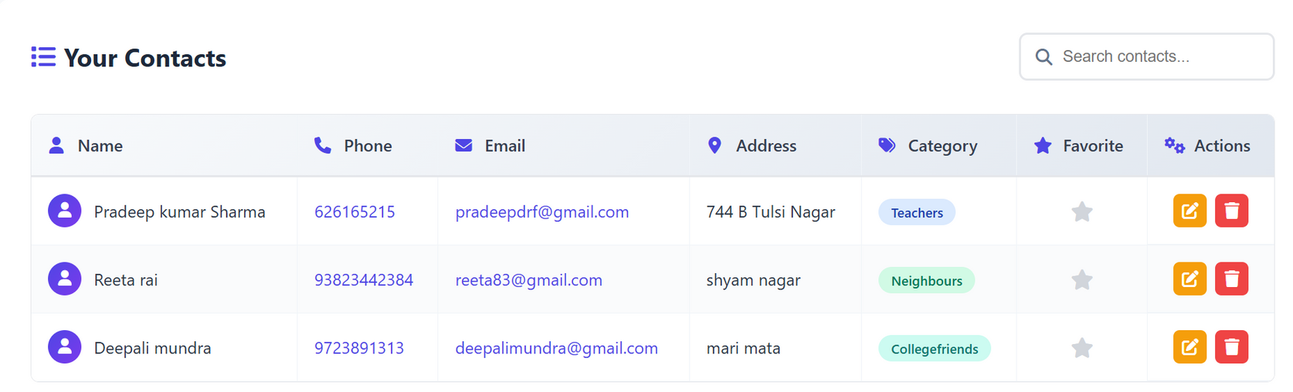

Slide 38
CONCLUSION & LEARNINGS 🎓
Gained hands-on experience with MVC architecture and MySQL integration.
Improved debugging, form validation, and session handling skills.
Access full source code and project files:
🔗 GitHub Link

Slide 39
THANK YOU

