Slide 1
Parikshan – Online Test Portal
Presented by: Harshdeep Sharma Mentor: Jaynam Sanghvi
2025 YASH Technologies | www.yash.com | Confidential

Slide 2

Project Introduction
Designed for integration with LMS platform
Dual roles: Student & Admin.
Post-exam analysis of recorded sessions
AI-based violation detection using Python (OpenCV, MediaPipe).

Slide 3

Problem Statement
LMS platforms have camera/mic but lack automated analysis of recordings.
Cheating detection is minimal or manual.
No integrated solution for recording + analysis.
Manual monitoring is time-consuming & inconsistent.

Slide 4
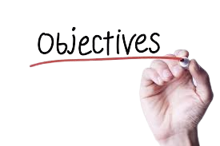
Purpose & Objectives
Provide analysis of LMS recordings for secure proctored testing.
Automate detection of key violations (multiple faces, absence, off-screen).
Store video evidence for review.
Ensure security & data integrity.

Slide 5

Technologies Used
Frontend: HTML, CSS, JavaScript(MediaRecorder API)
Backend: JSP, Servlets, Logger
AI Engine: Python (OpenCV + MediaPipe)
Database : MySQL(Test Data, Results, Violations, Recording metadata)
Security: Bcrypt, Session Tracking

Slide 6

Layered Architecture
Controller Layer - Handles HTTP requests &
routes them to services .
Service Layer - Defines business logic
(interfaces).
ServiceImpl Layer - Implements the business logic.
DAO Layer - Defines data access operations(interfaces).
DAOImpl Layer – Implements data access logic(MySQL queries).
Util Package – Global DB connection utility & helper classes.

Slide 7

Features for Students
Profile Management.
View & attempt tests.
Transparent notice: recordings may be analyzed post-exam.
Instant result display.

Slide 8
Features for Admin
Create & manage tests (questions, duration, rules).
View results & cheating reports.
Access recorded sessions from database.
Submit videos for Python analysis.

Slide 9
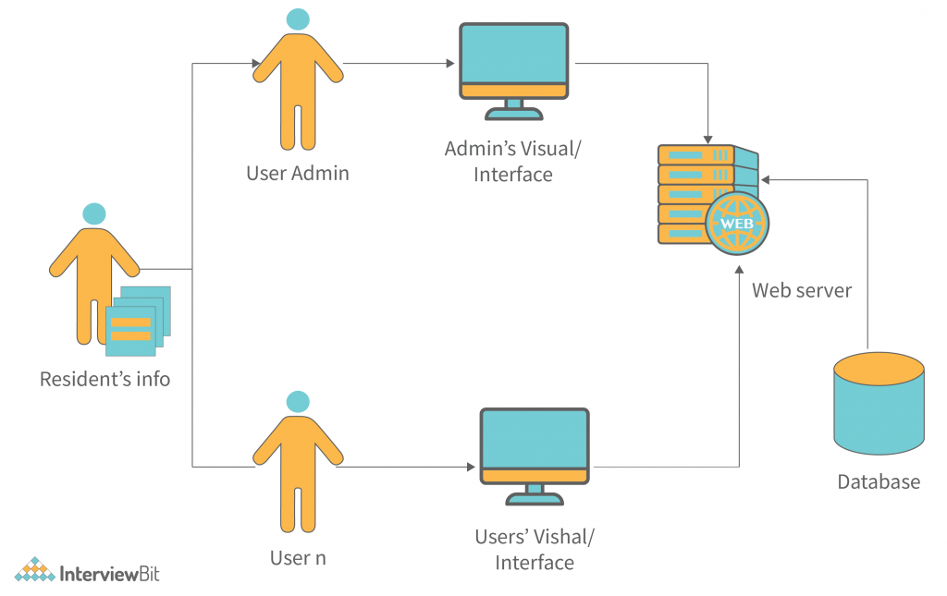
System Architecture
Frontend: Login, Test, Dashboard UI, Admin analysis pages.
Backend: Servlet + JSP for ingest, analysis trigger, reporting.
Media Capture: JS Media recorder API
Processing Engine: Python + OpenCV for face/presence/audio activity basics.
Database: Stores questions, results, media references, violation logs.

Slide 10
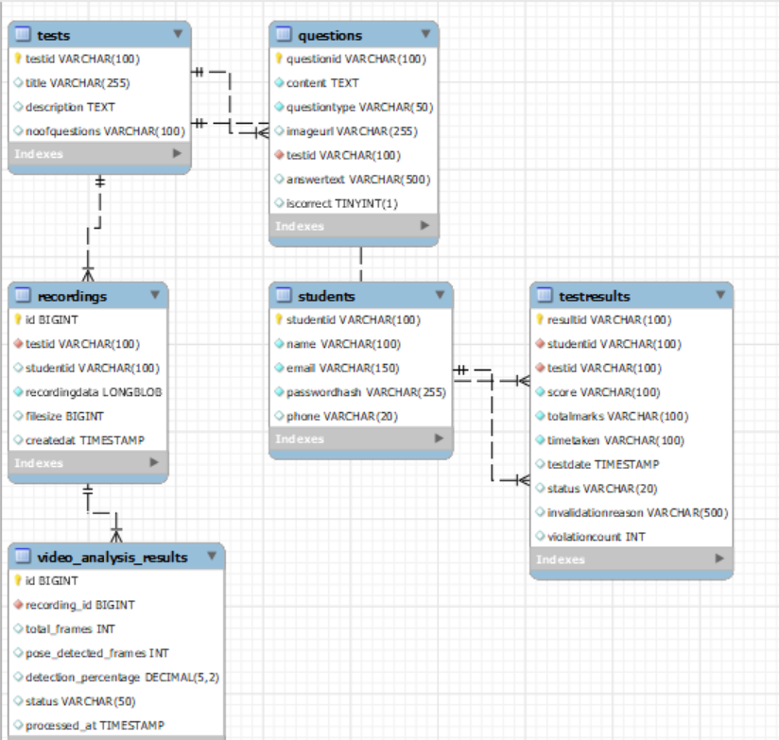
DB View

Slide 11
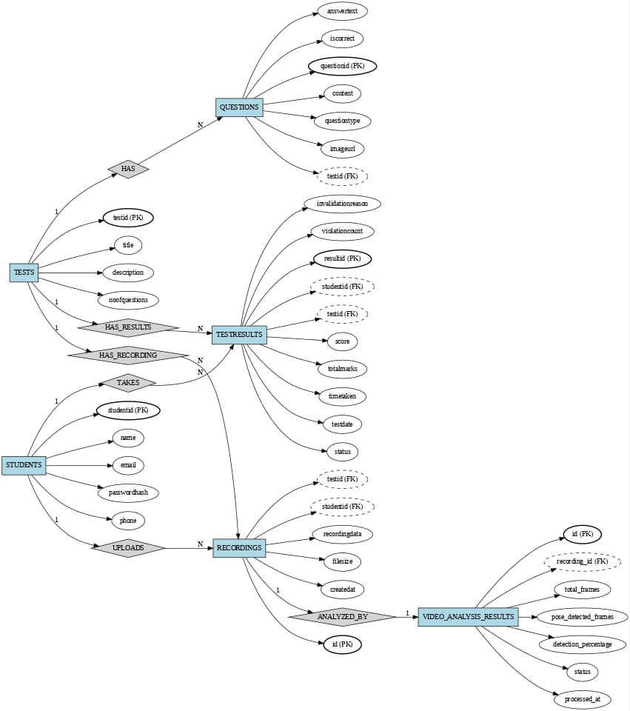
ER Diagram

Slide 12

Cheating Detection Mechanism
Python analysis on recorded sessions.
Uses OpenCV + MediaPipe.
Generates a simple cheating risk score.
Detects:
1. Multiple faces in frame.
2. Absence from screen.
3. Potential off-screen/head-away events.
4. Basic audio activity anomalies.

Slide 13
Challenges & Solutions
Challenge | Solution
Storing large files | Increase default SQL file size limit (e.g., max_allowed_packet), save uploads to a temp folder, and move full videos to external/object storage
AddQuestionServlet | Implement dynamic add-question servlets with a hardcoded max of 5 questions per test (reject the 6th with a clear message).
First-time Python integration | Set up a small separate Python project with a virtual environment, install basics (opencv-python, mediapipe, numpy), and write a clear videoanalyzer.py that reads a video path,

Slide 14
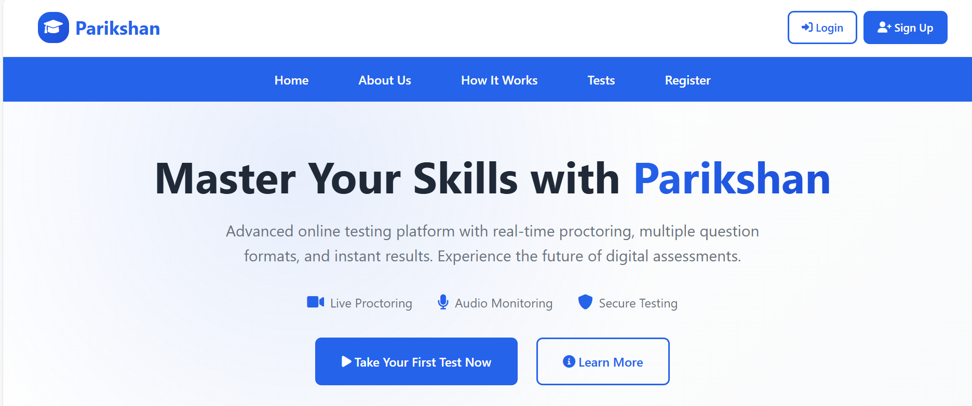
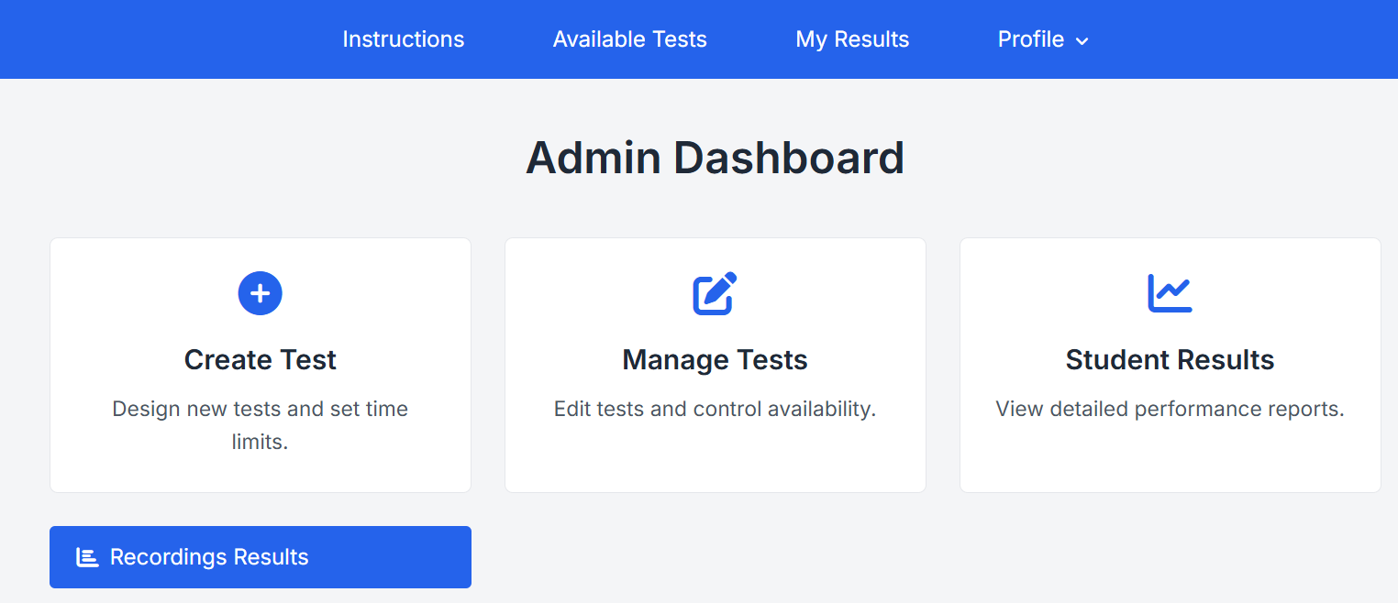
Website Overview

Slide 15
Future Enhancements
Real-time alerts during test.
Answer generation at website through AI
Cloud-based video storage.
Support for multiple languages.
Advanced deep learning models.
Integration with 3rd-party APIs.

Slide 16

Conclusion
Implemented a secure online testing platform.
Integrated Java web app + Python-based proctoring.
Enabled instant results
Improves integrity & fairness in online exams.

Slide 17
Thank you!
2025 YASH Technologies | www.yash.com | Confidential

