Slide 1
MAJOR PROJECT | PHASE 1
DEPARTMENT OF COMPUTER SCIENCE AND ENGINEERING
AI Based Crop
Recommendation
An Explainable Machine-Learning System for Data-Driven Crop Selection
TEAM MEMBERS
UNDER THE GUIDANCE OF
Alden Pais — NNM23CS020
Disha Shetty — NNM23CS067
Divya R — NNM23CS068
Harsheel S Gowda — NNM23CS082
Dr. Dhasny Lydia
Department of Computer Science and Engineering
NMAM Institute of Technology
Academic Year 2026–27

Slide 2
INTRODUCTION
Why Crop Selection Needs Intelligence
Agriculture remains the backbone of rural livelihoods, yet the choice of which crop to grow is still largely driven by tradition and instinct rather than the measurable condition of the soil and climate.
22
Crop types the model
can recommend
Soil nutrients (N, P, K), pH and weather jointly determine which crop will thrive on a given plot — machine learning can learn this mapping directly from real agronomic data and turn it into an actionable, explainable recommendation.
7
Soil + climate
input parameters
99.3%
Test accuracy of the
trained model
AI Based Crop Recommendation
Phase-1 | 02

Slide 3
PROBLEM STATEMENT
Farmers Lack Data-Driven Crop Guidance
N
Limited visibility into soil nutrient levels (N, P, K) and pH
PROBLEM
!
Crop choice relies on experience and guesswork, not measurement
~
Environmental conditions (temperature, humidity, rainfall) keep changing
Need for Data-Driven
Decision Support
x
Difficulty interpreting multiple agricultural parameters together
$
Wrong crop choice risks low productivity and financial loss
AI / ML-Based Crop
Recommendation
AI Based Crop Recommendation
Phase-1 | 03

Slide 4
EXISTING APPROACH & LIMITATIONS
How Crop Selection Is Done Today
Approach | Limitation
Traditional / experience-based selection | Not repeatable, ignores measurable soil chemistry
Generic agronomy advisories | One-size-fits-all; not specific to a farmer's own soil report
Rule-based agri advisory tools | Hand-coded thresholds; brittle, don't generalize across regions
Black-box ML demos (where they exist) | Give a prediction with no explanation a farmer can trust
This motivates a system that learns directly from real soil-and-climate data, produces a ranked recommendation with a probability score, and explains why — the direction this project takes.
AI Based Crop Recommendation
Phase-1 | 04

Slide 5
OBJECTIVES
What This Project Sets Out to Do
01
Build an ML-based crop recommendation system
02
Train and rigorously compare ML models
Predict the most suitable crop from soil and environmental parameters (N, P, K, temperature, humidity, pH, rainfall).
Evaluate Random Forest, Gradient Boosting, XGBoost and SVM with real accuracy, precision, recall and F1 — never a fabricated number.
03
Make recommendations explainable
04
Provide data-driven decision support
Use SHAP feature-contribution analysis so a farmer sees not just the crop, but why it was recommended.
Replace guesswork with a quantitative, reproducible recommendation pipeline.
05
Deliver a simple, farmer-oriented interface
06
Design for extensibility
Soil input form to ranked crop recommendation, in a few clicks.
Architect the system so future modules can be added without rewriting the core (see Future Scope).
AI Based Crop Recommendation
Phase-1 | 05

Slide 6
LITERATURE REVIEW
20 Peer-Reviewed References Across 4 Themes
Minimum 5 verified papers per team member — organized by theme rather than presented as a flat list.
Ref. 1-5
Member 1
Ref. 6-10
Member 2
Crop Recommendation using Machine Learning
Foundational ML Algorithms Used in This Project
Ref. 11-15
Member 3
Ref. 16-20
Member 4
AI / Smart Agriculture Approaches
Explainable AI & Recent Intelligent Agriculture Systems
AI Based Crop Recommendation
Phase-1 | 06

Slide 7
LITERATURE REVIEW | MEMBER 1
Crop Recommendation using Machine Learning
Ref. 1-5
# | Authors, Year & Title | Method | Key Result | Gap
1 | Pudumalar et al. (2017) Crop Recommendation System for Precision Agriculture IEEE ICoAC 2016 (publ. 2017) | Ensemble voting (Random Tree, CHAID, KNN, NB) | Beats single classifiers | Region-specific, no explainability
2 | Doshi et al. (2018) AgroConsultant: Intelligent Crop Recommendation System IEEE ICCUBEA 2018 | RF, ANN, NB, SVM compared | RF/ensemble most accurate | Limited to Maharashtra data
3 | Rajak et al. (2017) Crop Recommendation System to Maximize Crop Yield IRJET, Vol. 4 | SVM, ANN, RF, Naive Bayes (comparative) | Multi-classifier crop recommendation | No feature explainability
4 | Kulkarni et al. (2018) Improving Crop Productivity via Ensembling Technique IEEE CSITSS 2018 | Ensemble: RF, Naive Bayes, Linear SVM | 99.9% acc. on Kharif/Rabi crop data | Scale/generalizability untested
5 | Bondre & Mahagaonkar (2019) Crop Yield & Fertilizer Recommendation using ML IJEAST, Vol. 4 | Random Forest & SVM regression | RF outperformed SVM | Fertilizer logic is rule-based
AI Based Crop Recommendation
Phase-1 | 07

Slide 8
LITERATURE REVIEW | MEMBER 2
Foundational ML Algorithms Used in This Project
Ref. 6-10
# | Authors, Year & Title | Method | Key Result | Gap
6 | Breiman L. (2001) Random Forests Machine Learning, 45(1), 5-32 | Bagged decision-tree ensemble | Lower variance, less overfitting | Basis of this project's active model
7 | Friedman J.H. (2001) Greedy Function Approximation: A Gradient Boosting Machine Annals of Statistics, 29(5) | Stage-wise additive boosting | Defined the boosting framework used | Sensitive to hyperparameters
8 | Chen T., Guestrin C. (2016) XGBoost: A Scalable Tree Boosting System ACM SIGKDD (KDD) 2016 | Regularized gradient boosting | High accuracy/speed on tabular data | Needs careful tuning
9 | Cortes C., Vapnik V. (1995) Support-Vector Networks Machine Learning, 20(3), 273-297 | Max-margin kernel classification | Strong margin-based theory | Needs feature scaling, scales poorly
10 | Kumar et al. (2015) Crop Selection Method to Maximize Crop Yield Rate IEEE ICSTM 2015 | Crop Selection Method (CSM) | Better seasonal crop selection | No soil nutrient (N,P,K) features
AI Based Crop Recommendation
Phase-1 | 08

Slide 9
LITERATURE REVIEW | MEMBER 3
AI / Smart Agriculture Approaches
Ref. 11-15
# | Authors, Year & Title | Method | Key Result | Gap
11 | Liakos et al. (2018) Machine Learning in Agriculture: A Review Sensors (MDPI), 18(8):2674 | Systematic ML-in-agriculture review | ML beats traditional statistics | Explainability, usability gaps noted
12 | Kamilaris A., Prenafeta-Boldu F.X. (2018) Deep Learning in Agriculture: A Survey Computers & Electronics in Agri., 147 | Survey of deep-learning applications | Improves accuracy, needs big data | Data scarcity, low interpretability
13 | Suresh et al. (2021) Efficient Crop Yield Recommendation for Digital Farming Int'l J. of Modern Agriculture, 10(1) | SVM-based crop recommendation | Higher precision on soil+yield data | Single-region dataset only
14 | Reddy D.J., Kumar M.R. (2021) Crop Yield Prediction Using Machine Learning Algorithm IEEE ICICCS 2021 | RF vs. SVM vs. ANN comparison | RF gave best yield accuracy | No explainability layer
15 | Sharma A., Jain A., Gupta P., Chowdary V. (2021) ML Applications for Precision Agriculture: A Review IEEE Access, Vol. 9, 4843-4873 | Comprehensive ML-in-agri review | Maps ML methods to farm tasks | Few real-world deployments studied
AI Based Crop Recommendation
Phase-1 | 09

Slide 10
LITERATURE REVIEW | MEMBER 4
Explainable AI & Recent Intelligent Agriculture Systems
Ref. 16-20
# | Authors, Year & Title | Method | Key Result | Gap
16 | Ribeiro M.T., Singh S., Guestrin C. (2016) "Why Should I Trust You?" Explaining Predictions of Any Classifier ACM SIGKDD (KDD) 2016 | LIME: local surrogate explanations | Model-agnostic, increases trust | Local approximation, not global
17 | Lundberg S.M., Lee S.-I. (2017) A Unified Approach to Interpreting Model Predictions NeurIPS 2017, Vol. 30 | SHAP: Shapley-value attribution | Unifies prior explainability methods | Used directly in this project (SHAP)
18 | Jeong J.H. et al. (2016) Random Forests for Global & Regional Crop Yield Predictions PLOS ONE, 11(6):e0156571 | Random Forest yield regression | Beats traditional regression | Limited regional transferability
19 | Patel K., Patel H.B. (2020) A State-of-the-Art Survey on Recommendation System and Prospective Extensions Computers and Electronics in Agriculture, Vol. 178 | Survey of recommendation systems (incl. agriculture) | Maps techniques to farm use-cases | Calls for explainable, personalized RS
20 | Priya P., Muthaiah U., Balamurugan M. (2018) Predicting Yield of the Crop Using Machine Learning IJESRT, Vol. 7(1) | Random Forest regression | Beats linear regression baseline | No interactive farmer-facing system
AI Based Crop Recommendation
Phase-1 | 10

Slide 11
RESEARCH GAP
What the Literature Consistently Misses
Existing Systems
Accurate, but limited explainability
Trained on static, benchmark-style datasets
Limited farmer usability / interpretation
Limited real-world decision support
Our Proposed Direction: Explainable, Verified ML Pipeline
AI Based Crop Recommendation
Phase-1 | 11

Slide 12
PROPOSED SYSTEM
Data-Driven Crop Recommendation Workflow
Farmer / User Input
Soil + Environmental Parameters
(N, P, K, Temperature, Humidity, pH, Rainfall)
Data Preprocessing
Machine Learning Model
Crop Prediction
Recommended Crop
AI Based Crop Recommendation
Phase-1 | 12

Slide 13
DATASET
Crop Recommendation Dataset
Dataset name
Crop Recommendation Dataset
N | P | K | temp | humidity | ph | rainfall | label
90 | 42 | 43 | 20.9 | 82.0 | 6.50 | 202.9 | rice
85 | 58 | 41 | 21.8 | 80.3 | 7.04 | 226.7 | rice
71 | 54 | 16 | 22.6 | 63.7 | 5.75 | 87.8 | maize
20 | 67 | 20 | 17.0 | 16.9 | 7.63 | 88.6 | chickpea
Source
Kaggle: atharvaingle/crop-recommendation-
dataset (local CSV mirror)
Records
2,200 rows, 0 missing, 0 duplicates
Crop classes
22 crops, 100 samples each
Sample rows from ml/datasets/crop_recommendation.csv
Input features
7 numeric: N, P, K, temp,
humidity, pH, rainfall
Why this dataset is suitable
Target / label
Crop name (22 classes)
• Matches farmer-supplied soil + weather inputs directly
• Balanced: 100 samples/crop, no imbalance handling needed
• Retrains fast; large enough for a valid 80/20 split
• Widely used benchmark — enables literature comparison
Data type
Structured / tabular
AI Based Crop Recommendation
Phase-1 | 13

Slide 14
DATASET
Feature Ranges & Crop Classes
Feature | Meaning | Typical Range
N | Nitrogen content in soil (kg/ha) | 0 - 140
P | Phosphorus content in soil (kg/ha) | 5 - 145
K | Potassium content in soil (kg/ha) | 5 - 205
temperature | Ambient temperature (deg C) | 9 - 44
humidity | Relative humidity (%) | 14 - 100
ph | Soil pH | 3.5 - 10
rainfall | Rainfall (mm) | 20 - 300
22 Crop Classes
rice
maize
chickpea
kidneybeans
pigeonpeas
mothbeans
mungbean
blackgram
lentil
pomegranate
banana
mango
grapes
watermelon
muskmelon
apple
orange
papaya
coconut
cotton
jute
coffee
AI Based Crop Recommendation
Phase-1 | 14

Slide 15
DATA PREPROCESSING
From Raw CSV to Model-Ready Data
Raw Dataset
(2,200 rows)
Data Inspection
(schema + null/duplicate check)
Missing / Duplicate Row Check
(0 missing, 0 duplicates found)
Feature / Target Separation
(7 features vs. crop label)
Label Encoding
(22 crop classes -> integers)
Stratified 80/20 Train/Test Split
(random_state = 42)
Model-Ready Dataset
No scaling / normalization / SMOTE / PCA is applied — Random Forest, Gradient Boosting and XGBoost are scale-invariant. SVM is trained on raw features in this MVP (documented limitation).
AI Based Crop Recommendation
Phase-1 | 15

Slide 16
ML MODELS
Random Forest — The Active Model
Random Forest is an ensemble of many decision trees, each trained on a random subset of rows and features. The final prediction is the majority vote across all trees.
Model Comparison
(Experimentation)
-
Why suitable here
Handles non-linear soil/climate interactions; robust to noisy, mixed-scale tabular features like N,P,K vs. rainfall.
Random Forest
99.32%
-
How it predicts
300 trees vote independently on the crop class; the class with the most votes (highest average probability) wins.
Gradient Boosting
98.86%
-
Advantages
High accuracy, resistant to overfitting, gives feature importance for explainability, no scaling required.
XGBoost
98.64%
Larger model size than a single tree; less interpretable per-tree (addressed here using SHAP).
SVM
98.41%
-
Limitations
All 4 trained & saved for transparent comparison. Random Forest is the active model used for live prediction (highest test accuracy).
AI Based Crop Recommendation
Phase-1 | 16

Slide 17
TRAINING & TESTING
Pipeline: Dataset to Prediction
Dataset
Data Cleaning
Feature Selection
Train / Test Split (80/20)
Model Training (4 algorithms)
Model Evaluation
Best Model Selection
Save Trained Model
New Farmer Input -> Prediction (Recommended Crop)
Training
Testing
Prediction
Learns the relationship between soil/climate features and crop labels from the training split.
Evaluates the trained model on the unseen 20% split to measure real generalization.
The saved model receives new soil/environmental values and returns a ranked crop recommendation.
AI Based Crop Recommendation
Phase-1 | 17

Slide 18
SYSTEM ARCHITECTURE
End-to-End Block Diagram
Farmer Input: Soil & Environmental Parameters
(N, P, K, Temperature, Humidity, pH, Rainfall)
Data Validation & Preprocessing (schema check, clean, encode)
Feature Preparation (7-feature vector)
ML MODEL LAYER
Random Forest
(ACTIVE)
Gradient
Boosting
XGBoost
SVM
Model Evaluation (accuracy, precision, recall, F1)
Explainable AI (SHAP feature contribution)
Crop Recommendation (Top-5 ranked, with probability)
Farmer Dashboard / UI
AI Based Crop Recommendation
Phase-1 | 18

Slide 19
EXPLAINABILITY
Why This Crop? — SHAP-Based Explanation
Every recommendation is explained using SHAP (SHapley Additive exPlanations) applied to the active tree-based model — not a templated or hand-written justification.
Feature Importance (Active Model: Random Forest)
rainfall
22.1%
1
Build the 7-feature input vector for the requested crop
humidity
21.2%
2
Run SHAP TreeExplainer on the trained model
K
17.9%
3
Get a real per-feature contribution value
P
15.4%
4
Sort contributions by magnitude (largest influence first)
N
10.4%
temperature
7.6%
5
Generate a natural-language explanation from the top features
ph
5.4%
e.g. "Rice received a strong recommendation mainly because current rainfall, nitrogen levels and humidity are favorable for this crop."
AI Based Crop Recommendation
Phase-1 | 19

Slide 20
CURRENT IMPLEMENTATION — PHASE 1
What Is Working Today (Phase-1 Baseline)
✓
JWT-based authentication (register / login)
Extension Modules Delivered
✓
Farm creation & soil parameter input form
9 / 10
✓
Farmer dashboard with soil health snapshot
Baseline crop recommendation system verified end-to-end. 9 of the 10 originally-planned extension modules (see next slide) are now implemented and tested — only Satellite/NDVI remains future scope.
✓
Crop recommendation engine (trained Random Forest, real inference)
✓
Top-5 ranked crops with real model probabilities
✓
Explainable AI: SHAP feature-contribution chart + generated explanation
Under Development / Not Yet Wired to ML
✓
Model comparison lab: 4 trained algorithms, real metrics, confusion matrix
• Live weather data integration (currently mock/demo provider)
• Region/soil-type-specific model retraining
• Deployment-grade UI polish & user testing
• Satellite/NDVI monitoring (no data provider connected)
✓
Recommendation history log per farm
AI Based Crop Recommendation
Phase-1 | 20

Slide 21
RESULTS & EVALUATION
Model Performance on Held-Out Test Data
Stratified 80/20 split (1,760 train / 440 test rows), random_state=42 — metrics from models/metrics.json
Model | Accuracy | Precision | Recall | F1-Score | 5-Fold CV Mean
Random Forest (active) | 99.32% | 99.35% | 99.32% | 99.32% | 99.41% (+/-0.27%)
Gradient Boosting | 98.86% | 98.97% | 98.86% | 98.87% | 99.09% (+/-0.32%)
XGBoost | 98.64% | 98.74% | 98.64% | 98.62% | 99.32% (+/-0.20%)
SVM (RBF) | 98.41% | 98.66% | 98.41% | 98.39% | 97.82% (+/-0.40%)
Random Forest Feature Importance
Honest Reading of These Numbers
rainfall
22.1%
humidity
21.2%
This benchmark dataset is clean and perfectly balanced (100 samples/class), which is why all 4 models score 98-99%. Real field data is noisier — validating on messier, region-specific data is planned as the model matures beyond Phase 1.
K
17.9%
P
15.4%
N
10.4%
temperature
7.6%
ph
5.4%
AI Based Crop Recommendation
Phase-1 | 21

Slide 22
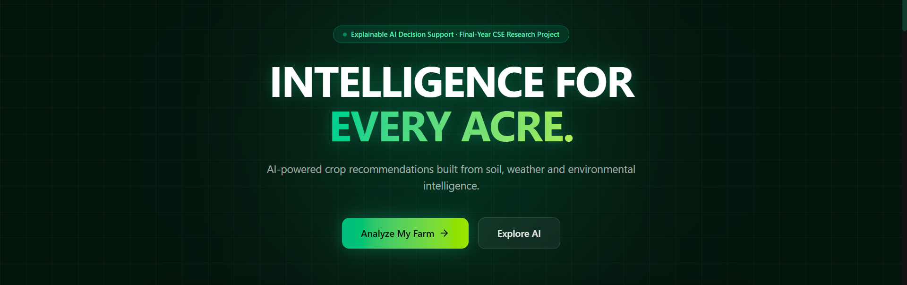
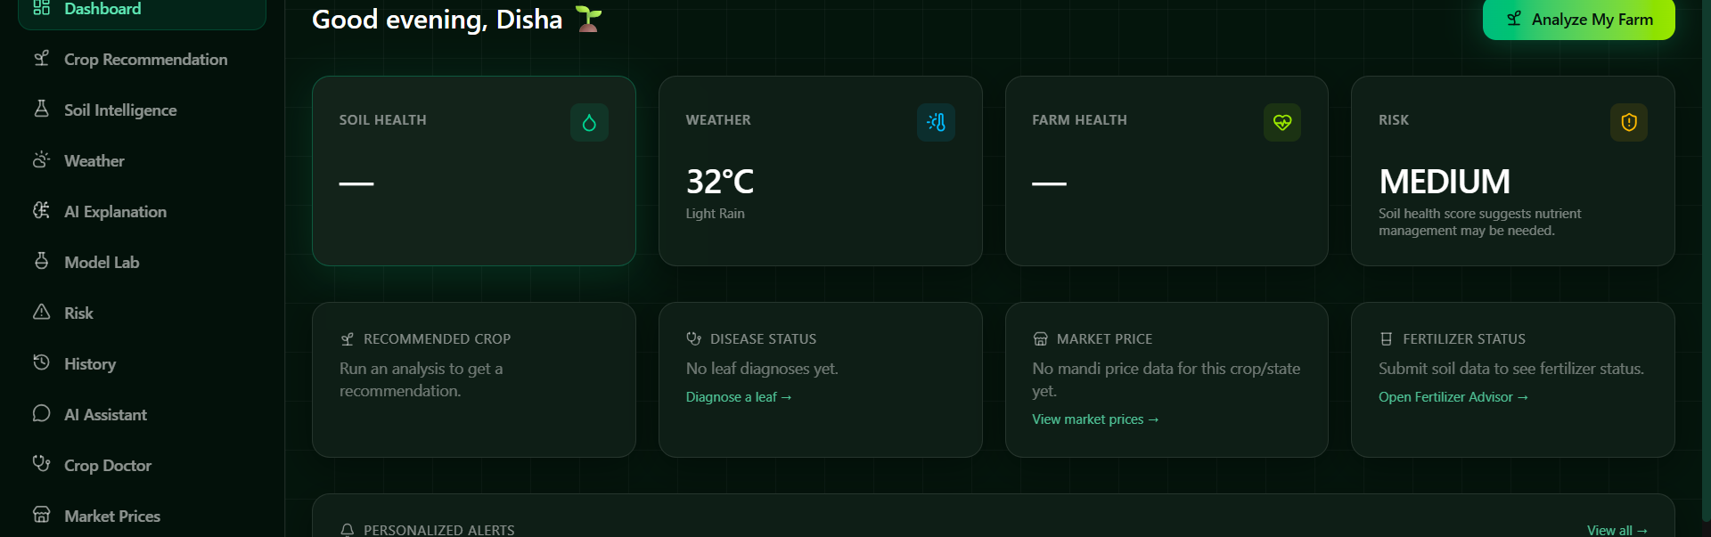
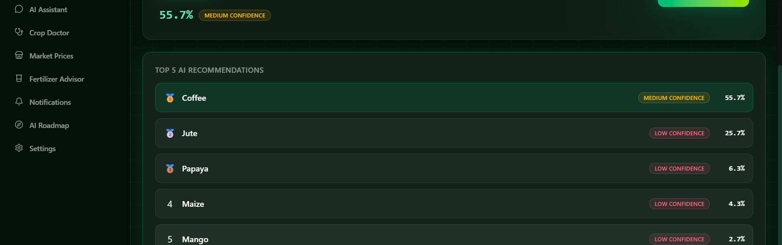
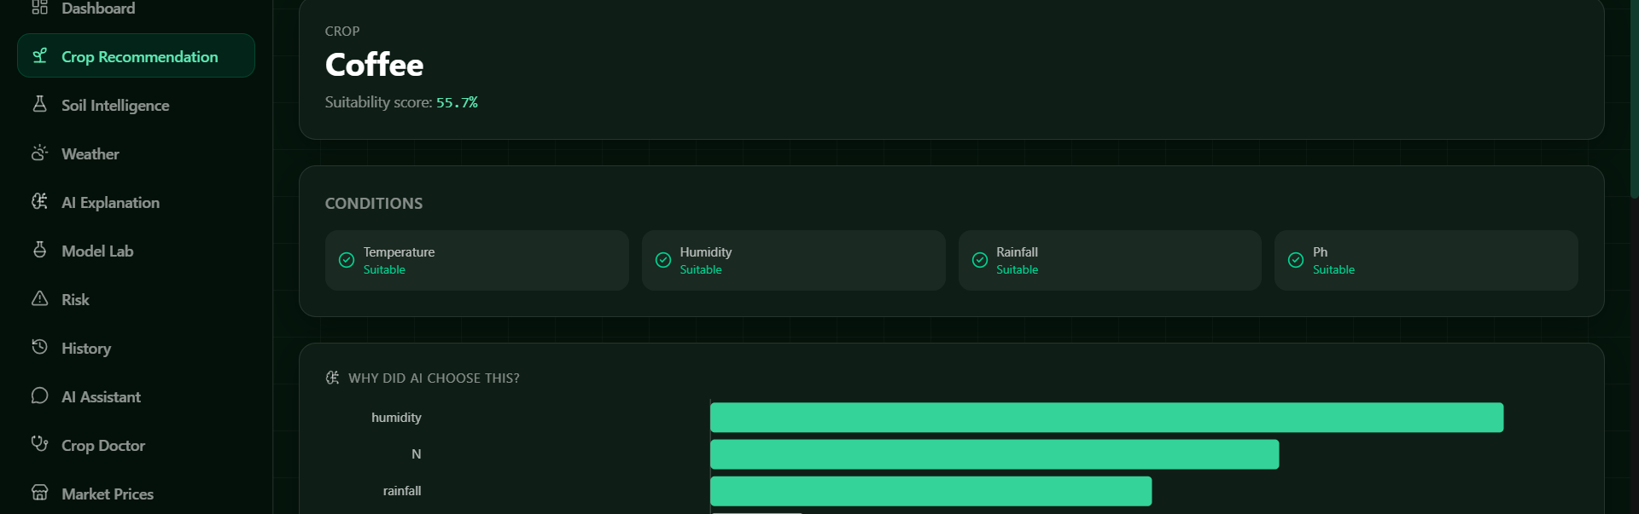
RESULT SCREENSHOTS
Application Walkthrough (Live Screens)
Introduction — System Landing Page
Farmer Dashboard
Crop Recommendation — Top-5 AI Results
Explainable AI — "Why This Crop?"
AI Based Crop Recommendation
Phase-1 | 22

Slide 23
LIMITATIONS
Honest Constraints of the Current Build
!
Benchmark dataset
Clean, perfectly balanced (100 samples/crop); real field data is noisier, which inflates today's accuracy numbers.
!
No soil-type / location signal
Soil type, location and irrigation availability are collected in the UI but not yet used as model inputs.
!
SVM not feature-scaled
SVM is trained on raw features in this MVP; a StandardScaler step is the documented next improvement.
!
Single global model
One model for all regions — not yet specialized to India's diverse agro-climatic zones.
!
Weather is farmer-supplied
Temperature / humidity / rainfall are entered values in this phase, not yet a live weather feed.
AI Based Crop Recommendation
Phase-1 | 23

Slide 24
IMPLEMENTATION STATUS UPDATE
Beyond Phase 1
The architecture was designed to be extensible — 9 of these 10 modules are now implemented and verified end-to-end (real trained ML models, published formulas, or rule-based logic on real farm data — never fabricated). Only Satellite/NDVI has no data provider connected and remains future scope; physical IoT hardware is also not connected (the real ingestion endpoint works with demo sensor data).
✓ Leaf Disease Detection
✓ Crop Market Price Intelligence
✓ Fertilizer Recommendation
✓ Personalized Farmer Messages
✓ Yield Prediction
✓ Water Requirement Estimation
✓ Risk Prediction
✓ Profit Intelligence
✓ AI Agriculture Assistant
Real-Time Agri Intelligence
(Weather / Satellite / IoT)
9 OF 10 MODULES IMPLEMENTED
AI Based Crop Recommendation
Phase-1 | 24

Slide 25
CONCLUSION
Summary & Path Forward
Problem
Research
Dataset
Preprocessing
ML Approach
Training & Testing
Current Build Status
Preliminary Results
Future Scope
AgriAI's crop recommendation baseline is real, trained and verified end-to-end: a public benchmark dataset, four honestly-compared ML models, a 99.3% test-accuracy Random Forest as the active model, and SHAP-based explainability. Since then, 9 of the 10 originally-planned extension modules — yield, profit, water, risk, disease detection, fertilizer, market price, notifications and the AI assistant — have also been implemented and verified end-to-end. Only satellite/NDVI monitoring remains future scope.
References
Full reference list: 20 literature-review papers (slides 7-10) + project documentation (docs/dataset.md, docs/ml-methodology.md, docs/architecture.md, docs/xai.md, docs/future-scope.md) + ml/crop_recommendation/train.py + models/metrics.json.
AI Based Crop Recommendation
Phase-1 | 25

